Slide 1

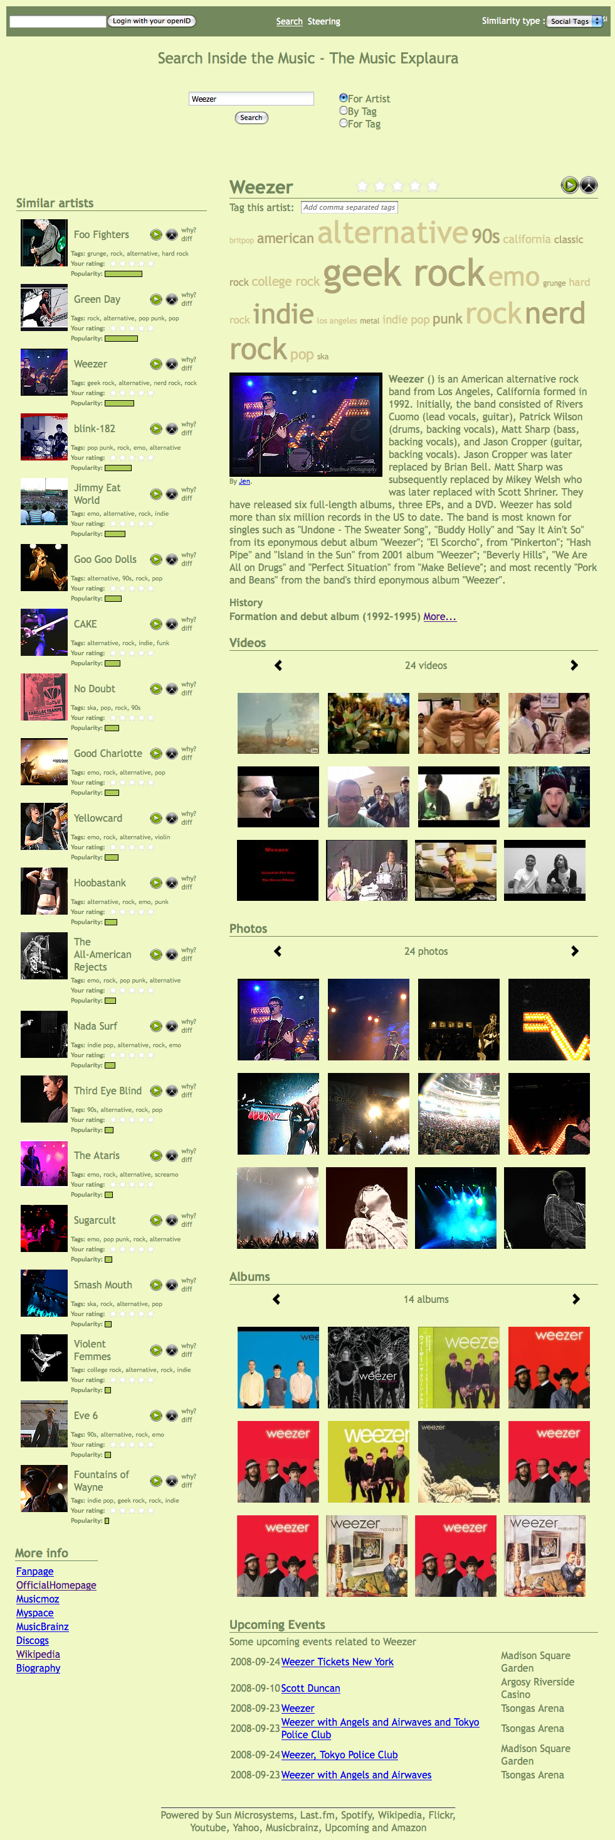
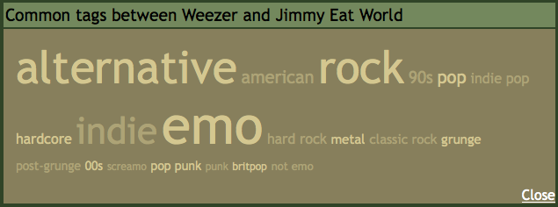
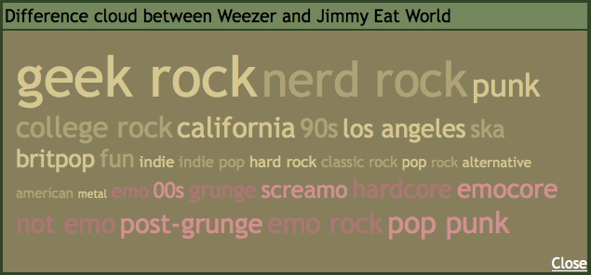
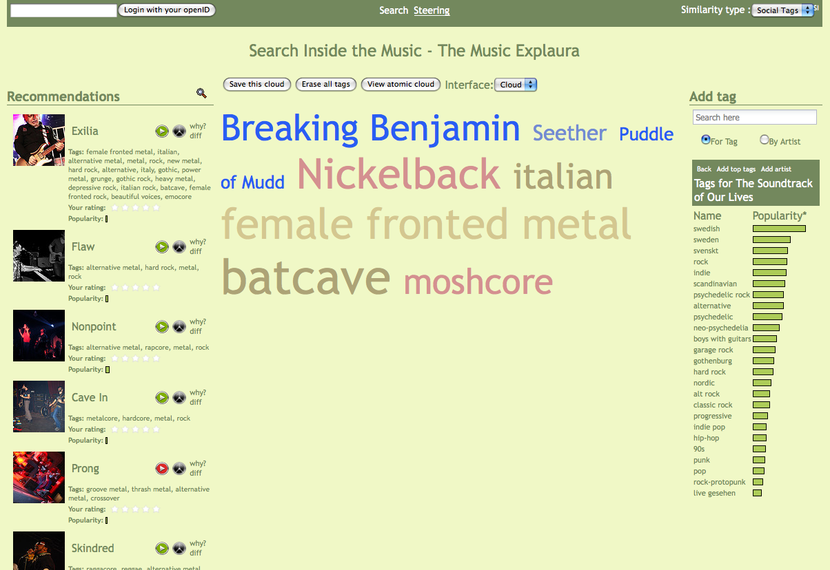
Creating transparent,
steerable recommendations
François Maillet
Sun Microsystems, Université de Montréal
francois.maillet@umontreal.ca
Paul Lamere
Sun Labs, Sun Microsystems
paul.lamere@sun.com
Why?
Most commercial music recommenders rely on collaborative filtering techniques to generate music recommendations. They are lacking two fundamental aspects:
  Transparency - they cannot explain why an item was recommended beyond the trivial “Other people who listened to XX also listened to YY”.
  Transparency - they cannot explain why an item was recommended beyond the trivial “Other people who listened to XX also listened to Y.
What?
The Sun Labs Music Explaura is a web-based recommender that:
  Shows detailed information about artists including biographies, pictures, videos and upcoming events.
  Recommends similar artists.
  Explains why a particular artist was recommended.
  Allows a user to steer the recommendations based up attribute of the artist.
Transparent recommendations
Tools to let the user understand exactly why artists are being recommended.
An explanation for every recommendation is always available. The common tags cloud contains the tags shared by the two artists – the bigger the tag, the stronger the overlap is.
The difference cloud highlights what differentiates the artists by giving less weight to common tags and pulling each artist's distinctive tags apart.
How the system works
Each artist in the system is represented by a weighted set of tags, its tag cloud.
The tags are weighted not by their frequency of application, but by their distinctiveness for an artist, using the text retrieval weighting function TF-IDF.
The similarity between two artists is determined by computing the cosine distance between their respective tag clouds.
Transparent recommendations
One important key to the success of a music recommender is to gain the trust of its users, which can be done by explaining to them why items are being recommended.
The Music Explaura can easily give a user a very clear explanation of why an item is recommended by showing how the two tag clouds overlap. This way, the user won't perceive the recommender as being broken if he doesn't agree with a recommendation.
Steerable recommendations
Similarity is computed using the artists' tag clouds. By allowing the user to build and tweak his own tag cloud – to which the Explaura will find similar artists - we allow him to be the architect of the perfect recommendations for his particular context.
It is possible to add tags and artists to a user's tag cloud. They can be grown or shrunk by dragging the mouse to modify their weight. The weight of a tag can even be made negative — at which point it is colored red. Tags with negative weights act as ﬁlters — artists tagged with a negatively weighted tag will not be recommended.
Steerable recommendations
By combining transparency and steerability, users easily and quickly obtain the perfect recommendations.
2) Drag a tag to grow it or
shrink it. They can even be
made negative so they
act as a filter.
3) Get recommendations that
match your tag cloud. For
each one, a single click gives
the user an explanation for the
recommendation.
1) Click to add a tag or an artist.

