Slide 1

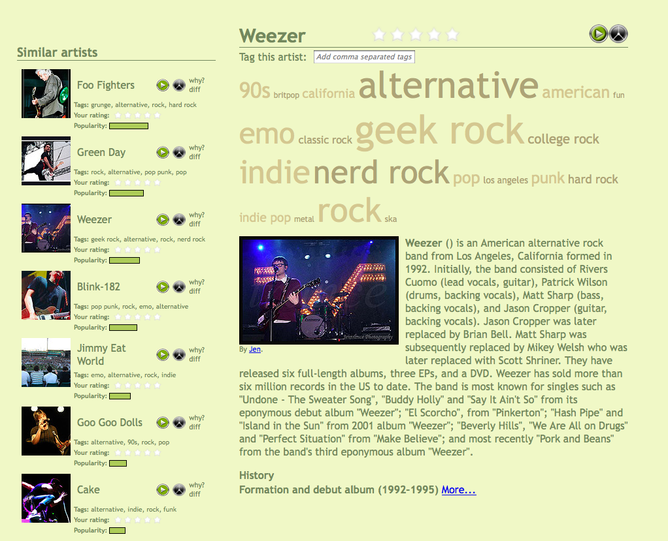
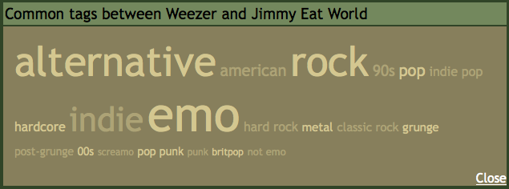
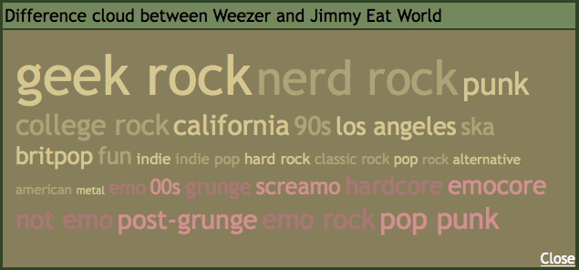
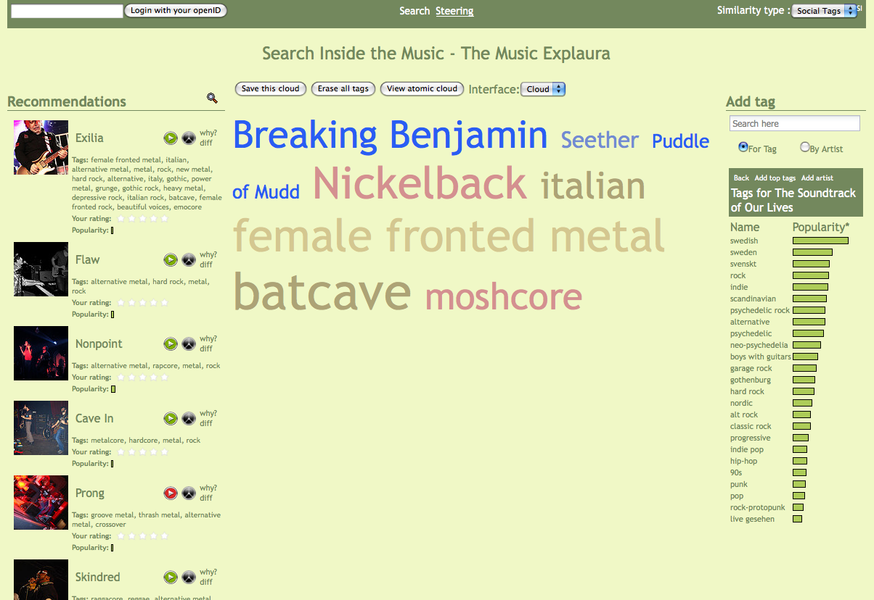
Creating transparent,
steerable recommendations
François Maillet Paul Lamere
Why?
Most commercial music recommenders rely on collaborative filtering techniques to generate music recommendations.
They are lacking two fundamental aspects :
  Transparency - they cannot explain why an item was recommended beyond the trivial “Other people who listened to XX also listened to YY”.
  Steerability - there is no way for a user to interact with the recommender to steer it to more relevant content.
Transparent recommendations
Tools to let you understand exacly why artists are being recommended.
An explantion for a recommendation is always available. The overlap XXX
What?
Web-based recommender that provides transparent and steerable recommendations.
Can give detailed explanation about why a particular item was recommended.
Allows a user to steer the recommendations based upon attributes of the music.
The difference cloud highlights what differentiates the artists by giving less weight to common tags and pulling each artist's distincitve tags further appart.
How the system works
Each artist in the system is represented by a weighted set of tags, its tag cloud.
The tags are weighted not by their frequency of application, but by their distinctiveness for an artist, using TF-IDT.
The similarity between two artists is determined by computing the cosine distance between their respective tag cloud.
Transparency of recommendations
We can easily give a user a very clear explanation of why an item is recommended by showing the overlap between the two tags clouds.
Steerable recommendations
At the atomic level, an artist is only a set of weighted tags. By allowing the user to build and tweek a costom tag cloud, XXXX
Steerable recommendations
Tools to let you build the perfect recommendation. By combining transparency and steerability, users can XXX
1) Click to add a tag or an artist
2) Drag a tag to
grow it or shrink it
3) Get recommendations
that match your tag cloud

