Slide 1
The 99-Cent Question: How Accurate Are Kalshi’s Odds?
What 7 million hourly prices say about Kalshi, and whether 90–99¢ favorites are as safe as they look
STATS 414 MIDTERM · OCTOBER 28, 2026
Juan Cortes-Aguiar · Ravikiran Madichetty · Ashish Singh
Notes:
About 0:30. We explored every hourly price on Kalshi for three weeks of October, then zoomed in on contracts priced 90 to 99 cents, the near-sure things, to see whether they are as safe as their price says.

Slide 2
Three questions about Kalshi prices
ROADMAP
1
2
3
What does Kalshi trade?
Are its prices right?
Can a model beat the price?
Markets, volume and liquidity across 840,000 markets
Calibration across 1–99¢, then a zoom on 90–99¢ favorites
Logistic, random forest and XGBoost vs the quoted price
Why favorites? A YES contract pays $1 or $0, so its price is the crowd's probability. Buying at 99¢ risks 99¢ to make 1¢: one loss wipes out 99 wins. Whether that is a good bet depends entirely on how accurate the price is.
Notes:
About 0:45. Three questions. First, what is actually traded on Kalshi. Second, are prices accurate, first across the whole range, then for favorites. Third, can a model predict which favorites lose better than the price already does. Favorites matter because the payoff is so lopsided: one loss at 99 cents erases 99 wins.

Slide 3
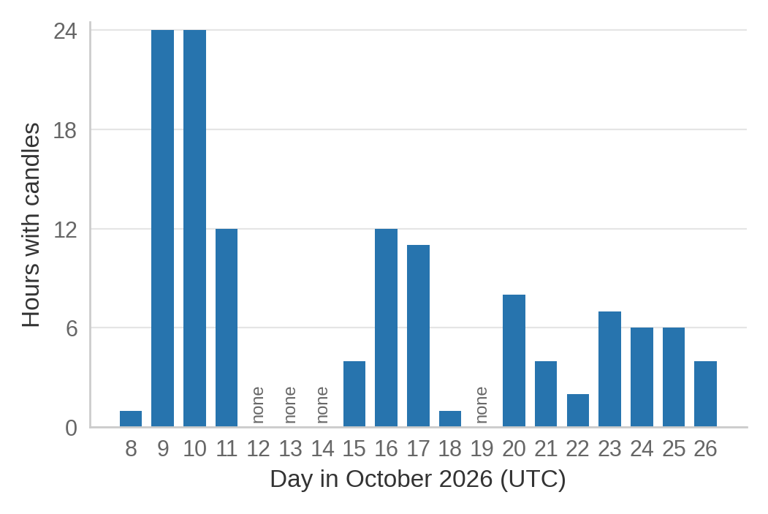
Every hourly Kalshi price for three weeks, with gaps
DATA
7.17M
hourly candles (bid, ask, volume), Oct 8–27
839,613
markets in 67,261 events
Data: Kalshi course database, hourly candles Oct 8–27, 2026 · hours with at least one candle per UTC day
Notes:
About 1:00. We pulled every hourly candle in the course database, 7.17 million rows covering 840 thousand markets, before access closes on Thursday. One thing EDA showed immediately: the record has holes. Some days have 24 hours, others one or none. And many rows were backfilled after the market closed. So everything we show is a retrospective look, not what a trader saw live.

Slide 4
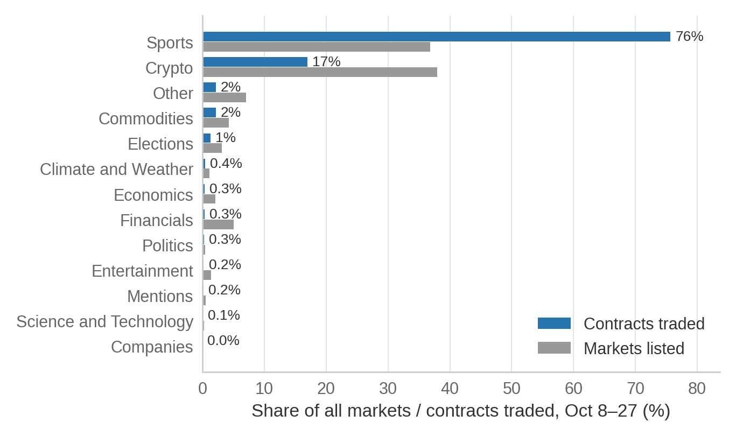
Sports and crypto are most of Kalshi
EXPLORATION 1
76%
of contracts traded were Sports, from 37% of markets
The top 1% of markets carry 82% of all volume
72% of markets never traded in the window
Politics, Economics, Tech and Entertainment: each under 0.4% of volume
Data: Kalshi course database, hourly candles Oct 8–27, 2026 · volume = contracts traded, summed over hourly candles
Notes:
About 1:00. Blue is share of contracts traded, gray is share of markets listed. Sports is three quarters of all trading; crypto is listed heavily but trades less. Trading is extremely concentrated: one percent of markets carry 82% of the volume, and most markets never trade at all. The categories our final project is about are a sliver of volume, which matters later.

Slide 5
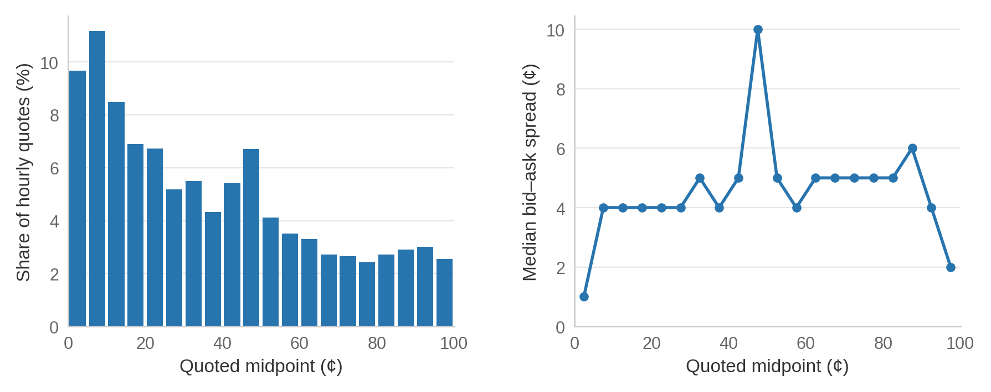
Most quotes are long shots; spreads peak at 50¢
EXPLORATION 2
Left: 21% of hourly quotes are below 10¢ and 5.5% above 90¢, because events list one market per outcome
Right: the median spread is 4¢ overall, 1–2¢ at the extremes and widest near 50¢, where outcomes are least certain
Data: Kalshi course database, hourly candles Oct 8–27, 2026 · 5.5M valid two-sided quotes (0 < bid ≤ ask < 1)
Notes:
About 0:50. Left, where prices sit: most quotes are cheap long shots, because an event like 'who wins' lists one market per candidate. Right, how wide the bid-ask spread is: tight at the extremes, widest at 50 cents where uncertainty is highest. Also, 89% of hourly candles have zero volume, so volume is mostly zeros, a hint for why it will not help our models.

Slide 6
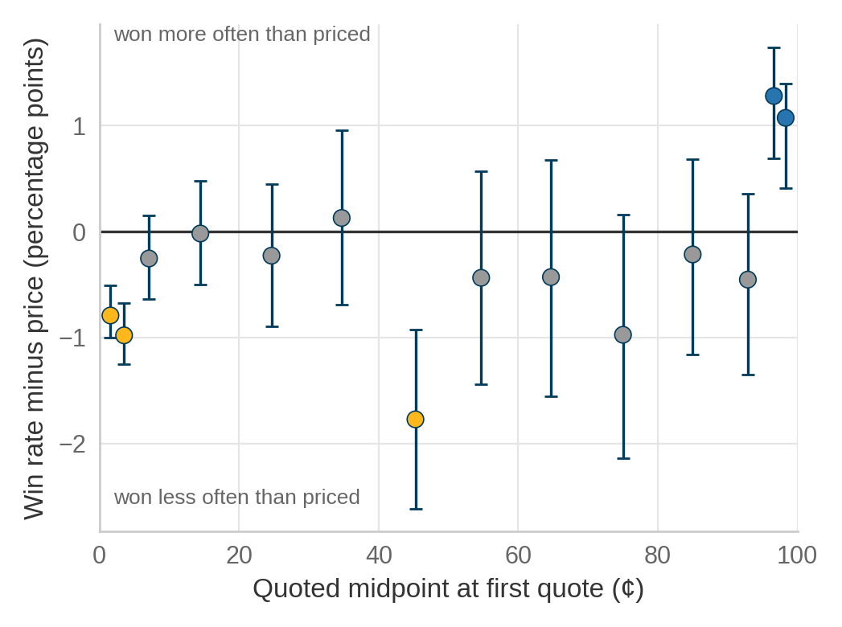
Prices are calibrated except at the extremes
EXPLORATION 3
0.5 pts
average gap between win rate and price, 129,866 markets
Long shots under 2¢ won 0.8% of the time vs 1.6% priced; 2–5¢ won 2.5% vs 3.5%
95–100¢ favorites won 1 point more often than priced
Gold: long shots overpriced; blue: favorites underpriced
Data: Kalshi course database, hourly candles Oct 8–27, 2026 · first quote per finalized market (spread ≤ 5¢) · 95% Wilson intervals
Notes:
About 1:10. We took every finalized market's first quote and compared the price with how often it actually won. Plotted as a gap, prices are within half a point on average. But at the ends there is the classic favorite–long-shot bias: cheap long shots win less often than their price, and heavy favorites win slightly more often. That makes favorites look like a possible edge, so we zoom in on them next.

Slide 7
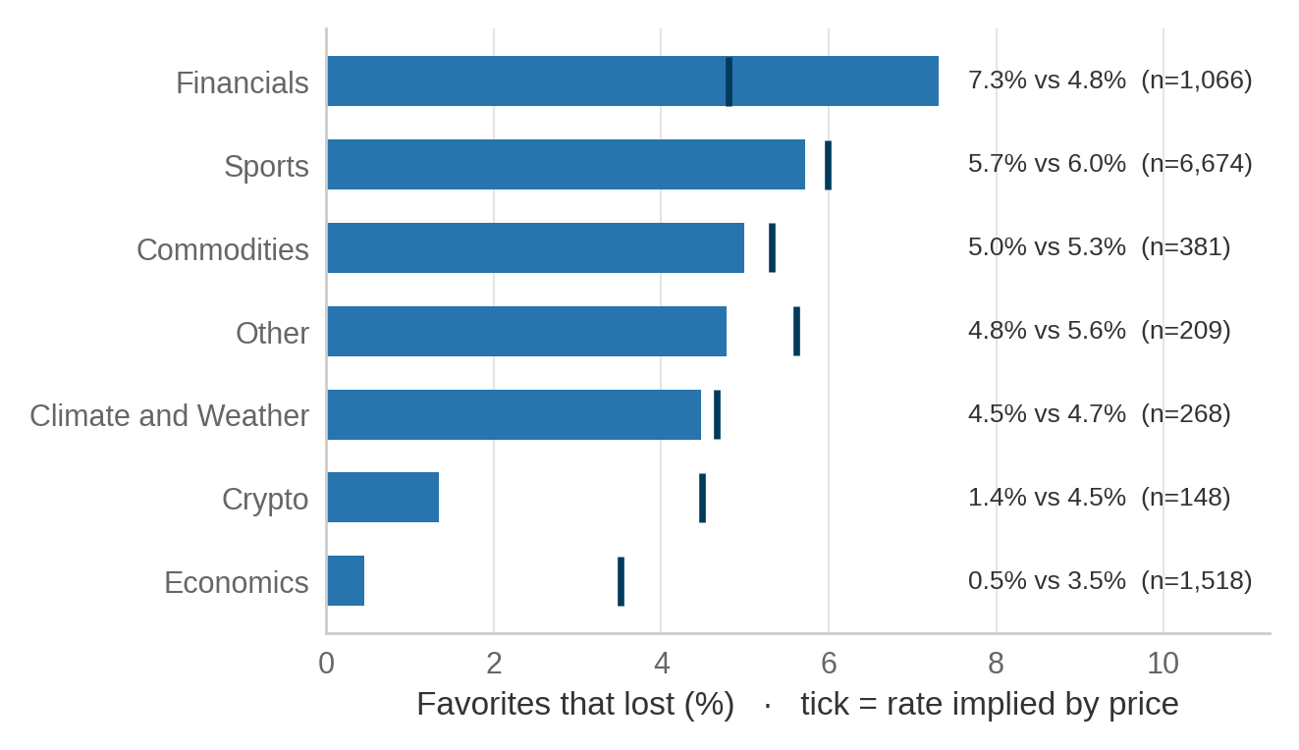
Economics favorites were underpriced
FAVORITES
10,351 favorites, 513 lost
First quote per market with ask 90–99¢, midpoint ≥ 90¢, spread ≤ 5¢
Economics
0.5% lost vs 3.5% implied; 95% CI of the gap [−3.4, −2.6] pts; held in every period; mostly AAA gas-price markets
Financials 7.3% vs 4.8%, but its CI includes 0
Data: Kalshi course database, hourly candles Oct 8–27, 2026 · intervals resample whole events (1,000 bootstrap draws)
Notes:
About 1:00. Now only the favorites: 10,351 markets whose first good quote was 90 to 99 cents, 513 of which lost. By category, most sit at their implied loss rate, the dark tick. Economics is the exception: 7 losses where the price implied about 53. Markets in one event move together, so we bootstrapped whole events; the interval still excludes zero, and it held in all three time periods.

Slide 8
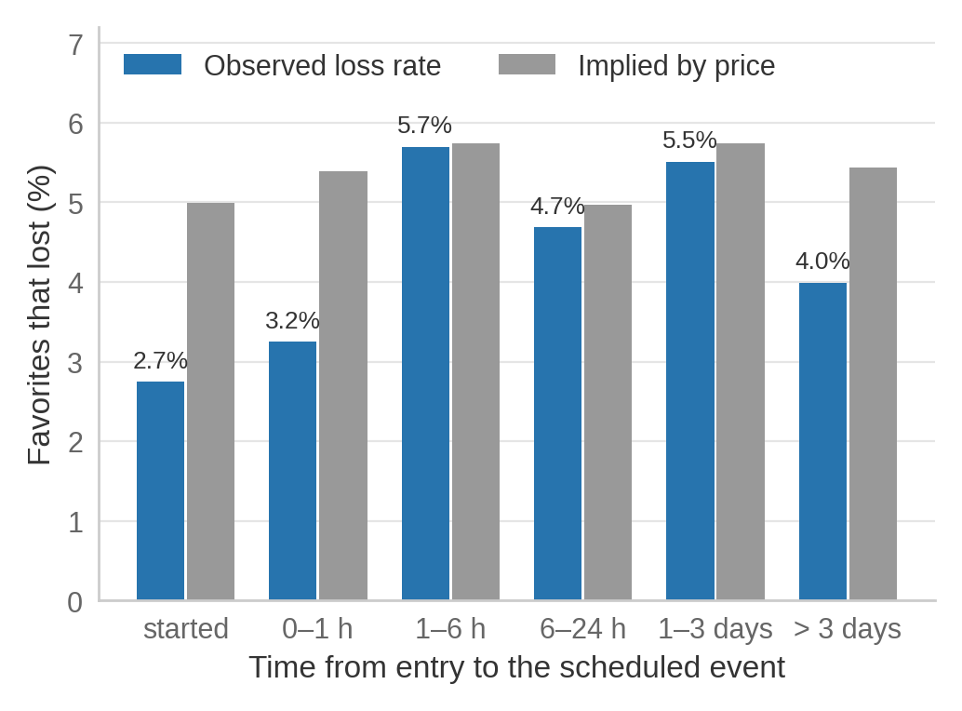
Favorites lose as priced until the event starts
FAVORITES
From 1 hour to 3 days out, loss rates match the price
At or after the scheduled event start: 2.7–3.2% lost vs about 5% implied
A small effect, and not stable across periods
Data: Kalshi course database, hourly candles Oct 8–27, 2026 · time from entry to the scheduled event time · all periods, n = 10,351
Notes:
About 0:40. Splitting favorites by how far away the event was: they lose about as often as priced, except right at or after the start, where they lose less. The effect is small and moves around between periods, so we treat it as a feature for the models rather than a finding.

Slide 9
We split by date and tuned three model families
MODELS
Train
Validation
Test
Entries Oct 9–11
Entries Oct 15–18
Entries Oct 20–25
4,358 markets · 179 losses
3,694 markets · 220 losses
2,299 markets · 114 losses
Features at entry
Models (tuned on validation Brier)
Price, spread, open interest
Volume now and in the prior 6 h
Hours to the scheduled event; recent price change
Category; markets in the event
Elastic-net logistic (Week 3): C = 0.01, L1 share 0.5
Random forest (Week 4): depth 4
XGBoost (Week 4): depth 2, learning rate 0.03
Each with and without volume; baseline = the quoted price
Notes:
About 1:00. We split by time, the way a forecaster would face it, and kept every event inside one split so related markets cannot leak across. Features are all known at the entry hour. We tuned three course models on the validation period by Brier score, the mean squared error of a probability, refit on train plus validation, and scored the test period once. Every model is fit with and without volume to isolate what volume adds.

Slide 10
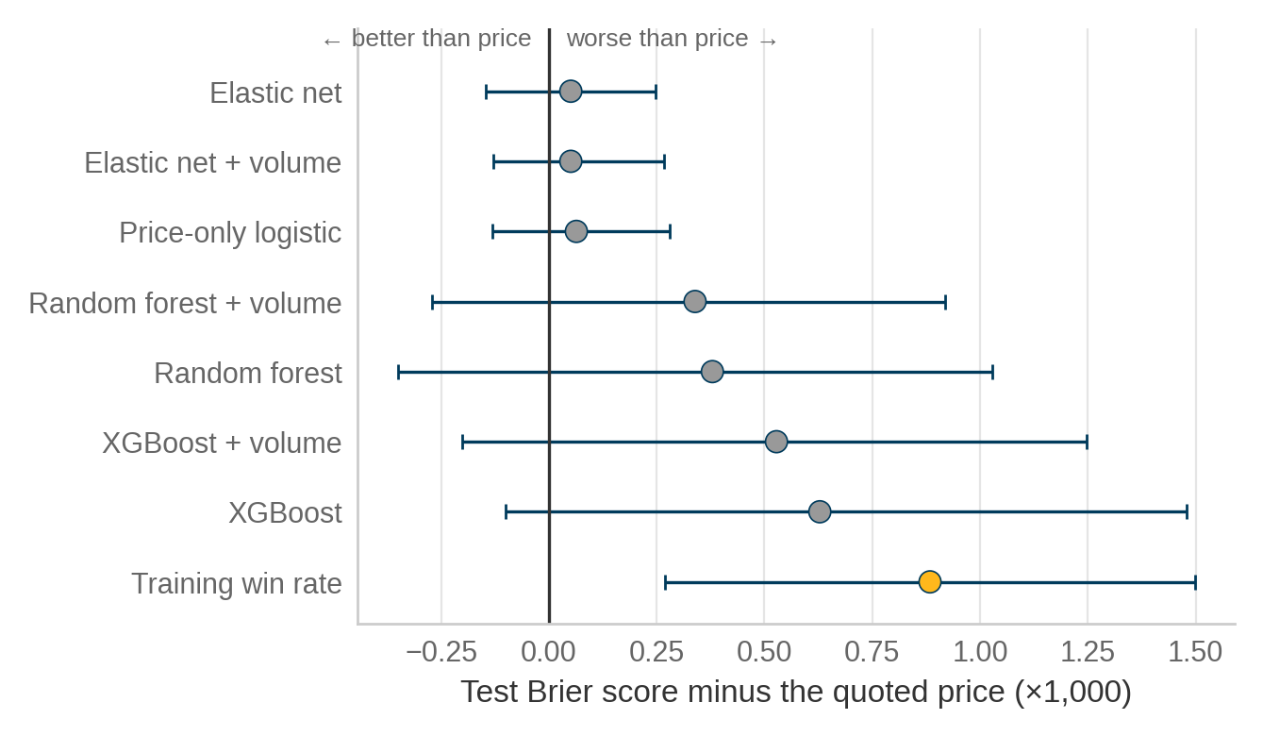
No model beat the quoted price
MODELS
0.04624
test Brier score of the quoted price: the best of all
Closest: elastic net, 0.04629 (gap CI −0.00015 to +0.00025)
Volume changed Brier by at most 0.0001 in every family
The elastic net set every volume, timing and category coefficient to 0
Data: Kalshi course database, Oct 8–27, 2026 · test n = 2,299 · event-bootstrap 95% CIs · gray: CI includes 0, gold: worse
Notes:
About 1:00. Each dot is a model's test Brier minus the price's; left of zero would beat the price, and none do clearly. The regularized logistic regression essentially ties the price, because it shrank everything except price-like features to zero. The tree models fit training data better and test data worse: bias versus variance. Consistent with the EDA, volume adds nothing.

Slide 11
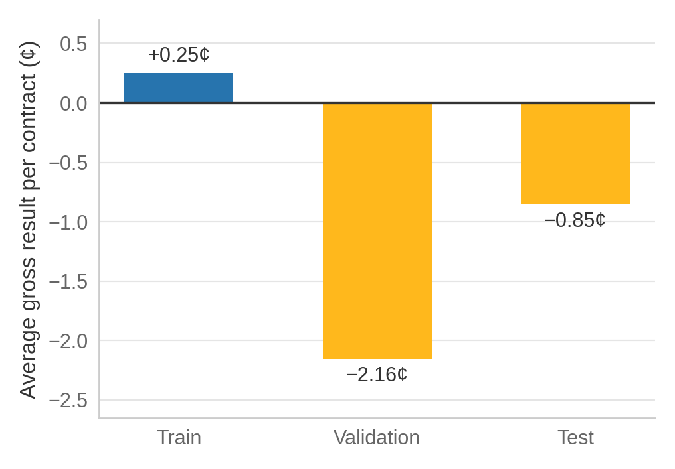
Buying every favorite at the ask still lost money
MODELS
−$19.61
on 2,299 test contracts, even though 95.0% of them won
Per contract: −0.85¢ in test, −2.16¢ in validation, +0.25¢ in train
The small favorite edge from slide 6 does not survive buying at the ask
Data: Kalshi course database, Oct 8–27, 2026 · one contract at the displayed ask, held to settlement, before fees
Notes:
About 0:40. If you bought one contract of every test favorite at the ask and held it, 95% would win and you would still be down about 20 dollars before fees. Buying at the ask rather than the midpoint eats the small favorite edge we saw in the calibration plot, and the result flips sign between periods.

Slide 12
What we learned
Kalshi is mostly sports and crypto, and most markets barely trade
Prices are calibrated within half a point, with a favorite–long-shot bias at the ends
No model beat the price for favorites, and buying them at the ask lost money
Notes:
About 0:45. Three takeaways: what Kalshi trades, how accurate its prices are, and that favorites are not free money. For the final we look at the other end of the calibration plot: long shots that won, and whether informed trading shows up before the news. Then questions. Total talk is about 10:20, leaving four to five minutes for questions.

Slide 13
Thank you
Questions?
Juan Cortes-Aguiar · Ravikiran Madichetty · Ashish Singh
STATS 414 · UCLA · Fall 2026
Notes:
Thank the class and open the floor for questions (about 4 to 5 minutes remain in the 15-minute slot).

