Slide 1
HL DevOps Conversations
Session #2: DevOps Security Primer

Slide 2


AT&T Bell Labs UNIX Crew (1970s era)

Slide 3
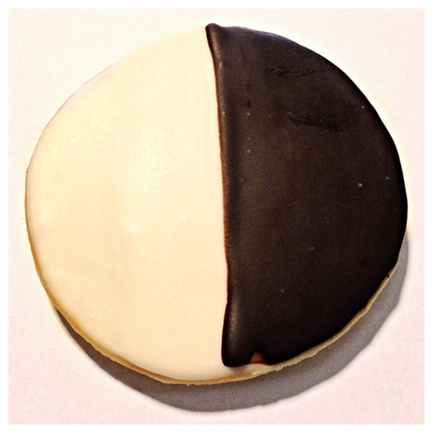
Sun Solaris Engineering Teams (~1990’s)
Developers
Sys Admins

Slide 4

DevOps Teams at Google / Facebook (~2010+)
You are Here!
Full Stack Developers
/ System Engineers
Site Reliability Engineers
/ Production Engineers

Slide 5
The Next Big Idea (~2030)
?

Slide 6
The Combustion Engine Analogy
Developers: The Pistons (Fuel Injectors, Spark Plug, SuperCharger?)
Ops: The Cylinders (and Block ?)
Orchestration: Timing Chain and CAM Shaft / Valve Operation
DevOps: The Crank Shaft

Slide 7
The Big Picture: Context Matters!
UNIX Systems: AT&T – Thompson, Kernighan and Ritchie - born in the 1970’s.
Implemented in C
Linear, Sequential (Virtual) Memory Model
Everything not in RAM is (in) a File: Somewhere, Somehow, and maybe even RAM too!
Multi-User
Multi-Process
Open and Shared for Collaboration by Default
Context-Sensitive Security Model
Host Security
enforced by the kernel, at the context boundaries
Full Disk Encryption
Network Security
Enforced by OS (kernel + root-level services - packet filter/firewall/vpn)
Wire Protocol Session Encryption
Web Application Security
Grafting Sessions onto Stateless (HTTP) Protocol (w/ Cookies & Capability URLs)
Controlling and Sanitizing Tainted Data (*before* Changing Context w/ it)
Encryption: Data at Rest vs. Data in Transit

Slide 8
Thematic Example 1: Joe’s S-Corp Infra
Solaris 11.4
ZFS
Robust, Scalable, Networked, Fast, Painless!
Zones (Virtualization “Containers”)
www
cms-build
DTrace (dynamic kernel-centric tracing system)
Hub (zeus) and Spoke (OCI Regional) Model
VPN-based
Zero-Trust Architecture

Slide 9
Thematic Example 2: Joe’s Windows Laptop
Windows 10 Professional – Windows Insider “dev” Flight
Bleeding Edge – often with dud releases
Painless Kernel Rollback!
WSL (2)
PowerShell controlled with `wsl` Command
Ubuntu 20.04 installed
UNIX Toolchain
git
zsh
emac
screen
pty
ssh
orthrus
htop

Slide 10
htop on WSL
Terminal UI top-matter
CPUs and HyperThreading
Memory Stats
Process/Load Avg. Overview
Process List
Threads vs. Processes
Tree View ‘t’ or ‘F5’
Searching ‘/’ or ‘F3’, and Filtering ‘F4’
Killing ‘k’ or ‘F9’
Listing Process Environment ‘e’
Listing Open Files ‘l’
System Call Tracing ‘s’

