Slide 1
Statistical Analysis of Gene Expression Data of Lungs
By
Kritika Verma
152123

Slide 2

Introduction
Gene expression analysis is a fundamental tool in bioinformatics, with the aim of understanding the genetic mechanisms that regulate the behavior of cells and organisms.
GEO (Gene Expression Omnibus) GEO is a public functional genomics data repository which is used to access datasets of gene expression which were analyzed using GEOquery library of R and GEO2R tool.
One of the key approaches used in gene expression analysis is hypothesis testing, which allows researchers to compare different samples and determine if there are significant differences in gene expression levels between them.
A statistical hypothesis is a statement of the parameters of a population or populations.

Slide 3
Implementation and Methodology

Slide 4
1. Retrieving Data from GEOquery Using R
GEO database provides datasets in various classes namely platform, samples, series and datasets.
Platform (GPLxxx)
Samples (GSMxxx)
Series (GSExxxxxx)
Datasets (GDSxxx)
These four classes can be accessed an analysed using R’s library GEOquery which can be used to obtain the sample values, GSEmatrix which can be used to plot a heatmap of the sample using pheatmap library, data summary consisting of mean, median, etc, and metadata about the expression values.

Slide 5
2. Analysing the Data
We used GEO2R a tool used for analysis for GEO series, samples and other classes. The series GSE10072 was used for the analysis which contained gene 3 expression data of 107 people for normal lung tissues as well as tumor lung tissues.
The data was then split into subcategories and sample mean of 3 genes was calculated for the whole data and for each subcategory.
a)Normal tissues and tumorous tissues
b) Gene expression in women and men
c) People who have never smoked and current/former smoker
The catagories were not further divided in current and former smoker due to the data set decreasing furthermore.

Slide 6
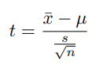
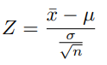
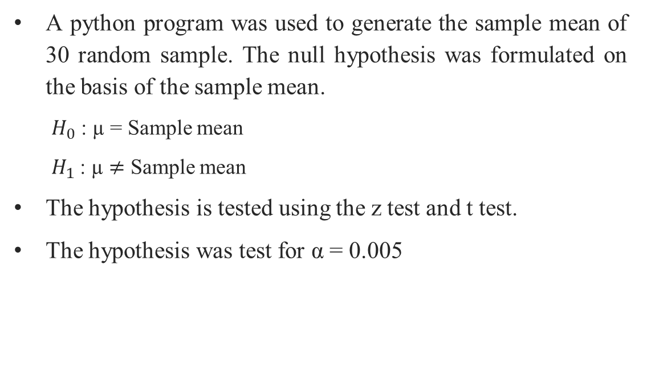
3. Hypothesis Testing
A python program was used to generate the sample mean of 30 random sample. The null hypothesis was formulated on the basis of the sample mean.
$H_{0}$ : µ = Sample mean
$H_{1}$: µ $≠$ Sample mean
The hypothesis is tested using the z test and t test.
The hypothesis was test for α = 0.005
where,
x̅:Mean of the sample.
μ: Mean of the population.
σ: Standard deviation of the population
μn: sample size.
S: Standard deviation of the sample

Slide 7
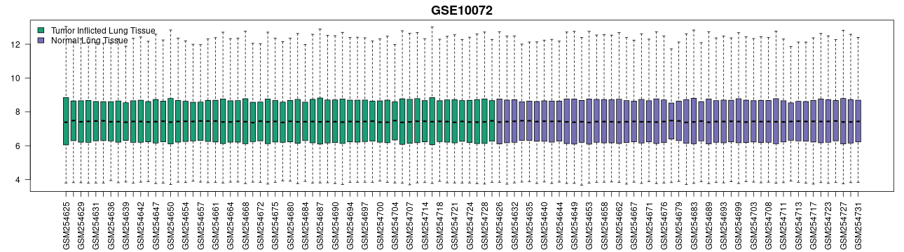
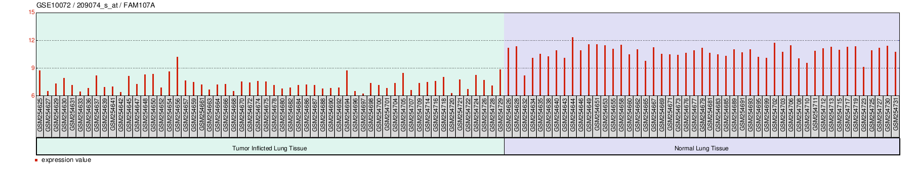
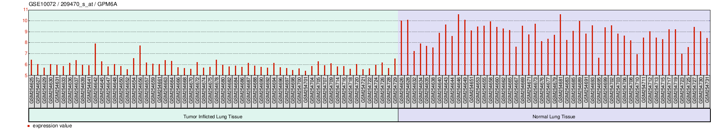
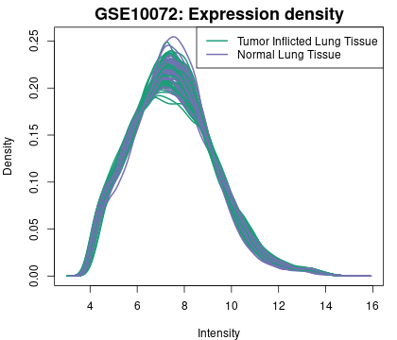
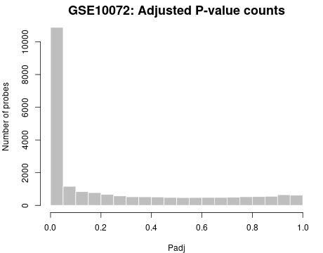
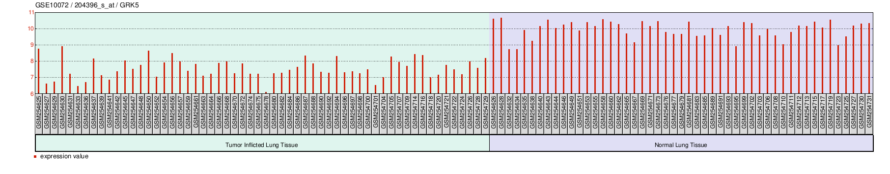
Results
For data divided into tumor and normal tissues.
Fig 1.1: Boxplot of the distribution
Fig 1.2:Gene expression level of different genes

Slide 8
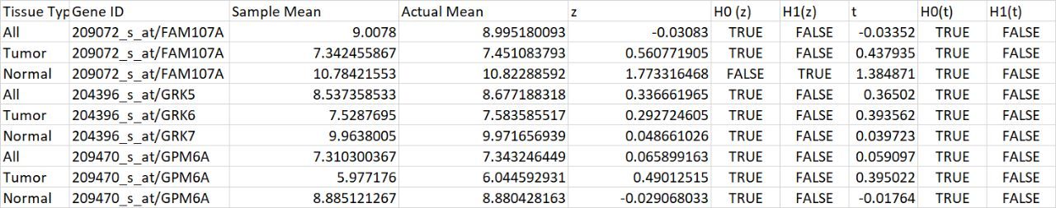
Results
For data divided into tumor and normal tissues.
Table 1.1: Hypothesis testing results.

Slide 9
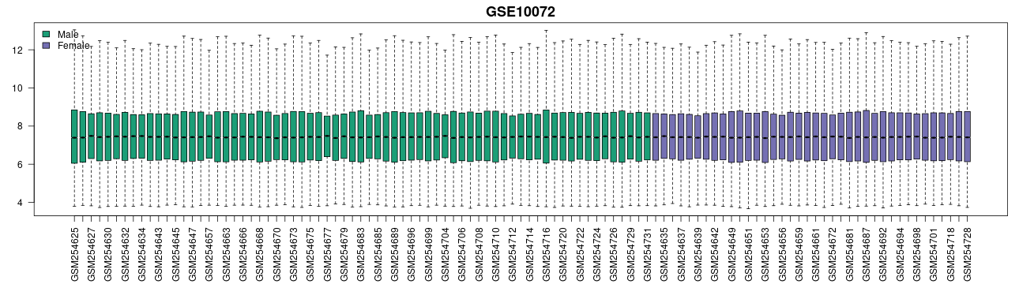
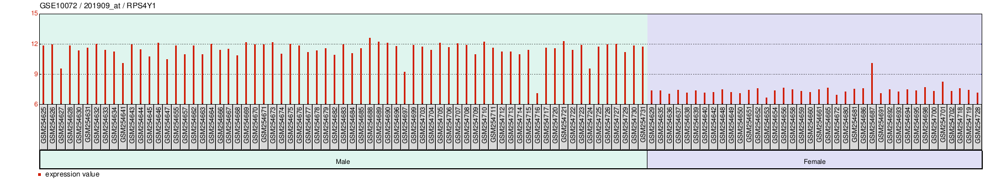
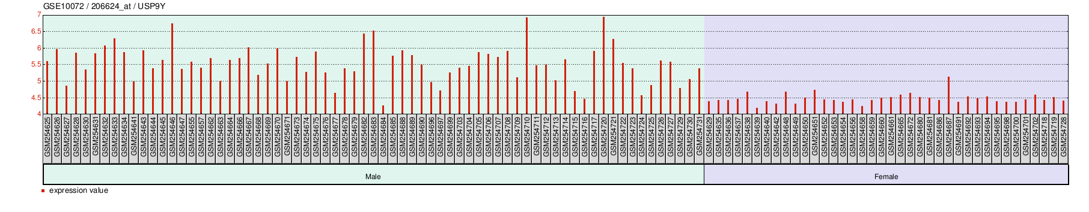
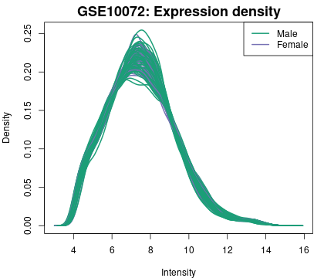
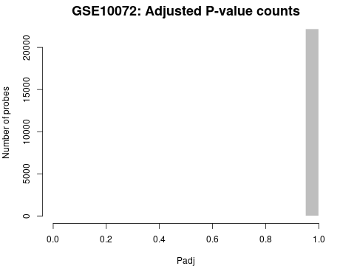
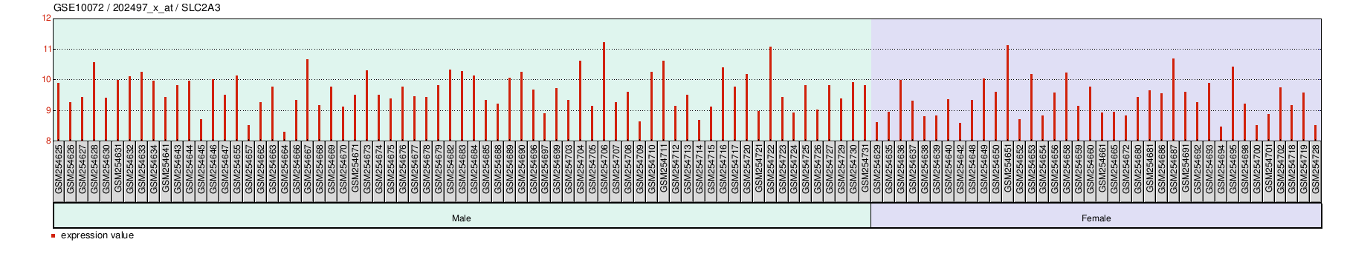
Results
For data divided into sample taken of men and women.
Fig 2.1: Boxplot of the distribution
Fig 2.2:Gene expression level of different genes

Slide 10
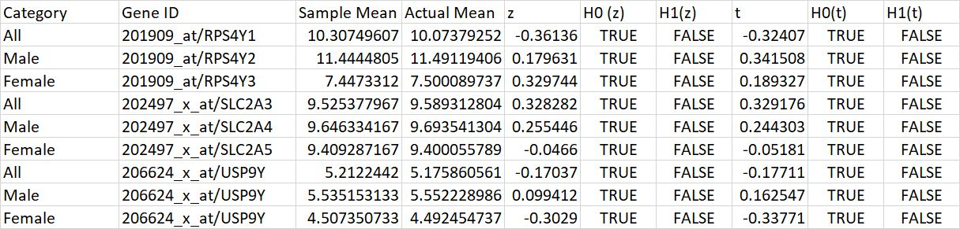
Results
For data divided into sample taken of men and women.
Table 2.1: Hypothesis testing results.

Slide 11
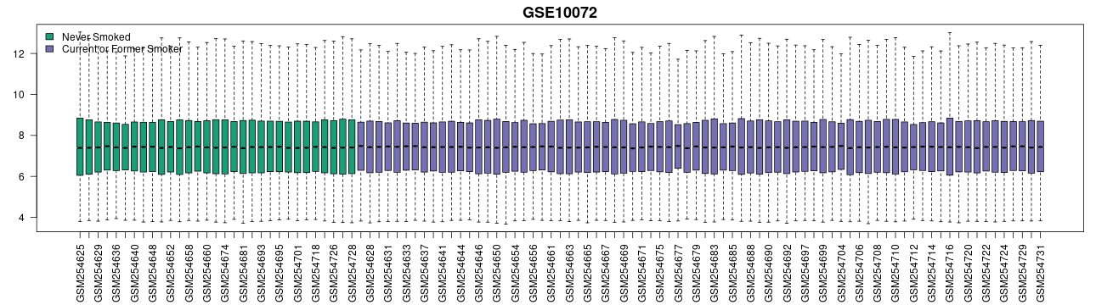
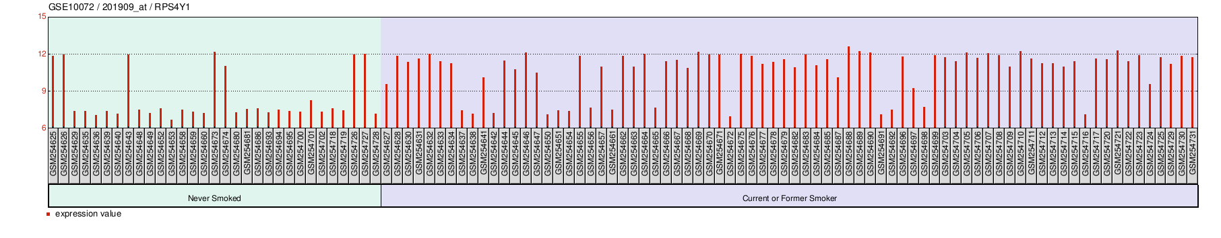
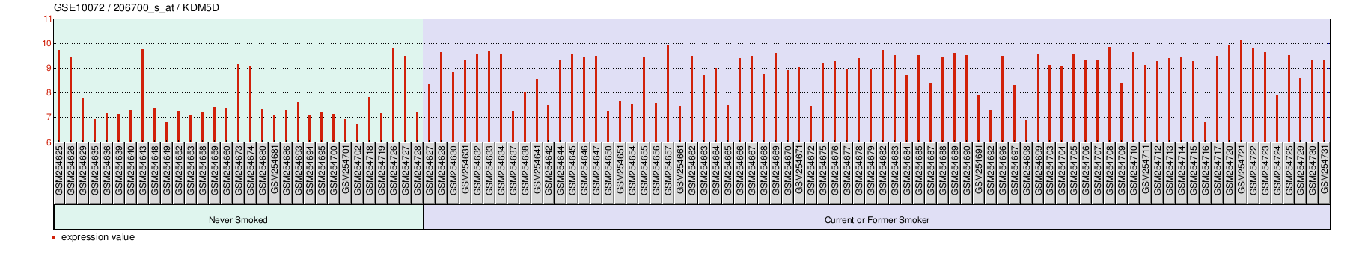
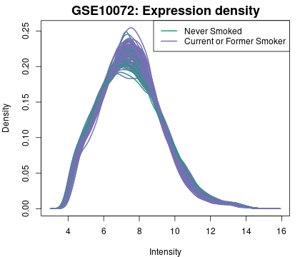
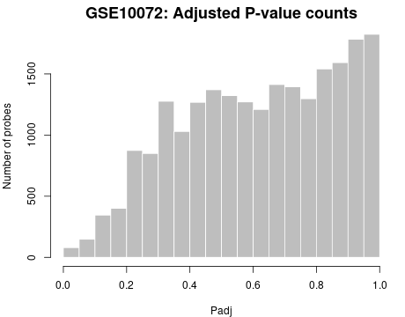
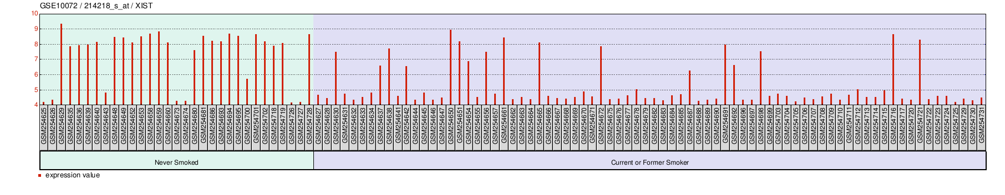
Results
For data divided into sample taken of people who have never smoked and current/former smokers.
Fig 3.1: Boxplot of the distribution
Fig 3.2:Gene expression level of different genes

Slide 12
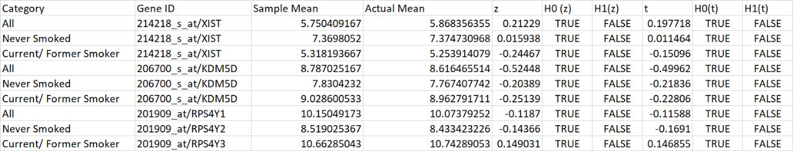
Results
For data divided into sample taken of people who have never smoked and current/former smokers.
Table 3.1: Hypothesis testing results.

Slide 13
Conclusion And Future Scope
We assumed our data follows normal distribution and since it was smaller in size we also tested t distribution.
The results show that for the most extent our hypothesis was true for the normal distribution and follows t-distribution for all the data values.
The population size was about 107 datapoints, categorizing the dataset diminished the population size further more and there were was much disparity in the population size in categories like men, women, smokers and non-smokers.
The data can be compared with and/or used to build a model for prediction gene expression level of certain genes during specific diseases and control situations. This can also be used to detect certain diseases like cancer with the help of just gene expression levels with parameters like age, gender, past health records and many more.
Gene expression levels can be analysed by statistics using hypothesis testing which provides an accurate tool for testing if the value of the parameter has changed or not, setting up a model and ensuring the validity of the model. heatmaps can also be analysed to predict statistical patterns and trends in the data. This data can be used to set up machine learning model for predicting and detecting certain diseases with the help of gene expression data.

Slide 14
References
Home - Geo - NCBI (no date) National Center for Biotechnology Information. U.S. National Library of Medicine. Available at: https://www.ncbi.nlm.nih. gov/geo/ (Accessed: April 25, 2023).
Lee, M. (2018) Geo accession viewer, National Center for Biotechnology Information. U.S. National Library of Medicine. Available at: https://www.ncbi .nlm.nih.gov/geo/query/acc.cgi?acc=gse10072 (Accessed: April 22, 2023).
Davis, S. (2014) Using the GEOquery Package, Using the GEOquery package. Available at: https://bioconductor.org/packages /devel/bioc/vignettes/GEOquery /inst/doc/GEOquery.html (Accessed: April 29, 2023).
Lee, M. (2018) Geo accession viewer, National Center for Biotechnology Information. U.S. National Library of Medicine. Available at: https://www.ncbi .nlm.nih.gov/geo/query/acc.cgi?acc=gse10072 (Accessed: April 22, 2023).
Shobha Bagai (2022) Scrutinizing String Art Through a Mathematical Lens, PRIMUS, DOI: 10.1080/10511970.2022.2068094
About geo2r - geo - NCBI (no date) National Center for Biotechnology Information. U.S. National Library of Medicine. Available at: https://www.ncbi .nlm.nih.gov/geo/info/geo2r.html (Accessed: April 25, 2023).
About geo2r - geo - NCBI (no date) National Center for Biotechnology Information. U.S. National Library of Medicine. Available at: https://www.ncbi. nlm.nih.gov/geo/info/geo2r.html (Accessed: April 25, 2023).
About geo2r - geo - NCBI (no date) National Center for Biotechnology Information. U.S. National Library of Medicine. Available at: https://www.ncbi. nlm.nih.gov/geo/info/geo2r.html (Accessed: April 25, 2023).

Slide 15
Thank You Kritika Verma B. Tech (IT and M1) 152123 kritikaverma3107@gmail.com

