Slide 1

Stock Analysis by Hebbian Learning
finding a relationship between stocks Sun Wu Choi

Slide 2

Example, what is related to TESLA?
Solar Power
3D – Printing
Electric Car
Bio / Pharmacy?

Slide 3
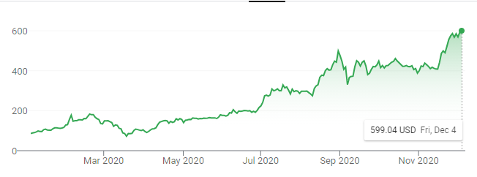
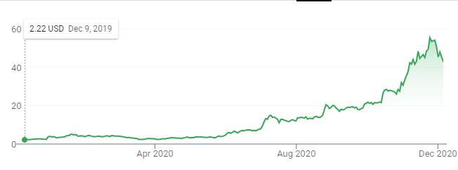
Problem to Solve
Tesla Stock
NIO Stock
Function
Relationship score / compared length
What does the score mean?
Problems
How will the function work?
What will the relationship score mean?

Slide 4
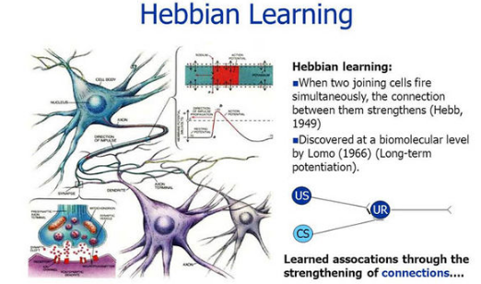
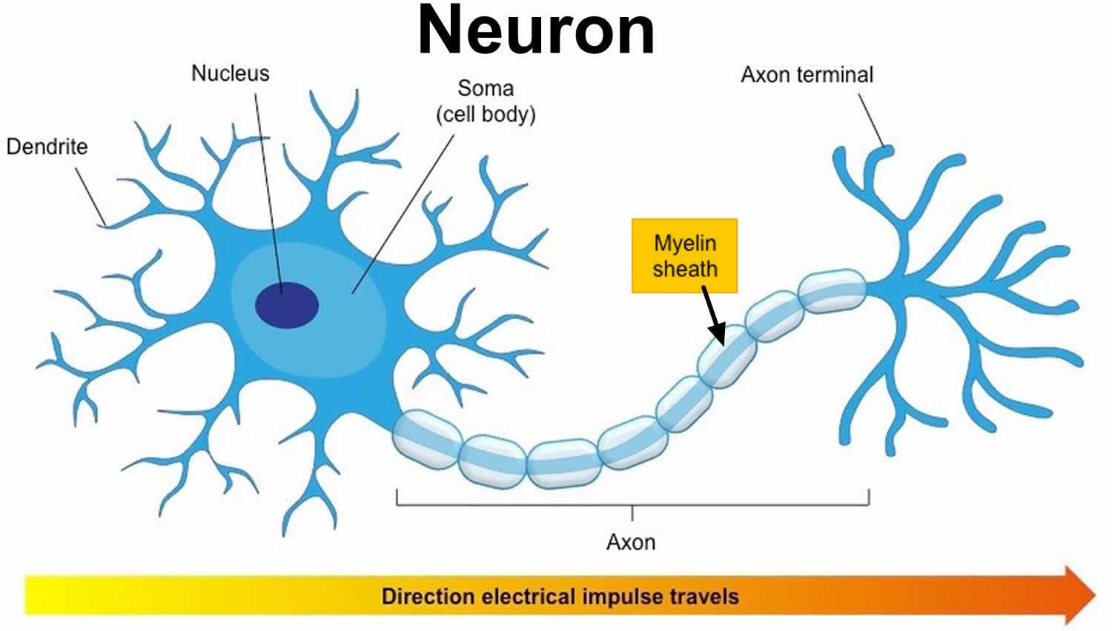
Main Idea
Tesla stock = neuron 1
Other stock = neuron 2
Stimulus of Neurons: history of stock fluctuation
Result: Strong connection if fluctuation is similar
Relationship score = Myelin Sheath

Slide 5

On the same day if they…
Tesla +6% NIO +5% = +25 points
Tesla -10% NIO +4% = -16 points
Tesla - 6% NIO - 1% = +1 points
Score = Sum of Points / Compare Length
But we square which is smaller
But keep the negative or positive
Results
[1] 152443 points NIO Electric Cars
[2] 141874 points Glu Mobile One of chief officer moved to this company
[3] 131066 points ROKU Streaming and TV ( no idea why related )
[4] 127795 points Canadian Solar Solar Panels
[5] 121056 points Sun Power Solar Panels
[6] 120590 points Precigen Bio tech
[7] 120472 points SmartSheet eCommerce supply chain ( has contract with Tesla )
[8] 119866 points PTC Therapeutics Pharmaceutical
[9] 118779 points Niu Technologies Electric Scooter
[10] 116784 points Jinko Solar Solar Panel
[11] 114485 points 3D Systems 3D printing
And many more related companies
Amazing Results !!!

Slide 6
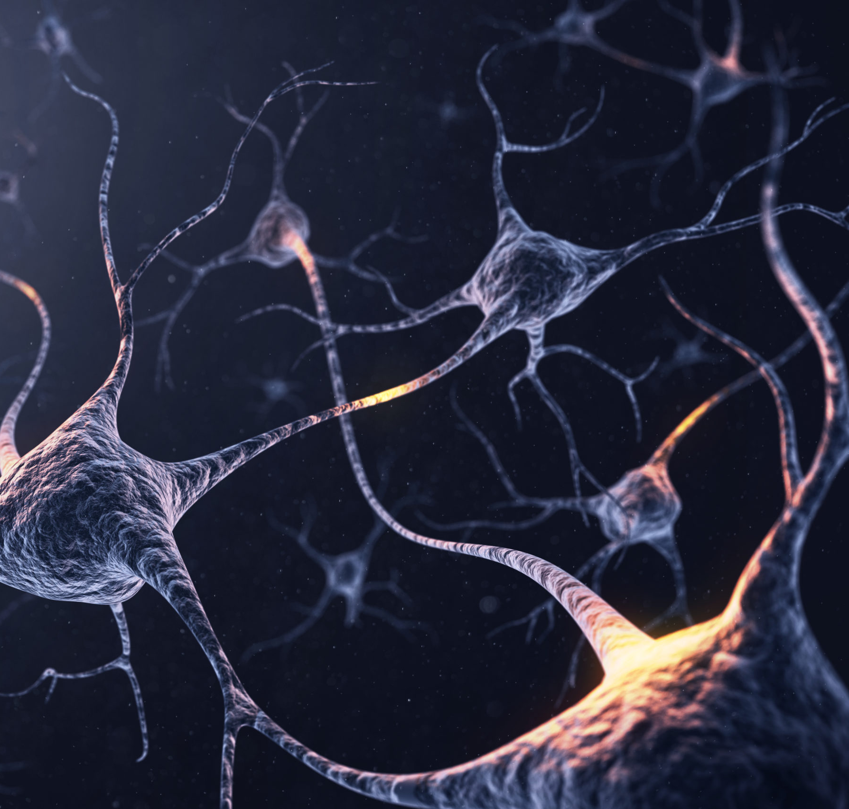
Conclusion
It is plausible create a Hebbian learning connection with stocks
The longer the data is, it shows similar industry or similar patterned industry like bio tech paired with game and eco energy
Short term data shows contracts or hidden information like the executive moved to that company

Slide 7

Question?

