Slide 1
←
3C analysis
9~13 page
한국환경공단_에어코리아_대기오염통계 현황
데이터분석 프로젝트
-선예은-

Slide 2
←
3C analysis
9~13 page
01
자료 수집 방법
02
자료 분석 과정
03
분석 결과

Slide 3
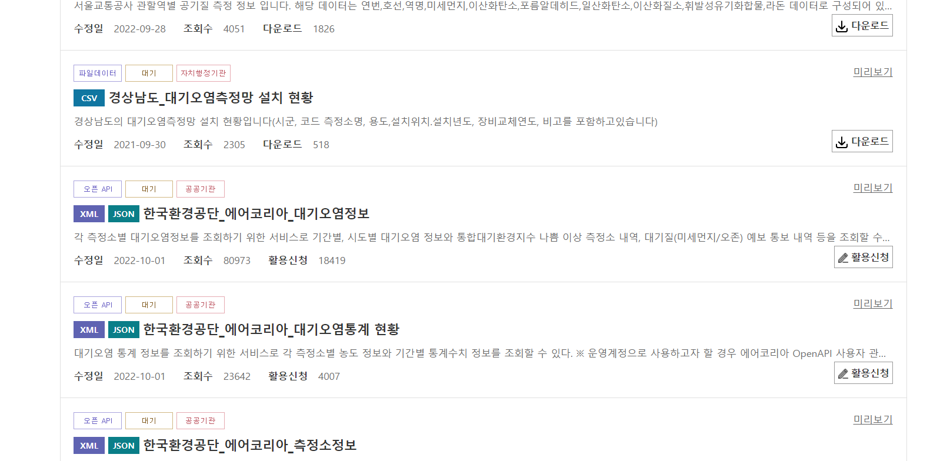
←
3C analysis
9~13 page

Slide 4
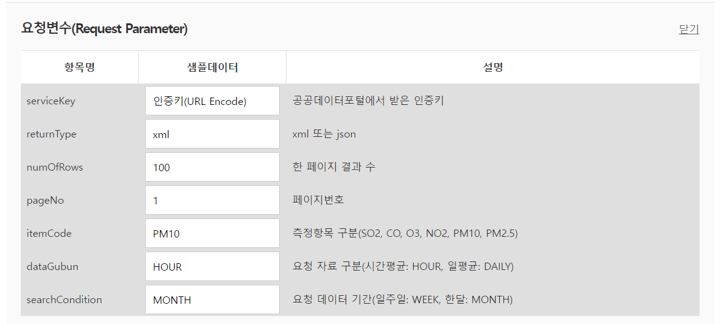
←
3C analysis
9~13 page

Slide 5
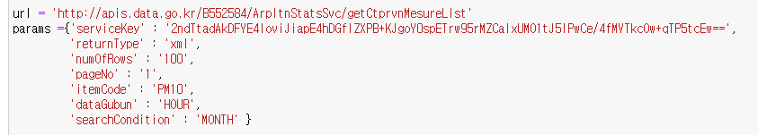
←
3C analysis
9~13 page
공개 API

Slide 6

←
3C analysis
9~13 page

Slide 7
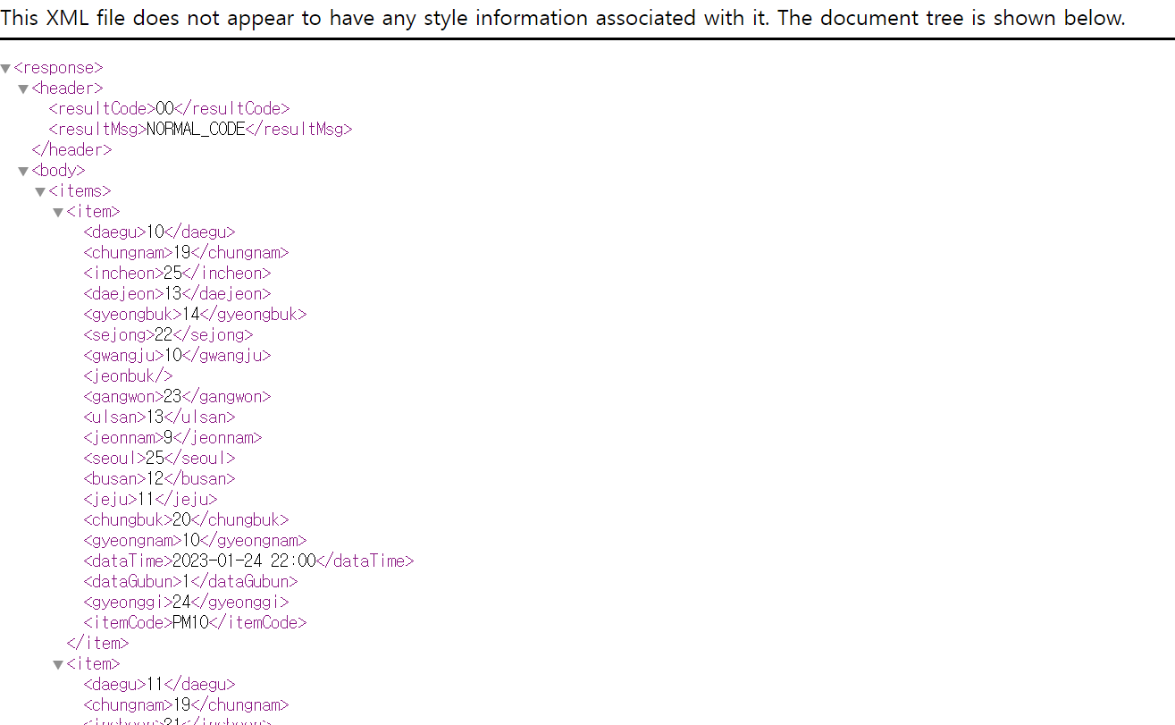
←
3C analysis
9~13 page

Slide 8
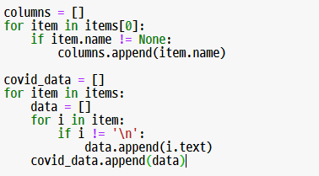
←
3C analysis
9~13 page

Slide 9
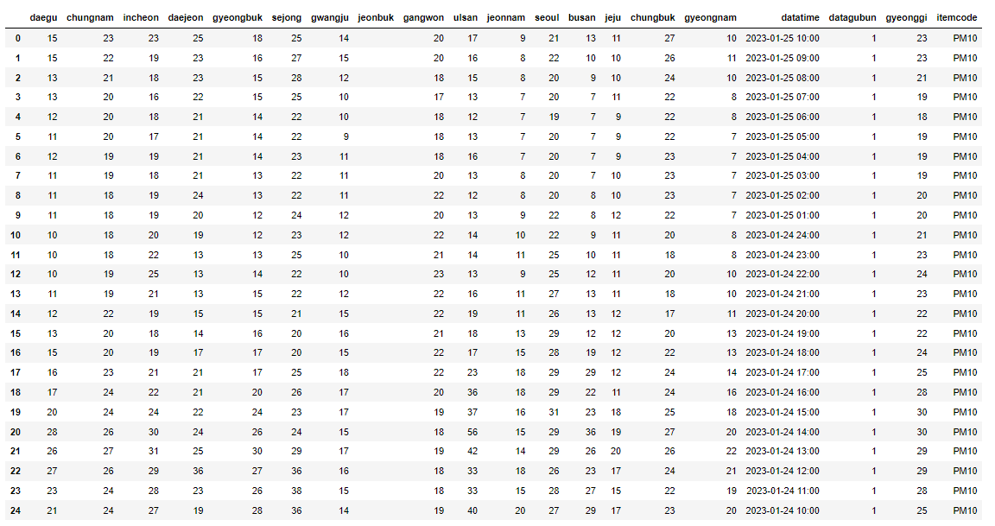
←
3C analysis
9~13 page

Slide 10
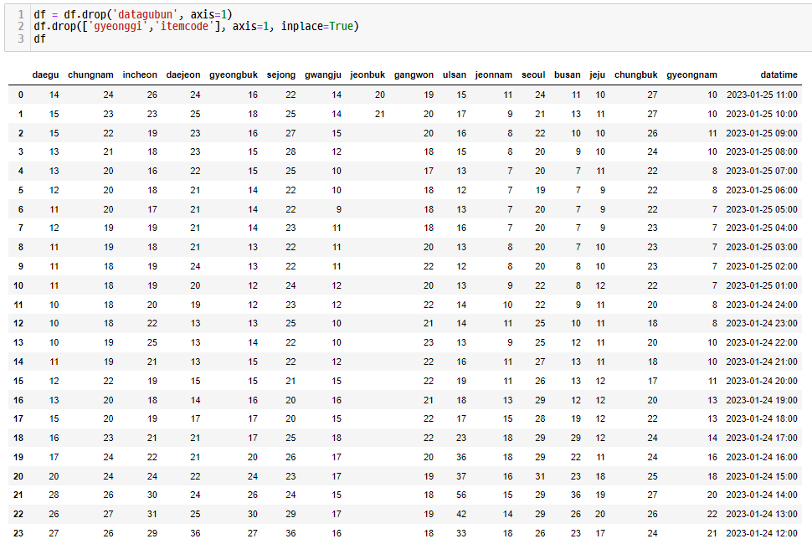
←
3C analysis
9~13 page

Slide 11
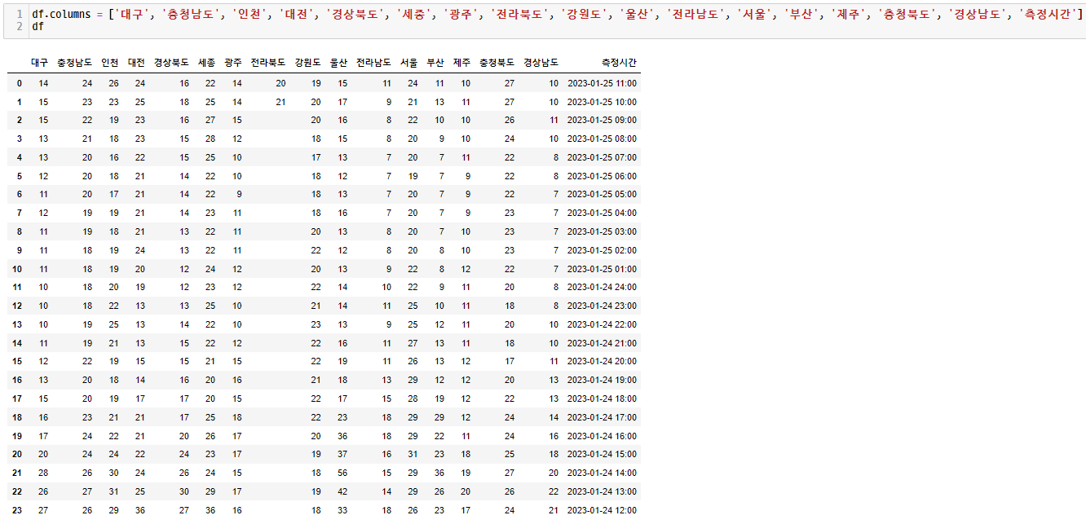
←
3C analysis
9~13 page

Slide 12
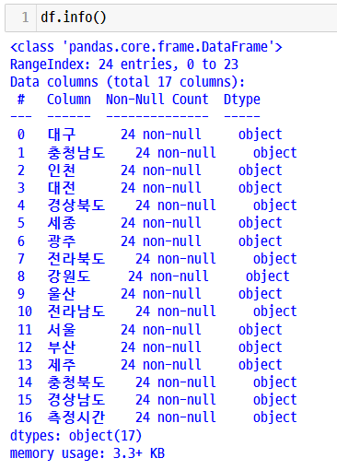
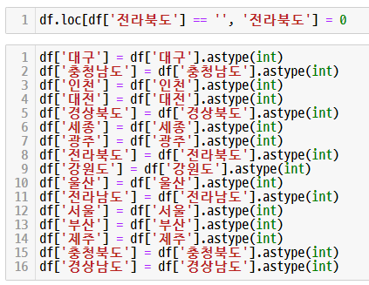
←
3C analysis
9~13 page

Slide 13
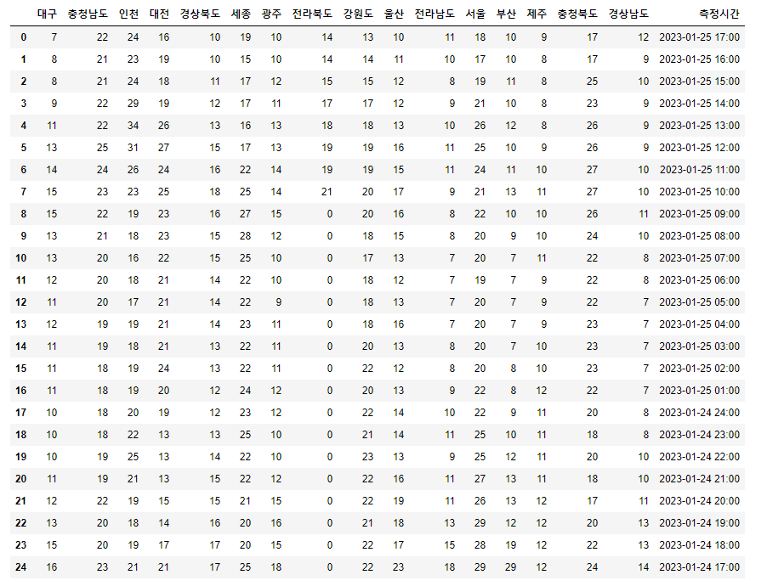
←
3C analysis
9~13 page

Slide 14
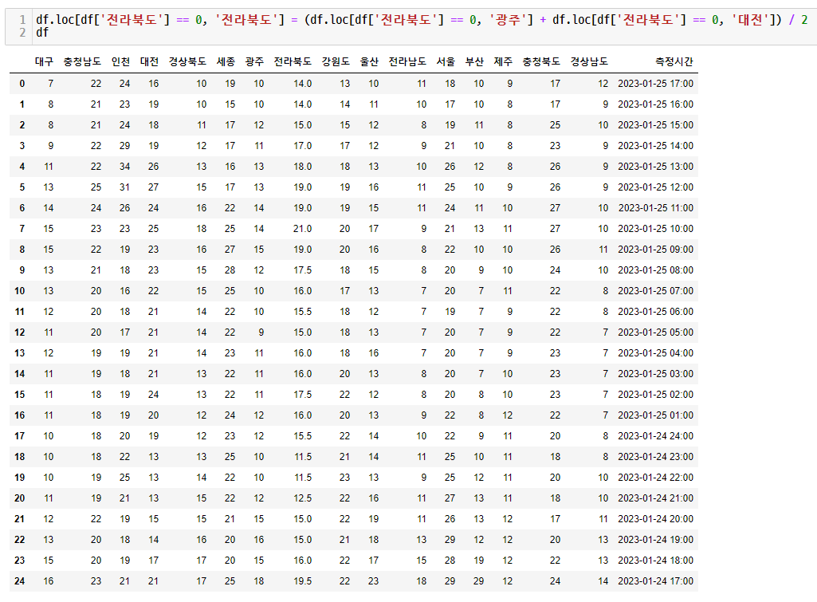
←
3C analysis
9~13 page

Slide 15
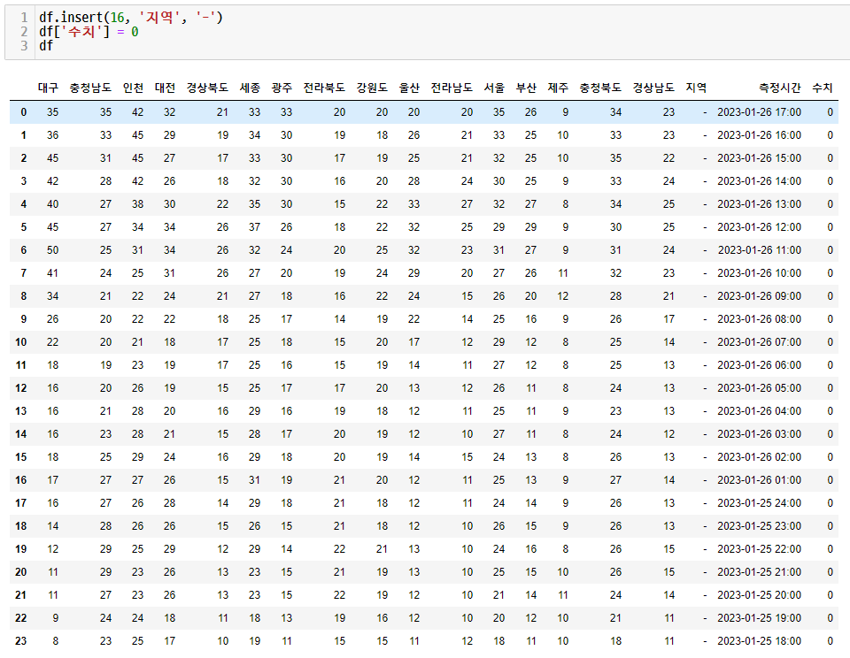
←
3C analysis
9~13 page

Slide 16
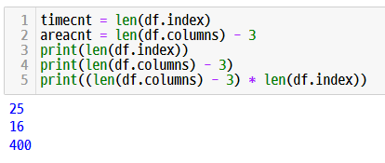
←
3C analysis
9~13 page

Slide 17
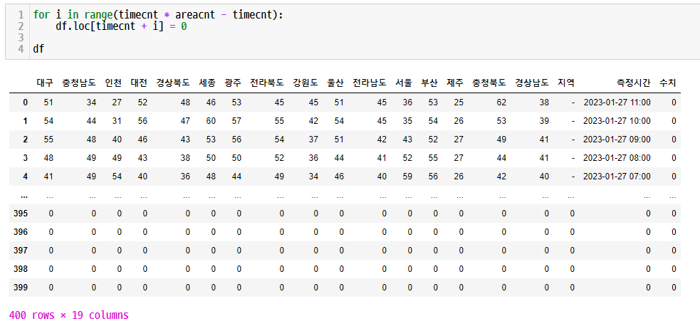
←
3C analysis
9~13 page

Slide 18
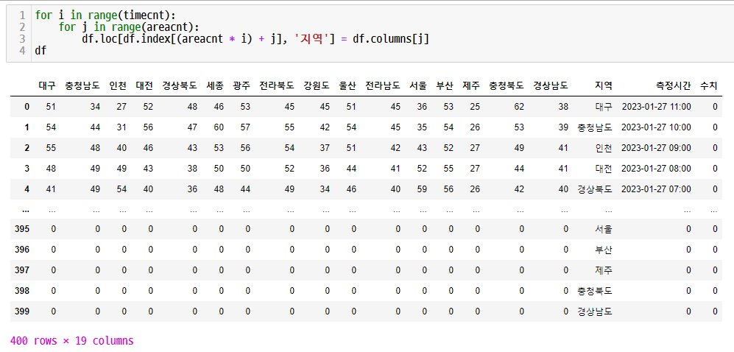
←
3C analysis
9~13 page

Slide 19
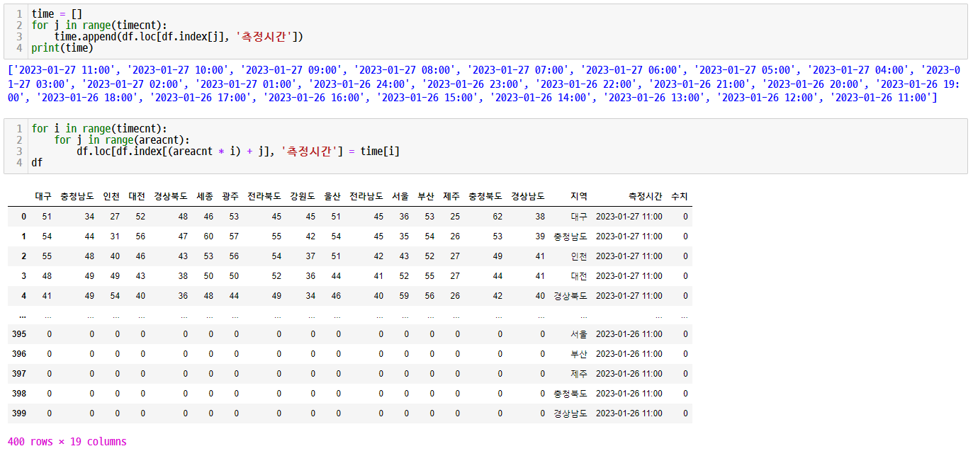
←
3C analysis
9~13 page

Slide 20
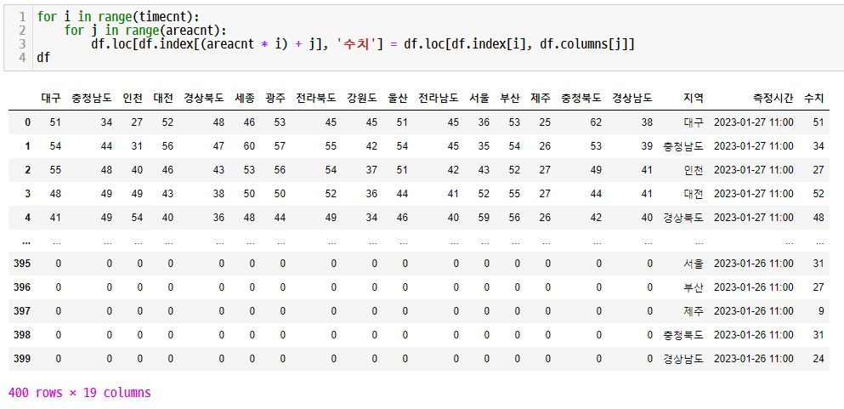
←
3C analysis
9~13 page

Slide 21
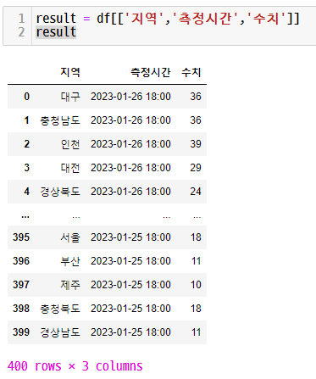
←
3C analysis
9~13 page

Slide 22
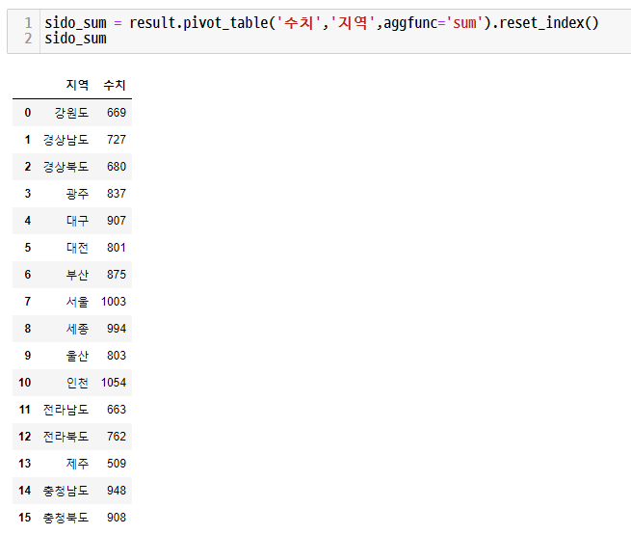
←
3C analysis
9~13 page

Slide 23
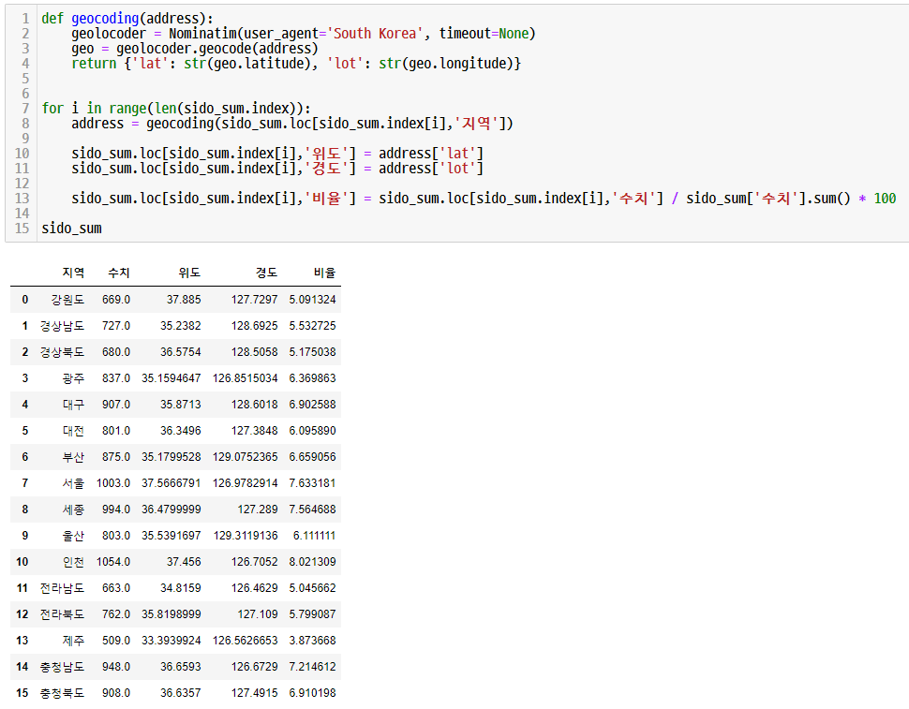
←
3C analysis
9~13 page

Slide 24
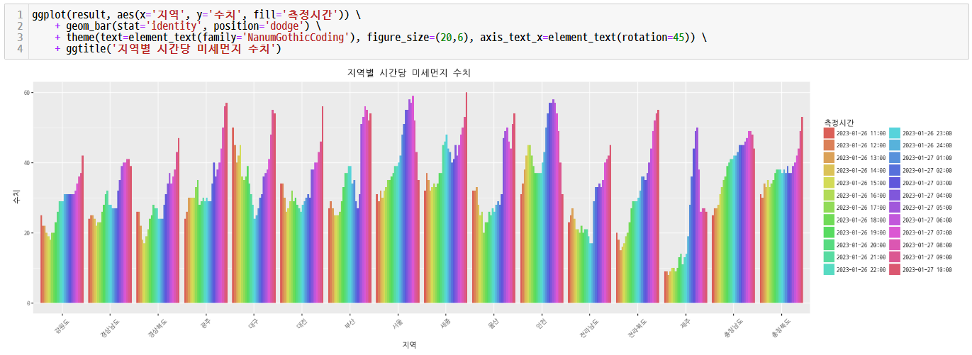
←
3C analysis
9~13 page

Slide 25
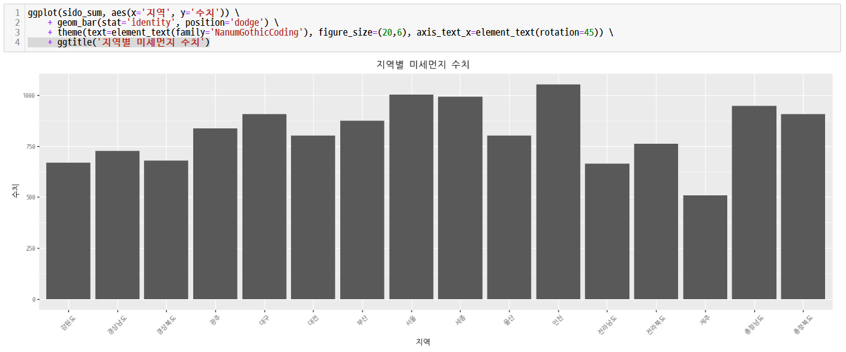
←
3C analysis
9~13 page

Slide 26
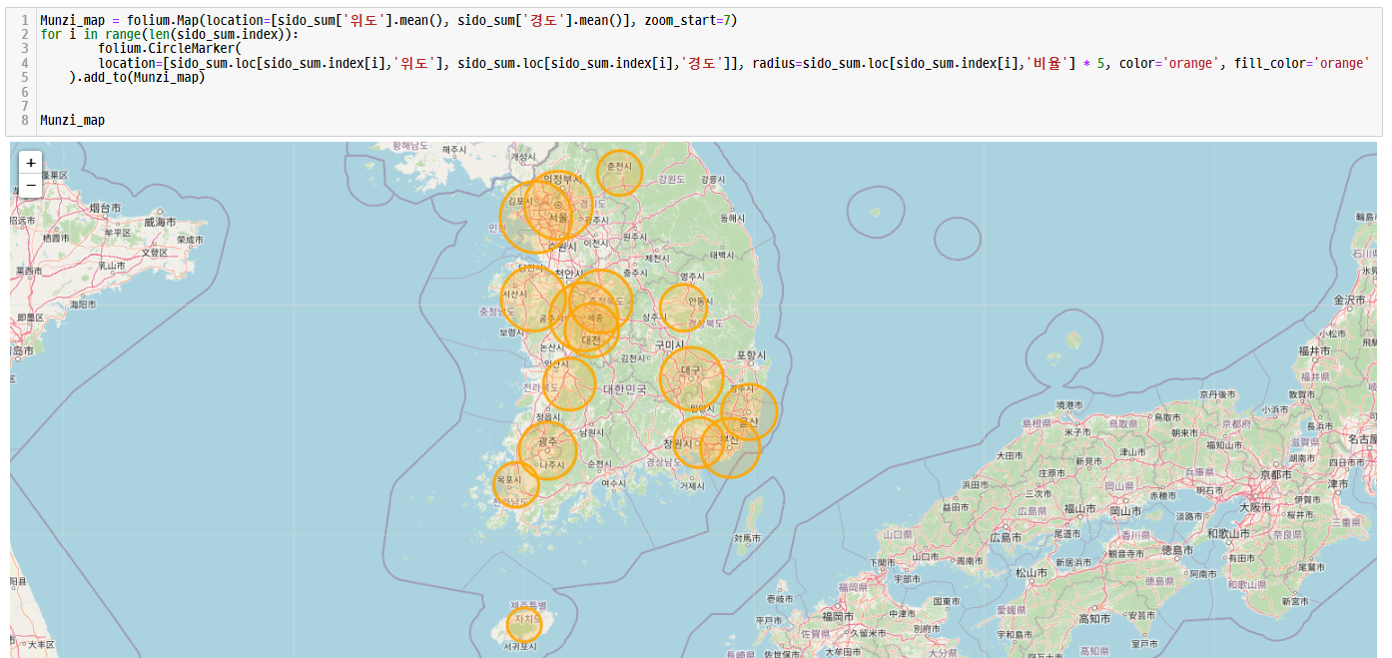
←
3C analysis
9~13 page

Slide 27
←
3C analysis
9~13 page
감사합니다

