Slide 1
Data Analysis
By Sunaina Yadav

Slide 2
Agenda A: Analyzing the Number of Students Registered on Khan Academy By District. Agenda B: Identifying the total number of students who have come on KA platform during a month .
Agenda C: Inspecting learning time spent on KA platform by active students.

Slide 3
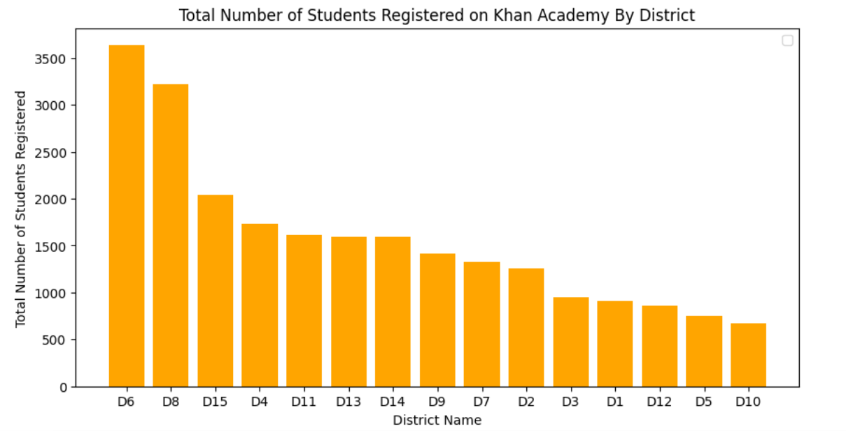
Agenda A: Analyzing the Number of Students Registered on Khan Academy By District.
Agenda A:
D1: District 1, D2: District 2, D3 District 3,D4: District 4,D5: District 5,D6: District6, D7: District 7, , D8: District 8, D9: District 9,, D10: District 10,
D11: District 11, D12: District12, D13 District 13,D14: District 14,D15:District 15

Slide 4
Analysis A
District 6 and District 8 has maximum number of students registered on Khan Academy.
The Academy should focus on Districts with lesser number of students registered i.e. District 10, District 5 .

Slide 5
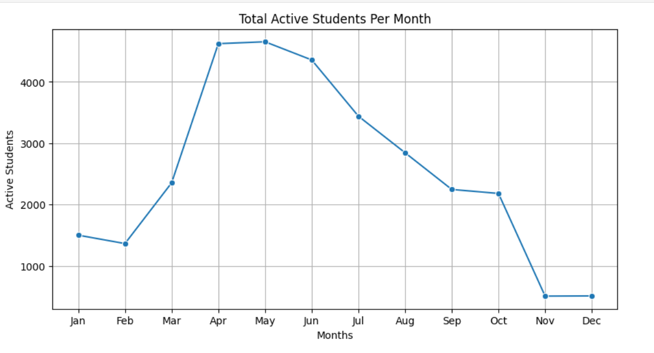
Agenda B: Identifying the total number of students who have come on KA platform during a month.

Slide 6
Analysis B
# Maximum number of students were active during the month of April and May.
# After May there is a sharp decline in the graph.
# Students were least active in the month of Nov,Dec.

Slide 7
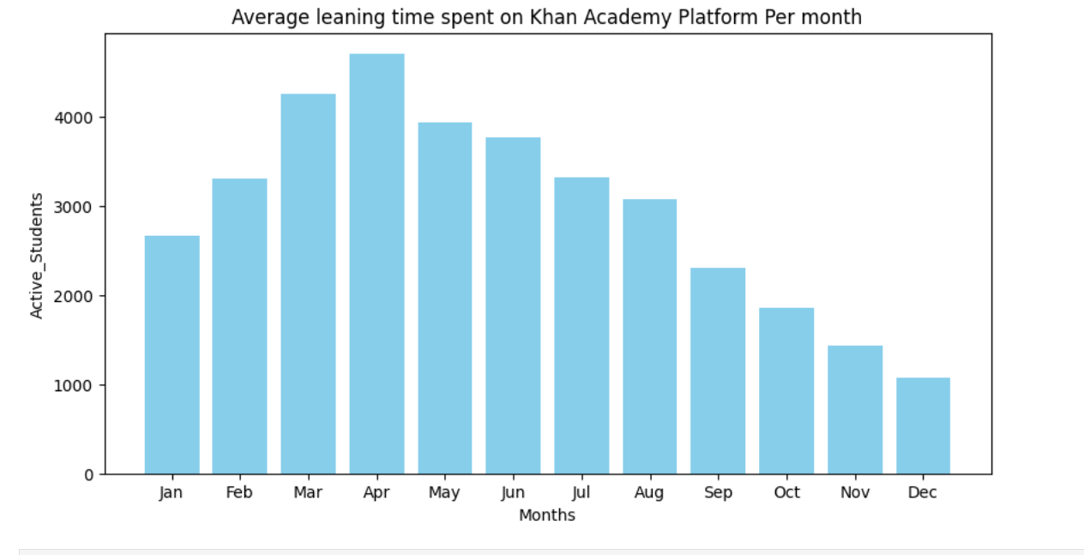
Agenda C: Inspecting learning time spent on KA platform by active students.

Slide 8
Analysis C
# Average learning time spent on KA platform was maximum in month of April.
# The graph show continuous decline in number of student spending time on KA platform after April.

Slide 9
Personal Analysis
Generally new session starts in month of April . Students are excited when they enter new class and they are found to be most active on KA platform .
Students should be asked for the feedback after a class. This activity can be conducted once in a month to know what they think is lacking in the class.
Feedback from parents about the classes should be also taken.
Teachers should be trained on innovative teaching methods .
Teacher’s performance should be assessed from time to time .
KA platform can also be assessed for further improvement.

Slide 10
Thank You

