Slide 1
AI Chatbot with
Streamlit + Ollama
A practical local-AI project that turns a Python interface into a conversational assistant.

Slide 2



THE PROJECT
The project turns a local model into a usable chatbot
Three pieces connect a prompt to a visible response.
Streamlit
Ollama
Conversation state
Provides the interactive web interface.
Runs and serves the language model locally.
Connects user prompts, model responses, and history.
A small application surface, a local model service, and state that keeps the conversation coherent.
02

Slide 3
SYSTEM MAP
Architecture: three layers, one conversation loop
The user enters a prompt, Python forwards the conversation, and Streamlit renders the model's response.
Ollama's local server uses the base URL http://localhost:11434/api; local requests do not need an authorization header.
03

Slide 4



THE FRONT END
Streamlit keeps the interface simple
The UI has only a few jobs, and each one stays visible.
Capture
Separate
Preserve
Chat input captures the next user message.
Chat message containers distinguish user and assistant turns.
Session state preserves the conversation while the app runs.
04

Slide 5
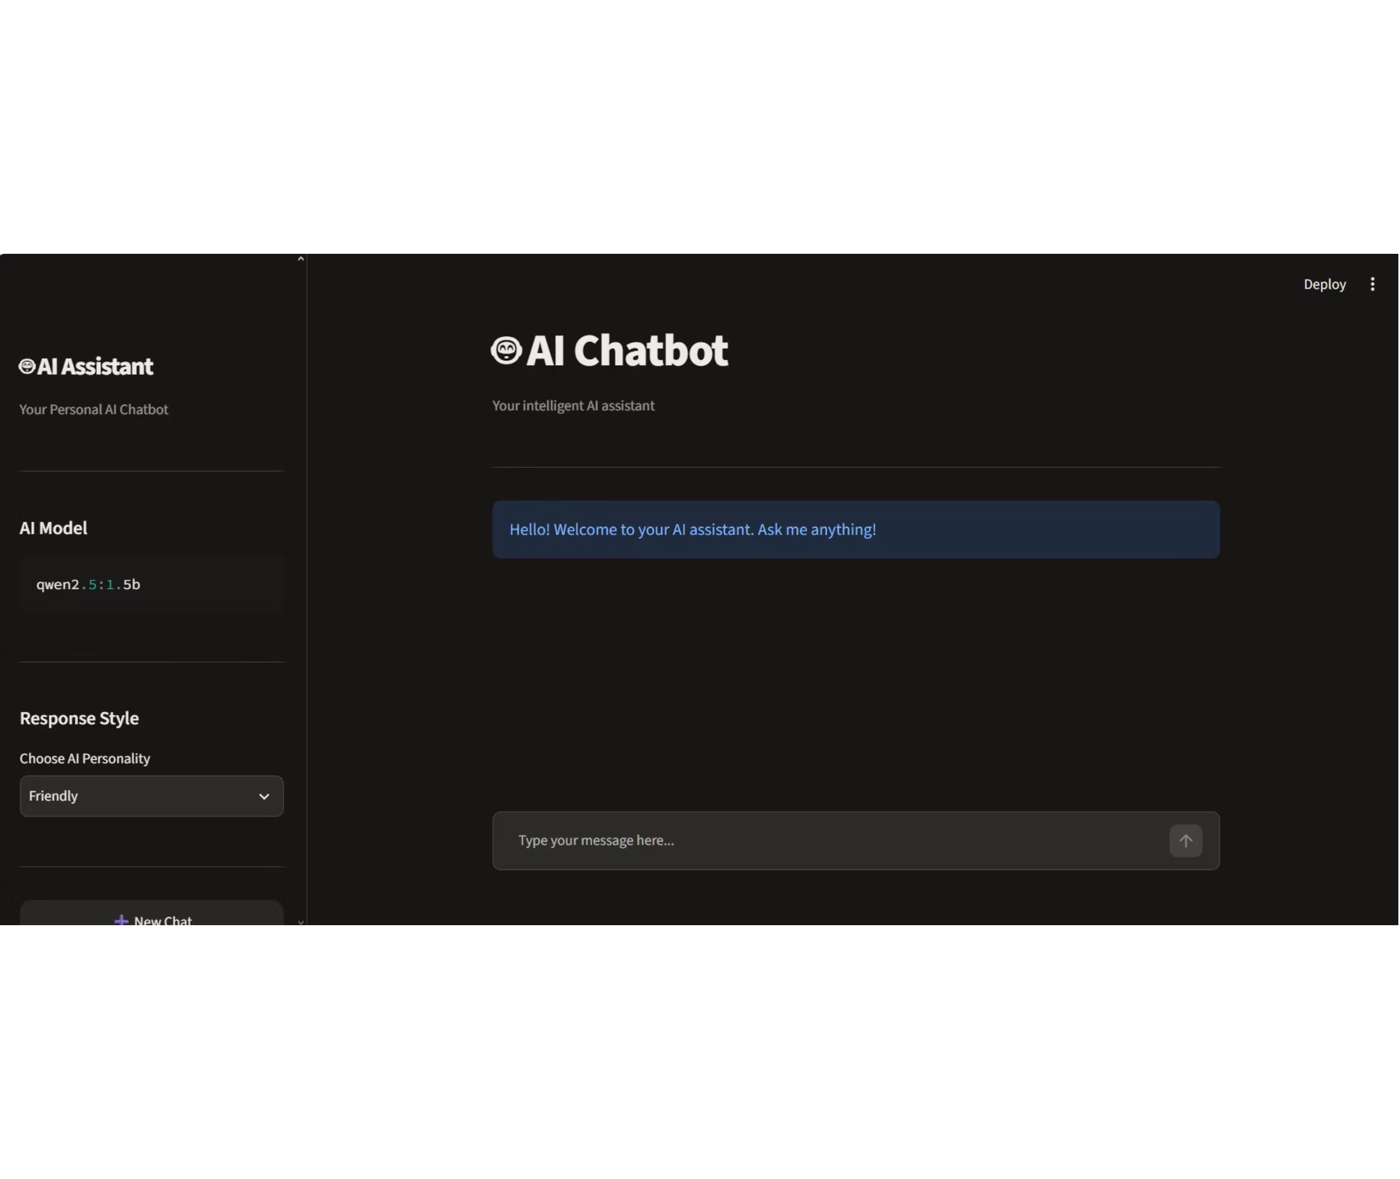
INTERFACE OVERVIEW
Dark chatbot interface
Sidebar with AI Assistant branding and model settings, the AI Chatbot heading, a welcome message, and the chat input.
05

Slide 6
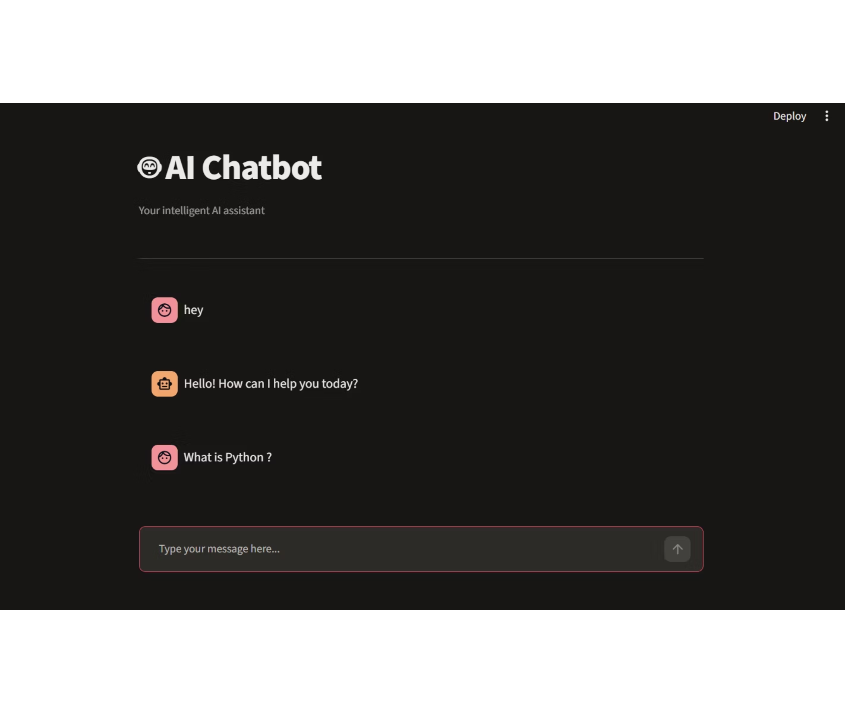
CHAT WINDOW
A short conversation and message input
The dark chat window shows a brief exchange above the message box, ready for the next prompt.
06

Slide 7
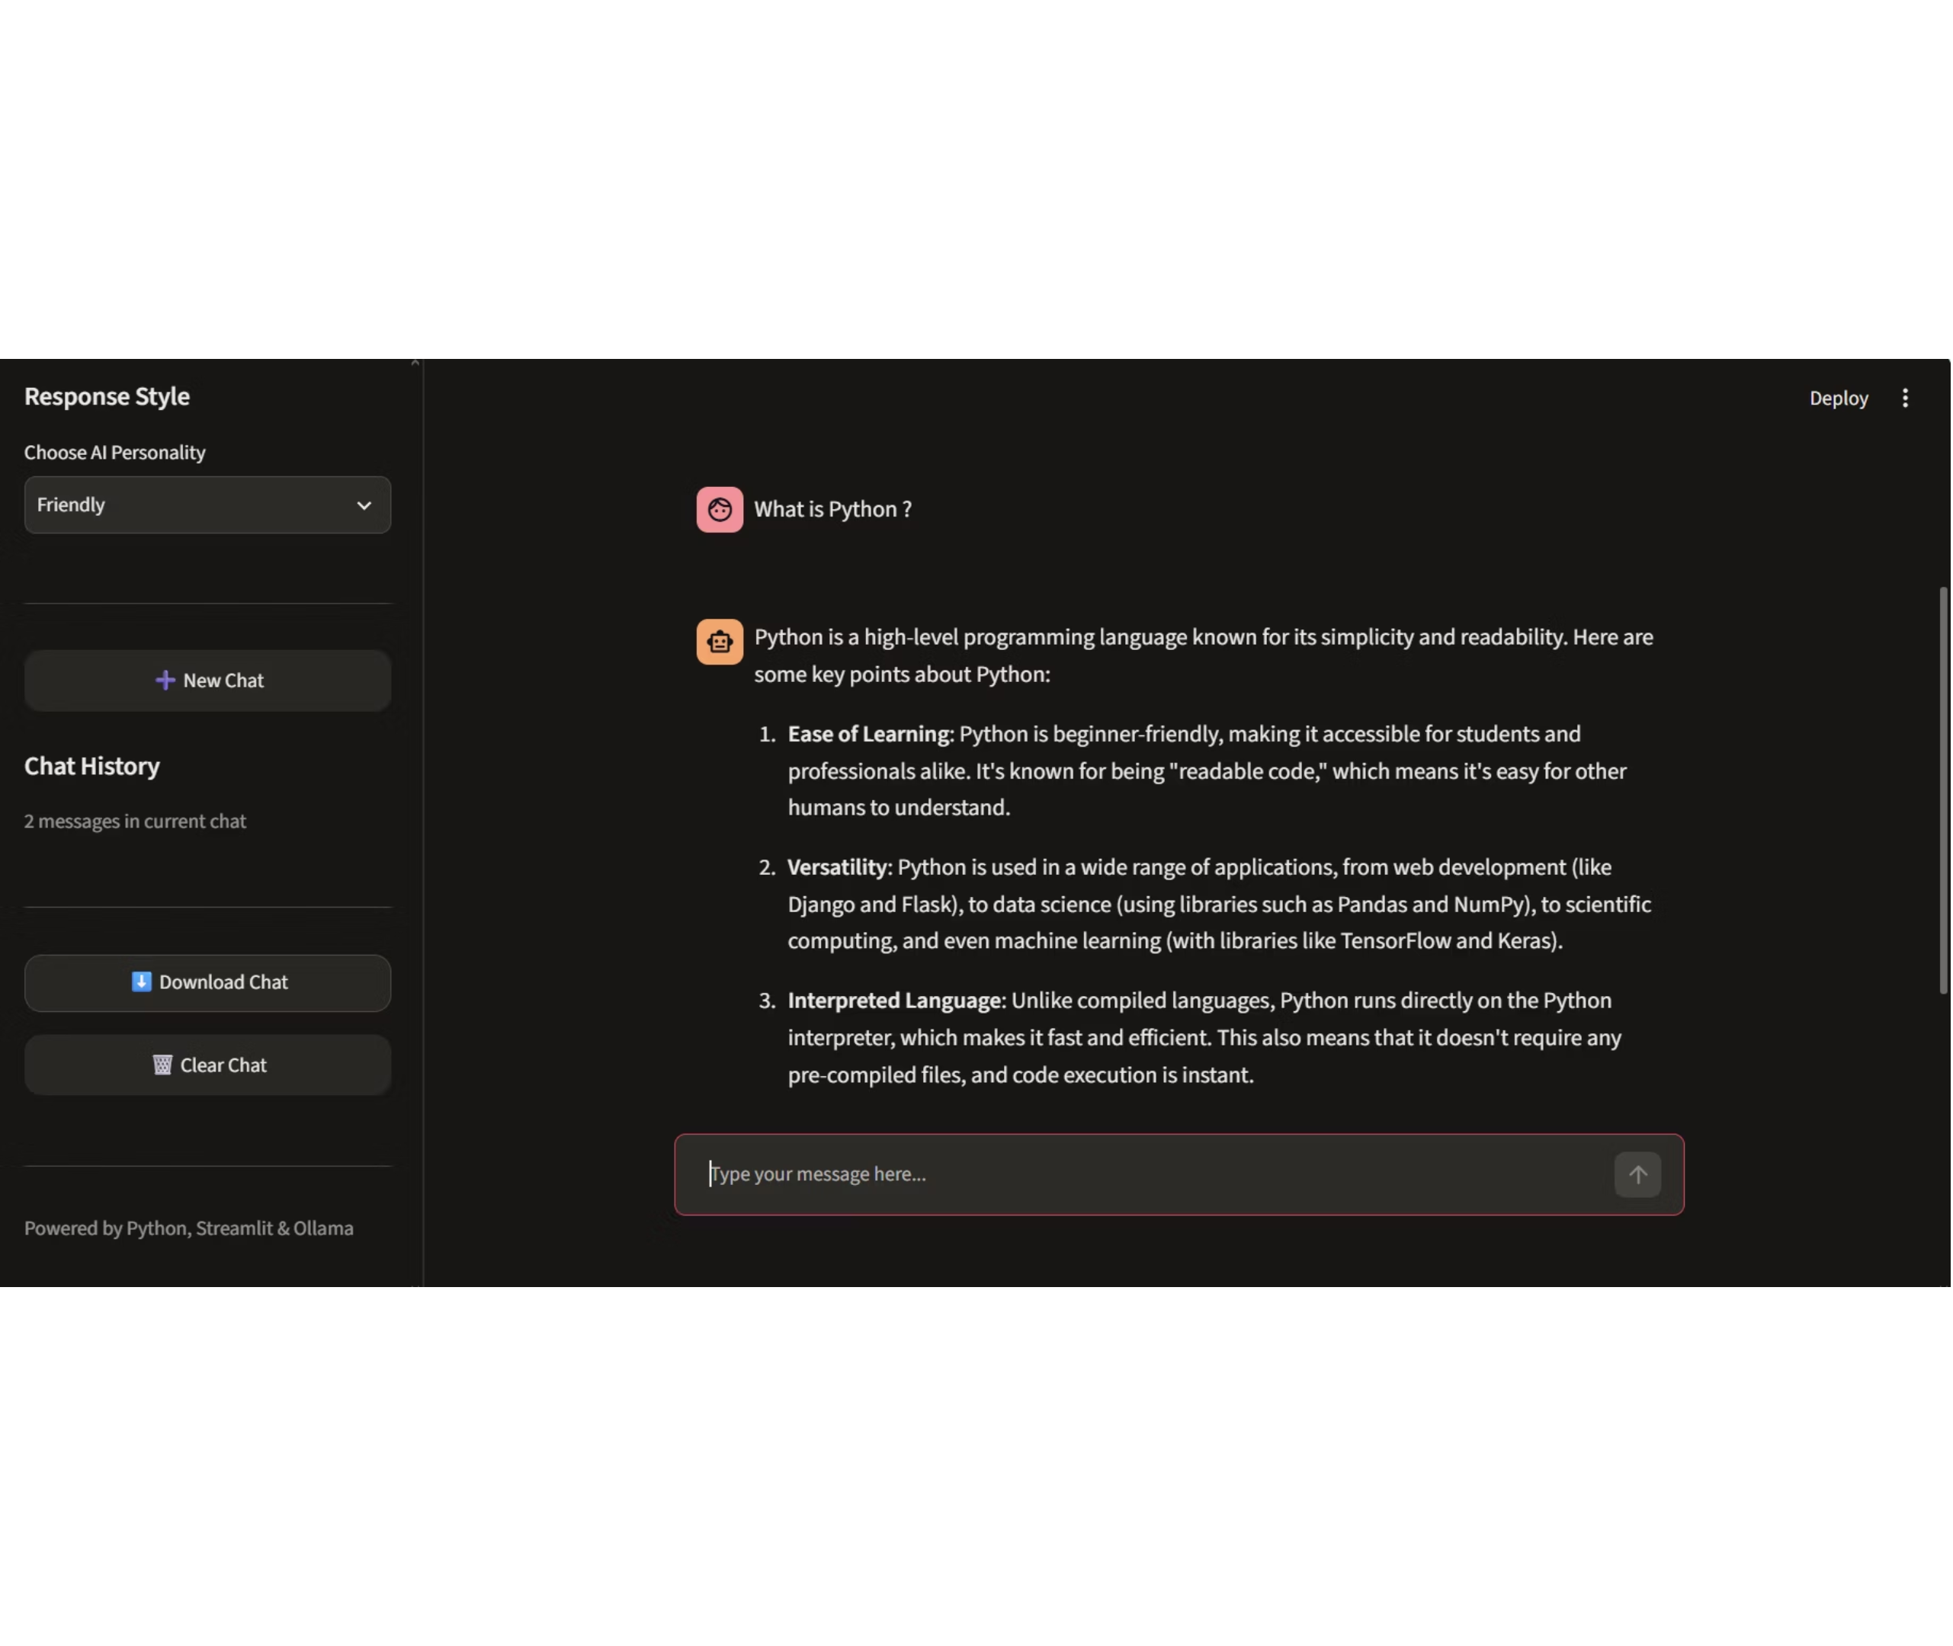
Q&A IN ACTION
A detailed answer in Friendly style
A Python question gets a structured answer, with the Friendly response style and chat controls visible.
07

Slide 8
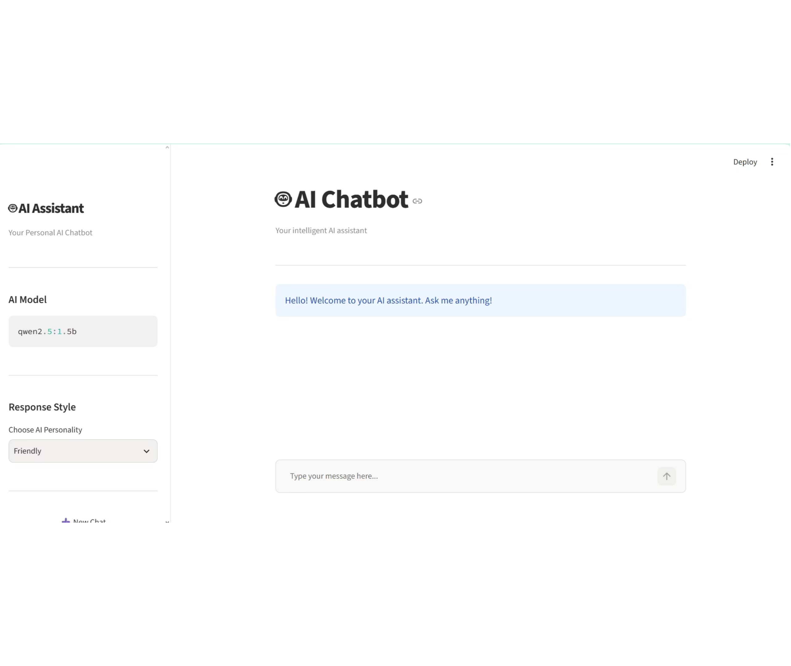
LIGHT THEME
The same layout in light theme
The light theme shows the qwen2.5:1.5b model selector and the Friendly response style setting.
08

Slide 9
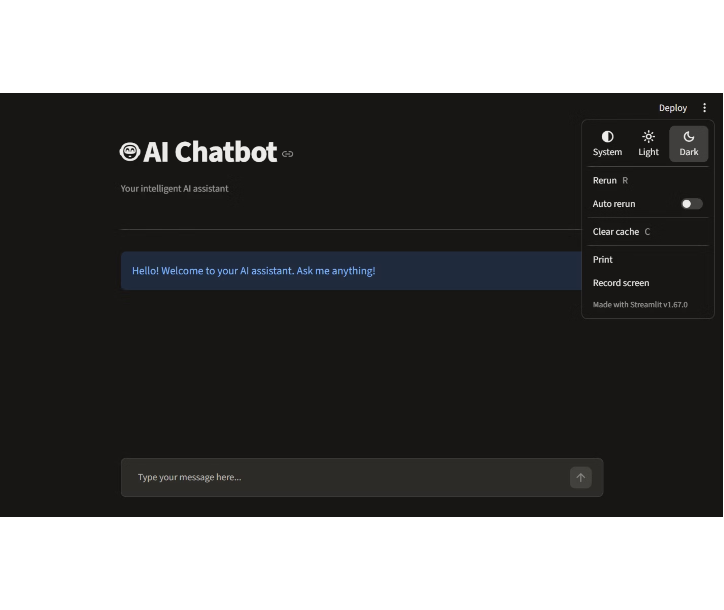
THEME CONTROL
Choose System, Light, or Dark
The theme menu offers System, Light, and Dark, with Dark selected.
09

Slide 10
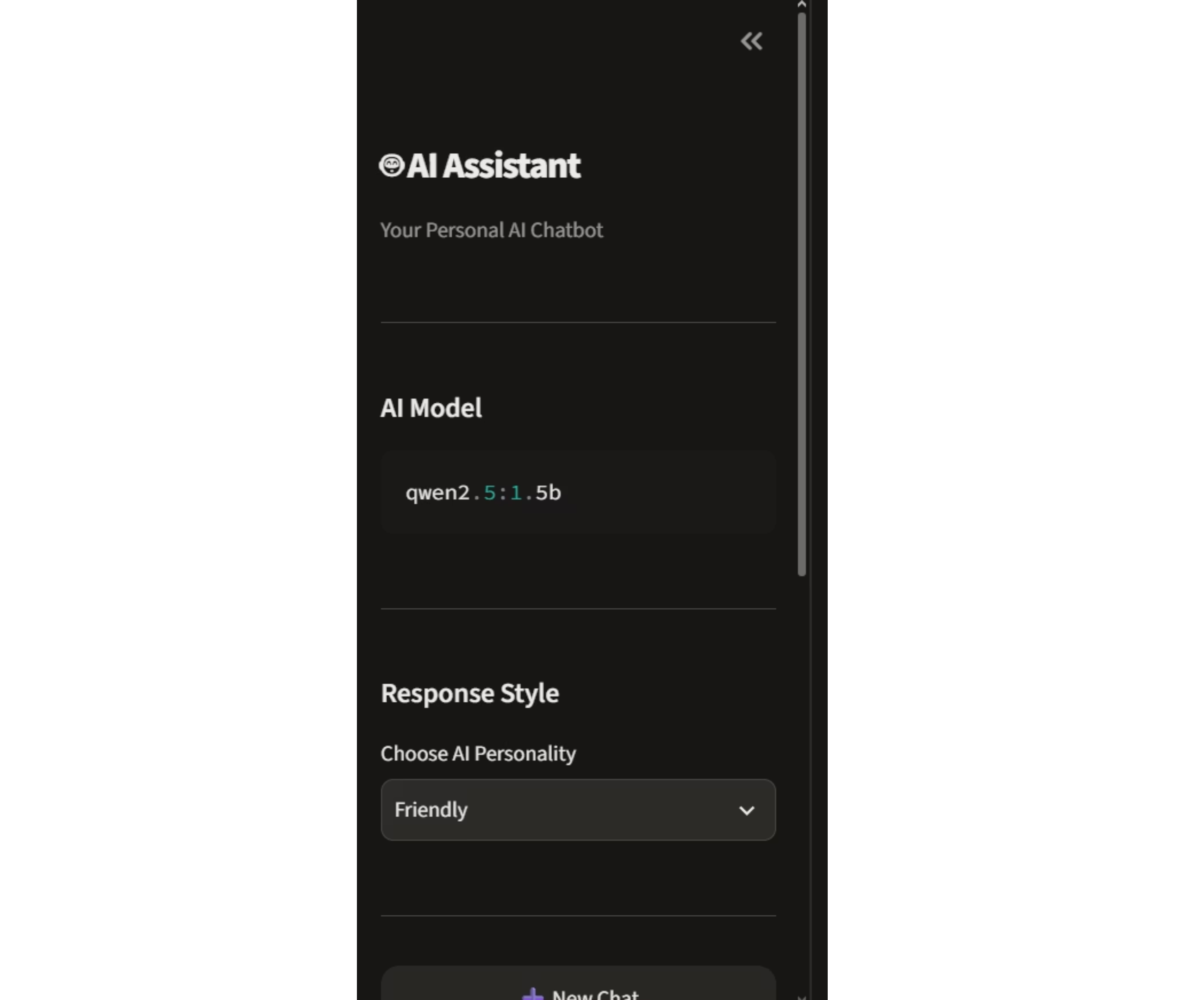
SIDEBAR
Model and response style in the sidebar
The sidebar shows AI Assistant branding, the qwen2.5:1.5b model, and the Friendly personality setting.
10

Slide 11
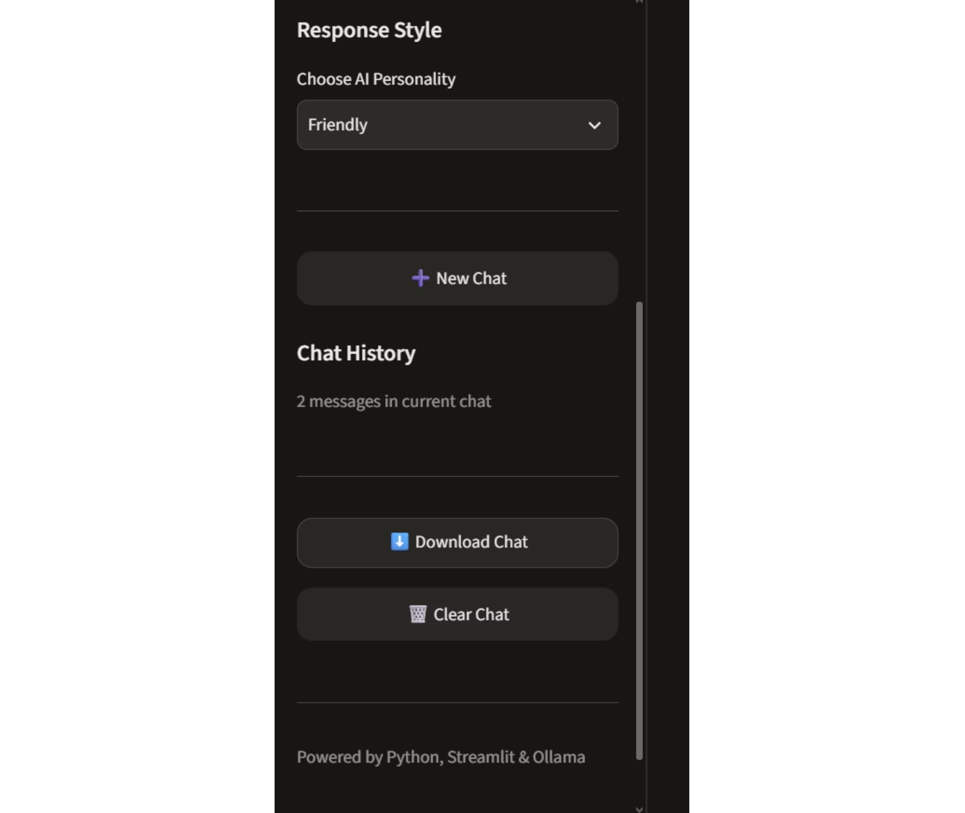
SIDEBAR ACTIONS
Chat actions stay one click away
New Chat, Chat History, Download Chat, and Clear Chat sit above a Python, Streamlit and Ollama footer.
11

Slide 12
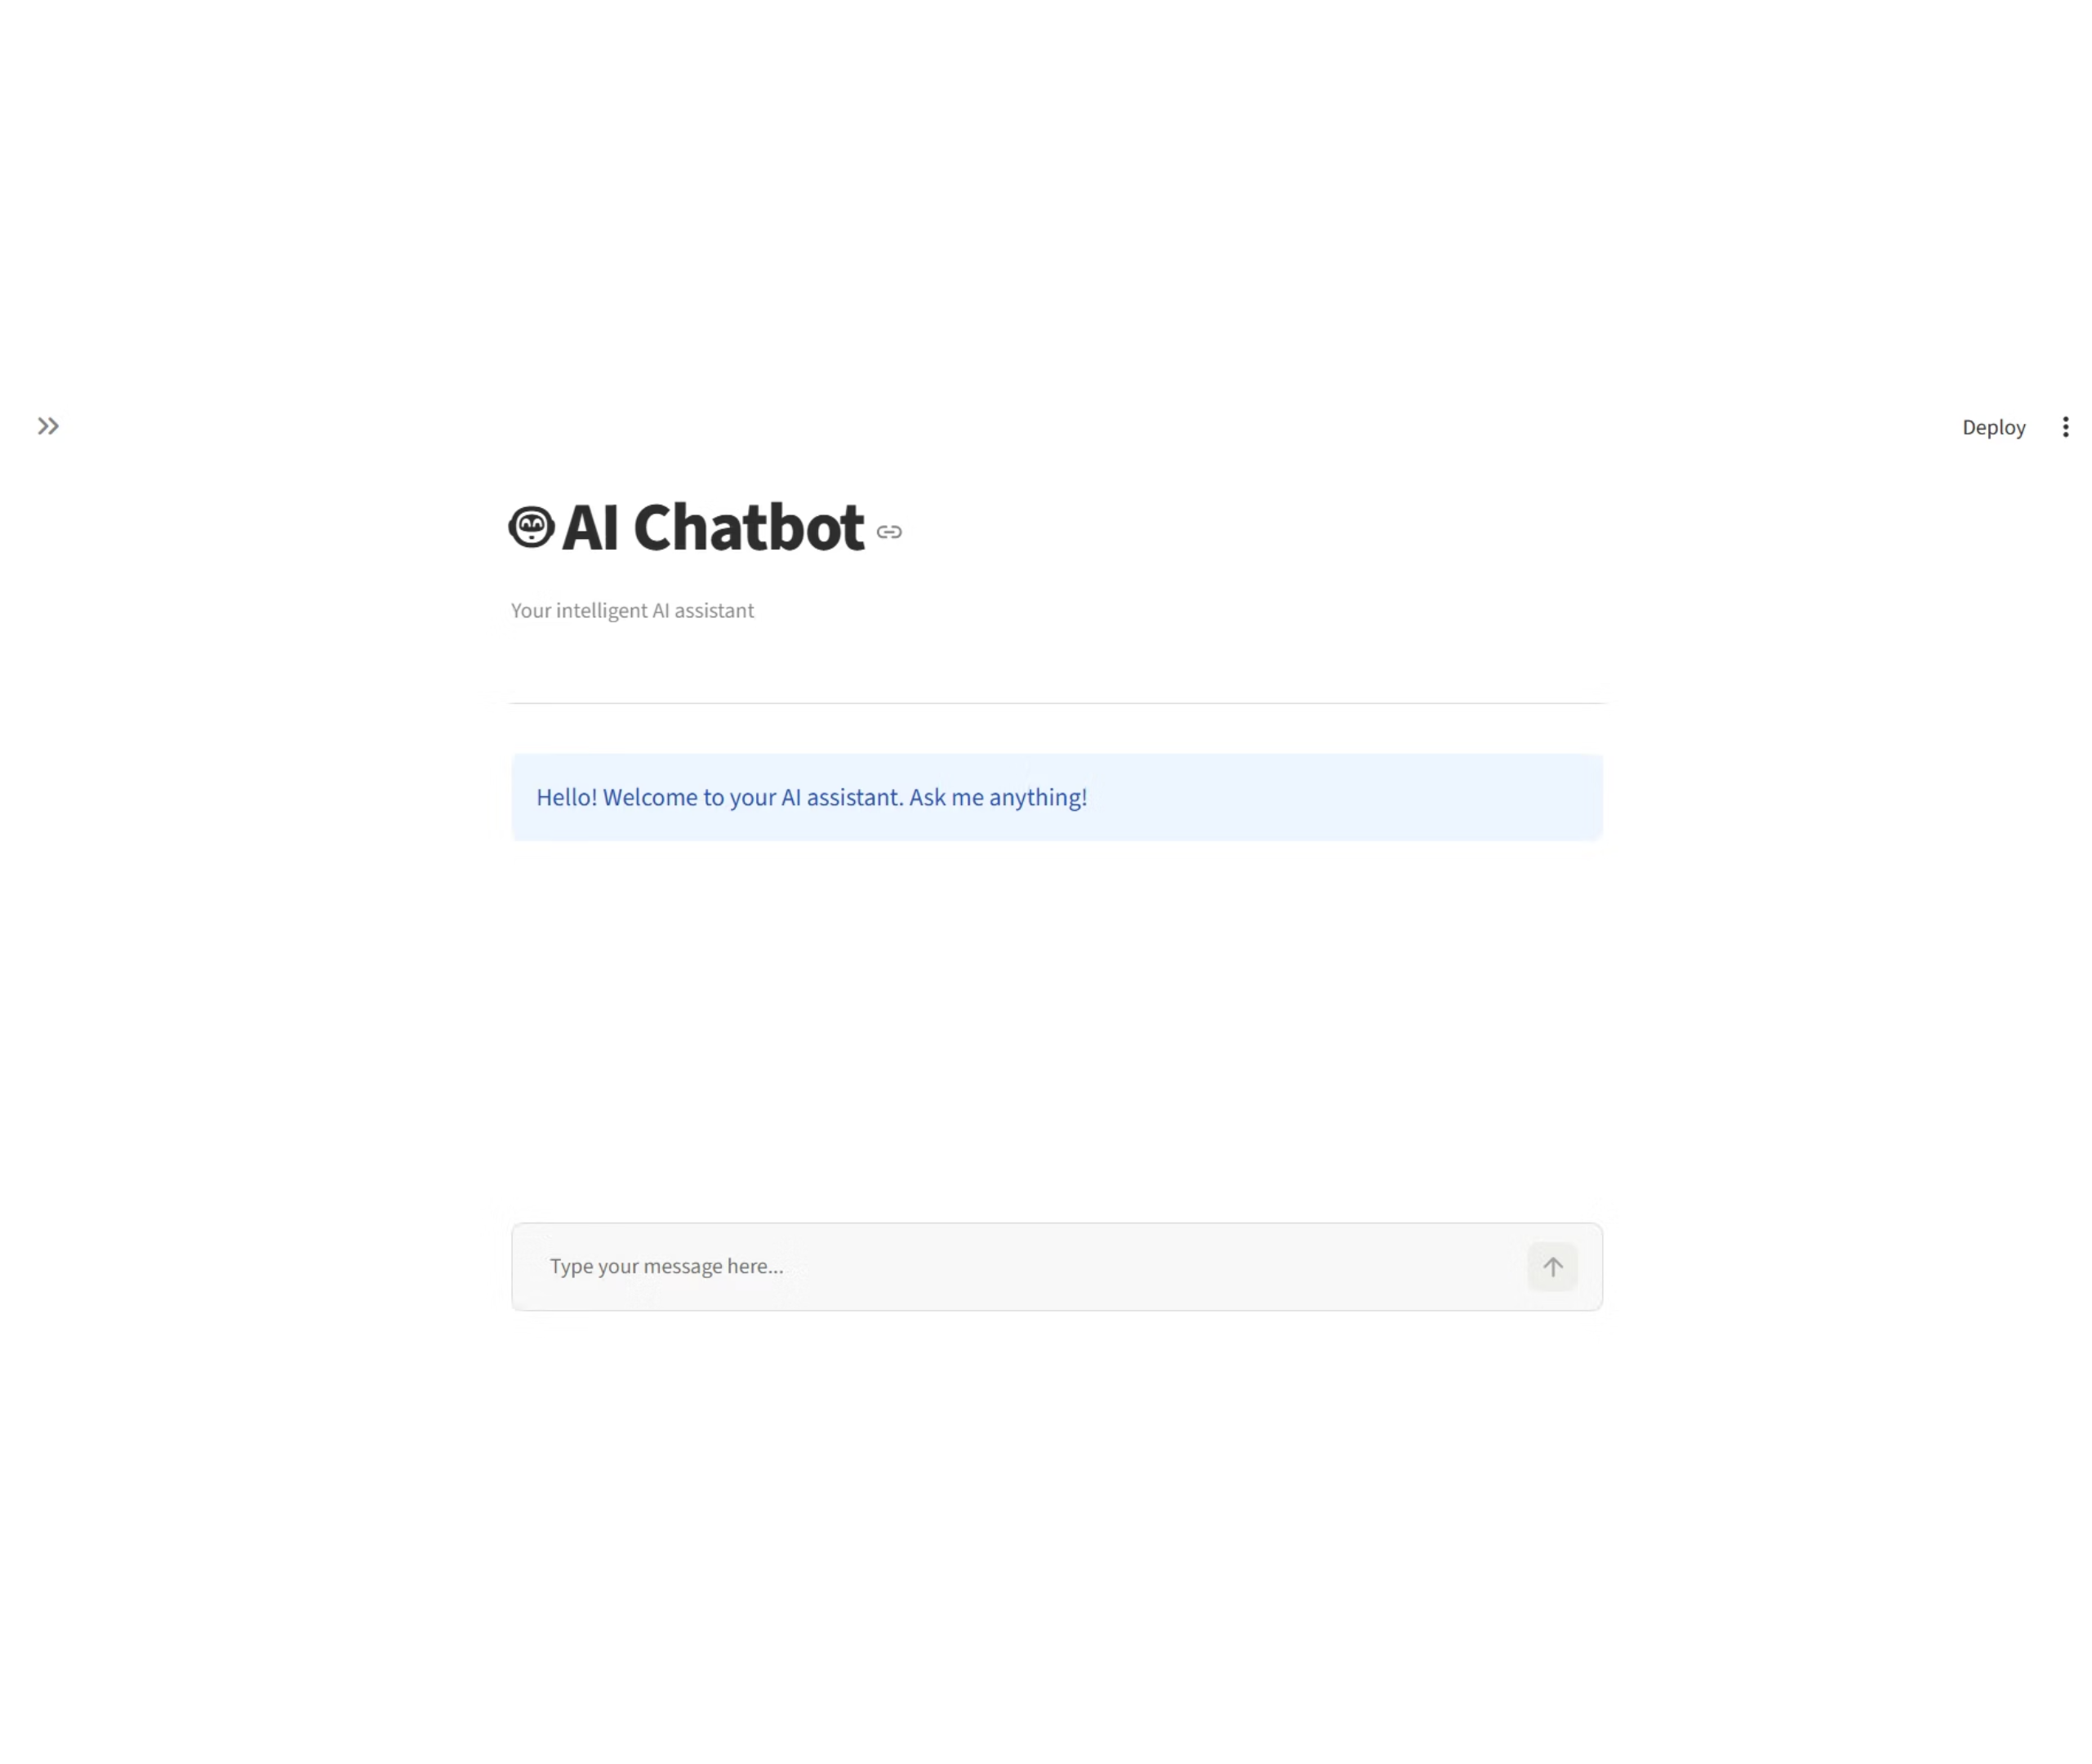
FOCUS MODE
The workspace with the sidebar hidden
With the sidebar hidden, the chat takes the full window, leaving the messages and input in focus.
12

Slide 13
THE MODEL CONNECTION
01
02
03
Ollama handles the model connection.
Install
Send
Read
Install Ollama and download a local model.
Send a model name plus the message history.
Read the returned assistant content and display it.
LOCAL MODEL RUNTIME
Ollama supports local models and provides official Python and JavaScript libraries.
It keeps the model boundary straightforward: install, send, read.
13

Slide 14
TRACE THE LOOP
The request cycle is easy to trace
01
Render prior messages
02
Wait for new input
03
Append the user message
04
Call Ollama
05
Append and render the assistant response
14

Slide 15
IMPLEMENTATION PATTERN
Core implementation pattern
Separate configuration
Keep configuration separate from the UI.
Keep the moving parts easy to replace, test, and explain.
Handle failure clearly
Explain connection errors and missing models.
Change with confidence
Single chat function
Keep prompts and model selection easy to change.
Use a single chat function for the model call.
15

Slide 16
DEMO FLOW
From prompt to response
The demo makes the architecture observable in a few moves.
1
2
3
4
Start
Launch
Ask
Show
Start the Ollama service.
Launch the Streamlit app.
Ask a practical question.
Show the response and preserved chat history.
16

Slide 17




PROJECT TAKEAWAY
What the project demonstrates
A compact build that makes the full application path concrete.
Python structure
Streamlit UI
Organize a working application around clear responsibilities.
Build a usable interface without a heavy front-end layer.
Local API integration
State and errors
Connect the interface to a model through Ollama.
Preserve context and make failures understandable.
17

