Slide 1
BestBuy GSP Plan Analysis

Slide 2
Outline:
Brief Introduction
Description of variables
Basic Plots
Check of Multicollinearity
Econometric Model/Results
Test for Heteroscedasticity and Endogeneity
Managerial Insights
Limitations & Suggestions

Slide 3
GOAL OF THE COMPANY:
Come up with Potential Strategies to increase Warranty Sale.
Research Question:
Identify the customers who have the high propensity to purchase the Geek Squad Protection Plan/ Warranty.

Slide 4

Dependent variable:
Warranty – A dummy variable, it is the key variable of interest.
PriceCategory (Range 0-17)
Hhincome (Range 0-1300)
ProductGeneration (Range 1-11)
NewCustomer (0-1)
personid
weekend (0-1)
Appliances (0-1)
Age (Range 52 – 86)
Married (0-1)
MyBestBuy (0-1)
Hisp (0-1)
Familysize (1-4)

Slide 5
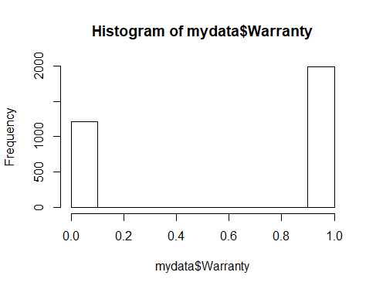
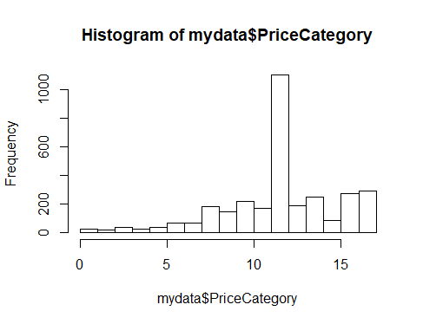
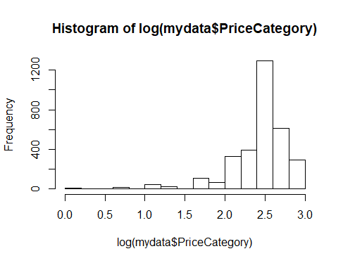
Plot Warranty
Plot PriceCategory

Slide 6
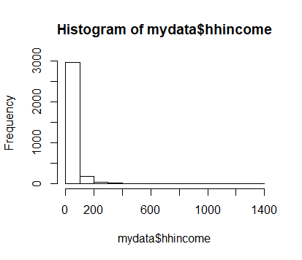
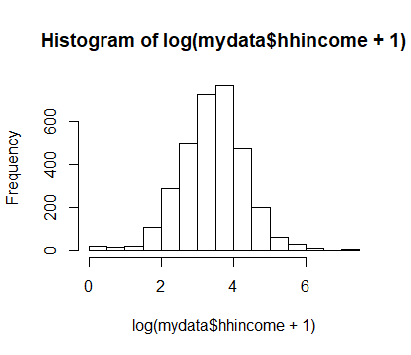
Plot HHIncome:

Slide 7
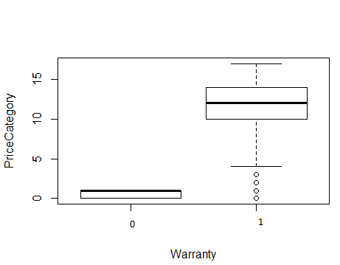
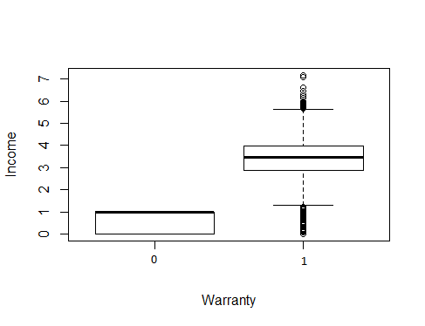
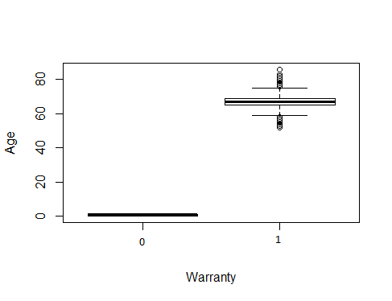
Other Plots
PriceCategory with Warranty
Income with Warranty
Age with Warranty

Slide 8
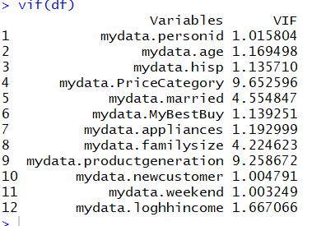
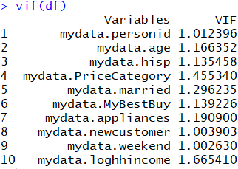
Multicollinearity: Through VIF and COR TEST
High correlation between product generation and price category. Hence, removing product generation.
High correlation between married variable and family size variable. Hence removing familysize

Slide 9
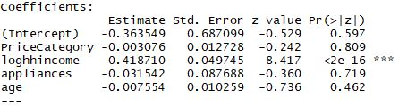
Model 1:
Warranty ~ PriceCategory + loghhincome + appliances + age
Notes:
Note: mydata$loghhincome <- log(mydata$hhincome+1)

Slide 10
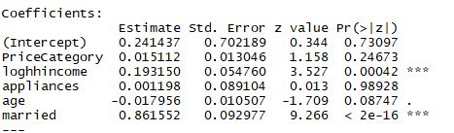
Model 2:
Warranty ~ PriceCategory + loghhincome + appliances + age + married
Likelihood Ratio Test between model 1 and model 2 is significant (P value = 2.2e-16 ***). So, model with married variable is better.

Slide 11
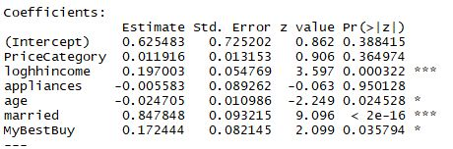
Model 3:
Warranty ~ PriceCategory + loghhincome + appliances + age + married + MyBestBuy
Likelihood Ratio Test between model 2 and model 3 is significant (P value = 0.03604 *). So, model with MyBestBuy variable is better.

Slide 12
Model 4:
Warranty ~ PriceCategory + loghhincome + appliances + age + married + MyBestBuy + newcustomer
Likelihood Ratio Test between model 3 and model 4 is insignificant (P value = 0.6067). So, model 3 is better.
Model 5:
Warranty ~ PriceCategory + loghhincome + appliances + age + married + MyBestBuy + weekend
Likelihood Ratio Test between model 3 and model 5 is insignificant (P value = 0.4112). So, model 3 is better.

Slide 13
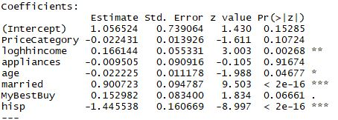
Model 6:
Warranty ~ PriceCategory + loghhincome + appliances + age + married + MyBestBuy + hisp
Likelihood Ratio Test between model 3 and model 6 is significant(P value = 2.2e-16 ***). So, model with hisp variable is better.

Slide 14
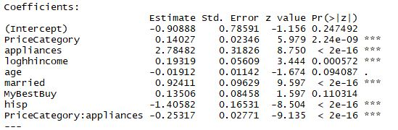
Model 7:
Warranty ~ PriceCategory*appliances + loghhincome + age + married + MyBestBuy + hisp
Likelihood Ratio Test between model 6 and model 7 is significant(P value = 2.2e-16 ***). So, model with interaction term is better.

Slide 15
Endogeneity assumption
Endogenous variable – “MyBestBuy” card
Instrumental variable – “newcustomer”
Collinearity between dependent variable, independent variable and IV’

Slide 16
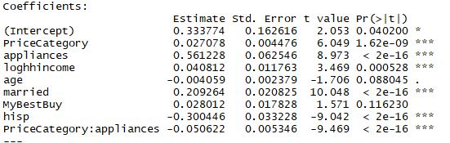
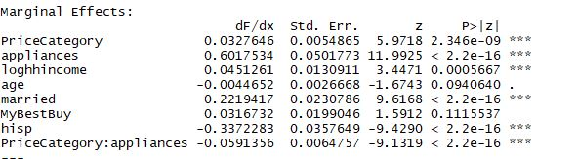
LPM and Logitmfx Model
LPM model and comparison between LPM model and the final Logitmfx model
Linear Probability Model Logitmfx
IV reg model – ”newcustomer” as IV

Slide 17
Endogeneity tests and Conclusion
Conclusion
There is endogeneity in the model but the impact is negligible !
Test 1 | Statistic | P-value
Weak instrument | 9.473 | 0.0021
Wu-Hausman | 0.178 | 0.6731
Sargan | NA | NA

Slide 18
Results of Test for heteroskedasticity
Goldfeld-Quandt Test: GQ test is not significant, implying there is no heteroscedasticity
Breusch-Pagan: BP test is significant, implying there is heteroscedasticity
So We use robust standard error

Slide 19
Final Model
Warranty ~ PriceCategory*appliances + loghhincome + age + married + MyBestBuy + hisp
Correct Classification Rate: 0.681846537741734
Confusion Matrix:
Model Fit Output:
Chi-square : 363.7545
Degrees of freedom : 8
Associated p-value less than 0.001 (1.047346e-73)
Hence, our model fits better than the Empty Model.
 | TRUE | FALSE
0 | 475 | 741
1 | 279 | 1711

Slide 20
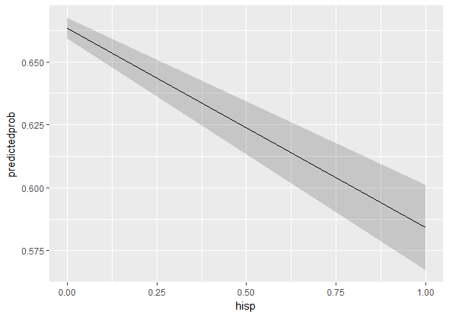
Managerial Insights:
Q: Identifying Target customers with high propensity to buy GSP Plan.
Plot of PP of all the significant independent variables of Final Model
Graph : Hispanic & Non Hispanic
Non Hispanic customers have comparatively
high propensity to buy the protection plan
than Hispanic customers.
Difference of Probability between
Hispanic vs Non-Hispanic is 8.23 % Points.

Slide 21
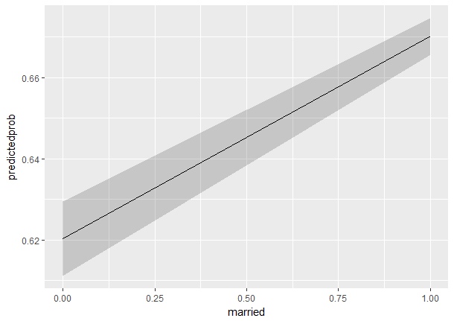
Managerial Insights Continued…
Q: Identifying Target customers with high propensity to buy GSP Plan.
Graph: Married & Unmarried
Married customers have comparatively
high propensity to buy the plan than unmarried
customers.
Difference of Probability between married
and unmarried customers is 5.00 % Points.

Slide 22
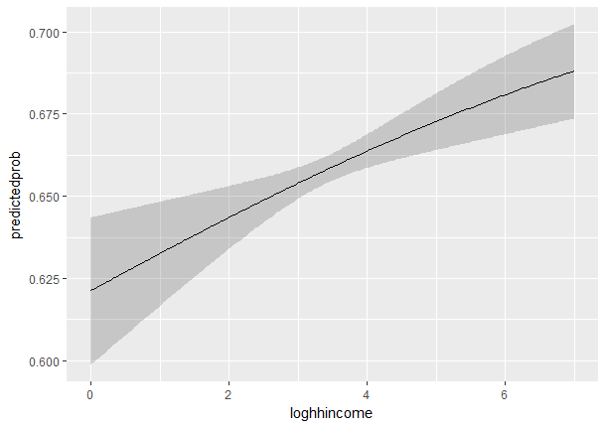
Managerial Insights Continued…
Q: Identifying Target customers with high propensity to buy GSP Plan.
Graph: High hhincome & Low hhincome
High loghhincome customers have comparatively
high propensity to buy the plan than low loghhincome
customers.
Difference of probability between high loghhincome
And low loghhincome is about 7% Points.

Slide 23
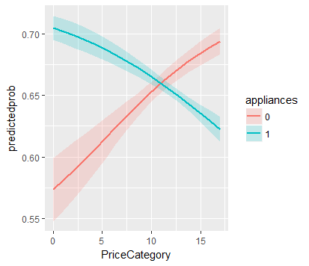
Managerial Insights Continued…
Q: Identifying Target customers with high propensity to buy GSP Plan.
Graph: Price category for home vs non home appliances
For home appliances, as the price the probability of buying warranty decreases roughly about 8% points.
For nonhome appliances, as price increases the probability of buying warranty increases roughly about 11% points.
So for high-priced non home appliances and low priced home appliances have high propensity to buy the plan.

Slide 24
Our Focus
Identified high propensity customers are:
Non-Hispanic Customers
Married Customers
High Hhincome Customers
And, customers who buy high priced non-home appliances and low priced home appliances
Our Marketing strategy is to focus on the above customer groups.

Slide 25
Limitations & Suggestions:
No information regarding price of the protection plans. So, revenue generated is not known.
No information regarding cost for various possible strategies like salesperson training, advertising etc.
So, without the above information it is difficult to suggest strategies the firm should take for the target high propensity customers.

Slide 26
Thank You

