Slide 1



POWERBI__REPORT__Shopping_Mall
View in Power BI
Last data refresh:
5/26/2023 10:02:57 AM UTC
Downloaded at:
5/27/2023 6:41:31 AM UTC

Slide 2
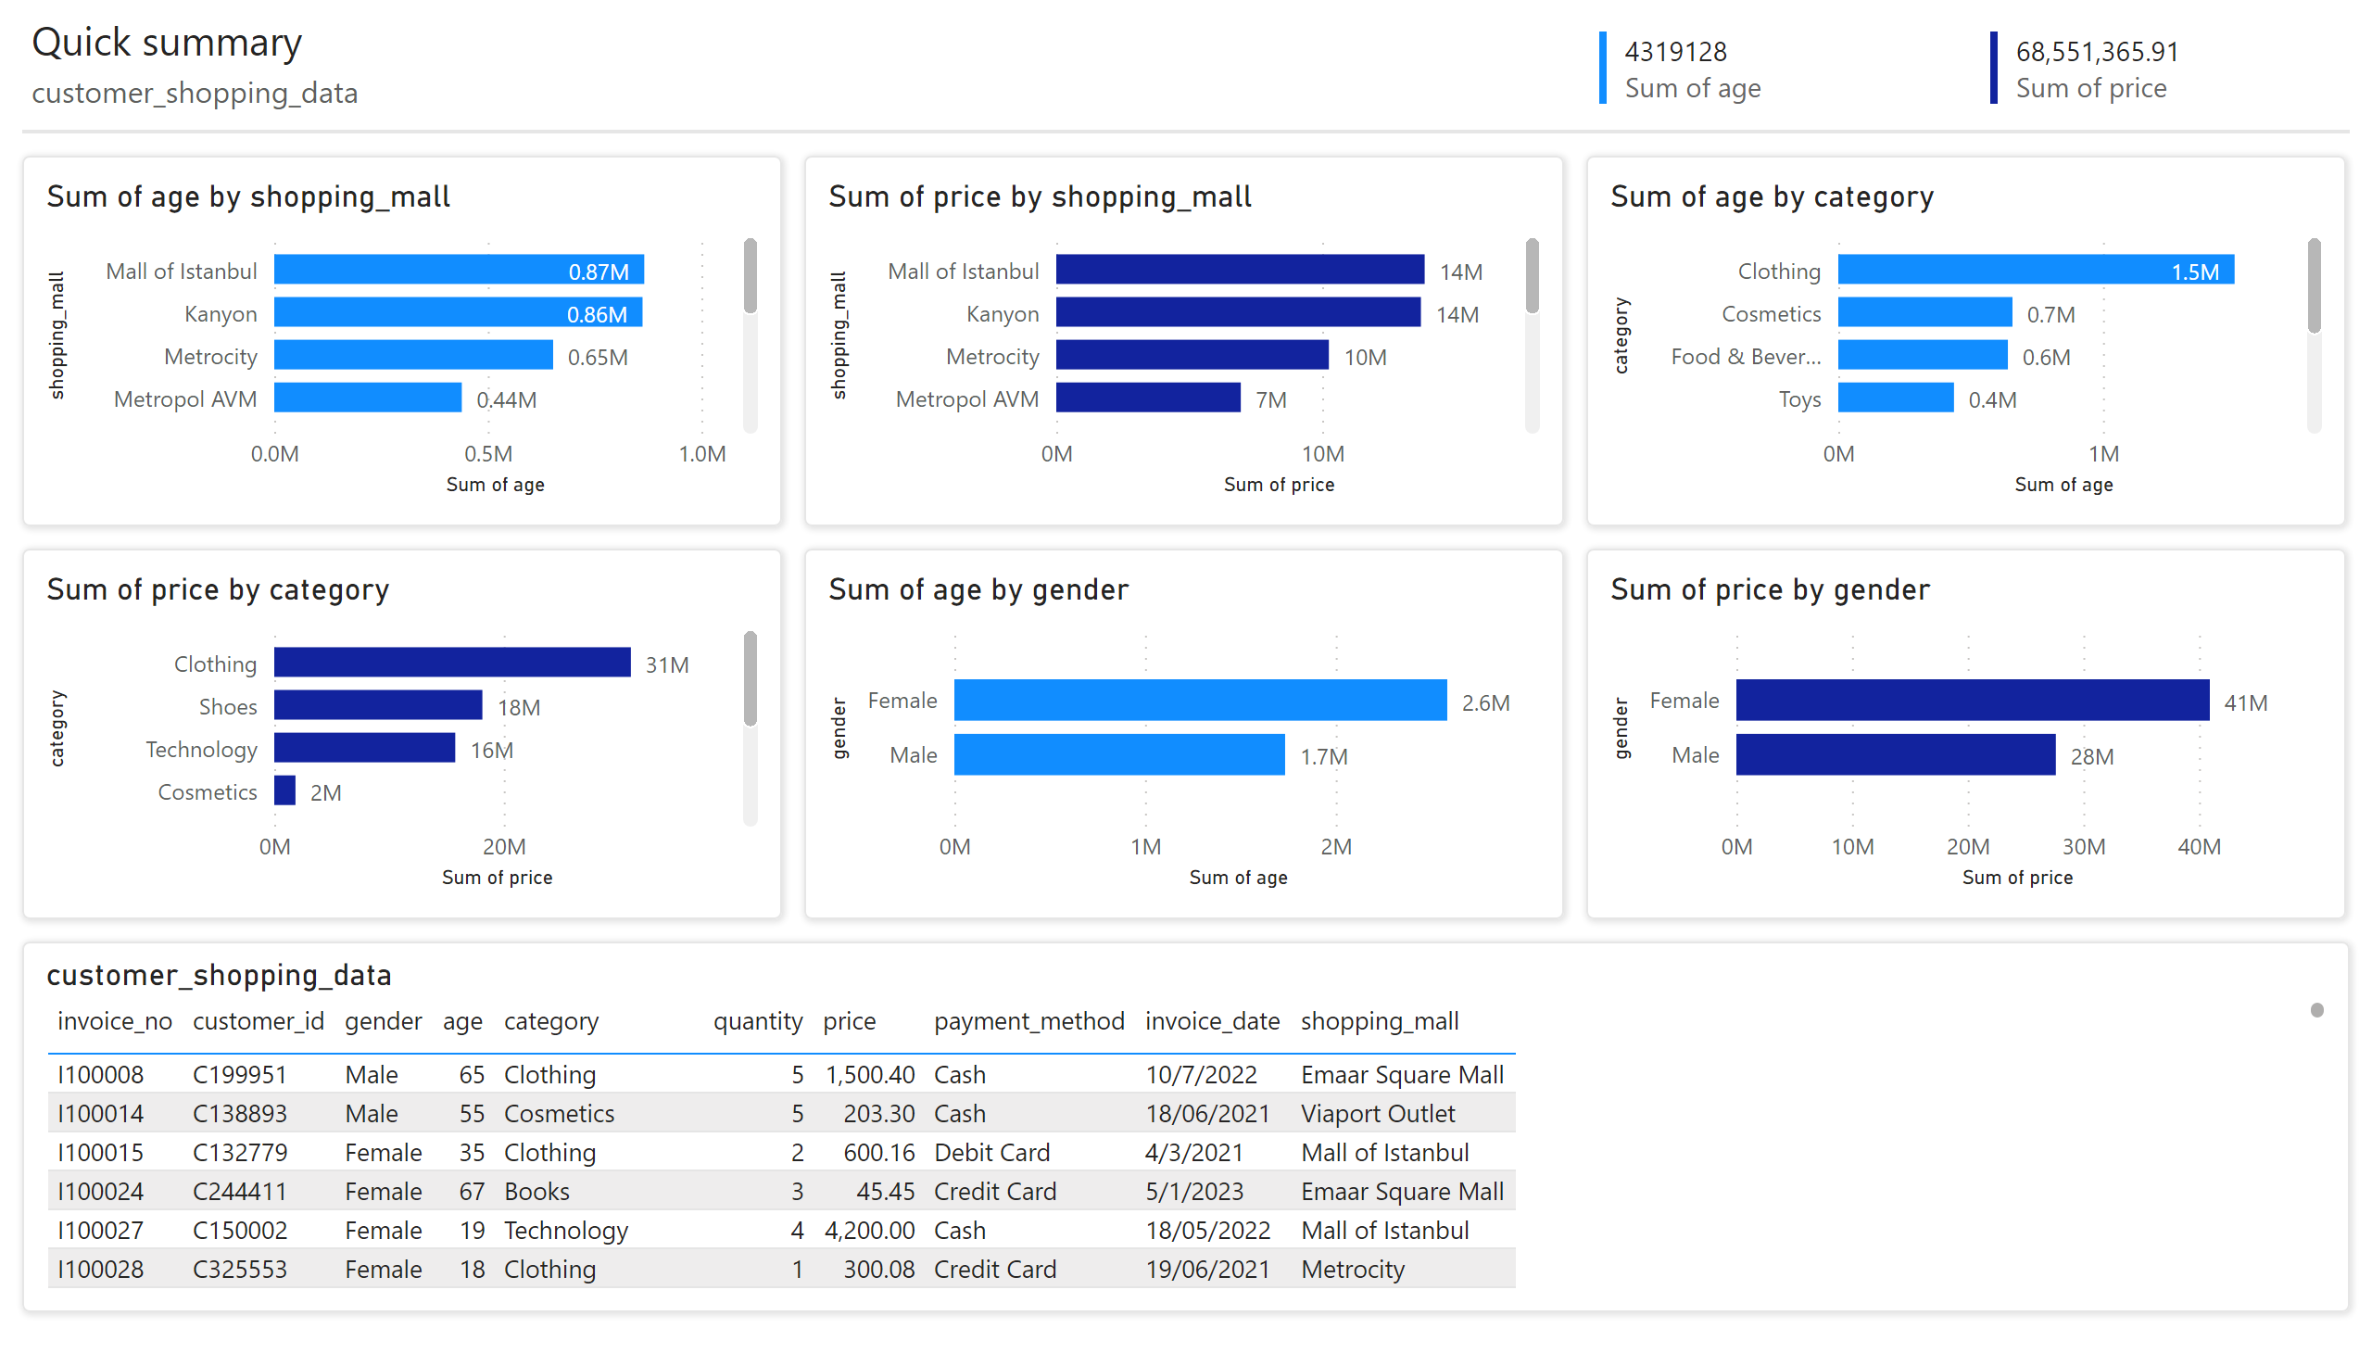
Page 1
Notes:
multiRowCard
No alt text provided
multiRowCard
No alt text provided
customer_shopping_data
No alt text provided
shape
No alt text provided
textbox
No alt text provided
textbox
No alt text provided
shape
No alt text provided
shape
No alt text provided
shape
No alt text provided
shape
No alt text provided
shape
No alt text provided
shape
No alt text provided
shape
No alt text provided
clusteredBarChart
No alt text provided
clusteredBarChart
No alt text provided
clusteredBarChart
No alt text provided
clusteredBarChart
No alt text provided
clusteredBarChart
No alt text provided
clusteredBarChart
No alt text provided

