Slide 1

TUTORIAL on LOGIC-BASED CONTROL
Part I: SWITCHED CONTROL SYSTEMS
Daniel Liberzon
Coordinated Science Laboratory and
Dept. of Electrical & Computer Eng.,
Univ. of Illinois at Urbana-Champaign
MED ’02, Lisbon

Slide 2
OUTLINE
Switched Control Systems
Questions, Break
Stability of Switched Systems
Notes:
General (details in notes), not just my work (many references in the notes), encourage questions

Slide 3
OUTLINE
Switched Control Systems
Questions, Break
Stability of Switched Systems
Notes:
General (details in notes), not just my work (many references in the notes), encourage questions

Slide 4
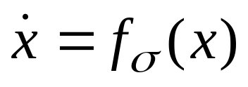
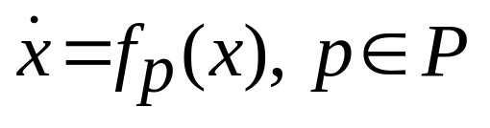
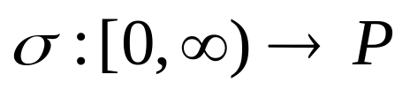
SWITCHED and HYBRID SYSTEMS
Switched systems: continuous systems with discrete switchings
emphasis on properties of continuous state
Hybrid systems: interaction of continuous and discrete dynamics
Switching can be:
State-dependent or Time-dependent
where
is a family of systems
and is a
switching signal
Autonomous or Controlled
Notes:
General remarks on hybrid systems: car example, will not give general definition (motivation: solving specific control problems),
Different points of view (continuous vs. discrete), hybrid/hysteresis/chattering, come back to the car example in the end

Slide 5
SWITCHING CONTROL
Plant:
u
y
P
u
y
Classical continuous
feedback paradigm:
P
C
u
y
But logical decisions
are often necessary:
P
C₁
C₂
The closed-loop
system is hybrid
l o g i c
Notes:
Main motivation is this

Slide 6
REASONS for SWITCHING
Nature of the control problem
Sensor or actuator limitations
Large modeling uncertainty
Combinations of the above
Notes:
Do not discuss, just list

Slide 7
REASONS for SWITCHING
Nature of the control problem
Sensor or actuator limitations
Large modeling uncertainty
Combinations of the above
Notes:
Mention environmental changes, multiple tasks, but more interesting: for some systems basic tasks such as stabilization are hard, mention Brockett’s necessary condition

Slide 8

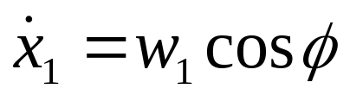

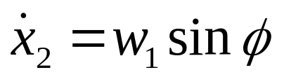
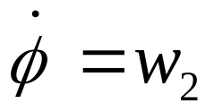

PARKING PROBLEM
Nonholonomic constraint: wheels do not slip
Notes:
Discuss nonholonomy and controllability

Slide 9
OBSTRUCTION to STABILIZATION
?
Solution: move away first
Notes:
Going around the table

Slide 10
REASONS for SWITCHING
Nature of the control problem
Sensor or actuator limitations
Large modeling uncertainty
Combinations of the above
Notes:
Actuator limitation: saturation, bang-bang control, then output feedback…

Slide 11



OUTPUT FEEDBACK
Example: harmonic oscillator
switched system
Notes:
Then – less classical: control with limited information…

Slide 12


QUANTIZED FEEDBACK
q(x)
u
x
PLANT
QUANTIZER
q(x)
x
CONTROLLER
sensitivity
M values
Notes:
Mention coding and decoding
Multidimensional quantizer - component-wise

Slide 13

OBSTRUCTION to STABILIZATION
Assume:
fixed
Asymptotic stabilization is impossible
Notes:
Quantization blocks
Saturation region - already problems
Asymptotic stabilization is impossible unless one makes
unrealistic open-loop stabilizability assumptions
That is, if M and Delta are fixed!

Slide 14
MOTIVATING EXAMPLES
1. Temperature sensor
normal
too high
too low
2. Camera with zoom
Tracking a golf ball
3. Coding and decoding

Slide 15
VARYING the SENSITIVITY
zoom out
zoom in
Why switch ?
More realistic
Easier to design and analyze
Robust to time delays
Notes:
So the sensitivity is my discrete state variable
After discussing the slide:
Now I’ll explain the switching policy, and the class of systems to which it applies, in more detail

Slide 16




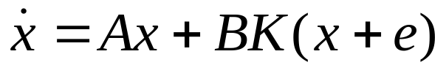
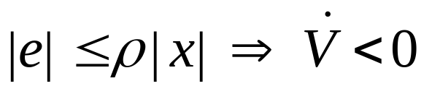

LINEAR SYSTEMS
Assume:
s.t.
is GAS:
Along solutions of
quantization error
we have for some
Then can achieve GAS

Slide 17
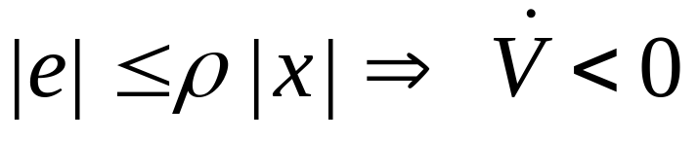
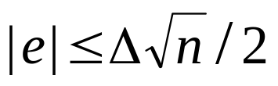

SWITCHING POLICY
We have
level sets of V
.
Notes:
This is zooming in
Can also do time-dependent switching

Slide 18
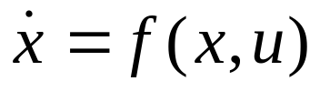

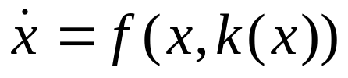
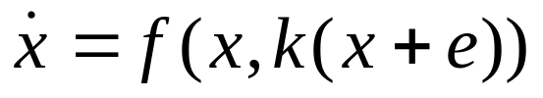
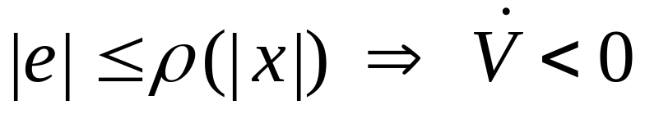

NONLINEAR SYSTEMS
Assume:
s.t.
is GAS:
Need: along solutions of
quantization
error
where is pos. def., increasing, and unbounded
(this is input-to-state stability wrt measurement error)
Then can achieve GAS
Notes:
Explain the difficulty with ISS, interesting connection

Slide 19
EXTENSIONS and APPLICATIONS
Arbitrary quantization regions
Active probing for information
Output and input quantization
Relaxing the assumptions
Performance-based design
Application to visual servoing

Slide 20
REASONS for SWITCHING
Nature of the control problem
Sensor or actuator limitations
Large modeling uncertainty
Combinations of the above

Slide 21

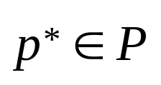
MODEL UNCERTAINTY
unmodeled
dynamics
parametric
uncertainty
Also, noise and disturbances
Adaptive control (continuous tuning)
vs. supervisory control (switching)
Notes:
Switching improves performance
Supervisory control

Slide 22

SUPERVISORY CONTROL
Supervisor
candidate controllers
u₁
Controller 1
u₂
u
Plant
y
Controller 2
.
.
.
m
u_{m}
Controller
.
.
.
switching signal
Notes:
Next, we “zoom in” on the supervisor

Slide 23
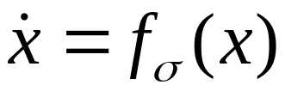
STABILITY of SWITCHED SYSTEMS
unstable
Stable if:
switching stops in finite time
slow switching (on the average)
“locally confined” switching
common Lyapunov function

Slide 24
REASONS for SWITCHING
Nature of the control problem
Sensor or actuator limitations
Large modeling uncertainty
Combinations of the above
Notes:
Discuss all three briefly
The first one: Brockett’s necessary condition
One way out - hybrid feedback

Slide 25
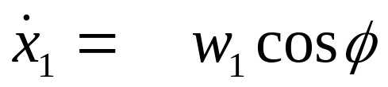
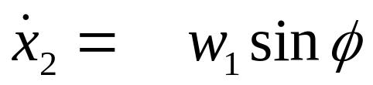
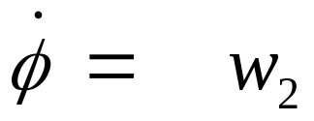

PARKING PROBLEM under UNCERTAINTY
p
1
p
1
p
2
Unknown parameters correspond to the
radius of rear wheels and distance between them
Notes:
Switching between switching control laws

Slide 26
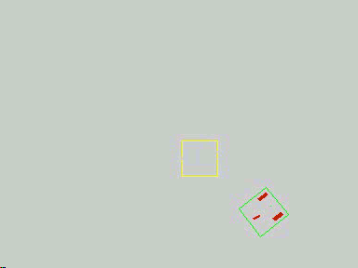
SIMULATION

Slide 27
OUTLINE
Switched Control Systems
Questions, Break
Stability of Switched Systems
Notes:
General (details in notes), not just my work (many references in the notes), encourage questions

Slide 28
OUTLINE
Switched Control Systems
Questions, Break
Stability of Switched Systems
Notes:
General (details in notes), not just my work (many references in the notes), encourage questions

Slide 29
TWO BASIC PROBLEMS
Stability for arbitrary switching
Stability for constrained switching
Notes:
Second is more relevant for control
First leads to second

Slide 30
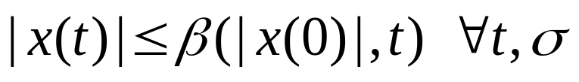
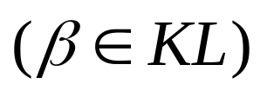

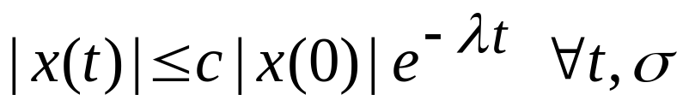
UNIFORM STABILITY
where is a family of GAS systems
is a piecewise constant switching signal
:
Want GUAS
w.r.t.
GUES:
Notes:
Mention epsilon-delta

Slide 31
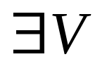
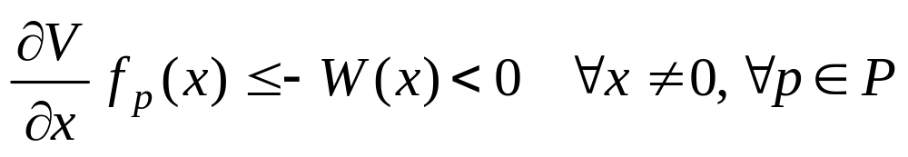
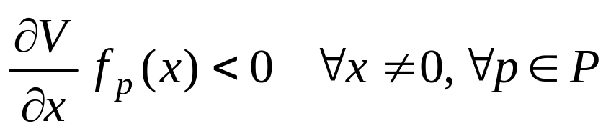
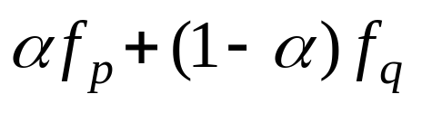
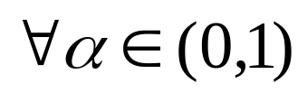
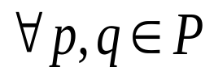
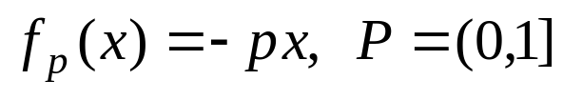
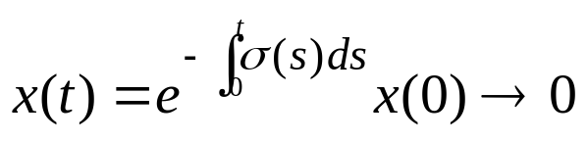

COMMON LYAPUNOV FUNCTION
is GUAS if and only if s.t.
Corollary: is GAS
is not enough
Example:
if
Usually we take P compact and f_{p} continuous
Notes:
But interesting things can really only happen in dimensions higher than 1

Slide 32
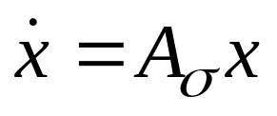


SWITCHED LINEAR SYSTEMS
LAS for every
GUES
common Lyapunov function
but not necessarily quadratic
Notes:
In fact just local attractivity is enough

Slide 33
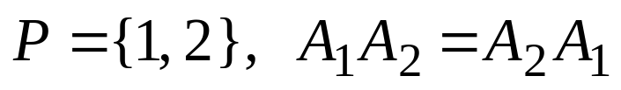






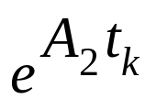
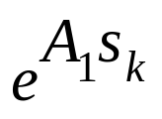
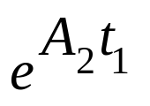
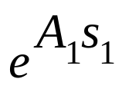

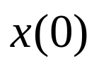
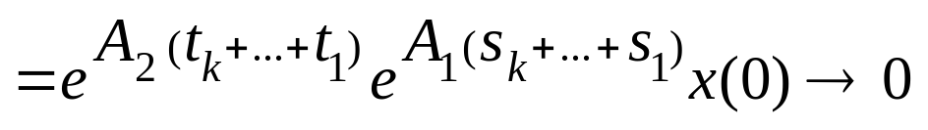

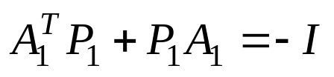
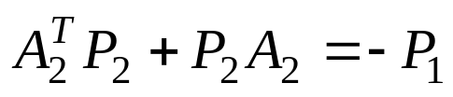
COMMUTING STABLE MATRICES => GUES
…
t
…
quadratic common Lyap fcn:
Notes:
Easy to generalize to m matrices

Slide 34
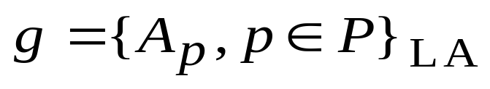
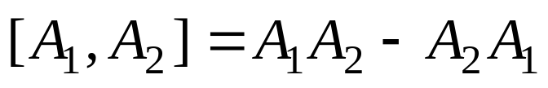
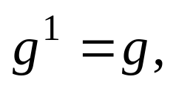
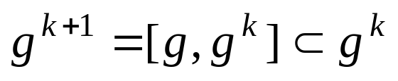

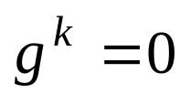

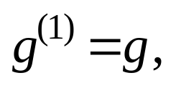
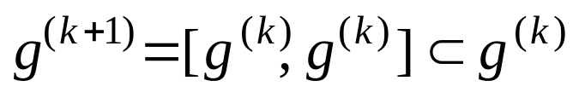
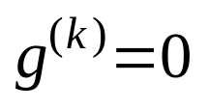
LIE ALGEBRAS and STABILITY
Lie algebra:
Lie bracket:
g is nilpotent if s.t.
g is solvable if s.t.
Notes:
Nilpotent just means that all sufficiently high order brackets are 0

Slide 35

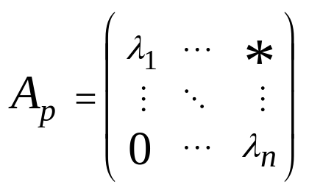

SOLVABLE LIE ALGEBRA => GUES
is solvable
Lie’s Theorem: triangular form
quadratic common Lyap fcn:
D diagonal
Notes:
Mention Gurvits
Sketch triangular reasoning

Slide 36


SOLVABLE + COMPACT => GUES
Levi decomposition:
radical (max solvable ideal)
is compact => GUES
quadratic common Lyap fcn
Notes:
Compact means purely imaginary eigenvalues
Lyapunov function is less constructive

Slide 37

SOLVABLE + NONCOMPACT => GUES
is not compact
a set of stable generators for
that gives GUES
a set of stable generators for
that leads to an unstable system
Lie algebra doesn’t provide enough information
Notes:
More on this in the notes

Slide 38

NONLINEAR SYSTEMS
Commuting systems
=> GUAS
Linearization
???
Notes:
Lie bracket is defined for differentiable vector fields, but commutativity of the flows is enough

Slide 39
REMARKS on LIE-ALGEBRAIC CRITERIA
Checkable conditions
Independent of representation
In terms of the original data
Not robust to small perturbations

Slide 40





SYSTEMS with SPECIAL STRUCTURE
Triangular systems
Linear => GUES
Nonlinear: need ISS conditions
u
y
Feedback systems
-
Passive:
=> GUAS
Small gain:
=> GUES
2D systems
convex combs of stable
quadratic common Lyap fcn
Notes:
More results on feedback systems in supervisory control – later

Slide 41



MULTIPLE LYAPUNOV FUNCTIONS
GAS
respective Lyapunov functions
is GAS
t
Very useful for analysis of state-dependent switching

Slide 42
MULTIPLE LYAPUNOV FUNCTIONS
decreasing sequence
is GAS
decreasing sequence
t
Notes:
Precise conditions and proof – in the notes
Need to have information about solutions

Slide 43














DWELL TIME
The switching times satisfy
GES
dwell time
respective Lyapunov functions
must be
Need:
t
Notes:
Continuous counterpart – stability of slowly time-varying systems
Not stating general result here because…

Slide 44









AVERAGE DWELL TIME
# of switches on
average dwell time
no switching: cannot switch if
dwell time: cannot switch twice if
=>
is GAS
if
Notes:
Motivate average dwell time: fault correction, switching criteria

Slide 45




SWITCHED LINEAR SYSTEMS
GUES over all with large enough
Finite induced norms for
The case when some subsystems are unstable
Notes:
Unstable: either finite total activation time or small enough proportion of time

Slide 46








STABILIZATION by SWITCHING
both unstable
Assume: stable for some
So for each :
either or
Notes:
So stable convex combination implies quadratic stability (single Lyapunov function)

Slide 47
UNSTABLE CONVEX COMBINATIONS
Can also use multiple Lyapunov functions
LMIs
Notes:
Motivate: stable conv comb difficult to find, may not exist
More on this in the notes

