Slide 1


System Model
1A. Synthesize Control Skipping Automaton (CSA)
Safe, Stable ACESS Generation From CSA
Of a Control Loop
1B. Offline-generated Task-wise ACESS library grouped/sorted by
Utilisation, Hyperperiod choices
Online Control Cost Observation for Each Control Loop
Stability,Safety Criteria
Choose Safe Subsystems, <period, CSS>
+
Stable Switching Rules
CLF-based Arbitrary Switching
MLF-based Slow Switching following MDADT
Design Criteria
$$θ2$$
$$θ2$$
Cost-aware Utilisation Assignment in every Hyperperiod
$$θ1$$
$$θ0$$
$$θ1$$
Closed-loops
$$θm’$$
$$θclf$$
$$θmlf$$
$$θm$$
Utilisation Budget
2. Online Dynamic Scheduling Algo.
1. Offline Aperiodic Control Execution Skipping Sequences (ACESSs) Generation

Slide 3






















$$Inv(θ2)$$
$$𝓖20,𝓡20$$
$$𝓖02,𝓡02$$
$$θ2$$
$$𝓖12,𝓡12$$
$$𝓖02,𝓡02$$
$$𝓖12,𝓡12$$
$$θ2$$
$$𝓖20,𝓡20$$
$$𝓖21,𝓡21$$
$$𝓖21,𝓡21$$
$$θ1$$
$$𝓖10,𝓡10$$
$$θ1$$
$$𝓖10,𝓡10$$
$$𝓖2m’,𝓡2m’$$
$$θ0$$
$$𝓖m’2,𝓡m’2$$
$$𝓖01,𝓡01$$
$$𝓖01,𝓡01$$
$$𝓖m2,𝓡m2$$
$$𝓖2m,𝓡2m$$
$$θclf$$
$$θmlf$$
$$𝓖m’0,𝓡m’0$$
$$𝓖m0,𝓡m0$$
$$θm’$$
$$θm$$
$$𝓖0m’,𝓡0m’$$
$$𝓖0m,𝓡0m$$

Slide 4
$$θ2$$
$$θ2$$
$$θ1$$
$$θ1$$
$$θ0$$
$$θclf$$
$$θmlf$$
$$θm’$$
$$θm$$

Slide 5
Switching Sequence : A$1hi→A100hi→A10hj→A1hj$
Plant
sensor
sensor data
Control Unit (CU)
Control Task
actuator
1hi 1hi 0hi 0hi 1hj 0hj 1hj
actuator data
Bus
y₇ __ y₅ __ __ y₂ y₁
u₀ u₁ u₁ u₁ u₄ u₄ u₅
No sensor data reception during 0
No control execution & transmission during 0
CU
CU

Slide 6






$$θ1$$
$$θ2$$
$$𝓖13,𝓡13$$
$$𝓖01,𝓡01$$
$$𝓖32,𝓡32$$
$$θ0$$
$$𝓖20,𝓡20$$
$$θ3$$

Slide 7
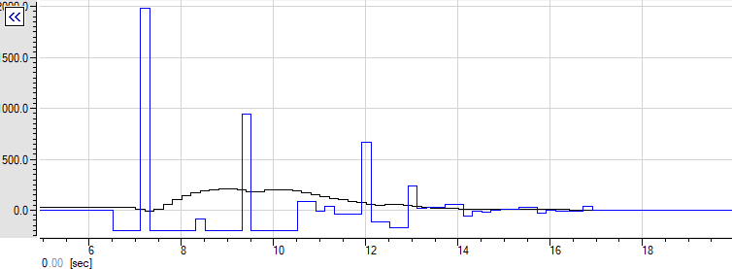
Closed-loop state following aperiodic control execution
Aperiodic control input

Slide 8
2000
Closed-loop state (deviation) following
aperiodic control execution
2000
1500
1500
Deviation (m)
1000
Acceleration (m/s²)
1000
500
Aperiodic control input
(acceleration)
500
0
0
Time (sec)

Slide 9
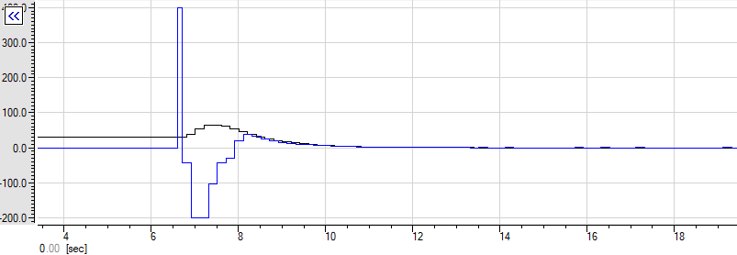
2000
2000
Closed-loop state (deviation) following periodic control execution
1500
1500
Deviation (m)
1000
Acceleration (m/s²)
1000
500
500
Periodic control input (acceleration)
0
0
Time (sec)

Slide 10
Closed-loop state following periodic control execution
Periodic control input

Slide 11
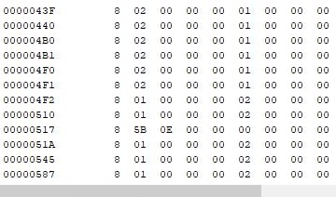
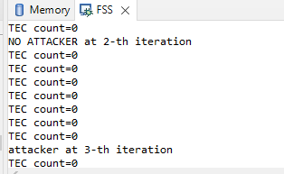
Execution skips

