Slide 1

Hybris Hackathon
Privacy-Preserving Selective Aggregation of Online User Behavior Data

Slide 2
Hybris Topic : Privacy-Preserving Selective Aggregation of Online User Behavior Data
Tons of online user behavior data are being generated every day on the booming and ubiquitous Internet. Growing efforts have been devoted to mining the abundant behavior data to extract valuable information for research purposes or business interests. However, online users’ privacy is thus under the risk of being exposed to third-parties. The last decade has witnessed a body of research works trying to perform data aggregation in a privacy-preserving way. Most of existing methods guarantee strong privacy protection yet at the cost of very limited aggregation operations, such as allowing only summation, which hardly satisfies the need of
behavior analysis. In this paper, we propose a scheme PPSA, which encrypts users’ sensitive data to prevent privacy disclosure from both outside analysts and the aggregation service provider, and fully supports selective aggregate functions for online user behavior analysis while guaranteeing differential privacy. We have implemented our method and evaluated its performance using a trace-driven evaluation based on a real online behavior dataset. Experiment results show that our scheme effectively supports both overall aggregate queries and various selective aggregate queries with acceptable computation and communication overheads.

Slide 3
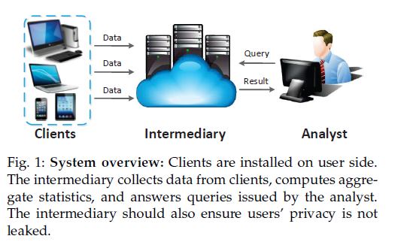

Slide 4
MODULES :
Aggregator
--- Login
--- Add Products with pcat,psub_Cat,Pname,pdesc(enc),pmanufacturer,price,puses,Add pimage
--- View all products (Show desc in Enc Format)with rank,ratings,reviews and give delete and edit option
--- View all Login users and find Total logins based on Date and Time and find Aggregation report(total login by Date) in Chart,
Give Search Option for particuar user to find user logins
--- Find all products rank in Chart
--- Find all Products No.of Positive and Negative behavior in Chart

Slide 5
Authority
--- Login
--- Add Behavior Filter
--- View Clients and authorize
--- View Client Account and Authorize
--- View all users Search request key and generate using RSA

Slide 6
Analyst
--- List all users and select user and check Positive and negative behavior on product reviews
--- View all users Added products into Cart
--- View all users purchased products with Total Bill
--- View all search query Transaction details

Slide 7
Client
--- Register and Login,View Profile
--- Create Account and Send Req to Authority and view Response,Manage Account
--- Send Search Request key to Authority
--- Enter Search key and Search Product and View details(Give rank),Give Review,Add to cart
--- View cart and purchase products,View all purchased products

Slide 8
SYSTEM REQUIREMENTS
➢ H/W System Configuration:-
➢ Processor - Pentium –IV
➢ RAM - 4 GB (min)
➢ Hard Disk - 20 GB
➢ Key Board - Standard Windows Keyboard
➢ Mouse - Two or Three Button Mouse
➢ Monitor - SVGA
Software Requirements:
Operating System - Windows XP
Coding Language - Java/J2EE(JSP,Servlet)
Front End - J2EE
Back End - MySQL

Slide 9
FEASIBILITY ANALYSIS
An important outcome of preliminary investigation is the determination that the system request is feasible. This is possible only if it is feasible within limited resource and time. The different feasibilities that have to be analyzed are
Operational Feasibility
Economic Feasibility
Technical FeasibilityOperational Feasibility
Operational Feasibility deals with the study of prospects of the system to be developed. This system operationally eliminates all the tensions of the Admin and helps him in effectively tracking the project progress. This kind of automation will surely reduce the time and energy, which previously consumed in manual work. Based on the study, the system is proved to be operationally feasible.

Slide 10
Economic Feasibility
Economic Feasibility or Cost-benefit is an assessment of the economic justification for a computer based project. As hardware was installed from the beginning & for lots of purposes thus the cost on project of hardware is low. Since the system is a network based, any number of employees connected to the LAN within that organization can use this tool from at anytime. The Virtual Private Network is to be developed using the existing resources of the organization. So the project is economically feasible.

Slide 11
Technical Feasibility
According to Roger S. Pressman, Technical Feasibility is the assessment of the technical resources of the organization. The organization needs IBM compatible machines with a graphical web browser connected to the Internet and Intranet. The system is developed for platform Independent environment. Java Server Pages, JavaScript, HTML, SQL server and WebLogic Server are used to develop the system. The technical feasibility has been carried out. The system is technically feasible for development and can be developed with the existing facility.

Slide 12
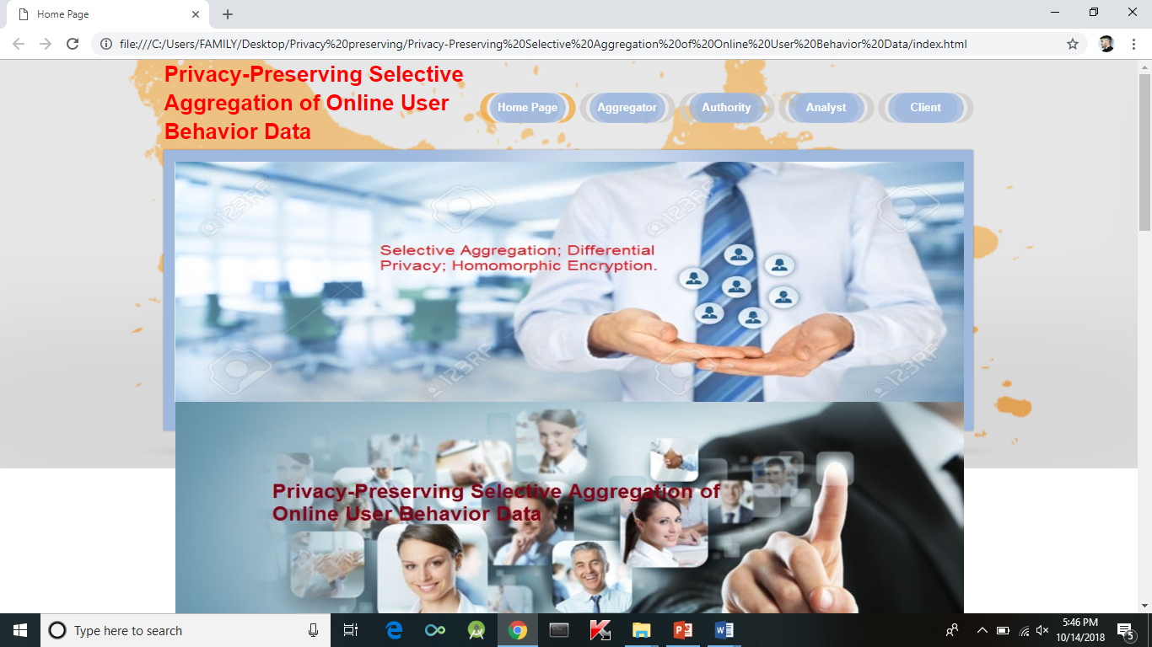
Prototype/ MVP Demo Video/Screenshots

Slide 13
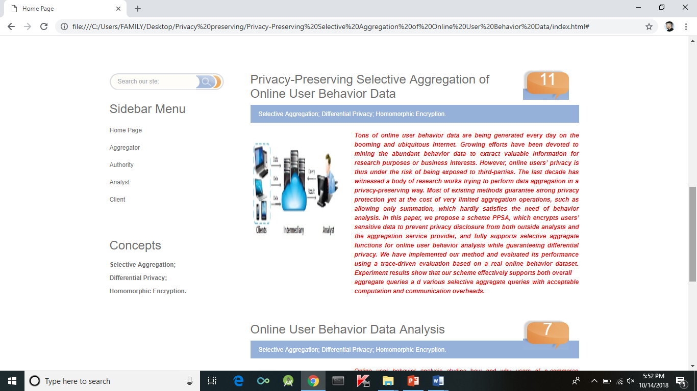

Slide 14
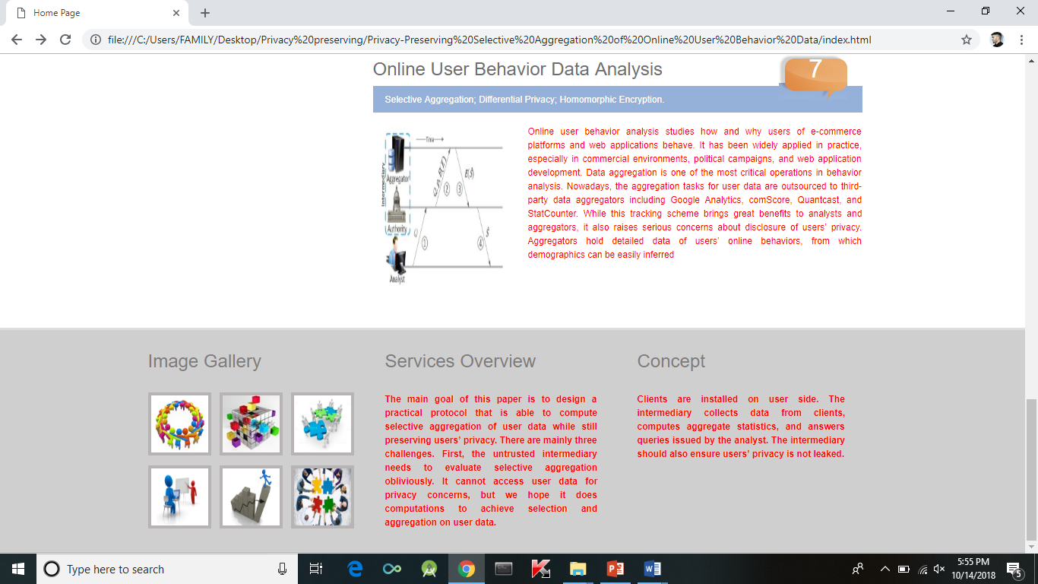

Slide 15
SYSTEM DESIGN AND DEVELPOMENT
INPUT DESIGN
Input Design plays a vital role in the life cycle of software development, it requires very careful attention of developers. The input design is to feed data to the application as accurate as possible. So inputs are supposed to be designed effectively so that the errors occurring while feeding are minimized. According to Software Engineering Concepts, the input forms or screens are designed to provide to have a validation control over the input limit, range and other related validations.
This system has input screens in almost all the modules. Error messages are developed to alert the user whenever he commits some mistakes and guides him in the right way so that invalid entries are not made.
Input design is the process of converting the user created input into a computer-based format. The goal of the input design is to make the data entry logical and free from errors. The error is in the input are controlled by the input design. The application has been developed in user-friendly manner. The forms have been designed in such a way during the processing the cursor is placed in the position where must be entered. The user is also provided with in an option to select an appropriate input from various alternatives related to the field in certain cases.
Validations are required for each data entered. Whenever a user enters an erroneous data, error message is displayed and the user can move on to the subsequent pages after completing all the entries in the current page.

Slide 16
OUTPUT DESIGN
The Output from the computer is required to mainly create an efficient method of communication within the company primarily among the project leader and his team members, in other words, the administrator and the clients. The output of VPN is the system which allows the project leader to manage his clients in terms of creating new clients and assigning new projects to them, maintaining a record of the project validity and providing folder level access to each client on the user side depending on the projects allotted to him. After completion of a project, a new project may be assigned to the client. User authentication procedures are maintained at the initial stages itself. A new user may be created by the administrator himself or a user can himself register as a new user but the task of assigning projects and validating a new user rests with the administrator only.The application starts running when it is executed for the first time. The server has to be started and then the internet explorer in used as the browser. The project will run on the local area network so the server machine will serve as the administrator while the other connected systems can act as the clients. The developed system is highly user friendly and can be easily understood by anyone using it even for the first time.

Slide 17
CONCLUSION
In this paper, we have described the challenges of making online user data aggregation while preserving users’ privacy. Based on BGN homomorphic cryptosystem, we have designed the first system that is able to securely and selectively aggregate user data, making it practical in realistic data analytics. It guarantees strong privacy preservation by utilizing differential privacy mechanism to protect individuals’ privacy. We have presented PPSA to evaluate aggregation selected by one boolean attribute, and extended it to aggregation selected by multiple boolean attributes and by one numeric attribute. Extensive experiments have shown that PPSA supports various selective aggregate queries with acceptable overhead and high accuracy.

Slide 18
WHY YOUR SOLUTION SHOULD BE CONSIDERED FOR THE FINAL ROUND
The reason is that ,I have come up with an optimum solution for the given problem statement in the elapsed time .I consider my model as one of the best working and accurate model .My solution offers key to all the problem statements declared such as it provides end to end provisioning – starting from user request form/approval form, security & business policies ,It has role based action provisions and all other statements .It uses Targeted certification methodology with partition with proper supporting use case believe my model is the best fit for the statement .I hope it gets selected among the top models for the final round.

Slide 19
Thank You

