Slide 1
SAFETY SIGNAL
REVIEW CAPSTONE
Pharmacovigilance | Synthetic adverse-reaction dataset
Objective: summarize case characteristics, outcomes, and onset timing; identify a cautious potential pattern; and recommend follow-up without claiming causation.
8 synthetic reports • Training use only • 23 October 2026
EdVyro | Synthetic training data only
1

Slide 2
Executive Summary
Descriptive review only — not a confirmed safety signal
Measure | Observed result | Interpretation
Reports | 8 | Small descriptive sample
Hospitalization outcomes | 3 / 8 (37.5%) | Outcome field; not a complete seriousness assessment
Life-threatening severity | 1 / 8 (12.5%) | Prioritize case-level review
Bleeding-related reports | 2 | Hypothesis-generating pattern only
Reaction onset | 1–30 days; median 8.5 | Not a calendar reporting trend
Conclusion: review ADR-9004 and ADR-9007 in more detail. The dataset cannot establish product causality or confirm a safety signal.
EdVyro | Synthetic training data only
2

Slide 3
Dataset & Method
Eight rows • Ten fields • Synthetic data
Fields included:
Report ID, age, gender, suspected drug, indication, reaction, onset days, severity, outcome, reporter type.
Method:
• Descriptive counts and proportions
• Onset range and median
• Qualitative review for repeated event themes
• All rows retained; no imputation
Data-quality checks:
• 8 unique report IDs
• 8 unique suspected products
• 0 missing cells in supplied CSV
• No reporting dates
• No exposure denominator or comparator
Not performed:
Statistical testing, disproportionality analysis, incidence estimation, or causal inference.
EdVyro | Synthetic training data only
3

Slide 4
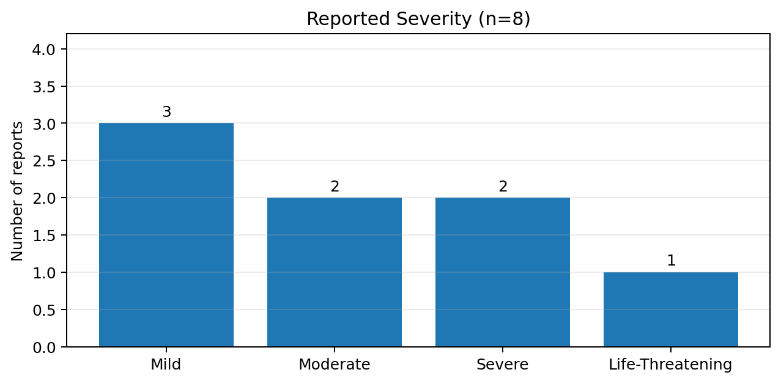
Reported Severity
Recorded intensity labels; seriousness must be assessed separately
3 Mild
2 Moderate
2 Severe
1 Life-threatening
A severe symptom is not automatically a serious case. This CSV does not include a separate formal seriousness field.
EdVyro | Synthetic training data only
4

Slide 5
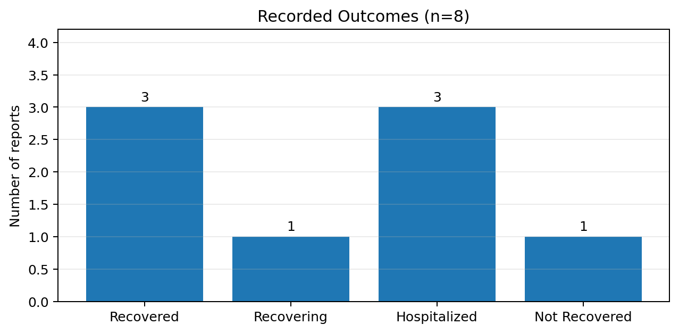
Recorded Outcomes
Outcome labels from the supplied dataset
3 Recovered
1 Recovering
3 Hospitalized
1 Not recovered
Outcome and seriousness are related but not interchangeable. Details are insufficient to validate every seriousness criterion.
EdVyro | Synthetic training data only
5

Slide 6
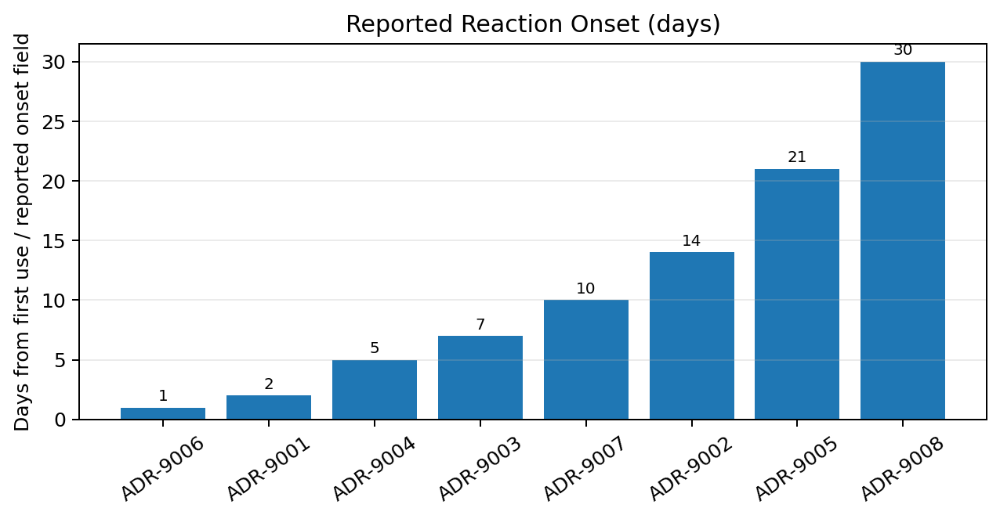
Reaction-Onset Timing
Reported onset days are not report dates
Range: 1–30 days
Median: 8.5 days
No report dates were supplied, so reporting trends over calendar time cannot be assessed.
EdVyro | Synthetic training data only
6

Slide 7
Case-Level Summary
Supplied fields reproduced for descriptive review
ID | Suspected drug | Reaction | Onset | Severity | Outcome
ADR-9001 | Amoxicillin | Skin Rash & Hives | 2 | Mild | Recovered
ADR-9002 | Atorvastatin | Severe Muscle Myalgia | 14 | Moderate | Recovering
ADR-9003 | Ciprofloxacin | Tendonitis | 7 | Severe | Hospitalized
ADR-9004 | Ibuprofen | Gastric Ulcer Bleed | 5 | Severe | Hospitalized
ADR-9005 | Lisinopril | Persistent Dry Cough | 21 | Mild | Recovered
ADR-9006 | Metformin | Nausea & Diarrhea | 1 | Mild | Recovered
ADR-9007 | Warfarin | Uncontrolled Hemorrhage | 10 | Life-Threatening | Hospitalized
ADR-9008 | Paclitaxel | Peripheral Neuropathy | 30 | Moderate | Not Recovered
EdVyro | Synthetic training data only
7

Slide 8
Potential Signal Observation
A hypothesis for follow-up — not a confirmed signal
Report | Supplied details | Priority rationale
ADR-9004 | Ibuprofen • Gastric Ulcer Bleed • Severe • Hospitalized | Bleeding-related event; verify details
ADR-9007 | Warfarin • Uncontrolled Hemorrhage • Life-threatening • Hospitalized | Highest-priority individual record in this dataset
Why not confirmed?
• Only two related reports in a selected sample of eight
• Different suspected products and indications
• No denominator, comparator, reporting dates, or verified medical records
• “Suspected drug” does not establish causality
EdVyro | Synthetic training data only
8

Slide 9
Alternative Explanations & Follow-up
Alternative explanations:
• Underlying conditions / comorbidities
• Concomitant medicines or interactions
• Dose, duration, adherence, or medication-use errors
• Unverified or imprecise event terms
• Selection and reporting effects
Follow-up questions:
• Confirm diagnosis, dates, course, and outcome
• Obtain relevant medical history
• Check concomitant products and dose details
• Review relevant lab results if available
• Clarify dechallenge/rechallenge
• Protect personal data during follow-up
EdVyro | Synthetic training data only
9

Slide 10
Risk-Minimization Questions & Limitations
Questions after evidence verification:
• Are preventable medication-use factors present?
• Are product information and communications appropriate?
• Is targeted education or a process safeguard justified?
• What measurable outcome would monitor effectiveness?
Key limitations:
• Synthetic sample, n=8
• No denominator or comparator
• No report dates
• No separate seriousness field
• No narratives, labs, co-medications, or verified diagnoses
• Cannot estimate incidence or establish causality
EdVyro | Synthetic training data only
10

Slide 11
Conclusion & Resume-Ready Description
Conclusion: two bleeding-related reports merit focused follow-up as a hypothesis-generating pattern. The dataset is insufficient to confirm a safety signal or infer causation.
Resume project title: Pharmacovigilance Practice Project | Safety Signal Review
• Reviewed an 8-record synthetic adverse-reaction dataset using descriptive analysis.
• Created charts and case-level tables for severity, outcomes, and reaction-onset timing.
• Flagged two bleeding-related reports for follow-up while documenting alternatives and evidence gaps.
• Applied cautious safety-data interpretation without unsupported causality claims.
ATS keywords: Pharmacovigilance, Adverse Event Review, Safety Signal Detection (training), Case Triage, Descriptive Data Analysis, Data Quality Review, Risk Minimization, Report Writing.
EdVyro | Synthetic training data only
11

Slide 12
References & Scope Note
Synthetic training data only
Primary source: EdVyro Safety Signal Review Capstone brief and supplied adverse-reaction aggregate CSV.
Learning references:
ICH E2A — https://database.ich.org/sites/default/files/E2A_Guideline.pdf
WHO–UMC causality assessment — https://who-umc.org/media/u4gjgxvv/who-umc-causality-assessment_new-logo.pdf
FDA: What is a Serious Adverse Event? — https://www.fda.gov/safety/reporting-serious-problems-fda/what-serious-adverse-event
This is not medical advice or a real safety report. No causal conclusion is made.
EdVyro | Synthetic training data only
12

