Slide 1
LẬP TRÌNH PHÂN TÍCH DỮ LIỆU
GIẢNG VIÊN HƯỚNG DẪN: TRƯƠNG VÌNH LINH

Slide 2
Post-it Board Infographics
20051051 Đặng Quốc Toàn
Phạm Chánh Trực
Nguyễn Tòng
20101981 Thạch Thị Thanh Thảo
Phạm Tiến Thành

Slide 3
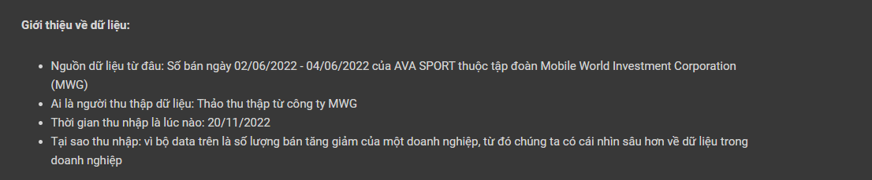
THUYẾT MINH DỮ LIỆU

Slide 4
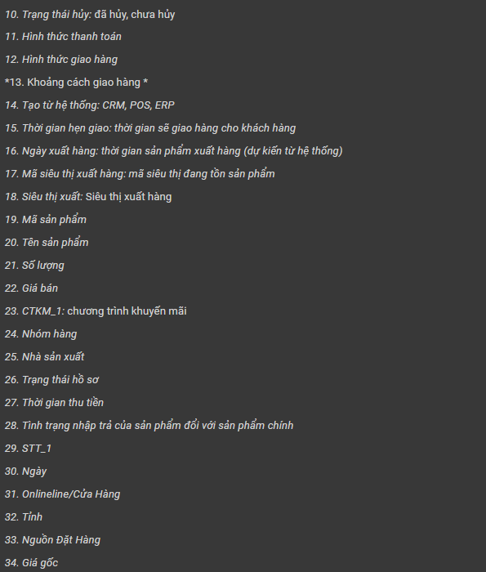
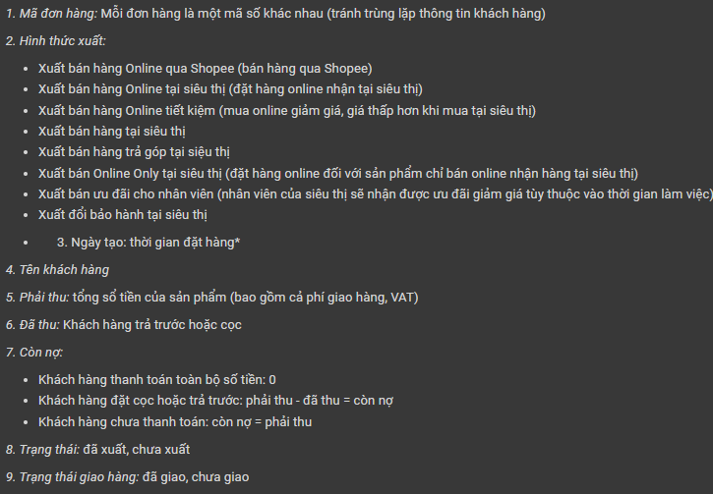
THUYẾT MINH DỮ LIỆU

Slide 5
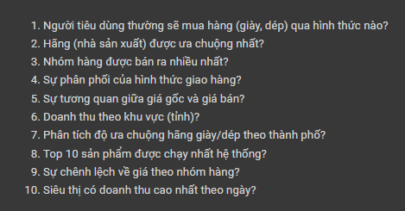
CÂU HỎI ĐẶT RA CHO BỘ DỮ LIỆU

Slide 6
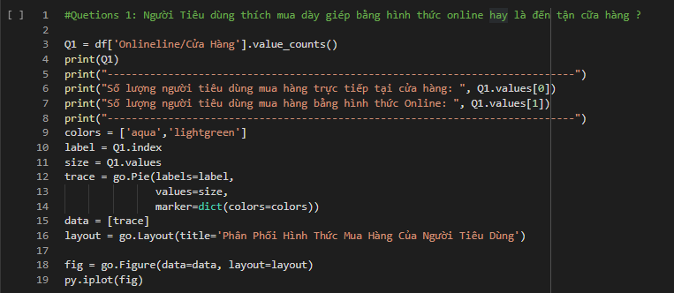
TRẢ LỜI CÂU HỎI ĐẶT RA CHO BỘ DỮ LIỆU
1.Người Tiêu dùng thích mua dày giép bằng hình thức online hay là đến tận cữa hàng ?
KẾT QUẢ: 1. Tại cửa hàng: 463 2. Online: 291

Slide 7
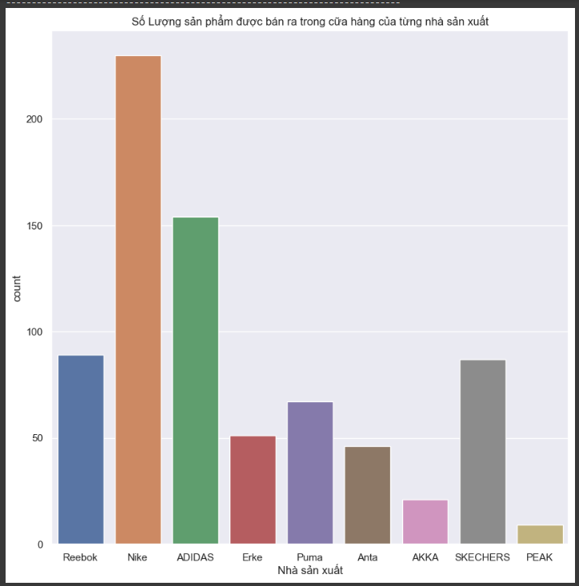
TRẢ LỜI CÂU HỎI ĐẶT RA CHO BỘ DỮ LIỆU
Câu 2:
Những nhà sản xuất nào được khách hàng ưa chuộng nhất ?
KẾT QUẢ: Nike 230 - ADIDAS 154 - Reebok 89 - SKECHERS 87 - Puma 67 - Erke 51 - Anta 46 - AKKA 21 - PEAK 9

Slide 8
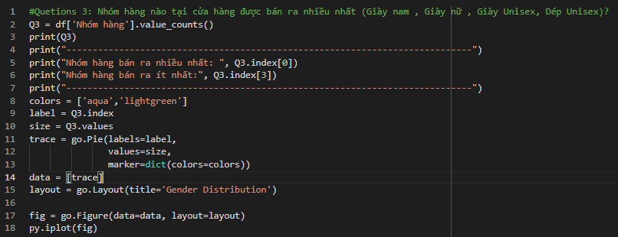
TRẢ LỜI CÂU HỎI ĐẶT RA CHO BỘ DỮ LIỆU
Câu 3: Nhóm hàng nào tại cửa hàng được bán ra nhiều nhất
KẾT QUẢ: 4964 - Giày nam 413 4965 - Giày nữ 236 4966 - Giày unisex 102 4981 - Dép Unisex 3

Slide 9
TRẢ LỜI CÂU HỎI ĐẶT RA CHO BỘ DỮ LIỆU
Câu 4: Thể hiện sự phân phối của Hình Thức Giao Hàng
KẾT QUẢ:

Slide 10
TRẢ LỜI CÂU HỎI ĐẶT RA CHO BỘ DỮ LIỆU
Câu 5: Cho biết sự tương quan giữa giá gốc và giá bán ra
KẾT QUẢ:

Slide 11
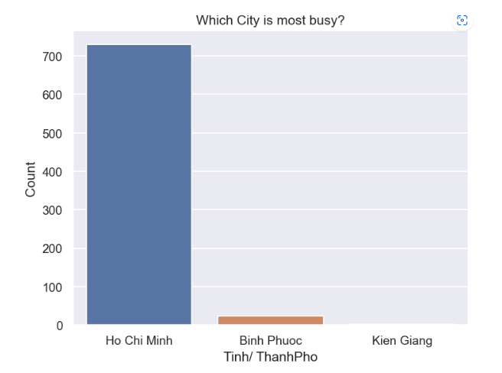
TRẢ LỜI CÂU HỎI ĐẶT RA CHO BỘ DỮ LIỆU
Câu 6: Cho biết doanh thu của cữa hàng theo tỉnh/ thành phố?
KẾT QUẢ: Hồ Chí Minh: 730 – Bình Phước: 23 – Kiên Giang: 1

Slide 12
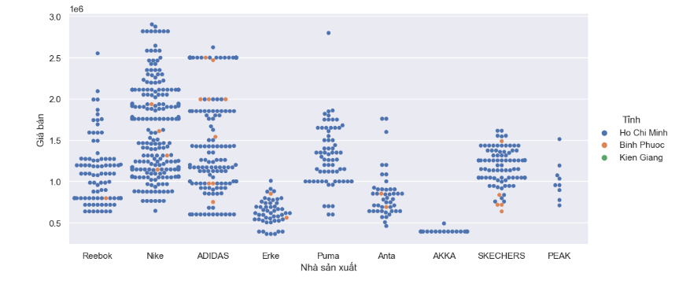
TRẢ LỜI CÂU HỎI ĐẶT RA CHO BỘ DỮ LIỆU
Câu 7: Phân tích độ ưa chuộng hãng giày/dép theo thành phố ?
KẾT QUẢ:

Slide 13
TRẢ LỜI CÂU HỎI ĐẶT RA CHO BỘ DỮ LIỆU
Câu 8:
KẾT QUẢ:

Slide 14
TRẢ LỜI CÂU HỎI ĐẶT RA CHO BỘ DỮ LIỆU
Câu 9:
KẾT QUẢ:

Slide 15
TRẢ LỜI CÂU HỎI ĐẶT RA CHO BỘ DỮ LIỆU
Câu 10:
KẾT QUẢ:

Slide 16
Post-it Board Infographics
Neptune
It’s the farthest planet from the Sun
Saturn
It’s a gas giant with an average radius of about nine times that on Earth
Mars
Earth
It’s the fourth planet from the Sun and a very cold place
It’s the third planet from the Sun
Jupiter
Uranus
It’s the fifth planet from the Sun and the largest in the Solar System
Uranus is seventh planet from the Sun

Slide 17
Post-it Board Infographics
Jupiter
Mars
Saturn
Neptune
It's the fifth planet from the Sun and the largest of them all
It’s the fourth planet from the Sun and a very cold place
It’s a gas giant with a radius of nine times that on Earth
It’s the eighth and farthest-known planet from the Sun
Stars
Uranus
Mercury
Moon
Sun
Pluto
Earth
Sun

Slide 18
Post-it Board Infographics
Jupiter
Mercury
Jupiter is the biggest planet of them all
It’s the smallest planet of them all
Title
Neptune
Mars
It’s the farthest planet from the Sun
Despite being red, it’s a cold place
Saturn
Earth
It’s a gas giant and has several rings
Earth is the third planet from the Sun

Slide 19
Post-it Board Infographics
01
Jupiter
Mars
Jupiter is the biggest planet of them all
Despite being red, it’s a very cold place
05
02
Title
Neptune
Earth
It’s the farthest planet from the Sun
Earth is the planet where we live on
Saturn
04
It’s a gas giant and has several rings
03

Slide 20
Post-it Board Infographics
Title
Mars
Saturn
Jupiter
Neptune
It’s the fourth planet from the Sun and it’s cold
It’s a gas giant and has several rings around
It’s the fifth planet from the Sun and the largest
It’s the eighth and farthest-known solar planet

Slide 21
Post-it Board Infographics
1
Jupiter
Venus
6
Jupiter is the biggest planet of them all
It’s the second planet from the Sun
2
Neptune
Uranus
5
It’s the farthest planet from the Sun
Title
Uranus is the seventh planet from the Sun
3
Saturn
Earth
4
It’s a gas giant and has several rings
It’s the third planet from the Sun

Slide 22
Post-it Board Infographics
01
02
03
04
Mars
Neptune
Jupiter
Mercury
It’s the fourth planet from the Sun and a cold place
It’s the eighth and farthest-known planet from the Sun
It’s the fifth planet from the Sun and the largest of them all
Mercury is the smallest planet in the Solar System

Slide 23
Post-it Board Infographics
Jupiter
Saturn
Mars
Jupiter is the fifth planet from the Sun and the largest
It’s a gas giant with a radius of about nine times that on Earth
It’s the fourth planet from the Sun and a very cold place
Neptune
Venus
Earth
It’s the eighth and farthest-known planet from the Sun
Venus has a beautiful name, but also very high temperatures
Earth, the third planet from the Sun, is where we all live on

Slide 24
Post-it Board Infographics
Jupiter
Venus
Neptune
Uranus
Jupiter is the biggest planet of them all
Venus was named after a goddess
It’s the farthest planet from the Sun
Uranus is the seventh planet from the Sun
Mars
Pluto
Earth
Saturn
Despite being red, it’s actually a cold place
Pluto is considered a dwarf planet
It’s the third planet from the Sun
It’s a gas giant and has several rings

Slide 25
Post-it Board Infographics
Jupiter
Mars
Venus
Jupiter is the biggest planet of them all
Despite being red, it’s actually a cold place
This planet was named after a goddess
Neptune
Title
Uranus
It’s the farthest planet from the Sun
Uranus is the seventh planet from the Sun
Saturn
Pluto
Earth
It’s a gas giant and has several rings
Pluto is now considered a dwarf planet
Earth is the third planet from the Sun

Slide 26
Post-it Board Infographics
Mars
Jupiter
It’s the fourth planet from the Sun and a very cold place
It’s the fifth planet from the Sun and the largest of them all
Title
Subtitle
Saturn
Neptune
It’s a gas giant and has several rings around it
Neptune is the eighth and farthest-known solar planet

Slide 27
Post-it Board Infographics
Jupiter
Saturn
Mars
It’s the fifth planet from the Sun and the largest of them all
It’s a gas giant with a radius of about nine times that on Earth
It’s the fourth planet from the Sun and a very cold place
Earth
Venus
Neptune
Earth, the third planet from the Sun, is where we all live on
Venus has a beautiful name, but also very high temperatures
Neptune is the eighth and farthest-known solar planet

Slide 28
Post-it Board Infographics
Jupiter
Pluto
Saturn
Mercury
It’s the fifth planet from the Sun and the largest of them all
It’s a gas giant with a radius of about nine times that on Earth
Uranus
Moon
Neptune
Sun
Venus
Earth
It’s the eighth and farthest-known planet from the Sun
This planet was named after a Roman goddess
Stars
Uranus

Slide 29
Post-it Board Infographics
Jupiter
Mars
Jupiter is the fifth planet from the Sun and the largest
It’s the fourth planet from the Sun and a very cold place
Saturn
Neptune
It’s a gas giant with a radius of about nine times that on Earth
It’s the eighth and farthest-known planet from the Sun

Slide 30
Post-it Board Infographics
Mars
It’s the fourth planet from the Sun and a very cold place
Jupiter
Neptune
Jupiter is the fifth planet from the Sun and the largest
It’s the eighth and farthest-known planet from the Sun
Saturn
It’s a gas giant with a radius of about nine times that on Earth

Slide 31
Post-it Board Infographics
Mars
It’s the fourth planet from the Sun and a very cold place
Jupiter
Neptune
Jupiter is the fifth planet from the Sun and the largest
Title
It’s the eighth and farthest-known planet from the Sun
Saturn
It’s a gas giant with a radius of about nine times that on Earth

Slide 32
Post-it Board Infographics
Saturn
Venus
It’s a gas giant with a radius of about nine times that on Earth
Venus has a beautiful name, but also very high temperatures
Jupiter
Neptune
It's the fifth planet from the Sun and the largest of them all
It’s the eighth and farthest-known planet from the Sun

Slide 33
Post-it Board Infographics
Jupiter
Saturn
It's the fifth planet from the Sun and the largest of them all
It’s a gas giant with a radius of about nine times that on Earth
Neptune
Title
It’s the eighth and farthest-known planet from the Sun
Venus
Uranus

Slide 34
Post-it Board Infographics
01 Business idea
02 Research
03 Meeting
Stars
Jupiter
Neptune
Mars
It’s the farthest planet from the Sun
Jupiter is the biggest planet of them all
Pluto
Saturn
Pluto is considered a dwarf planet
Earth
It’s a gas giant and has several rings
Venus
Uranus
Sun

Slide 35
Post-it Board Infographics
NOW
FUTURE
1
Jupiter is the biggest planet of them all
Venus is the second planet from the Sun
1
2
It’s the farthest planet from the Sun
Uranus is the seventh planet from the Sun
2
3
It’s a gas giant and has several rings
It’s the third planet from the Sun
3

Slide 36
Post-it Board Infographics
Jupiter
Venus
Earth
Jupiter is the biggest planet of them all
Saturn
Venus is the second planet from the Sun
Uranus
Earth is the planet where we all live on
It’s a gas giant and has several rings around
Uranus is the seventh planet from the Sun

Slide 37
Post-it Board Infographics
Neptune
Mercury
Mars
Jupiter
Saturn
It’s the fourth planet from the Sun and a very cold place
It’s the fifth planet from the Sun and the largest in the Solar System
It’s a gas giant with an average radius of about nine times that on Earth
Pluto
Uranus

Slide 38
Post-it Board Infographics
Jupiter
Venus
It's the fifth planet from the Sun and the largest
Venus is the second planet from the Sun
Saturn
Mars
It’s a gas giant with a radius of nine times that on Earth
It’s the fourth planet from the Sun and a cold place
Neptune
Earth
It’s the eighth and farthest-known solar planet
Earth is the only known planet to harbor life inside

Slide 39
Post-it Board Infographics
Jupiter
It’s the fifth planet from the Sun and the largest in the Solar System
Neptune
It’s the eighth and farthest-known planet from the Sun
Mars
It’s the fourth planet from the Sun and a very cold place
Venus
Venus has a beautiful name, but also very high temperatures
Saturn
It’s a gas giant with an average radius of about nine times that on Earth

Slide 40
Post-it Board Infographics
Saturn
Venus
It’s a gas giant and has several rings
Venus is the second planet from the Sun
Title 1
Title 2
Jupiter
Neptune
It's the fifth planet from the Sun and the largest
It’s the farthest-known planet from the Sun

Slide 41
Post-it Board Infographics
1
Venus
Saturn
4
Venus is the second planet from the Sun
It’s a gas giant and has several rings
Title
It’s the fourth planet from the Sun and a very cold place
2
Jupiter
Neptune
It's the fifth planet from the Sun and the largest
It’s the farthest-known planet from the Sun
3

Slide 42
Post-it Board Infographics
Subtitle 1
Subtitle 2
Subtitle 3
It’s the fifth planet from the Sun and the largest
Neptune is the farthest planet from the Sun
Pluto
Venus has a beautiful name, but also very high temperatures
Saturn
Uranus
Subtitle 4
Earth is the third planet from the Sun
Mercury
Uranus is seventh planet from the Sun
Moon

Slide 43
Post-it Board Infographics
Saturn
Neptune
It’s a gas giant and has several rings
It’s the farthest-known planet from the Sun
Jupiter
Earth
Title
It's the fifth planet from the Sun and the largest
Earth is the only known planet to harbor life inside
Venus
Mars
Venus is the second planet from the Sun
It’s the fourth planet from the Sun and a cold place

