Slide 1

Assessment
Sunil BETHAPUDI

Slide 2
Task – 1 [Running nginx image as non-root user]
______________________________________________________________________________________________
Use nginx official image as baseline.
Create custom user.
Overwrite nginx configuration files with custom configuration files.
Provide necessary permissions to the nginx configuration files and logs.
Switch user.
Reference : https://github.com/Sunbetha/assignment/blob/main/task1/Dockerfile

Slide 3
Task – 2 [Create EKS cluster using modules and create given input of namespaces on EKS cluster]
______________________________________________________________________________________________
Use AWS provider & terraform AWS modules to create VPC & EKS cluster with local hardcoded variables & managed node groups in 2 AZs.
Use Kubernetes provider to create given input of namespaces as variable.
statefile to be saved in S3 bucket for version control & coherence in multi user environment & lock file in dynamo DB to avoid conflict and consistency.
Reference : https://github.com/Sunbetha/assignment/blob/main/task2/main.tf

Slide 4
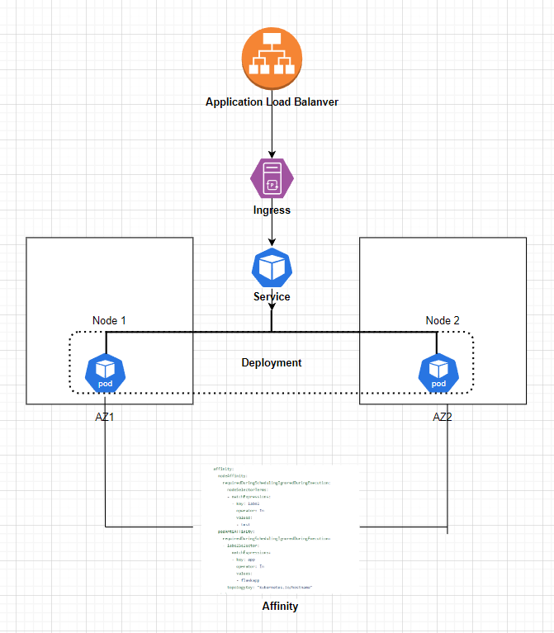
Task – 3 [PRD ready service running in kubernetes]
______________________________________________________________________________________________
Worker nodes from 2 Azs are part of node group.
Affinity rules to ensure pods gets deployed on both the nodes.
Service of type: ClusterIp is defined.
ALB routes traffic to ingress and based on ingress rules the traffic is routed to service. [Path based routing].
Depending on the resource utilization HPA scale the number of pods.
Reference: https://github.com/Sunbetha/assignment/tree/main/task3

Slide 5
Task – 4 Service Mesh
______________________________________________________________________________________________
What is Service Mesh
Why service mesh is needed.
What it offers?
Istio Architecture
Istio features

