Slide 1



National Teacher Platform
Our Teachers, Our Heroes
Andhra Pradesh – Vision & Roadmap
3rd August 2017, New Delhi

Slide 2
Teachers in A.P - 2,88,191
Schools – 61,528,
Enrolment – 68.47 Lks
- Govt. - Aided - Private - Unrecognised/
- 64.66% - 2.71 - 31.81% Madrasas – 0.80%
Department of School Education, Government of Andhra Pradesh
Source :UDISE 2016-17

Slide 3

VISION
Leverage Technology for Empowerment and Professional Development of Teachers to Ensure Better Student Learning Outcomes.

Slide 4
Objectives
To support building the confidence, capability and passion to become better teachers
To enhance access to information, content, tools and resources for better teaching, assessing and learning
Build capacities to create and curate contextual digital interactive learning content
Teachers across the state becoming comoirtable with technology use, network and share learning experiences

Slide 5
Goals
Community participation is building 5000 Digital Classrooms by 31.3.2018
To develop 1000 lesson plans to address assessment & learning gaps by 31st March 2018
10,000 Teachers, including Student Teachers, actively using NTP by 31st March 2019
2000 teachers will complete at least one Professional Development Course on NTP by Mar’2018

Slide 6
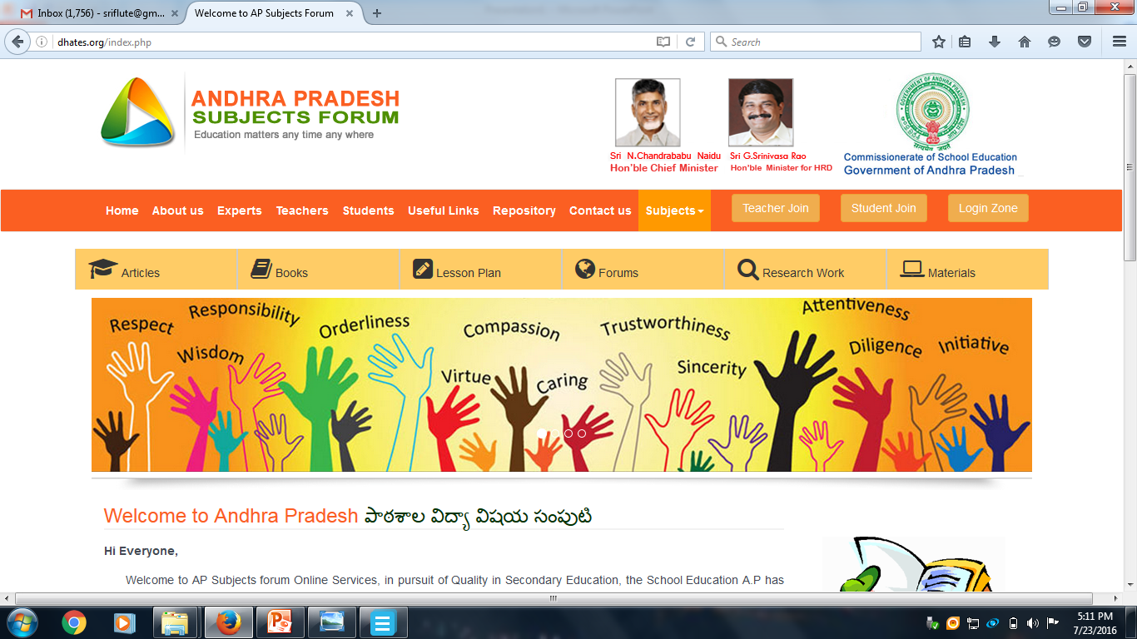


Subject Teacher Forum Web portal
AP e-Knowledge Exchange launched on 7th Sept’2016
Platform for collaborative work by Teachers to enhance the quality of teaching-learning
Linkages to Digital Content & Online Courses

Slide 7
Overall Principles & Strategies
Leverage Technology
To integrate APeKX with NTP
To build, adapt User friendly interface
To identify and support early adopters, key contributors and evangelists of NTP
Need based Teacher Support
To help Teacher learn how to access and use NTP Resources
To enhance curriculum delivery, lesson planning, presentations, in-class activities, assessments, and student achievement and engagement
To find, use, create and share content to address learning gaps
To develop partnerships, provide contextual & relevant Courses for Teachers’ Professional Development

Slide 8









1. Support Professional Development of Teachers
Home | Courses | Forums | Repository | Services | Materials | Contact Us
Initiative concept/details/highlights:
1
2
Self-paced Learning
for teachers through the portal where courses (subject-wise/pedagogy) will be made available
Point System
will be introduced here to incentivize teachers to take the online courses
CLIX Certification Course
4
3
Discussion Forums
for the teachers to share their TLMs, Past Exam Questions, Past Curriculum Materials, Teaching Modules etc.
University Partnerships and Online Certification in developing the best curriculum and courses for teachers to learn and add-value
24/7
Accessibility to the Repository Platform

Slide 9
2. Content Strategy
Content Creation
Accessing existing AP content on NTP
Review, map quality content of NGOs, Vendors to AP Curriculum
Capacity building for content creation for gap areas
Content creation relevant to address Teachers’ In-Class and Training needs
Content creation driven by learning gaps analytics
Find, create content for pre-service Student Teachers
Content Curation
Create a PMU in SCERT & DIETs
Design& Use Quality and Standards for Content Assessment Framework
Build capacities of Curation Team to manage the entire process
SCERT Certification of content for quality and correctness

Slide 10
Technology Strategy
Integration Principal
Integrate APeKX with NTP
Build interconnections to Student Assessment analytics
Teacher Registry linked to AP-SIMS
Single sign-on (SSO) access between APEkX and NTP
Enhance access through
Online & Offline modes
TAB, Smartphone based Platforms
Adapting/Developing Mobile Apps – Genie, partner Apps, etc
Leverage Social Media Platforms like FB, Whatsapp, Blogs etc.
Improving connectivity to Schools, TEIs, etc.
Enhance access to existing Partner, Vendor, Teacher & Student Developed e-Content

Slide 11
Outreach Strategy
Leveraging the teacher profile feature to make using NTP aspirational
Continuously engage 45,000 Teachers oriented on APeKX & Education Technology to access NTP
Creating ‘what is NTP’ and ‘How to use it’ information packets for them in local language, for ease of training and onboarding
Extensive use of Smartphone based Bit sized contents
Capacity Building for Core Team
Points to be given for creation, curation, and translation of content- to be added to personnel record
Facilitate Online Courses for In-Service Teachers & Student Teachers

Slide 12
Implementation Strategy, Roadmap
APSCERT to be the Key Institutional Support System
Merge SIET with ET Dept. of SCERT
Provide dedicated team of Core Team Teachers to work at SCERT on NTP content dissemination, content creation & curation, capacity building, management, etc.
Content Creation & Curation
500 Core Team Teachers intensive Training and capacity building working at SCERT, DIETs and School Levels
Workshops for Content creation, curation, translation once in 2 months
Training for dedicated team of content reviewers
Issue necessary Government Orders and Guidelines
for institutionalizing the structures and processes
Develop and implement a strong communication strategy

Slide 13
Organizational Structure
Head - NTP
Program Lead - Academics
Program Lead - Administration
Technology Manager
Curriculum and Pedagogy Manager
Planning and Outreach Manager
Training Manager
Support Team
Creation
Data Analysis
Creation & Curation
Outreach
Online Courses Facilitation
Help Desk
Curation
Administrator NTP
Translation
Adoption
Consumption & Adoption
Incentives and Certification
Data Usage
Documentation
Vendors and Partners

Slide 14
Next Steps
Timelines (TBD) and broad next steps
Content Creation
-Scope of content -Type of content (lesson plans/assessments/ worksheets, interactive content for children) -Grade and Language scope
Analysis of what content is there, what is needed and what can be translated
Importing existing content + identifying partners
Team Set up
Final decision on ideal Org Structure and distribution of responsibilities
All team set-up
Trainings
Training on creation, curation
Training on using NTP
Awareness on Online Courses
Training on Community and Participation
Incentives
Provide certification
Incentive model
Badges and awards
NTP Setup
SSO integration
Logins for teachers
Language- AP NTP in Telugu
Admin for AP NTP
Setting up goals for the State
Data
Deciding on what data is needed
Different dashboards for different teams and levels (districts/ blocks etc>)
Analytics on various aspects ( consumption, creation, quality of teaching, etc.)
Content Curation
Setting guidelines for creation of content
Setting guidelines for reviewing content
Setting systems for awards and badges
Outreach
Goals setting for using NTP
Pilot for using NTP
Notes:
Useable gantt chart here-https://docs.google.com/spreadsheets/d/1OjZUr7xAXrZBHIJS1r20WtSyq7zw3XPD2uBfY8-g-L0/edit#gid=0

Slide 15


