Slide 1
KEYLOGGERS
Presented by
R.Reshma
Computer science and Engineering
Holycross Engineering college

Slide 2
OUTLINE
What is keyloggers?
Hardware keylogger
Software Key logger
How does keylogger works
Why do people use key logger
Prevention
Conclusion

Slide 3
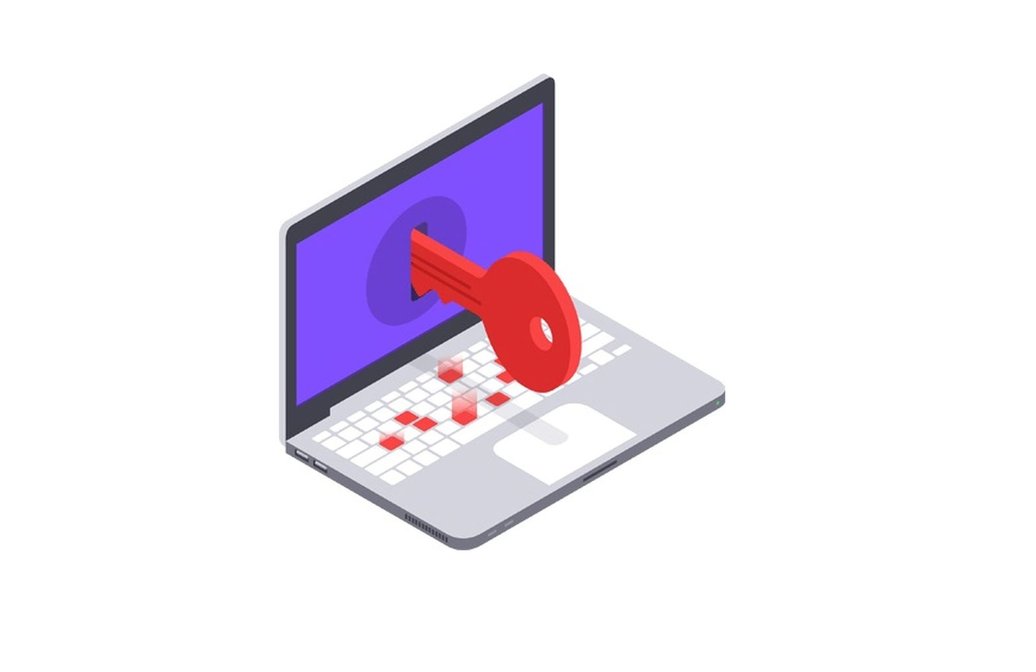
What is keyloggers?
A keylogger is a type of software or hardware device that is designed to record the keystrokes typed on a computer or mobile device keyboard.

Slide 4
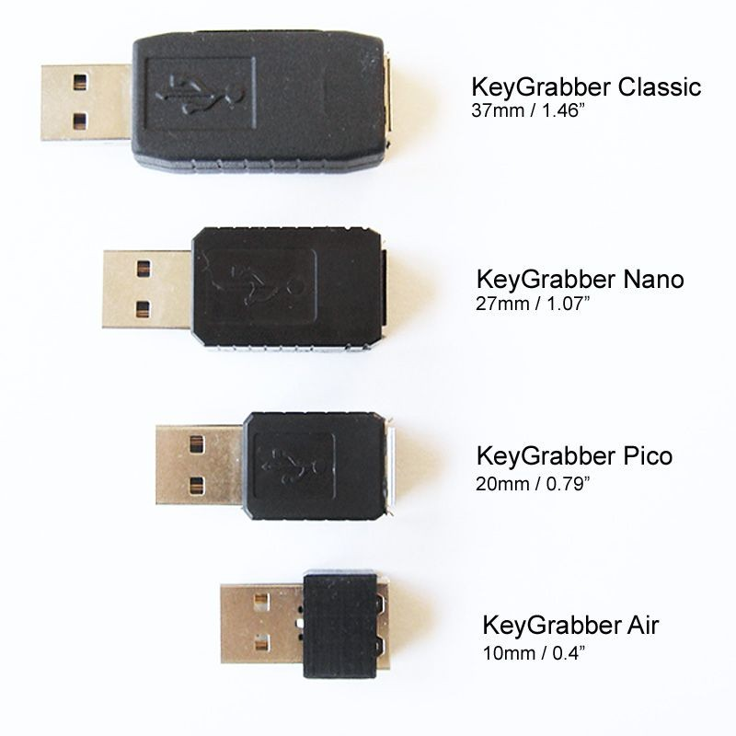
Hardware keylogger
These are physical devices that are connected between the keyboard and the computer or device. They intercept and record keystrokes as they pass through the device, regardless of the operating system or software being used.

Slide 5
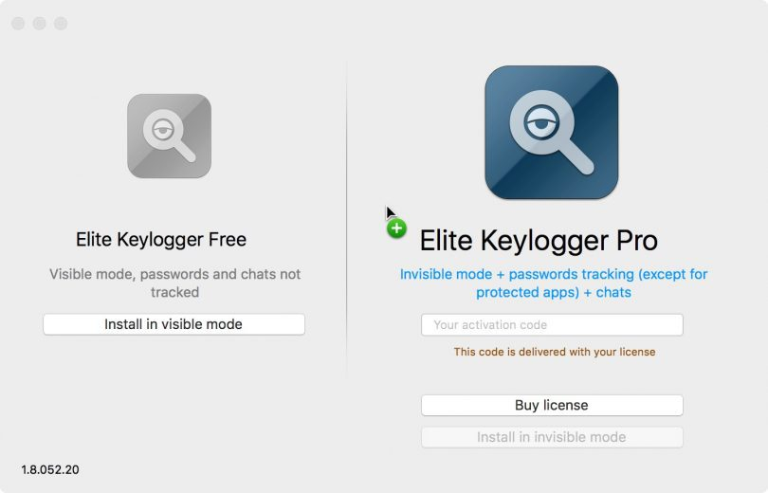
Software keylogger
These are programs that are installed on a computer or device like any other software. Once installed, they run in the background, silently recording all keystrokes made by the user.

Slide 6
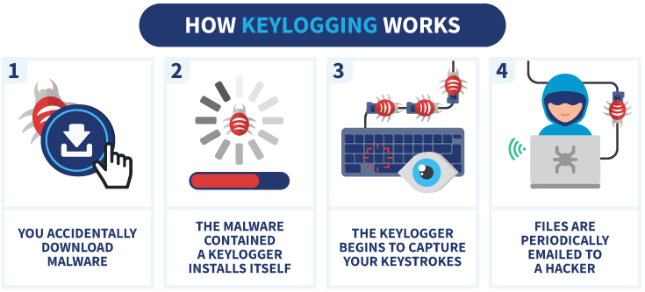
How does keylogger works

Slide 7
Why do people use keylogger
Keyloggers can also be used for malicious purposes, such as stealing sensitive information like passwords, credit card numbers, and personal data for identity theft, fraud, or espionage.
The use of keyloggers for such purposes is illegal and unethical.

Slide 8
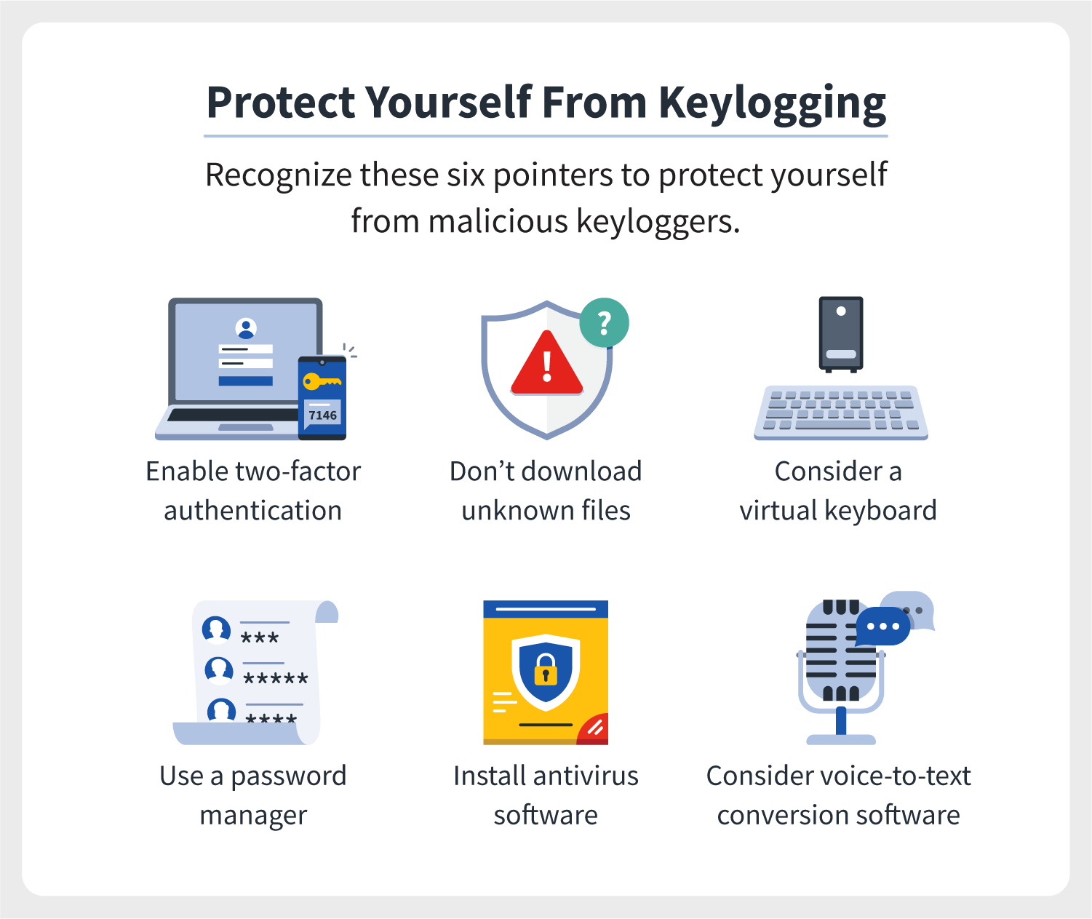
Prevention

Slide 9
Conclusion
Keyloggers can be used for legitimate purposes such as parental control or employee monitoring, but they can also be used maliciously by hackers to steal personal information or compromise security. Therefore, their use and distribution are often subject to legal restrictions and ethical considerations.

Slide 10


