Slide 1
Bert
By Xuanyu SU

Slide 2
Content
Background
Model Architecture
Two types
Text processing and pre-train
Fine tuning
Transformer
Evaluate
Good example

Slide 3
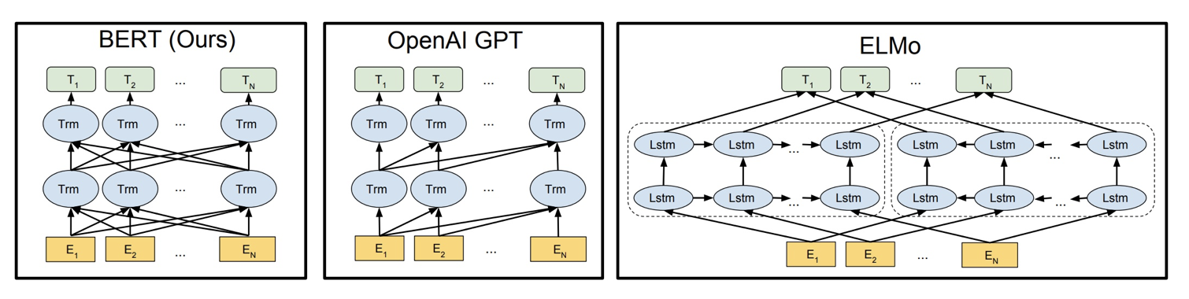
Background about Bert
What: Bert (Bidirectional Encoder Representations from Transformers), created in 2018 by Google AI team.
Why: Bert model is bidirectional. Which bidirectionally trained can have a deeper sense of language context and flow than single-direction language models. It’s in contrast to OpenAI GPT and ELMo(figure1). It would be more accurate than non-directional ones. This characteristic allows the model to learn the context of a word based on all of its surroundings (left and right of the word).
Figure1from:https://www.analyticsvidhya.com/blog/2019/09/demystifying-bert-groundbreaking-nlp-framework/

Slide 4
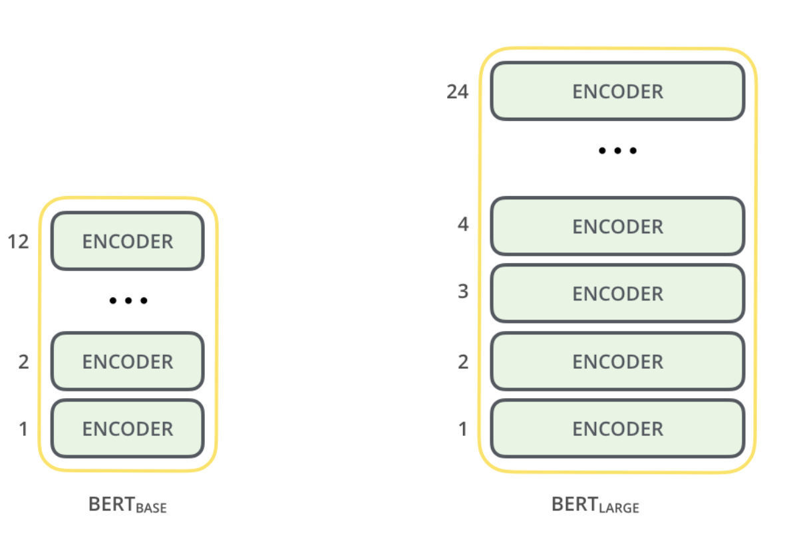
Model architecture Two main types
Model | BERT_{base} | BERT_{large}
Layers | 12 | 24
Hidden Size | 768 | 1024
Attention Head | 12 | 16
# of Paramters | 110M | 340M
Figure2 from: https://www.analyticsvidhya.com/blog/2019/09/demystifying-bert-groundbreaking-nlp-framework/
Table1: the differences between Bert-base and Bert-large

Slide 5
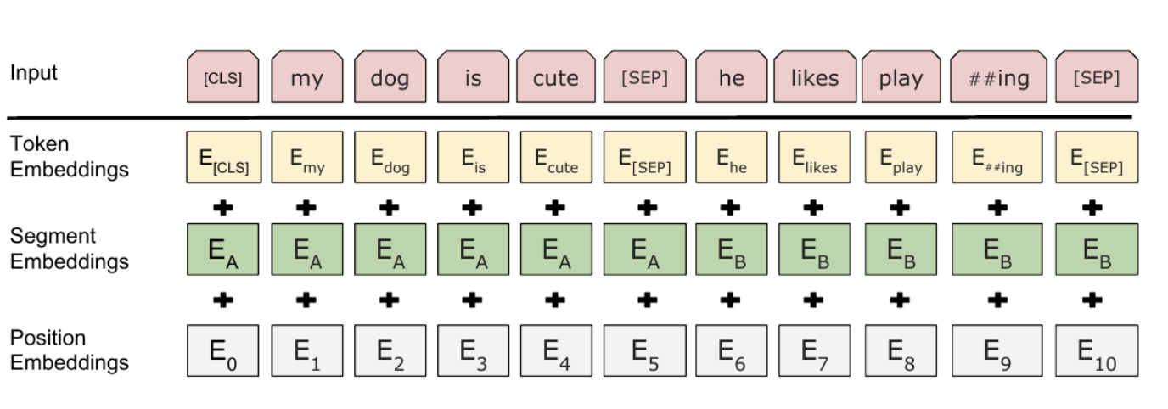
Text processing
The inputs contain 3 main embeddings:
Token embeddings: learned for the specific token from the WordPiece token vocabulary.
Segment embeddings: take sentence pairs as inputs for tasks and use symbols to distinguish between them. In the right example, all the tokens marked as EA belong to sentence A (and same as EB).
Position embeddings: express the position of words in a sentence by using this(always mark each word from 0 to n).
Figure3 from: https://www.cnblogs.com/nxf-rabbit75/p/11629163.html#auto-id-4

Slide 6
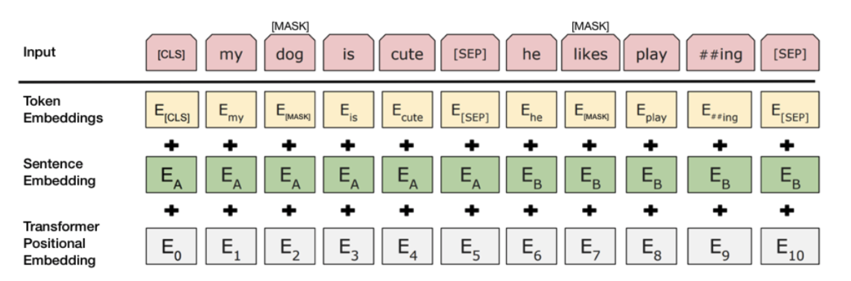
pre-train
MaskLM: Before feeding word sequences into BERT, 15% of the words in each sequence are replaced with a [MASK] token. The model then attempts to predict the original value of the masked words, based on the context provided by the other, non-masked, words in the sequence.
Adding a classification layer on top of the encoder output.
Multiplying the output vectors by the embedding matrix, transforming them into the vocabulary dimension.
Calculating the probability of each word in the vocabulary with softmax.
Figure4 from; Devlin, Jacob, et al. "Bert: Pre-training of deep bidirectional
transformers for language understanding." arXiv preprint arXiv:1810.04805 (2018).
NextSentence Preidiction: To predict if the second sentence is indeed connected to the first
The entire input sequence goes through the Transformer model.
The output of the [CLS] token is transformed into a 2×1 shaped vector, using a simple classification layer (learned matrices of weights and biases).
Calculating the probability of IsNextSequence with softmax.
When training the BERT model, Masked LM and Next Sentence Prediction are trained together, with the goal of minimizing the combined loss function of the two strategies.

Slide 7
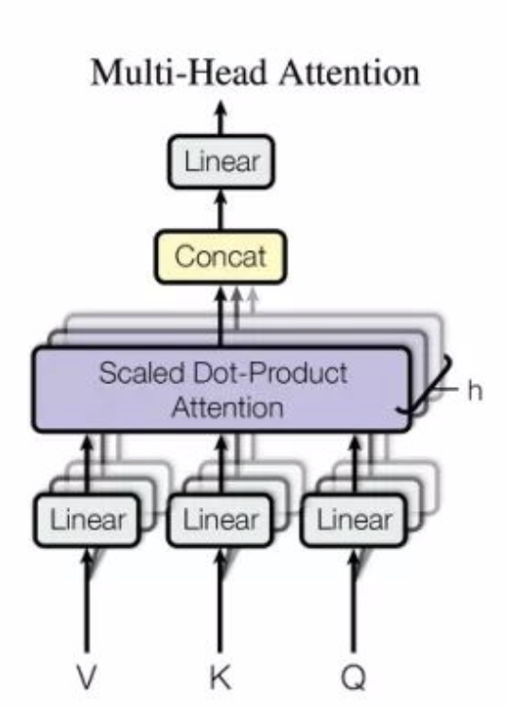
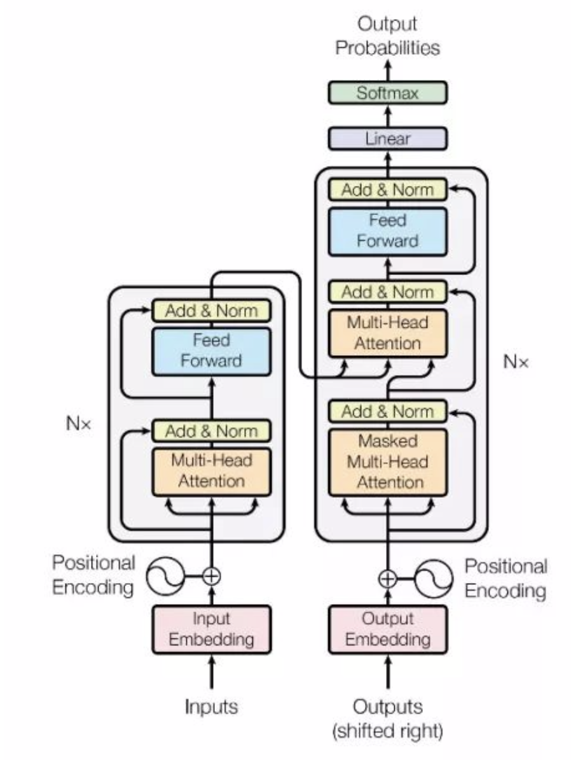
Transformer
Encoder: Self Attention and Feed Forward.
Decoder: Self Attention, Encoder-Decoder attention and Feed Forward.
Attention(self attention):
create three vectors from each of the encoder’s input vectors Query/Key/Value: are created by multiplying the embedding by three matrices trained during the training process.
Then do calculations by using matrics
Normalization layer: The encoder start by processing the input sequence. The output of the top encoder is transformed into a set of attention vectors K and V. These are to be used by each decoder in its “encoder-decoder attention” layer which helps the decoder focus on appropriate places in the input sequence:
Encoder-Decoder Attention” layer works like multiheaded self-attention, except it creates its Queries matrix from the layer below it, and takes the Keys and Values matrix from the output of the encoder stack.
Final output layer and softmax: linear层是一个简单全连接层
Figure6 from: https://www.analyticsvidhya.com/blog/2020/07/transfer-learning-for-nlp-fine-tuning-bert-for-text-classification/
The softmax layer then turns those scores into probabilities (all positive, all add up to 1.0). The cell with the highest probability is chosen, and the word associated with it is produced as the output for this time step.

Slide 8
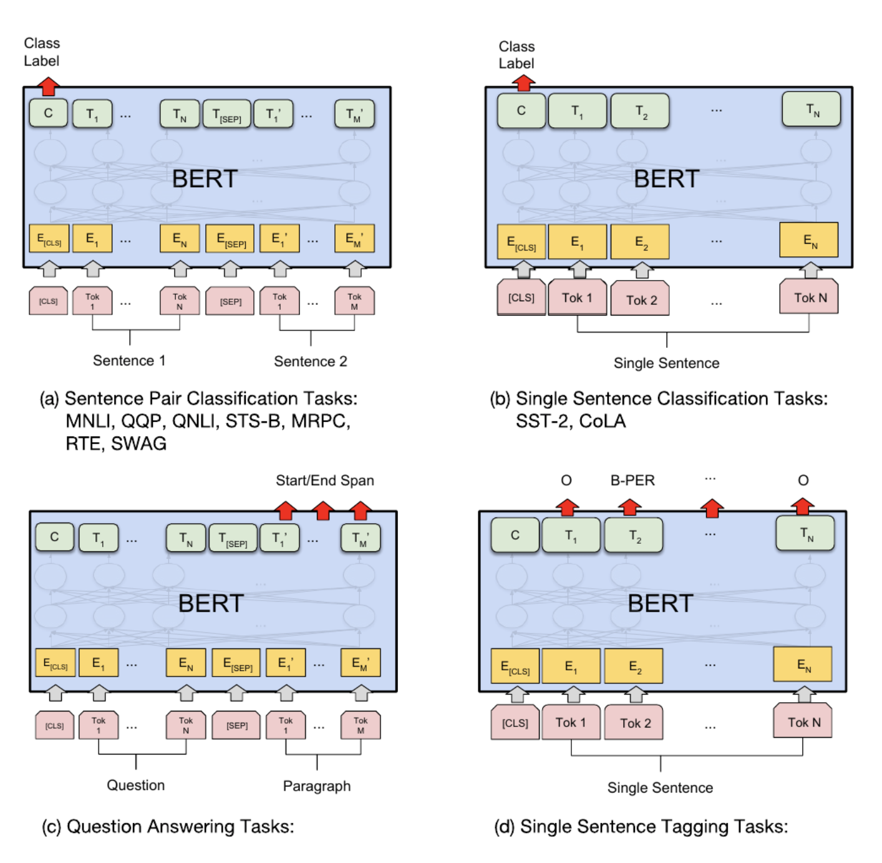
Fine-tunning
1
2
3 4
Sentence pair classification tasks: add a classification layer on top of the Transformer output for the [CLS] token.
Single sentence classification tasks: add a mark in front of the sentence, and output the embedding obtained by Bert to the binary classification model to get the classification result.
Question answering tasks: learn two extra vectors that mark the beginning and the end of the answer.
Single sentence tagging tasks: feed the output vector of each token into a classification layer that predicts the NER label.
Figure5 from: https://www.analyticsvidhya.com/blog/2020/07/transfer-learning-for-nlp-fine-tuning-bert-for-text-classification/

Slide 9
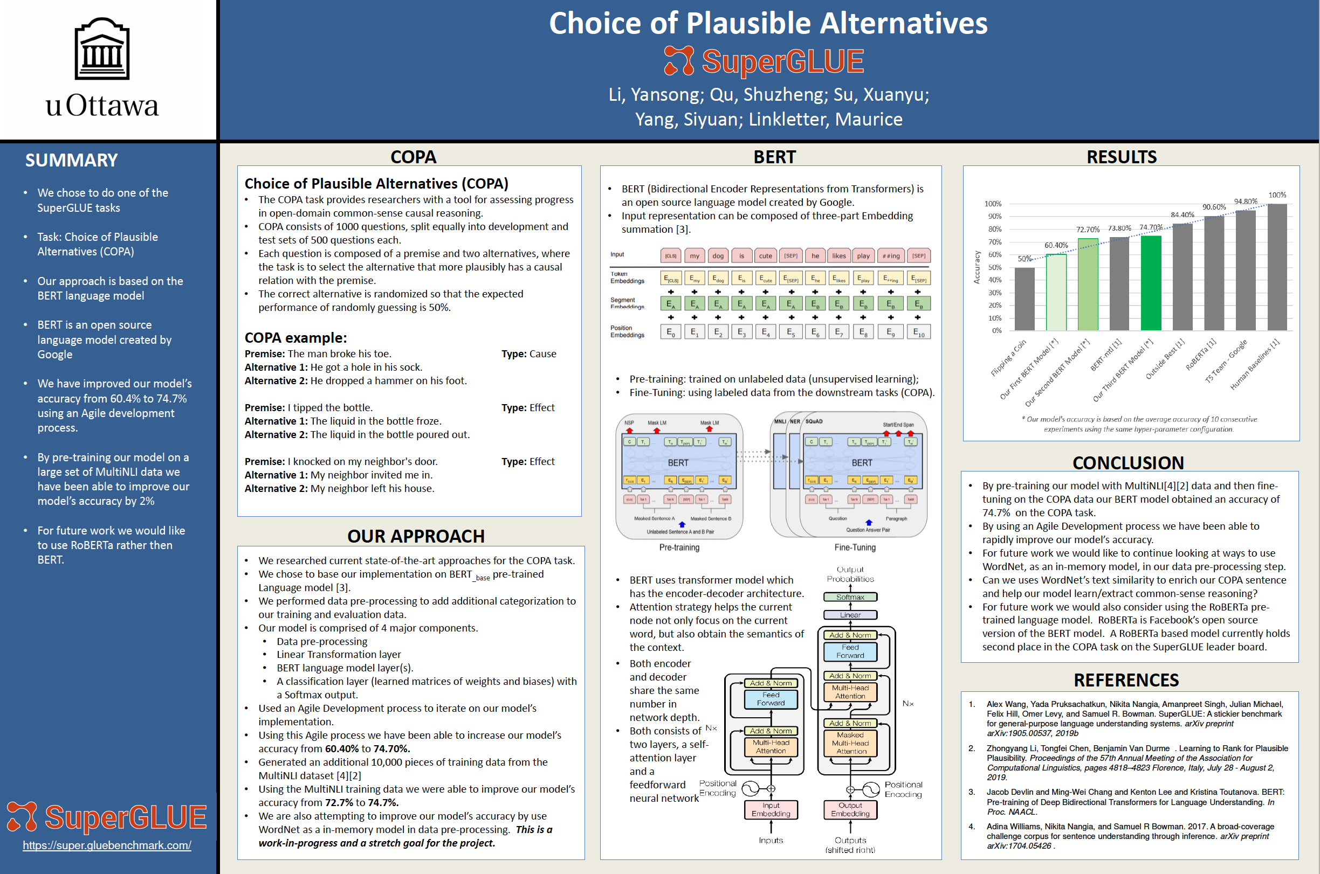
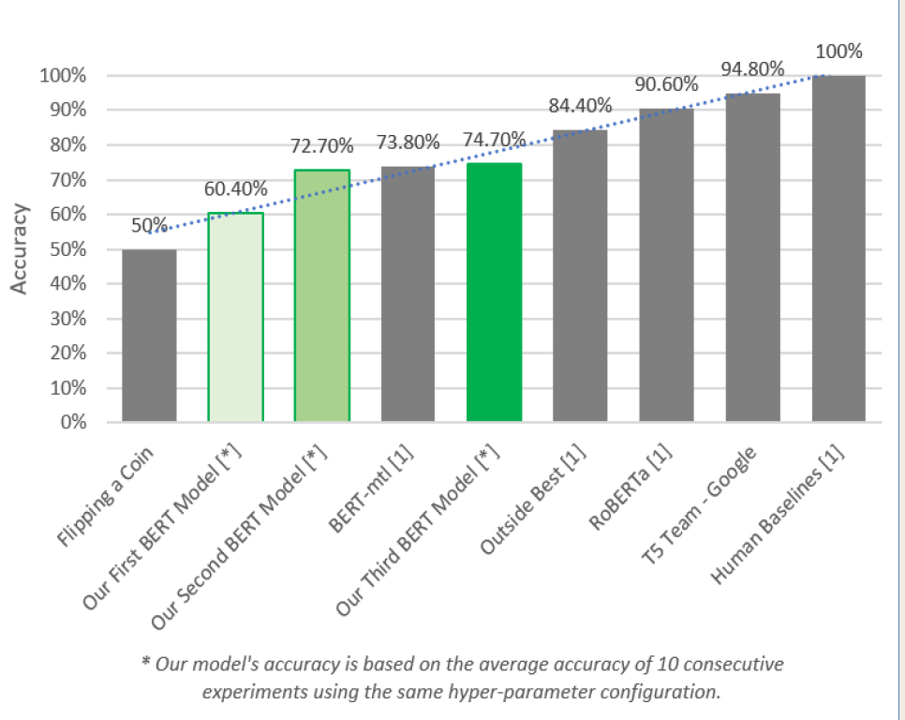
Evaluate
Take deep learning course project for an example: the COPA task ( from SuperGLUE tasks)
Github: The COPA task
cross-entropy and Kullback–Leibler divergence.

Slide 10
Good example
Fine-Tune BERT for Spam Classification: https://www.analyticsvidhya.com/blog/2020/07/transfer-learning-for-nlp-fine-tuning-bert-for-text-classification/
Github: https://github.com/prateekjoshi565/Fine-Tuning-BERT/blob/master/Fine_Tuning_BERT_for_Spam_Classification.ipynb
(Very clear structure and concise codes!)

