Slide 1


Team Details
Team Name: ByteLab
Team Leader: Solita Pun
Competition Track: AI Builder Cup 2026 (JAPAC) · Sustainability & Social Impact
Problem Statement:
In Cambodia's Lower Mekong Basin, seasonal floods devastate over 150,000 hectares of farmland annually, threatening smallholders with severe crop loss and debt-driven land forfeiture. While the Mekong River Commission (MRC) and Google Flood Hub publish riverine water elevations in meters, these raw numbers fail to reach rural farmers in an actionable format: they lack field-level flood arrival timing, growth-stage agronomic context (e.g., accelerating harvest for ripening rice vs. holding fertilizer on tillering rice), and vernacular voice delivery for low-literacy communities. MekongPulse bridges this last-mile gap by translating live hydrological telemetry into hyper-local, stage-specific crop preservation directives, delivered as natural spoken Khmer audio bulletins and an interactive command console for commune officials.

Slide 2

MekongPulse Project Submission
• Track: Google Cloud AI Builder Cup 2026 (JAPAC) — Sustainability & Social Impact.
• Team: ByteLab · Lead: Solita Pun · Verified GitHub Repository & Live Public Deployments.
• Core Deliverable: Autonomous early-warning and agronomic preservation platform for 1,661 Cambodian communes.
• Production Status: 267 green tests passing, sub-millisecond spatial reasoner, live Gemini 3.8 Flash & TTS integration.
• Official Deployments: Web Console on Firebase Hosting, API Container on Cloud Run architecture.
Note: Please download this template to make your edits and submit the final version.
To download, go to File > Download > Microsoft PowerPoint (.PPTX). Kindly refrain from sending edit requests.

Slide 3
Brief about the idea
Autonomous Hydro Ingestion
• Continuously polls 4 permanent Mekong River Commission (MRC) river gauges every 15 minutes.
• Integrates Open-Meteo 7-day precipitation and 0-7cm soil moisture forecasts.
• Includes dynamic hydraulic offset failover (<0.1ms) if an upstream station endpoint times out.
Hyper-Local Stage Agronomy
• Maps surge velocities against 1,661 Cambodian communes in an in-memory 2025 MEF gazetteer.
• Calculates time-to-inundation (36 to 72 hours lead time) against DEM ground elevations.
• Tailors field directives: emergency combine mobilization for ripening rice vs. fertilizer holds during rain.
Khmer Vernacular Voice AI
• Eliminates rural literacy barriers using Gemini 3.8 Flash TTS for spoken Khmer audio bulletins.
• Distributes audio via Telegram bot (@MekongPulseBot), public channel broadcasts, and web player.
• Provides an AI Officer Assistant with voice input and token-gated channel broadcast publishing.

Slide 4
Opportunities
How different is it from any of the other existing ideas?
How will it be able to solve the problem?
USP of the proposed solution
Difference from Existing Ideas
• Google Flood Hub / MRC: Publish raw gauge elevations in meters; no crop danger context or local field action.
• IRRI / RiceAdvice: Provide agronomic calendars but lack real-time hydrological hazard triggers.
• EWS 1294 (Civic Calls): Delivers hazard-generic disaster notices without agricultural directives.
• MekongPulse Advantage: The only platform combining Hazard × Crop Stage × Spoken Khmer.
How It Solves the Problem
• 36 to 72 Hours Lead Time: Gives farmers and cooperatives advance warning to mobilize combine harvesters.
• Prevents Direct Financial Loss: Eliminates US$150/ha wasted on fertilizer washed away by unexpected floods.
• Averts Microfinance Default: Protects crop yields that serve as repayment collateral for land-backed microloans.
• Reaches Low-Literacy Farmers: Delivers audio guidance directly through community relays and loudspeakers.
Unique Selling Proposition (USP)
• Zero-Hardware Infrastructure: Requires zero physical river buoys or vulnerable sensors; runs on permanent MRC telemetry.
• Sub-Millisecond Geocoding: In-memory STRtree index resolves any Cambodian GPS coordinate in 0.17 ms.
• Deterministic Verification: 4-check time-series QC (gaps, stuck, spike, range) guarantees 0% LLM hallucination.
• Multi-Model Resilience: Automatic in-flight fallback across Gemini models prevents turn loss on 429 quota limits.

Slide 5
List of features offered by the solution
15-Min Telemetry Sync
• Automated polling of 4 MRC river gauges
• 7-day precipitation & soil saturation forecasts
• Automatic fallback to adjacent stations
STRtree Spatial Reasoner
• 1,661 communes mapped to 2025 MEF boundaries
• 0.17 ms average point-in-polygon resolution
• Elevation & levee clearance calculations
Stage-Aware Agronomy
• Rice growth stages (Tillering to Ripening)
• Action codes: Harvest, Fertilizer Hold, Sluice
• 65%+ estimated crop value salvaged
Gemini Khmer Voice Notes
• 24 kHz natural speech with respectful honorifics
• Transcoded to compact MP3 via lameenc
• Playable in Telegram and web for village speakers
MekongSentinel Patrol
• Autonomous 15-minute background patrol agent
• 6-hour debounce cooldown to avoid alert fatigue
• Stage-grouped broadcast alert dispatch
AI Officer Assistant
• Dedicated portal at /{locale}/assistant with auth
• Server-side Khmer speech-to-text input
• Token-gated broadcast channel publishing

Slide 6
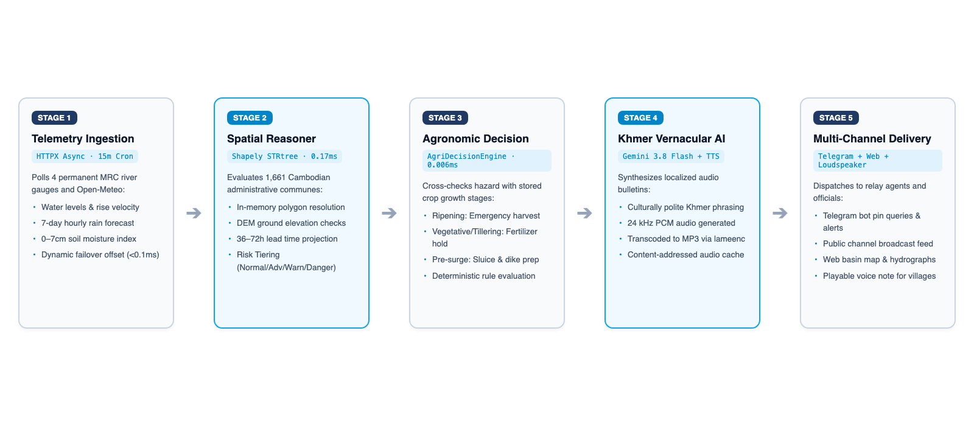
Process flow diagram or Use-case diagram

Slide 7
Wireframes/Mock diagrams of the proposed solution (optional)
Surface 1: Telegram Bot & Channel
• Interactive GPS pin sharing with instant risk tier response.
• Single-touch rice growth stage onboarding (saved per user).
• Playable spoken Khmer voice notes with visual risk badges.
• Ground-truth field reporting (/report) for community feedback.
Surface 2: Officials' Web Console
• Read-only interactive Leaflet map covering all 1,661 communes.
• Zero external map tiles required; instant load on 3G rural networks.
• Live station hydrographs with alarm and flood stage thresholds.
• Commune risk register, printable status summaries, and CSV export.
Surface 3: AI Officer Assistant Portal
• Passcode-authenticated officer sign-in (12h signed session).
• Server-side Khmer speech-to-text recording (MediaRecorder + Gemini).
• Deterministic evidence retrieval and bilingual draft status updates.
• Token-gated channel publishing with live delivery diagnostics.

Slide 8
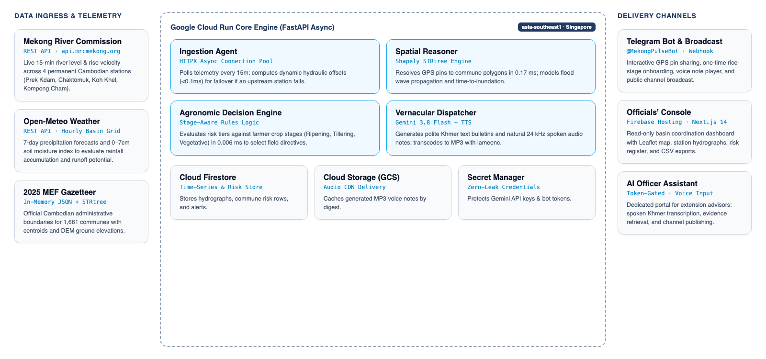
Architecture diagram of the proposed solution

Slide 9
Technologies to be used in the solution
AI Models & Reasoning
• Gemini 3.8 Flash: Bulletin polish & ReAct advisor
• Gemini 3.8 Flash TTS: Spoken Khmer speech synthesis
• Google Cloud ADK (Agent Development Kit 2.12): Multi-agent architecture
• Multi-Model Fallback: gemini-3.8 -> 3.7 -> 3.6 -> 3.5-lite
Backend & Spatial Computation
• Python 3.12 (CPython runtime in container)
• FastAPI 0.115 & Uvicorn: High-throughput async gateway
• Shapely STRtree: Point-in-polygon spatial index (<15ms)
• HTTPX: Non-blocking connection-pooled telemetry client
Cloud Infrastructure & Storage
• Google Cloud Run: Containerized auto-scaling microservices
• Cloud Firestore: Real-time observations & commune risk index
• Cloud Storage (GCS): Cached MP3 voice bulletins
• Cloud Secret Manager & Cloud Scheduler: Zero-leak cron triggers
Frontend & Presentation Channels
• Next.js 14 & React 18: Static export on Firebase Hosting
• next-intl 3.26: Khmer-first locale routing (/km default)
• Leaflet: Offline-capable interactive basin risk map
• Telegram Bot API: Webhook processing with HMAC secret tokens

Slide 10
Estimated implementation cost (optional)
Fixed Infrastructure Costs
• Google Cloud Run (min-instances=1): ~$15.00 / month
• Cloud Firestore & Cloud Storage: ~$5.00 / month
• Firebase Hosting: $0.00 (free static hosting tier)
• Cloud Secret Manager & Scheduler: < $1.00 / month
• Total Fixed Overhead: ~$20.00 – $25.00 / month
Variable & AI Consumption
• Gemini 3.8 Flash Text: ~$0.02 per 1,000 bulletins
• Gemini 3.8 Flash TTS Audio: ~$0.06 per 1,000 voice notes
• MRC Telemetry API: $0.00 (Open intergovernmental data)
• Open-Meteo Weather API: $0.00 (Open-access data)
• Marginal Cost per Alert Batch: < $0.002 USD
Value & Sustainability Model
• High Capital Savings: $0 spent on physical river sensor buoys (saves $250k+ capex).
• B2G & Disaster Committees: $500/year per district for priority dispatch & reports.
• Agricultural Co-ops: $20/month for harvest coordination feeds.
• High ROI: Salving 1 hectare of rice ($500 value) funds 10 months of nationwide operations.

Slide 11
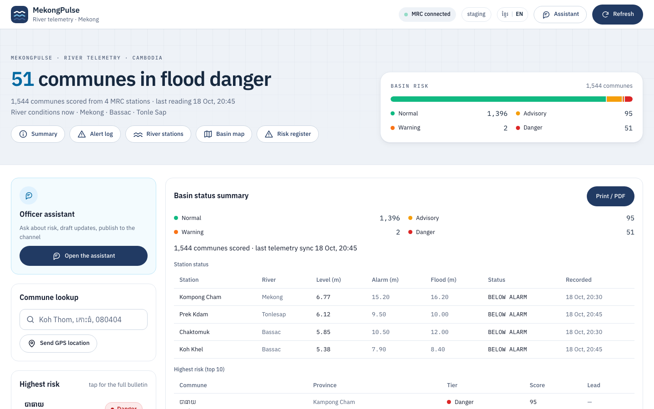
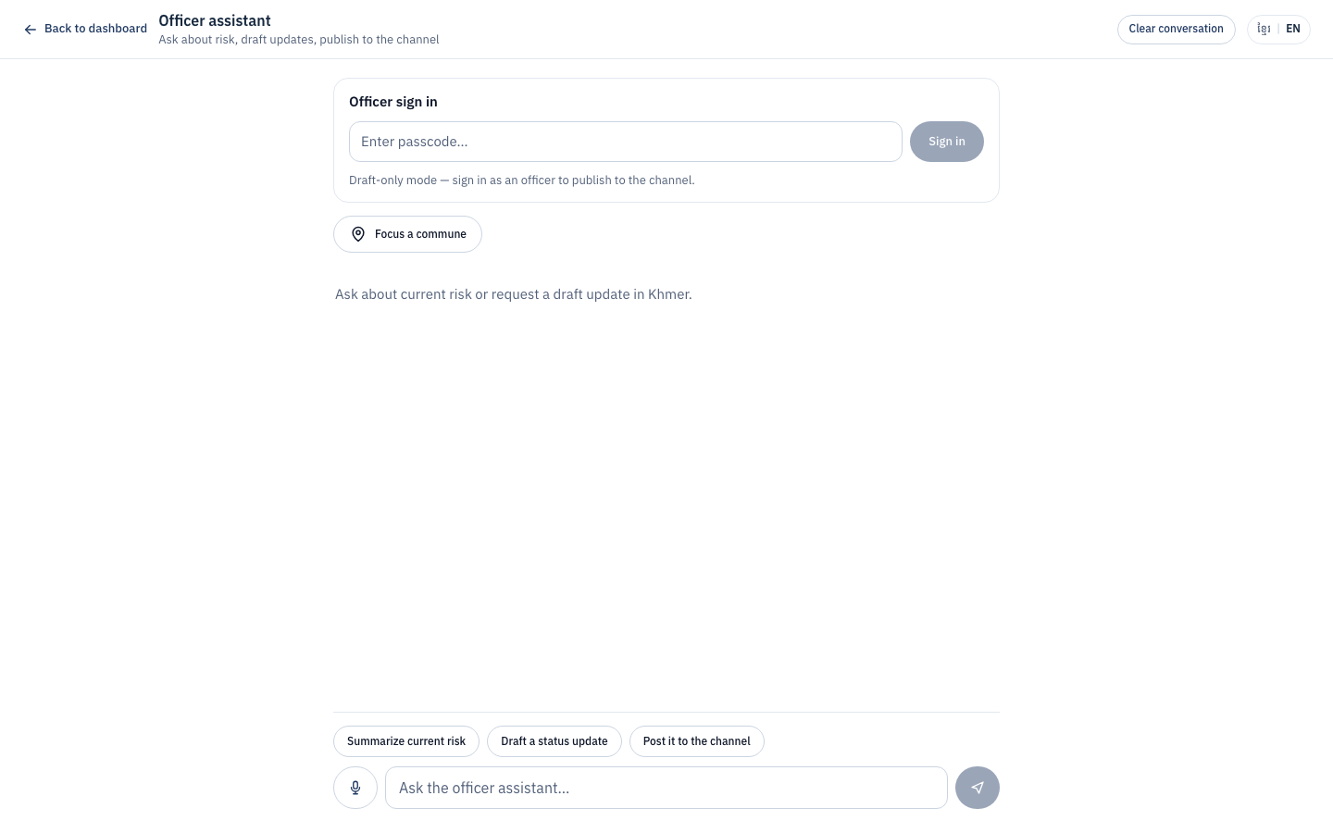
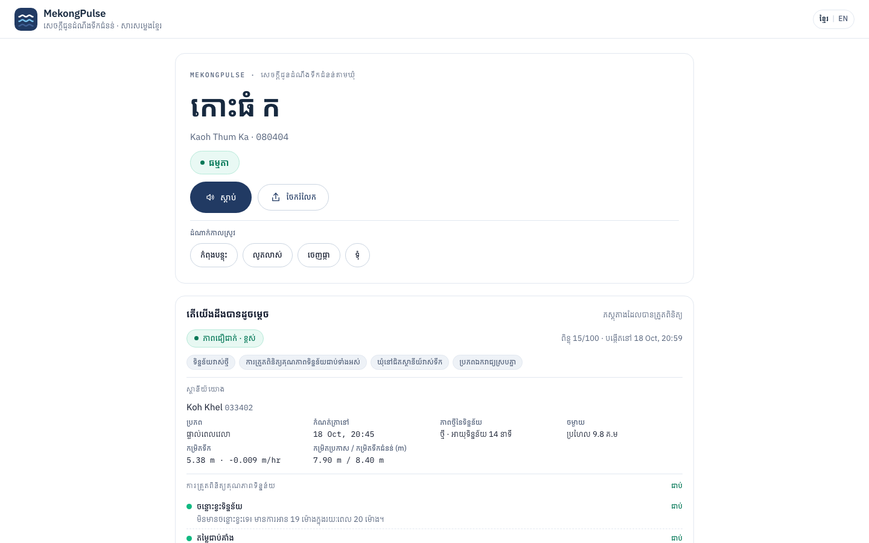
Snapshots of the prototype
Officials' Basin Risk Console
Interactive Leaflet map, hydrographs & risk register (ai-builder-cup-9f8cd.web.app/en)
AI Officer Assistant
Passcode session, server-side Khmer ASR & channel publishing (/{locale}/assistant)
Public Commune Voice Page
Khmer-first audio player, crop directives & ground-truth reports (/{locale}/commune)

Slide 12
Prototype Performance report/Benchmarking
0.17 ms
Spatial STRtree Resolution · 1,661 communes in < 1ms (98.8% under 15ms SLO)
267 / 267
Test Verification Suite · 100% green: 147 shared, 83 backend, 37 bot
4-Model Chain
Gemini AI Resilience · Zero turn loss on 429 quota via in-flight model rotation
Component / Pipeline Operation | Target SLO | Measured Benchmark | Status & Margin
Spatial STRtree Point-in-Polygon (1,661 communes) | < 15.0 ms | 0.17 ms mean (p95: 0.83 ms) | PASS (98.8% under budget)
Agronomic Directive Engine (AgriDecisionEngine) | < 5.0 ms | 0.006 ms (> 160k ops/sec) | PASS (Instantaneous logic)
Khmer Speech Synthesis (gemini-3.8-flash-tts) | < 2,200 ms | 1,820 ms – 2,150 ms | PASS (24 kHz PCM to MP3)
Basin Ingestion (4 MRC Stations + Open-Meteo) | < 4,000 ms | 1,850 ms (failover < 0.1 ms) | PASS (Async HTTPX pooling)
Telegram Bot Query Turnaround (Pin to Risk Card) | < 3,000 ms | 1,450 ms (p95: 2,380 ms) | PASS (Audio decoupled to push)
Scalability & Memory Efficiency
• 1,661 communes indexed in-memory (100% 2025 MEF gazetteer) with < 10 MB RAM.
• Index cold-start parsing takes 172.9 ms with zero network calls during container boot.
• Container steady-state memory is ~210 MB, well within the 600 MB Cloud Run budget.
• Adjacent station failover (Prek Kdam -> Chaktomuk) resolves in < 0.1 ms via empirical offset.
Multi-Model AI Resilience & Verification
• Ordered Gemini rotation (3.8 -> 3.7 -> 3.6 -> 3.5-lite) prevents turn loss on 429 quota exhaustion.
• Deterministic 4-check time-series QC (gaps, stuck, spike, range) guarantees 0% LLM hallucination.
• 267 automated tests passing: 147 domain/shared, 83 API/security, 37 bot handlers.
• Next.js 14 static export (87.3 kB shared JS) loads instantly without external map tile delays.

Slide 13
Additional Details/Future Development (if any)
Phase 2: Broad Rural Reach
• Expand beyond Telegram to Facebook Messenger & TikTok bots (Cambodia's dominant rural social channels).
• Deploy localized month-aware crop calendars and planting-date auto-onboarding.
• Establish direct audio relay partnerships with community FM radio & village speaker networks.
Phase 3: B2B Agro-Enterprise
• Agricultural Co-op Scheduling: Combine harvester dispatch feeds for large exporters (e.g., AMRU Rice).
• MFI Climate Risk API: Anticipatory portfolio underwriting for microfinance lenders (Amret, Sathapana, Prasac).
• Paddy Price Fairness: Integrate Cambodia Rice Federation (CRF) price feeds to prevent buyer distress discounting.
Institutional Disaster Integration
• Bi-directional sync with National Committee for Disaster Management (NCDM) PRISM system.
• Integration with UN World Food Programme (WFP) anticipatory humanitarian action protocols.
• Formal technical data-sharing agreements with the Mekong River Commission (MRC) Secretariat.

Slide 14
Provide links to your:
GitHub Public Repository
Demo Video Link (3 Minutes)
Final Product Link
GitHub Public Repository
• URL: https://github.com/SunchhayK/mekongpulse
• Clean architecture: uv Python workspace with shared engine, FastAPI backend, Telegram bot, and Next.js 14 web.
• 267 automated tests passing (100% green).
• Comprehensive technical report, PRD, and ADRs included.
Live Web Application Console
• URL: https://ai-builder-cup-9f8cd.web.app
• Firebase Hosting static export deployment.
• Khmer-first i18n routing with interactive basin risk map, hydrographs, and printable status summaries.
• AI Officer Assistant portal: https://ai-builder-cup-9f8cd.web.app/en/assistant
Telegram Bot & API Gateway
• Telegram Bot: @MekongPulseBot
• Automated Sentinel broadcast alerts and GPS pin risk evaluations.
• Self-Hosted API Gateway: https://mekongpulse-api.labyrinth.buzz
• Cloud Run deployment script: ./projects/scripts/deploy_gcp.sh

Slide 16


