Slide 1
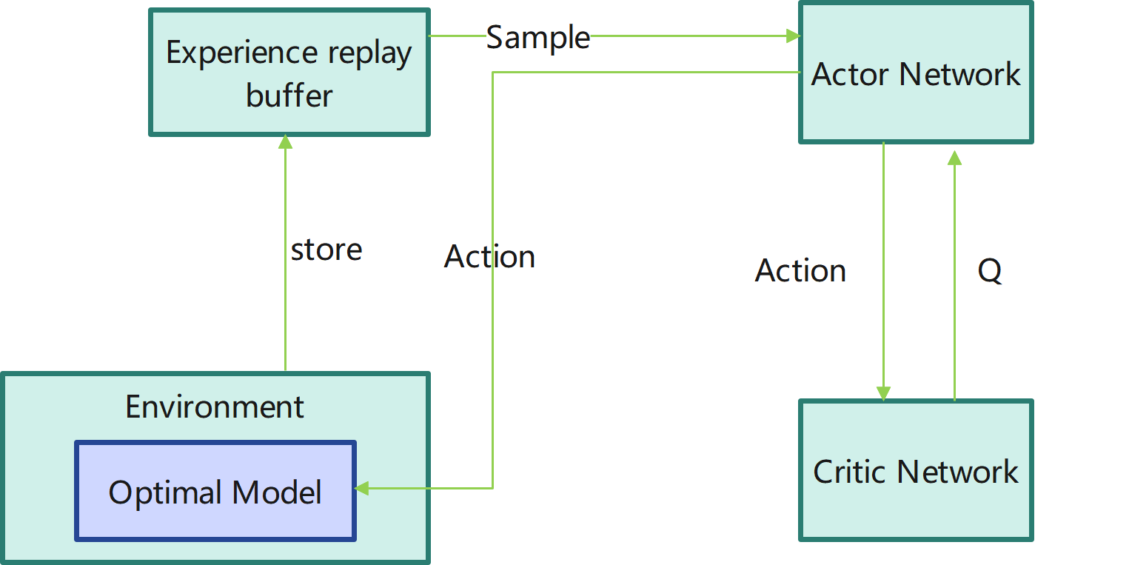

Slide 2
Hidden Layers
Input Layer
^{[1}a]₁
a^{[2]}₁
a^{[3]}₁
Output Layer
a^{[1]}₂
a^{[2]}₂
a^{[3]}₂
For Every Order
Action
a^{[1]}₃
a^{[2]}₃
a^{[3]}₃
a^{[1]}_{n}
a^{[2]}_{n}
a^{[3]}_{n}
X = global_v_vector+o_vector
32
32
16
ACTION
Notes:
Created By @srvmshr
sourav@yahoo.com

Slide 3
Hidden Layers
Input Layer
^{[1}a]₁
a^{[2]}₁
a^{[3]}₁
Output Layer
a^{[1]}₂
a^{[2]}₂
a^{[3]}₂
a^{[4]}
State Value
State
a^{[1]}₃
a^{[2]}₃
a^{[3]}₃
a^{[1]}_{n}
a^{[2]}_{n}
a^{[3]}_{n}
X = global_v_vector+global_o_vector
32
32
16
value
Notes:
Created By @srvmshr
sourav@yahoo.com

