Slide 1




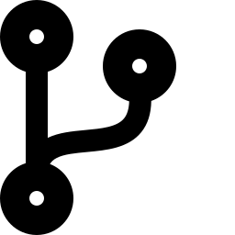







APACHE DEVLAKE — OUR CHOSEN ENGINEERING METRICS TOOL
WHAT IT FETCHES
Cycle Time
Commit-to-Merge
›
›
LOC / Story Pt
Code Review Depth
GitLab
Grafana
Dashboard
Deploy Frequency
Change Failure Rate
DevLake
Correlation Engine
Jira
Why Picked
Deployment — 2 Pilot Apps
The Outcome
Native GitLab + Jira support
Self-hosted, Docker Compose
One Grafana view, both apps
Pre-built DORA dashboards
Read-only GitLab token
Sprint-over-sprint refresh
Best story-point fit
One project per app
CIO-ready, audit-traceable
Active Apache project
6-month historical pull
Reusable for 430+ apps

