Slide 1





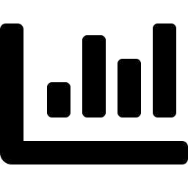




DEVLAKE DORA IMPLEMENTATION — GITLAB + JIRA
From source systems to a live DORA dashboard, in five steps
›
›
›
›
1. Connect
2. Scope Config
3. Create Project
4. Collect Data
5. Grafana Dashboard
GitLab PAT (read_api) + Jira API token
Deployment regex, story-point field, issue mapping
Link both connections to one DevLake project
6-month historical pull, then scheduled sync
DORA + Cycle Time dashboards, ready to use
Each project correlates GitLab commits/MRs with Jira issues + story points, so DORA metrics and cycle time are calculated per project — not just per repo.
GitLab role must be above Guest
Map Jira Story Points field
Deployment regex is required for DORA
Grafana access: http://localhost:3002 — pre-built DORA & Cycle Time dashboards ship out of the box

Slide 2


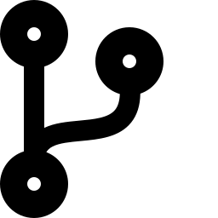




METRICS, THROUGHPUT & CYCLE TIME — THE EFFICIENCY LENS
What DevLake can calculate, and how we turn it into an efficiency signal
What We Can Measure
Throughput + Cycle Time → Efficiency
Requirements
Count, Lead Time, Delivery Rate, Granularity
Efficiency Gain % = (Baseline − AI-Period) / Baseline × 100
applied to Cycle Time (↓ better) and Throughput (↑ better)
Quality
Bug Age, Bugs/1k LOC, Incident Age
Code Activity
Commits, Authors, Lines Added/Deleted
Guardrails Before Declaring a Win
Cycle time ↓ but PR Size/Review Depth stable — not shallower reviews
PR / MR
Cycle Time, Review Time, Time to Merge, Size
Throughput ↑ but Bug Rate & Change Failure Rate stable — not traded for defects
CI/CD
Build Count, Duration, Success Rate
Gains hold in same-period AI vs. non-AI comparison, not just before/after dates
DORA Core 4
Deploy Frequency, Lead Time, MTTR, Change Failure Rate
DORA's Elite / High / Medium / Low benchmarks give an externally validated way to present these gains — not a self-defined scale.

