Slide 1
ATTENDANCE
SMART
ATTENDANCE

Slide 2
INTRODUCTION
SYSTEM REQUIREMENTS
PROJECT PROGRESS
MODULES
BLOCK DIAGRAM
TESTING & TRAINING
CONCLUSION

Slide 3
The Attendance system is developed in Python programming language with the use of Python and its Libraries such as open-cv , Numpy, face_recognition,Tkinter etc..
The Attendance system is easy and is designed with a user friendly interface.
The main purpose of this system this attendance system is to help schools and colleges in keeping track of the attendance of the students.
INTRODUCTION

Slide 4
EXISTING SYSTEM
The existing system is manual entry for the students.
Here the attendance will be carried out in the hand written registers.
It will be tedious job to maintain the record for the students.
Here the human effort is more.
The retrieval of the information is not easy as the records are
maintained in the hand written registers.
This system requires correct feed on input to the respective field.
Suppose the wrong inputs are entered the system resist to work
so the user find it is difficult to use it.

Slide 5
PROPOSED SYSTEM
To overcome the drawbacks of the existing system, the proposed system has been evolved.
Here our project aims to reduce the paper work and saving the time to generate accurate results from the student’s attendance.
The system provides with the best interface and no malpractice is entertained like proxy.
The efficient reports can be generated by using this proposed system.
We can retrieve data when ever it’s required with consuming less amount of time.

Slide 6
WHAT IS SMART ATTENDANCE?
A biometric method of identifying an individual by comparing live capture or digital image data with the stored record of students.
Most of the students are not understanding and have no awareness about the importance of the attendance.
It provides an automated attendance system that is practical, reliable and eliminate disturbance and time loss of traditional attendance systems.

Slide 7
In this project we use a camera to monitor the student who arrived the college proper time using these techniques and we store the information in the system and we can read and write the attendance .
All the information is available in real time and making easier to manage the absentees.
Example: Truein is smart attendance management system used by TATA 1mg for recording attendance of the 2000 employees.

Slide 8
SYSTEM REQUIREMENTS
Hardware requirements:-
Display:1080x920px LCD monitor
CPU: AMD PRO A4-4350B 3.5Ghz
RAM: 8gb
Memory: 500gb HDD
Camera: 720P 3mp-webcam
Software requirements:-
Windows 10
Python-Pycharm
Python libraries (opencv, face_recognition, numpy,Tkinter)
MS-Excel
Xampp server(mysql)

Slide 9
PROJECT PROGRESS
STEPS INVOLVED | JANUARY | FEBRUARY | MARCH | APRIL
Software Development
Requirement Analysis
Coding
Blackbox Testing

Slide 10
The proposed system face recognition-based attendance system can be divided into five main modules. The modules and their functions are defined as follows.
1.Image Capture:
The high-resolution camera which is used for capturing video is used to take frontal images of the students.
MODULES
WEB
CAM
FACE DETECTION &
RECOGNITION
RESULT
STUDENT DATA
DATABASE
STUDENTS

Slide 11
2.Pre-processing:
The images are converted from RGB to Grayscale and are scaled down by a factor of 1.2 and the recorded images are stored into a separate folder called “TrainingImage”.
3. Face Detection:
In this project, I implemented a system for locating faces in digital images. These are in JPEG format only. Before we continue, we must differentiate between face recognition and face detection. They are not the same, but one depends on the other. In this case face recognition needs face detection for making an identification to “recognize” a face. I will only cover face detection. Face detection uses classifiers, which are algorithms that detects what is either a face (1) or not a face (0) in an image.

Slide 12
4.Developing the Dataset:
The faces detected in images are stored in the database after pre-processing and detection. A minimum of 20 images are captured per individual student along with a unique ID. The dimensions of these stored images are 212×212 pixels. These images are later used to train the recognizer.
5.Face Recognition:
Local Binary Pattern (LBP) is a smooth & adequate operator, which operates by setting the pixels of an image by thresholding the neighborhood of each pixel and examines the outcome as a binary number. Histogram of Oriented Gradients (HOG) descriptor increases the detection performance when combined with LBP. Therefore, a combination of LBP & HOG which gives LBPH algorithm is used for face recognition.

Slide 13
TRAINING PHASE
STUDENT
LOGIN
REGISTERED STUDENTS
WEB CAMERA
TRAINING SET
DETECT FACES
CAPTURE IMAGES

Slide 14
RECOGNITION PHASE
TRAINING SET
TESTING SET
FEATURE EXTRACTION
FEATURE EXTRACTON
CLASSIFICATION
FACE RECOGNITON
CLASSIFICATION
ATTENDANCE SHEET

Slide 15
WORKING PHASE
STUDENT
LOGIN
REGISTERED STUDENTS
WEB CAMERA
TESTING SET
DETECT FACES
CAPTURE IMAGES

Slide 16
DATABASE DICTIONARY
FIELD NAME | DATA TYPE | LENGTH | DESCRIPTION
ROLL_NO | int | 10 | Student’s roll no
STUDENT NAME | varchar | 25 | Name of student
DATE&TIME | varchar | 15 | Date & Time of attendance
SUBJECT | varchar | 50 | Student’s subject

Slide 17
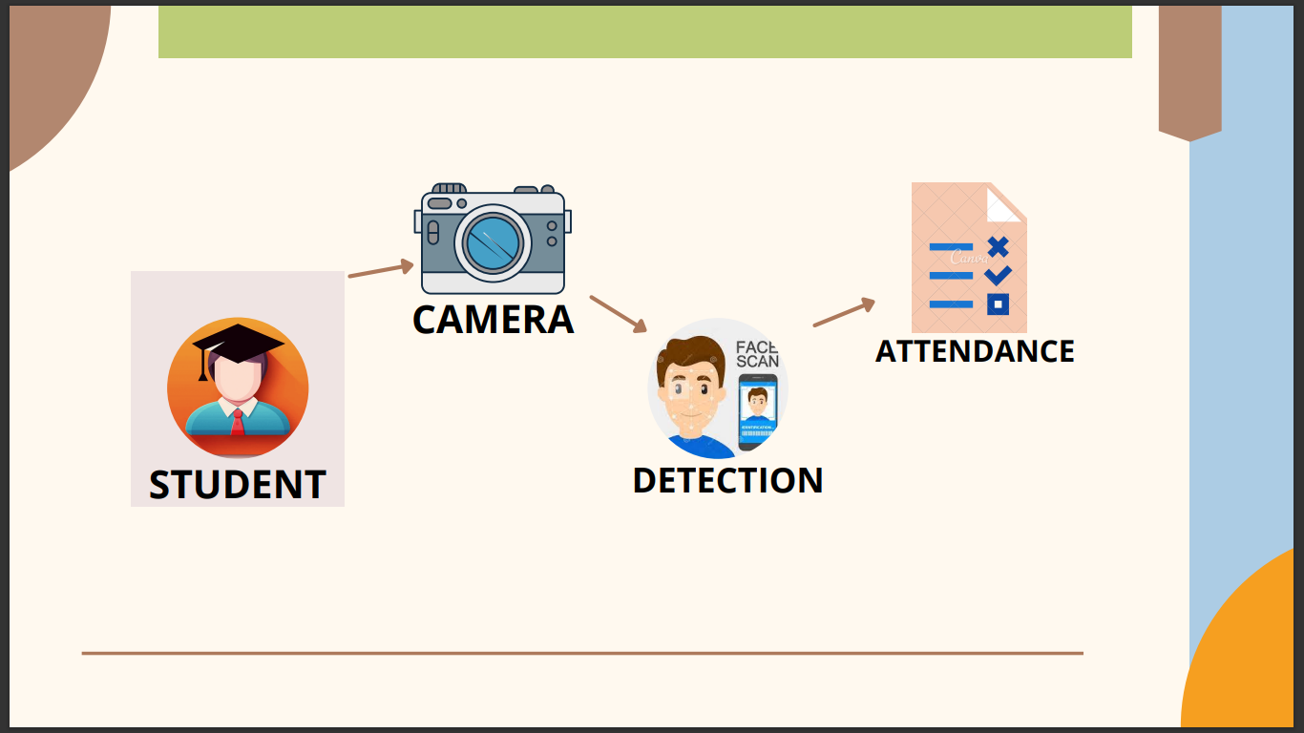

BLOCK DIAGRAM
CAMERA
ATTENDANCE
DETECTION
STUDENT

Slide 18
WORKING DEMONSTRATION OF THE PROJECT
LOGIN:
The login phase is provided for the Lecturer and student class Representative. Login name and password is given to both the lecturer and Representative. In the absence of lecturer, the representative can login into the system. After log-in the input image is captured and sent for feature extraction
STUDENT REG:
Information about staff’s such as their name, email id, mobile number, subject they are handling and their department. In student information the name of each student in the class are displayed with each student’s image. In this module, we have update and clear button. Update button is used to take the student attendance details and clear button is used to clear the previous attendance details.

Slide 19
TESTING IMAGE:
Feature Extraction is applied to both training and testing images. It is used to extract the features of image. Feature Extraction is done using PCA Algorithm. PCA is used in Face recognition for finding patterns. Eigen faces approach is a principal component analysis method which is used to describe the variation between face images. Eigen faces approach is used due to its simplicity, speed and learning capability. Using Eigen face method, the images are represented as vectors instead of using Matrix representation
TRAINING IMAGE:
The Extracted image from feature extraction is sent to the Classification Module. In feature classification the feature of both training and testing image are compared. The difference between the values of training and testing image is calculated using Euclidean distance. The value of Euclidean distance should be minimum that is between 0 to 1

Slide 20
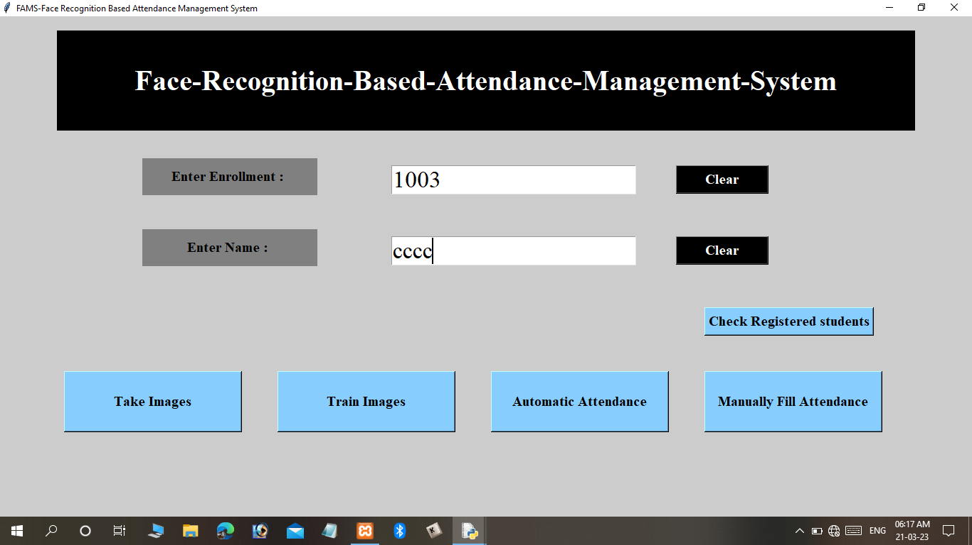
REGISTRATION OF STUDENT’S ATTENDANCE

Slide 21
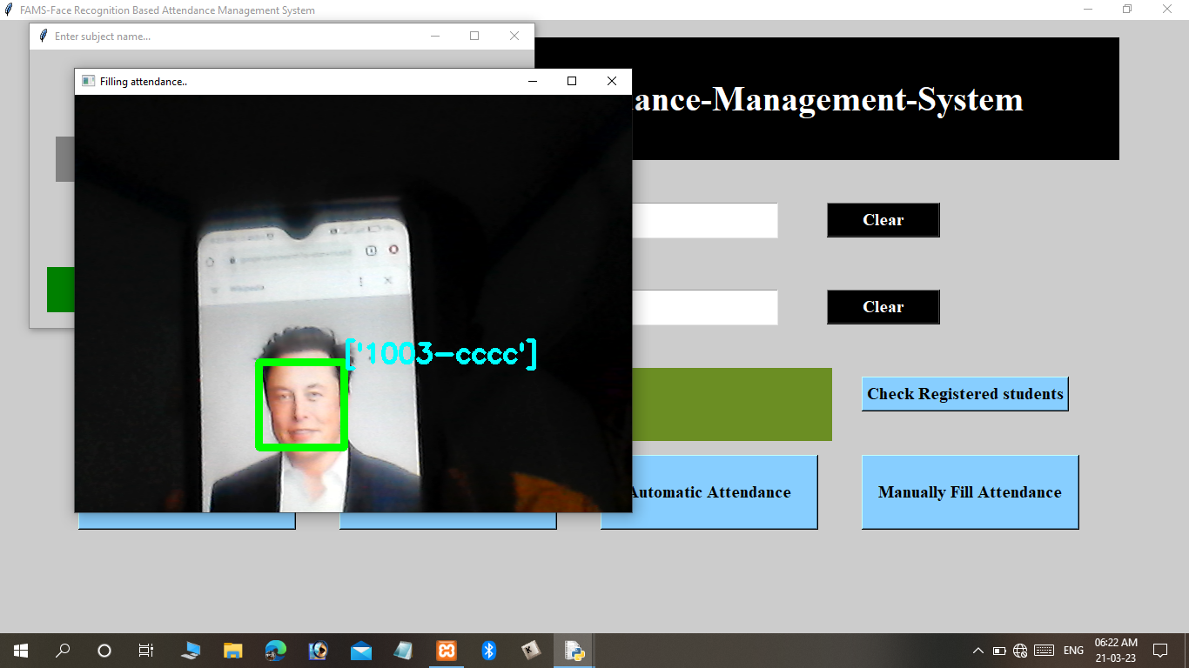
CAPTURING THE STUDENT’S IMAGE

Slide 22
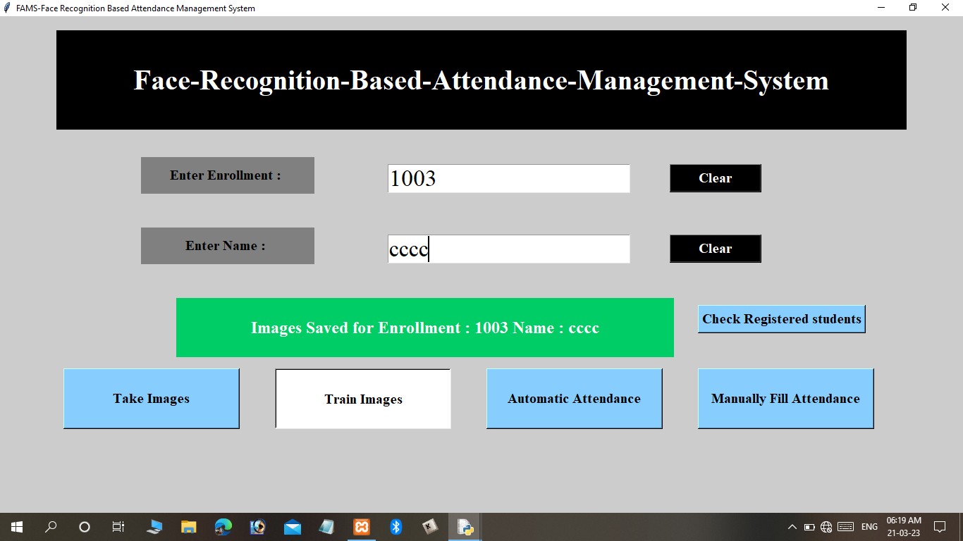
STORING STUDENT’S IMAGE

Slide 23
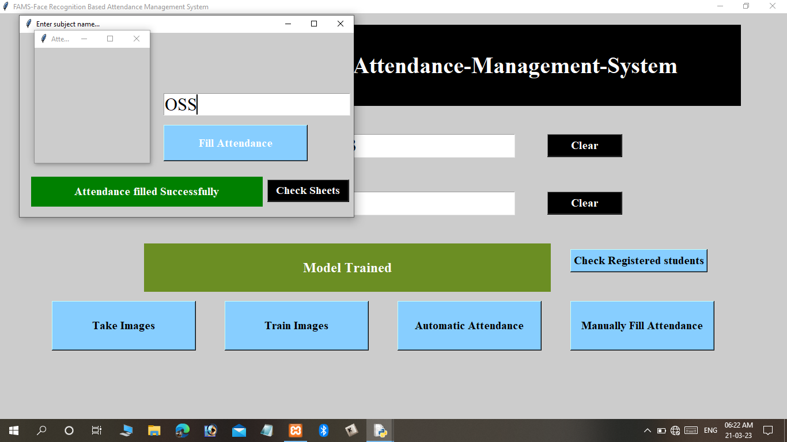
MANUAL ATTENDANCE USING STUDENT’S DATA

Slide 24
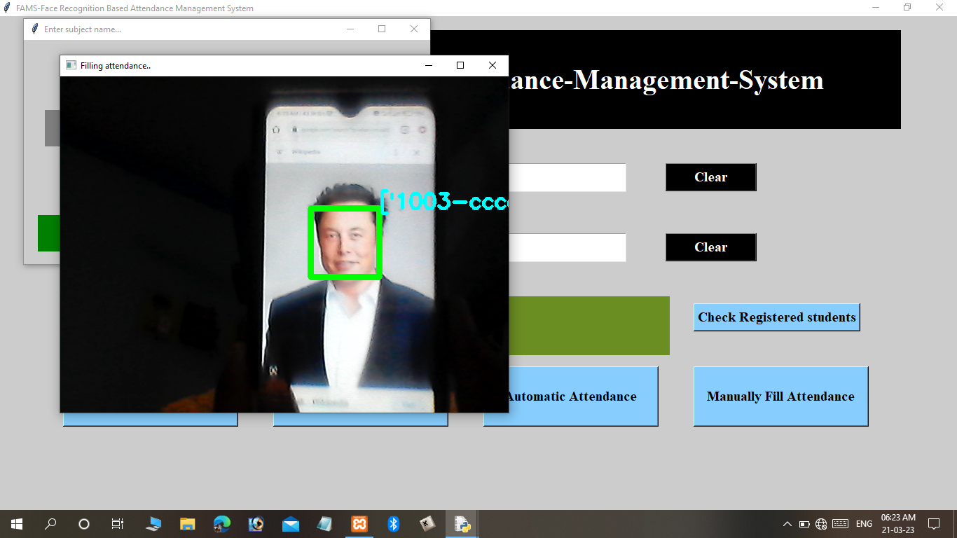
AUTOMATIC ATTENDANCE USING STUDENT’S DATA

Slide 25
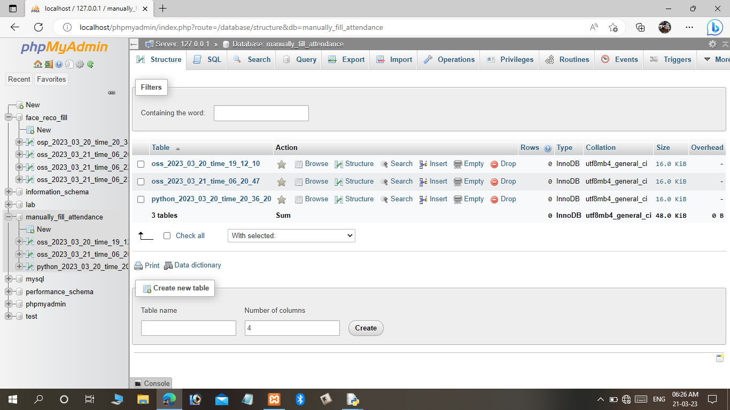
DATABASE STRUCTURE OF STUDENT’S DATA

Slide 26
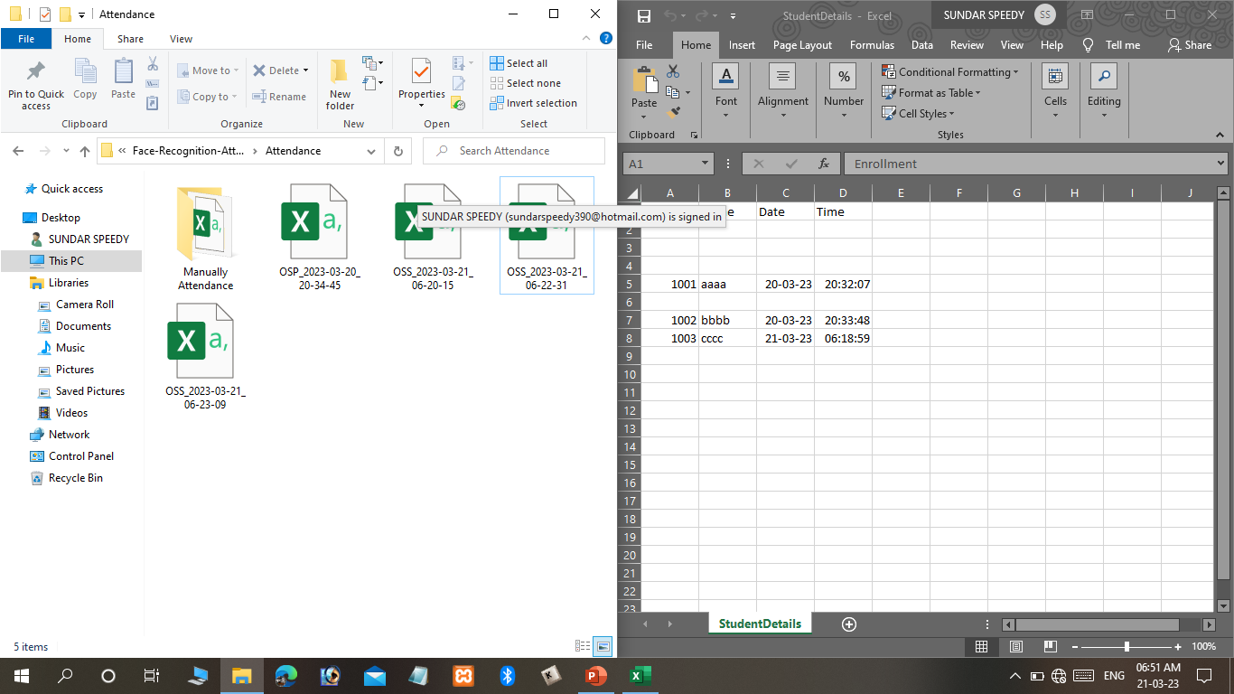
STORING ATTENDANCE IN EXCEL SHEET

Slide 27
LEARNING AND EXPERIENCE:
We could gain more experience working on smart attendance using face recognition and where we explore a part of artificial intelligence.
Image processing, which is related to our system from capturing images, detecting faces, storing them in excel, recognizing them and generating attendance through different algorithms with guidance of our “GUIDE”.
We have to learn most of the industrial strategies used for completion of project by keeping account of time, quality and budget.

Slide 28
PLEASE ACCEPT
MY DEEPEST
GRATITUDE!!

