Slide 1
AGENDA
INTRODUCTION
ABSTRACT
LITERATURE SURVEY
EXISTING SYSTEM AND ITS LIMITATION
PROPOSED SYSTEM
SYSTEM ARCHITECTURE
DATA FLOW DIAGRAM
ALGORITHM USED
CONCLUSION
REFERENCES

Slide 2
INTRODUCTION
In today's dynamic and ever-evolving financial landscape, investors and traders seek reliable methods to predict stock market trends and make informed decisions.
Traditional approaches, such as technical analysis and fundamental analysis, have their limitations when it comes to capturing complex patterns and interdependencies within financial data.
Unlike traditional statistical models, LSTM networks can capture long-term dependencies and intricate patterns in sequential data, making them well- suited for analyzing stock market trends that exhibit temporal correlations.
This introduction aims to provide an overview of how LSTM models can be leveraged to predict stock market in addition to Sentiment analysis.

Slide 3
ABSTRACT
This abstract presents a novel approach for stock market prediction using Long Short-Term Memory (LSTM) neural networks in conjunction with sentiment analysis.
Sentiment analysis involves natural language processing techniques to analyze textual data and determine the sentiment expressed within it, such as positive, negative, or neutral.
Positive or negative sentiments can affect investors' decision-making processes and subsequently influence stock market dynamics.
The integration of these techniques aims to improve the accuracy of stock market predictions by capturing both temporal dependencies in historical data and the impact of market sentiment on stock prices.

Slide 4
LITERATURE SURVEY
JOURNAL NAME | AUTHOR | YEAR | ADVANTAGES | DISADVANTAGE
Stock Market Prediction Using Deep Learning Techniques. International Conference on Communication, Control and Information Sciences | Rekha, K. S., & Sabu, M. K. | 2021 | Ability to capture complex patterns Handling large amounts of data Automatic feature extraction Generalization ability | Model complexity and interpretability Computational resource demands Risk of overfitting
Deep learning with long short-term memory networks for financial market predictions. | Fischer, T., & Krauss, C. | 2018 | Ability to capture temporal dependencies Handling of variable-length sequences Nonlinear modeling capability | Computational complexity Need for large amounts of data Interpretability
Twitter mood predicts the stock market. Journal of computational science. | .Bollen, J., Mao, H., & Zeng, X. | 2011 | Public opinion representation Timeliness Complementary information | Noise and data quality Limited generalizability Endogeneity and correlation versus causation.

Slide 5
JOURNAL NAME | AUTHOR | YEAR | ADVANTAGE | DISADVANTAGE
Predicting stock market indicators through twitter . Procedia-Social and Behavioral Sciences, | Zhang, X., Fuehres, H., & Gloor, P. A. | 2011 | Rapid dissemination of information Real-time data Complementary information | Market noise and complexity Endogeneity and correlation versus causation Limited generalizability
A Comparative Review of Sentimental Analysis Using Machine Learning and Deep Learning Approaches. | Nagelli, A., & Saleena, B. | 2023 | Capturing long-term dependencies Handling sequential data Nonlinear modeling capability: Incorporating sentiment analysis | Noisy and unreliable sentiment data Limitations in generalizability Market unpredictability
Stock price prediction using news sentiment analysis. | Mohan, S., Mullapudi, S., Sammeta, S., Vijayvergia, P., & Anastasiu, D. C | 2019 | Incorporation of news sentiment Access to relevant information Potential for interpretability | Difficulty in capturing all relevant information Market unpredictability Noise and accuracy of sentiment analysis

Slide 6
EXISTING SYSTEM AND ITS LIMITATION
A stock market prediction system using LSTM (Long Short-Term Memory) and sentiment analysis can be designed to analyze historical stock data and sentiment from news articles, social media, or other sources to make predictions about future stock prices.
Historical stock data might not fully capture all the relevant factors that influence stock prices, and sentiment analysis of news or social media can be subjective and prone to noise and bias.
LSTM models can capture some nonlinear patterns, but they may still struggle to handle sudden shifts or structural changes in the market.
Sentiment analysis, while useful, has limitations. It relies on the sentiment expressed in text and may not fully capture nuanced information or complex market dynamics.

Slide 7
PROPOSED SYSTEM
The proposed system is mainly focused on Stock market prediction using sentiment analysis involves leveraging natural language processing (NLP) techniques to analyze and quantify sentiment expressed in textual data, such as news articles, social media posts, or expert opinionsby using Machine Learning (ML) and deep learning algorithms.

Slide 8
MODULES SPLIT-UP
Module 1 ➔ Dataset Collection
Module 2 ➔ Data Preprocessing
Module 3 ➔Sentiment Analysis
Module 4 ➔ Feature engineering Feature LSTM
Module 5 ➔ model training module
Module 6 ➔ Model fusion module
Module 7 ➔Model evaluation module
Module 8 ➔ Plotting the values

Slide 9
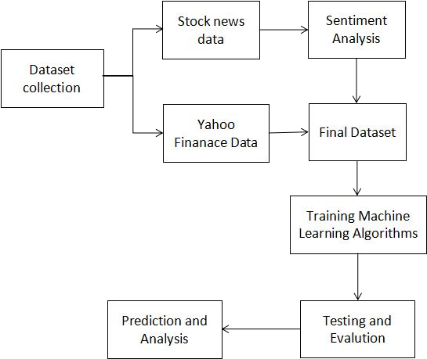
SYSTEM ARCHITECTURE

Slide 10
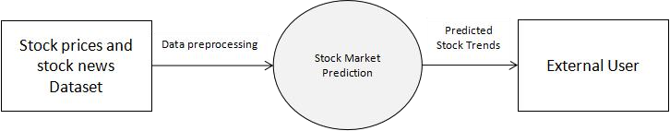
DATA FLOW DIAGRAM
Level 0

Slide 11
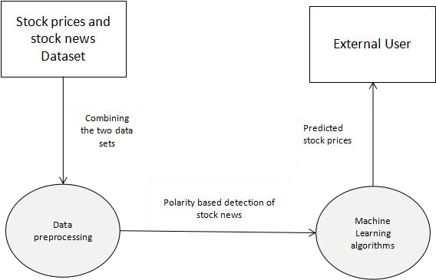
Level 1

Slide 12
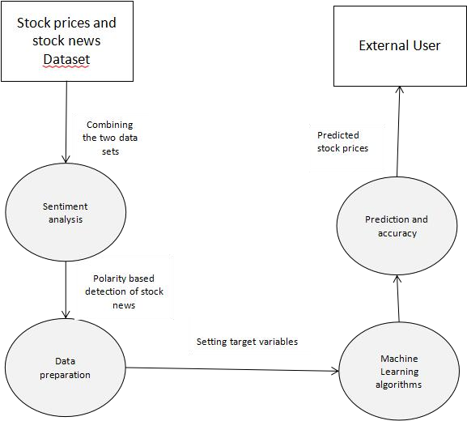
Level 2

Slide 13
ALGORITHMS USED
Long Short-Term Memory (LSTM)
Recurrent Neural Network (RNN)
Autoregressive Integrated Moving Average (ARIMA)

Slide 14
CONCLUSION
We are predicting the closing stock price of any given organization, we have developed an model for predicting close stock price using LSTM and sentiment analysis.
The utilization of LSTM neural networks allows for capturing long-term dependencies and patterns in historical stock market data. Positive or negative sentiments can influence investor decision-making and subsequently affect stock market dynamics.
The integration of sentiment analysis allows for a more holistic understanding of the market, considering both numerical data and the emotional state of investors.

Slide 15
REFERENCES
[1] Rekha, K. S., & Sabu, M. K. (2021, June). Stock Market Prediction Using Deep Learning Techniques. In 2021 International Conference on Communication, Control and Information Sciences (ICCISc) (Vol. 1, pp. 1-6). IEEE.
[2] Fischer, T., & Krauss, C. (2018). Deep learning with long short-term memory networks for financial market predictions. European journal of operational research, 270(2), 654-669
[3] Bollen, J., Mao, H., & Zeng, X. (2011). Twitter mood predicts the stock market. Journal of computational science, 2(1), 1-8.
[4] Zhang, X., Fuehres, H., & Gloor, P. A. (2011). Predicting stock market indicators through twitter “I hope it is not as bad as I fear”. Procedia-Social and Behavioral Sciences, 26, 55-62.
[5] Nagelli, A., & Saleena, B. (2023). A Comparative Review of Sentimental Analysis Using Machine Learning and Deep Learning Approaches. Journal of Information & Knowledge Management, 2350003.
[6] Urlam, S. (2021). Stock market prediction using LSTM and sentiment analysis. Turkish Journal of Computer and Mathematics Education (TURCOMAT), 12(11), 4653-4658.

Slide 16


