Slide 1
UNSUPERVISED MITOSIS DETECTION
Sundar Ram, Andrew Cohen
Drexel University, Philadelphia, PA

Slide 2
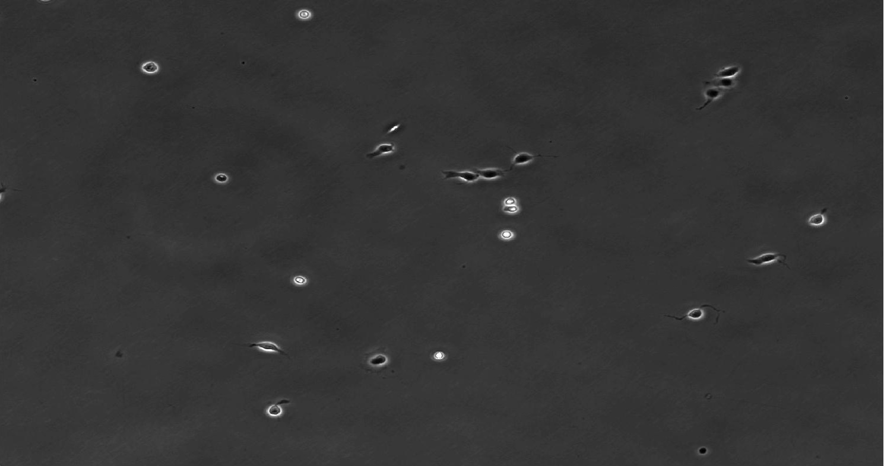
WHAT?
RAW IMAGE

Slide 3
WHY?
Analysis of cell proliferation
Neurons or glia
Lineage tree construction
Number of mitotic events
Cancer screening and assessment
Regenerative medicine
Previous methods (fluorescent, luminescent or colorimetric assays)
Destructive methods of cell manipulation : cell lysis / in vitro staining
Phase Contrast Time Lapse Microscopy
Non destructive imaging modality
Automated time lapse systems
Continuous monitoring of live cells
No expensive reagents for staining

Slide 4
PREVIOUS WORK
Tracking based or non-tracking based
Tracking based
Tracking cells using ensemble of nested kernels – based on mitotic stage morphological changes
Non-tracking based
Graphical models: Hidden conditional random fields - computationally expensive preconditioning
Disadvantage
dependent on tracking performance
more challenging than mitosis detection problem itself
supervised methods
large amounts of manually evaluated data for training
cannot be generalized to new data without retraining

Slide 5
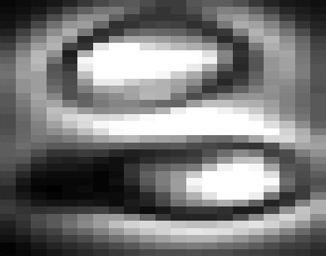
HOW?

Slide 6
MONTAGE
2D Wavelets
NON-MITOTIC
MITOTIC

Slide 7
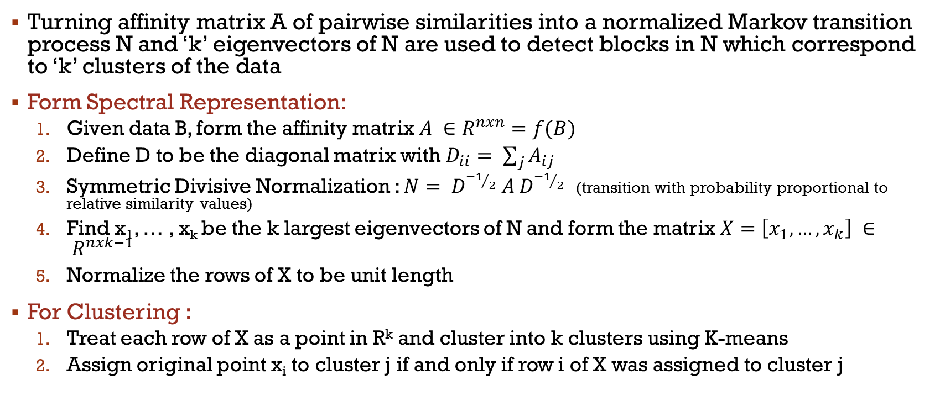
SPECTRAL CLUSTERING
Turning affinity matrix A of pairwise similarities into a normalized Markov transition process N and ‘k’ eigenvectors of N are used to detect blocks in N which correspond to ‘k’ clusters of the data
Form Spectral Representation:
Given data B, form the affinity matrix $A ∈R^{nxn}=f(B)$
Define D to be the diagonal matrix with $D_{ii}= \sum_{j}{A_{ij}}$
Symmetric Divisive Normalization : $N= D^{{−1}/2} A{ D}^{{−1}/2}$ (transition with probability proportional to relative similarity values)
Find x₁, … , x_{k} be the k largest eigenvectors of N and form the matrix $X=\left[x_{1}, …, x_{k}\right] ∈ R^{nxk−1}$
Normalize the rows of X to be unit length
For Clustering :
Treat each row of X as a point in R^{k} and cluster into k clusters using K-means
Assign original point x_{i} to cluster j if and only if row i of X was assigned to cluster j

Slide 8
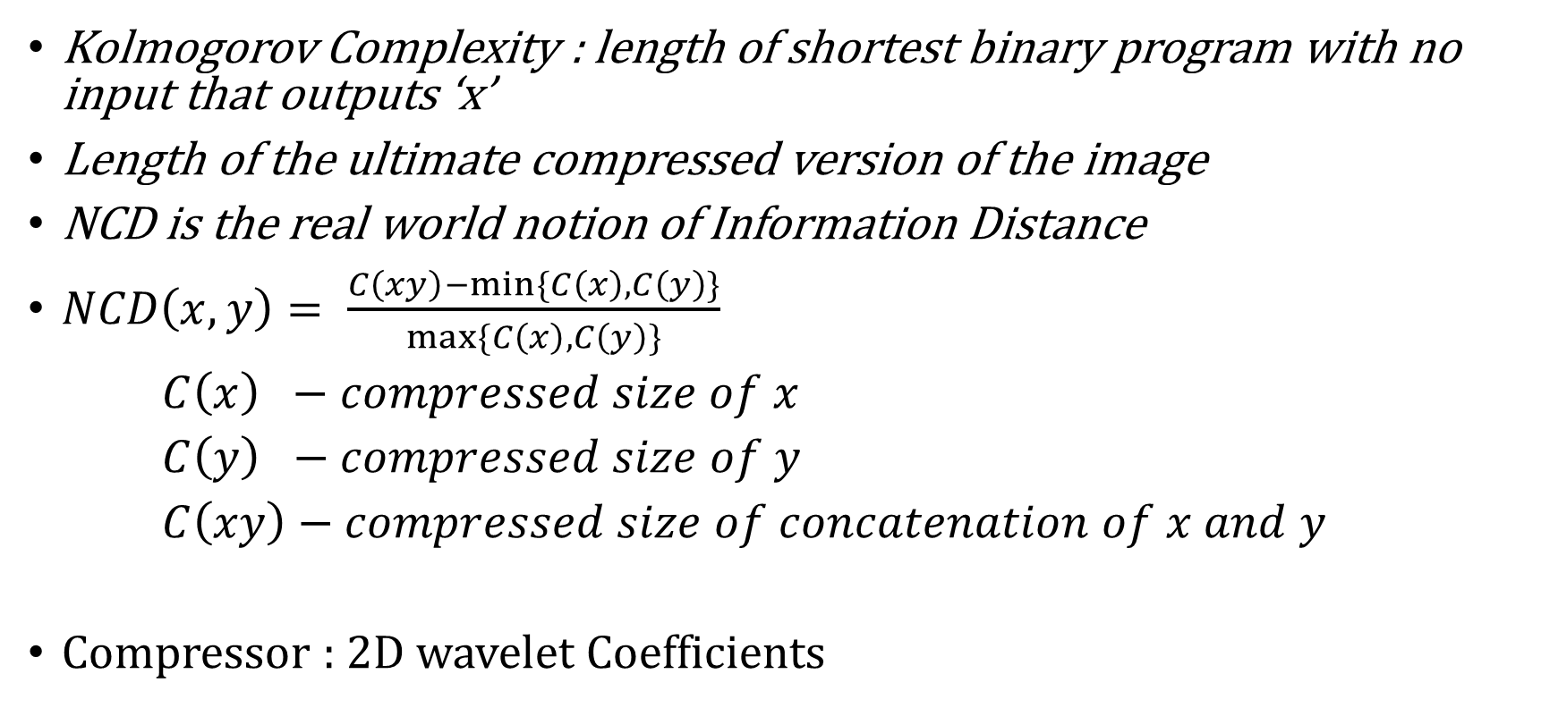
Normalized Compression Distance (NCD)
Kolmogorov Complexity : length of shortest binary program with no input that outputs ‘x’
Length of the ultimate compressed version of the image
NCD is the real world notion of Information Distance
$NCD\left(x,y\right)= \frac{C\left(xy\right)−min⁡\{C\left(x\right), C\left(y\right)\}}{max⁡\{C\left(x\right),C\left(y\right)\}}$
$C\left(x\right) −compressed size of x$
$C\left(y\right) −compressed size of y$
$C\left(xy\right)−compressed size of concatenation of x and y$
Compressor : 2D wavelet Coefficients

Slide 9
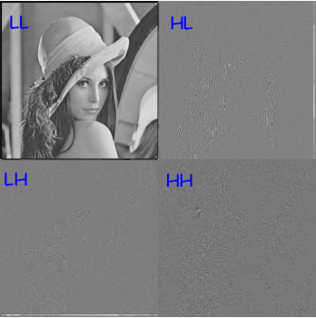
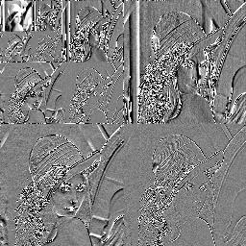

HL
Horizontal
Why approximation coefficients?
LH
Vertical
HH
Diagonal
Power is most compact in the LL band. From algorithmic information theory point of view, more bits can be spent on the low frequency band and less bits on the high frequency band or even set them to zero.
Approximation coefficients: LL band

Slide 10
Why Wavelets?
Analyzes whole image unlike JPEG
DCT based JPEG divides image into 8x8 blocks - correlation across blocks exists
Block boundaries are noticeable in some cases
Wavelet presents image as sets of real coefficients. Most of the coefficients are nearly zero and image is well approximated with small no. of large wavelet coefficients
Better compression ratio while maintaining quality

Slide 11

FLOW CHART
STANDARD DEVIATION FILTER
24 Image array
FINDING PAIRWISE SIMILARITY – NORMALIZED COMPRESSION DISTANCE (A)
24 x 24 double array
SYMMETRIC DIVISIVE NORMALIZATION
$$N= D^{{−1}/2} A{ D}^{{−1}/2}$$
$D_{ii}= \sum_{j}{A_{ij}}$
INPUT
24 Image array
K-MEANS CLUSTERING
24 x 1 labels
NORMALIZE ROWS OF EIGENVECTORS
24 x 2 double array
FINDING 2 LARGEST EIGENVECTORS OF N
24 x 2 double array

Slide 12
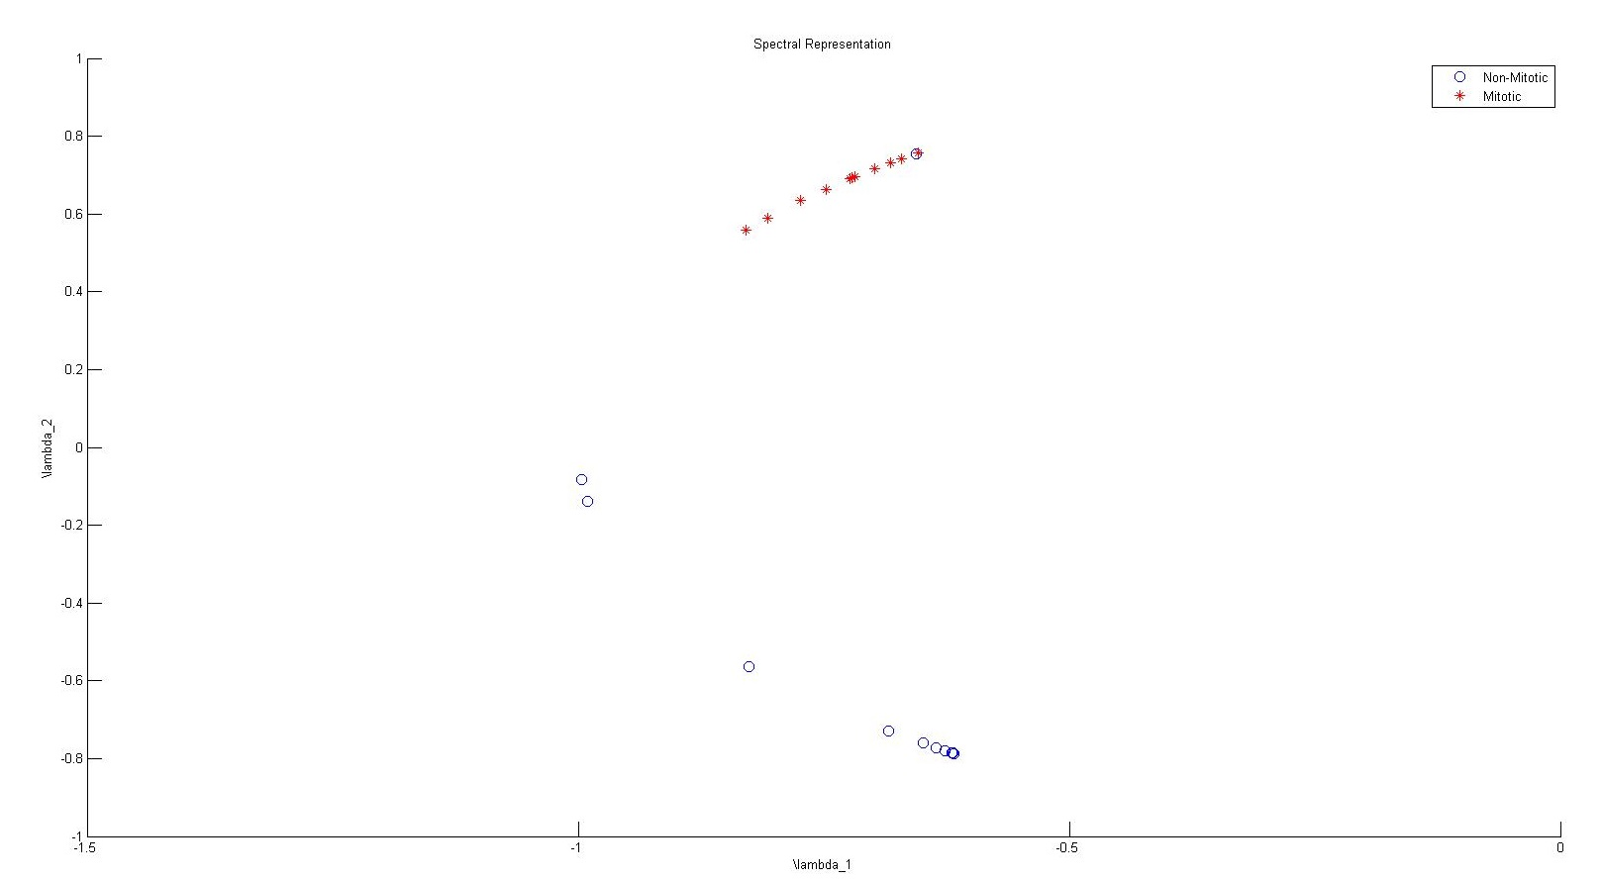
Misclassification error

Slide 13

RESULTS
-- MISCLASSIFICATION ERROR

Slide 14
Wavelets 3D
T - 1
T
MITOTIC
T - 1
T
NON-MITOTIC
Compressor : BZIP2

Slide 15
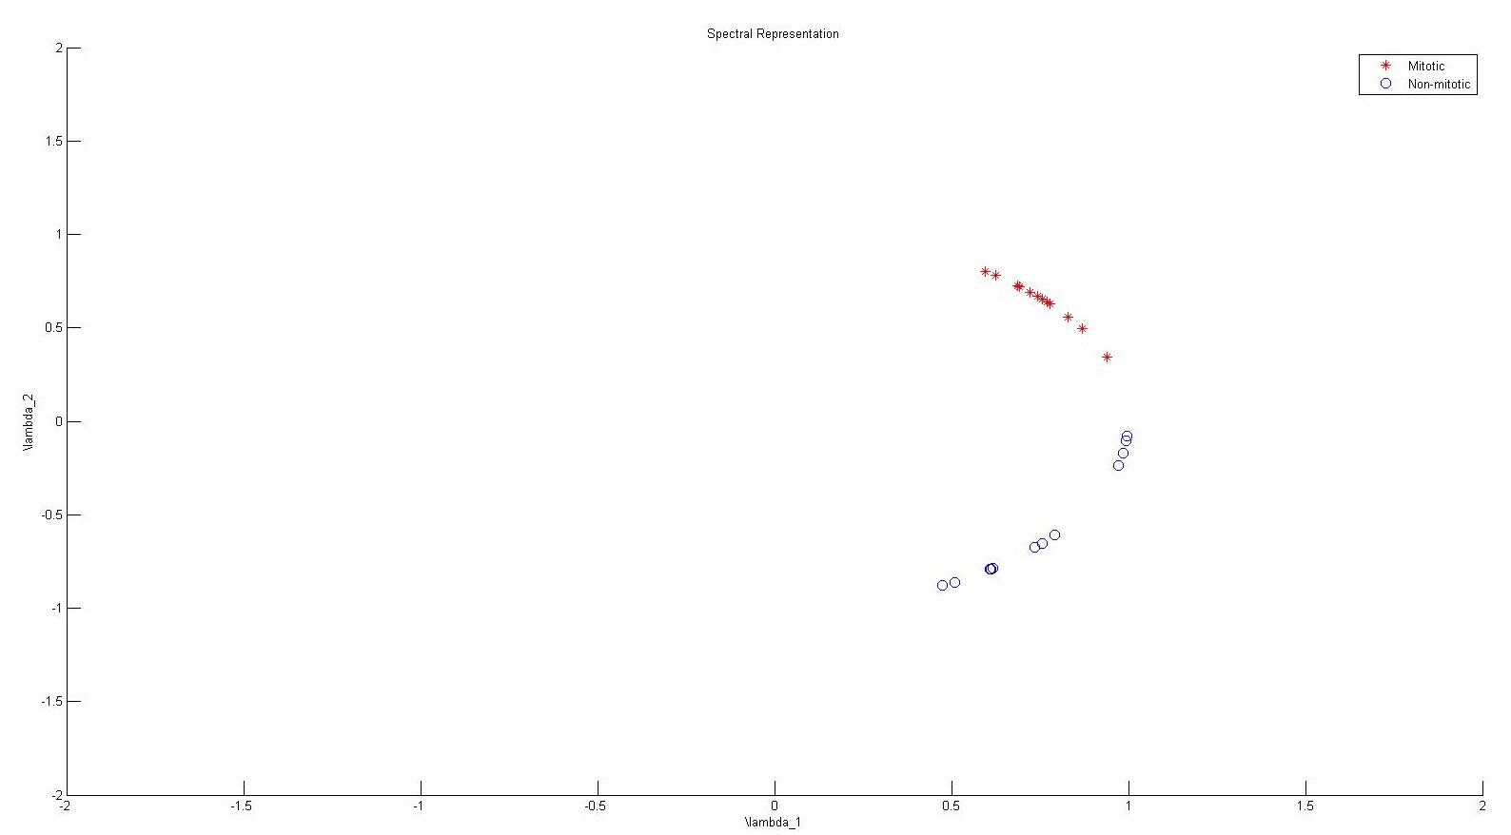

Slide 16
REFERENCES
Xianglilan Zhang, Hongnan Wang, Tony J. Collins, Zhingang Luo and Ming Li, “Classifying Stem Cell Differentiation Images by Information Distance”, ECML PKDD 2012, Part I, LNCS 7523, pp. 269–282, Springer-Verlag Berlin Heidelberg 2012.
Rudi Cilibrasi and Paul Vitanyi, “Clustering by Compression”, IEEE transactions on Information Theory, Vol. 51, No. 4, April 2005.
Sepandar Kamvar, Dan Klein and Christopher Manning, “Spectral Learning”, International Joint Conference on Artificial Intelligence, pp.561-566, 2003.
M. Li and P. M. B. Vitányi, An Introduction to Kolmogorov Complexity and Its Applications, 2nd ed. New York: Springer-Verlag, 1997

