Slide 1


Tech ABC Corp - HR Database
Sunday Okechukwu Tuesday 25th March, 2025

Slide 2
Step 1
Data Architecture Foundations

Slide 3
Business requirement
Tech ABC Corp saw explosive growth with a sudden appearance on the gaming scene with its new AI-powered video game console. As a result, they have gone from a small 10-person operation to 200 employees and 5 locations in under a year. HR is having trouble keeping up with the growth since they are still maintaining employee information in a spreadsheet. While that worked for ten employees, it has become increasingly cumbersome to manage as the company expands.
In this project, I designed a database using the foundational principles of data architecture that is best suited to the department's needs. I went through all the steps of database architecture, creating database proposals, database entity relationship diagrams (ERD), and finally creating the database itself. This project is important, as it is a scaled-down simulation of the kind of real-world assignments data architects work on every day.

Slide 4
Data Architect Business Requirement
Purpose of the new database:
The purpose is to build a secure and scalable database for the HR department to replace their current error-prone and inefficient Excel spreadsheet.
Describe the current data management solution:
Tech ABC Corp’s HR department currently relies on a shared Excel spreadsheet to manage employee data. Initially adequate for a small team, this solution has become unsustainable due to rapid growth and lacks the structure, security, and scalability required for 200+ employees.
Describe current data available:
Tech ABC Corp’s HR spreadsheet contains 206 employee records with 11 columns of human-readable data.

Slide 5
Data Architect Business Requirement
Additional data requests:
The user wants to be able to connect with payroll to share data on employee attendance and paid time off (PTO)
Who will own/manage data
The HR department (led by Sarah Collins) will own the employee data, as directly aligns with their responsibility for employee records, compliance, and policy enforcement.
Who will have access to the database
Employees should have read-only access to the database and should be restricted from viewing or accessing the salary information. HR and management-level employees should have full read-and-write access to the database and should be able to access the employees’ salary information.

Slide 6
Data Architect Business Requirement
Estimated size of database
The database has about 200 rows (1 row per employee).
Estimated annual growth
The data is estimated to grow by 20% a year for the next 5 years
Is any of the data sensitive/restricted
The salary of every employee is the sensitive data.

Slide 7
Data Architect Technical Requirement
Justification for the new database
A database is needed to restrict user access to sensitive information like salaries. Another reason is to ensure data consistency and maintain data integrity across the database.
Database objects
Salaries, Employee records, Employees, Departments, Jobs, Education Levels, Addresses, Cities, States, and Regions.
Data ingestion
Since the data provided is a flat file, ETL will be employed as it is the current best practice for working with flat files.

Slide 8
Data Architect Technical Requirement
Data governance (Ownership and User access)
The HR department (led by Sarah Collins) will own the employee data, as it directly aligns with their responsibility for employee records, compliance, and policy enforcement.
Employees should have read-only access to the database and should be restricted from viewing or accessing the salary information. HR and management-level employees should have full read-and-write access to the database and should be able to access the employees’ salary information.
Scalability
Replication is the recommended scalability strategy based on current needs and projected growth. 90% of users are read-only (employees viewing data). Replicas offload read traffic from the primary database.
Flexibility
Tables are normalized to ensure that data is split into logical, standalone tables. Relationships are enforced via foreign keys enabling easy joins with external systems.
Columns like location are split into cities, states, and regions tables for granular integration (e.g., payroll systems needing state-specific tax rules).

Slide 9
Data Architect Technical Requirement
Storage & retention
Storage (disk or in-memory):
Database will be stored on the disk, since higher level computations is not required.
Retention: how long does the data have to be kept for?
Federal regulations require that the data be retained for at least 7 years.
Backup
Since this is considered business-critical data. The backup schedule is full backup 1x per week, and incremental backup daily.

Slide 10
Step 2
Relational Database Design

Slide 11
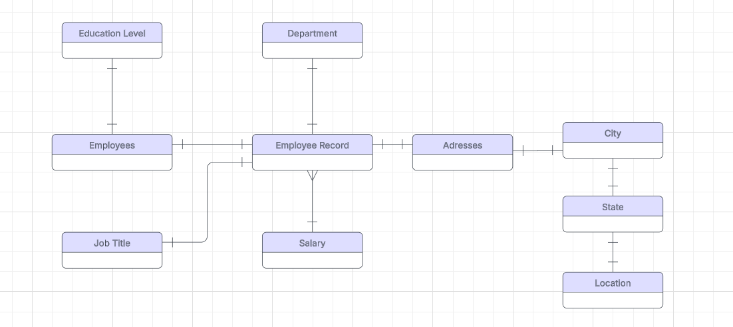
ERD
Conceptual Model

Slide 12
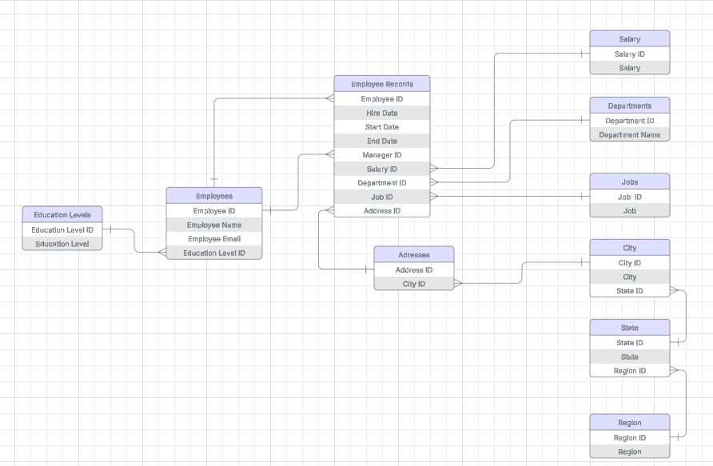
ERD
Logical Model

Slide 13
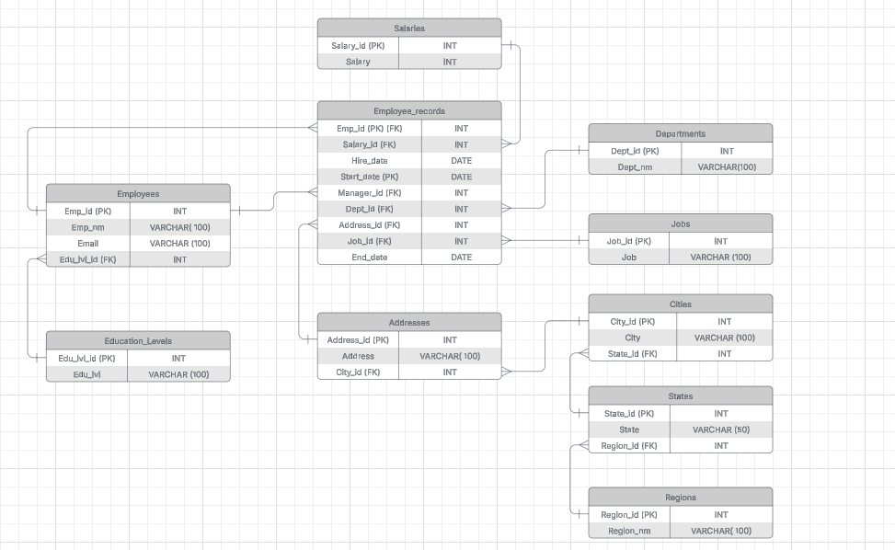
ERD
Physical Model

Slide 14
Step 3
Create A Physical Database

Slide 15
Step 3: Create A Physical Database
In this step, you will be turning your database model into a physical database.
You will:
Create the database using SQL DDL commands
Load the data into your database, utilizing flat file ETL
Answer a series of questions using CRUD SQL commands to demonstrate your database was created and populated correctly
Submission
For this step, you will need to submit SQL files containing all DDL SQL scripts used to create the database.
You will also have to submit screenshots showing CRUD commands, along with results for each of the questions found in the starter template.
Hints
Your DDL script will be graded by running the code you submit. Please ensure your SQL code runs properly!
Foreign keys cannot be created on tables that do not exist yet, so it may be easier to create all tables in the database, then to go back and run modify statements on the tables to create foreign key constraints.
After running CRUD commands like update, insert, or delete, run a SELECT* command on the affected table, so the reviewer can see the results of the command.

Slide 16
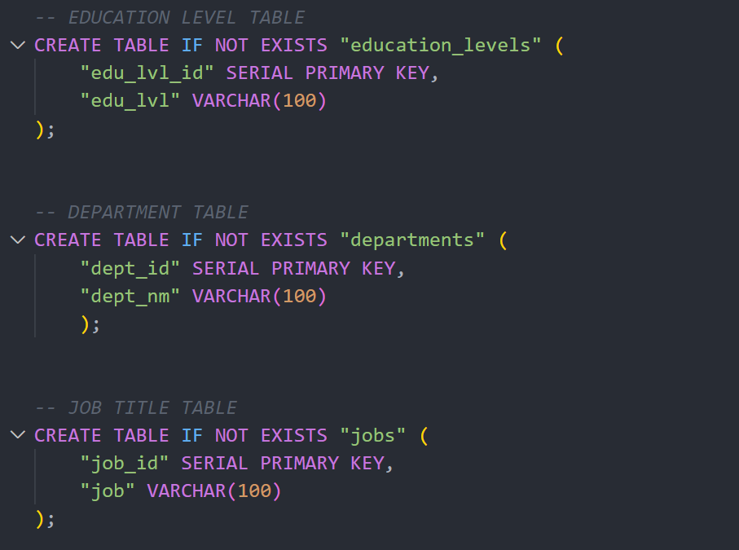
DDL
Create a DDL SQL script capable of building the database you designed in Step 2
Hints
The DDL script will be graded by running the code you submit. Please ensure your SQL code runs properly.
Foreign keys cannot be created on tables that do not exist yet, so it may be easier to create all tables in the database, then to go back and run modify statements on the tables to create foreign key constraints

Slide 17
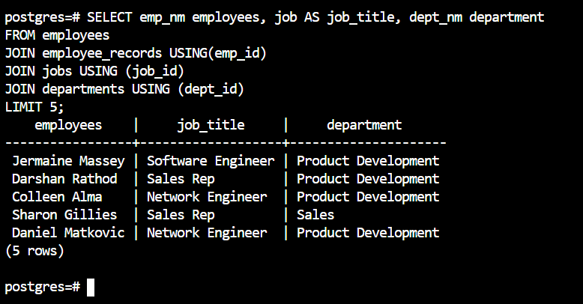
CRUD
Question 1: Return a list of employees with Job Titles and Department Names

Slide 18
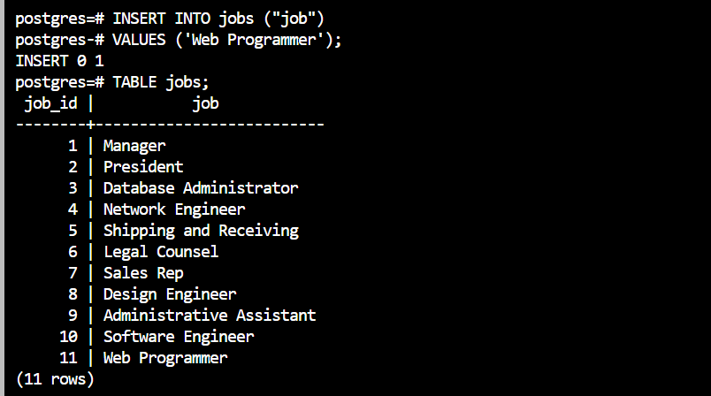
CRUD
Question 2: Insert Web Programmer as a new job title

Slide 19
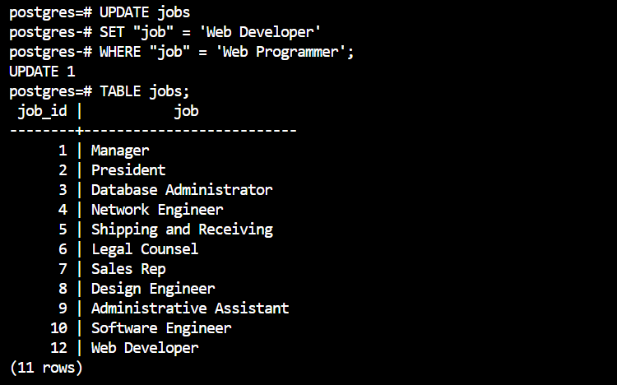
CRUD
Question 3: Correct the job title from web programmer to web developer

Slide 20
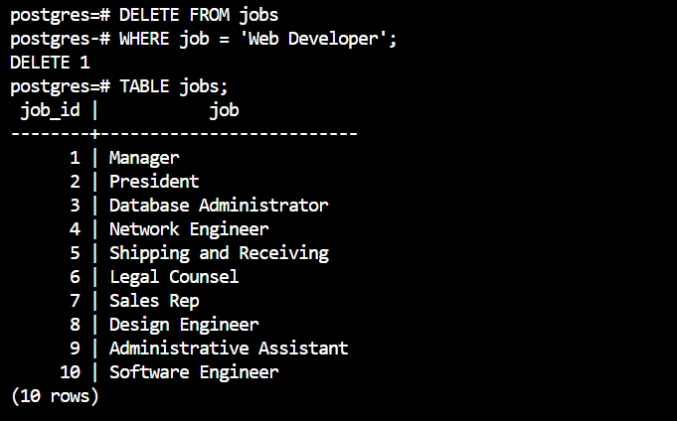
CRUD
Question 4: Delete the job title Web Developer from the database

Slide 21
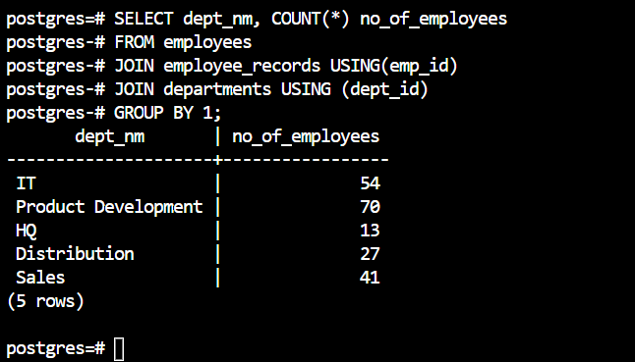
CRUD
Question 5: How many employees are in each department?

Slide 22
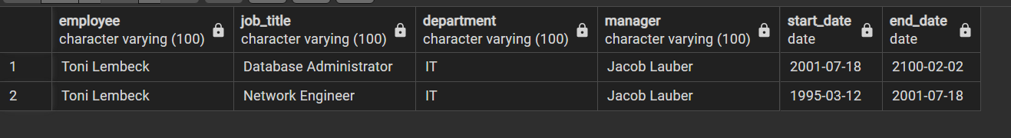
CRUD
Question 6: Write a query that returns current and past jobs (include employee name, job title, department, manager name, start and end date for position) for employee Toni Lembeck.

Slide 23
CRUD
Question 7: Describe how you would apply table security to restrict access to employee salaries using an SQL server.
In the table-level security method, sensitive data is moved to a separate table and mapped to the rest of the tables in the database. We can then limit user access to the table with sensitive data.

Slide 24
Step 4
Above and Beyond (optional)

Slide 25
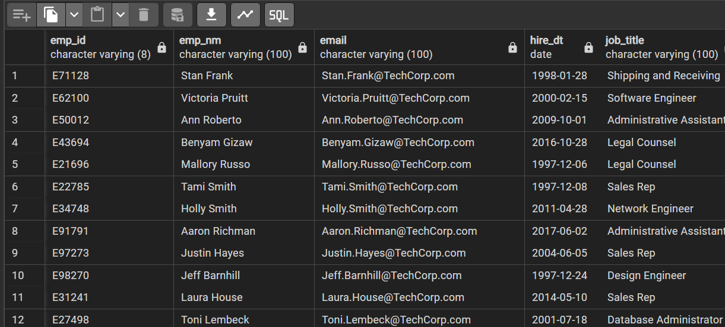
Standout Suggestion 1
Create a view that returns all employee attributes; results should resemble initial Excel file

Slide 26
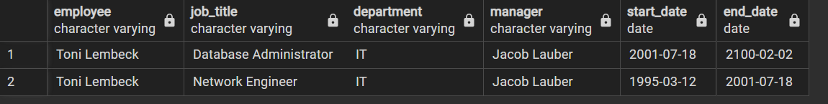
Standout Suggestion 2
Create a stored procedure with parameters that returns current and past jobs (include employee name, job title, department, manager name, start and end date for position) when given an employee name.

Slide 27
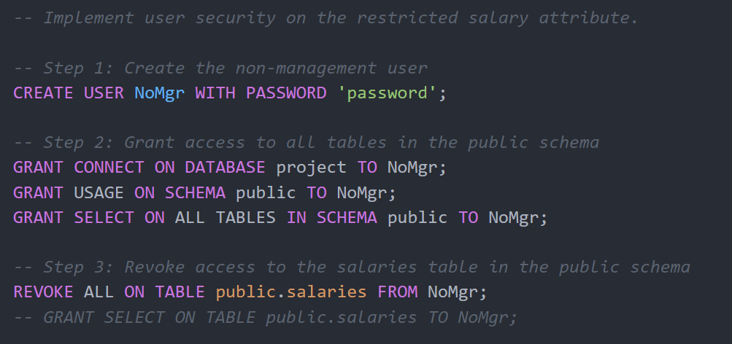
Standout Suggestion 3
Implement user security on the restricted salary attribute.

