Slide 1
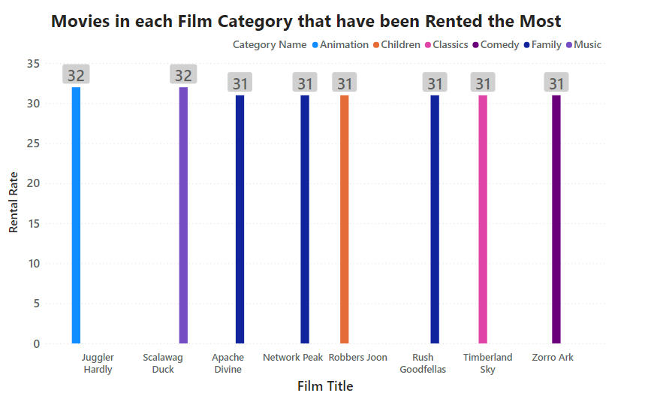
What Movies in each Family-Friendly Film category have been rented the most?
We can see that Juggler Hardly was the most rented movie - 32 in Animation category. Scalawag Duck was the most rented movie - 32 in Animation category.. etc.
Staff ID
Notes:
SELECT DATE_TRUNC('month',rental_date) AS mon, staff_id,
COUNT(rental_id)
FROM rental
GROUP BY mon, staff_id
ORDER BY mon, staff_id
/* This query isn’t as complex as yours should be, as there isn’t a join - this is just an example template of what your ending slide should like */

Slide 2
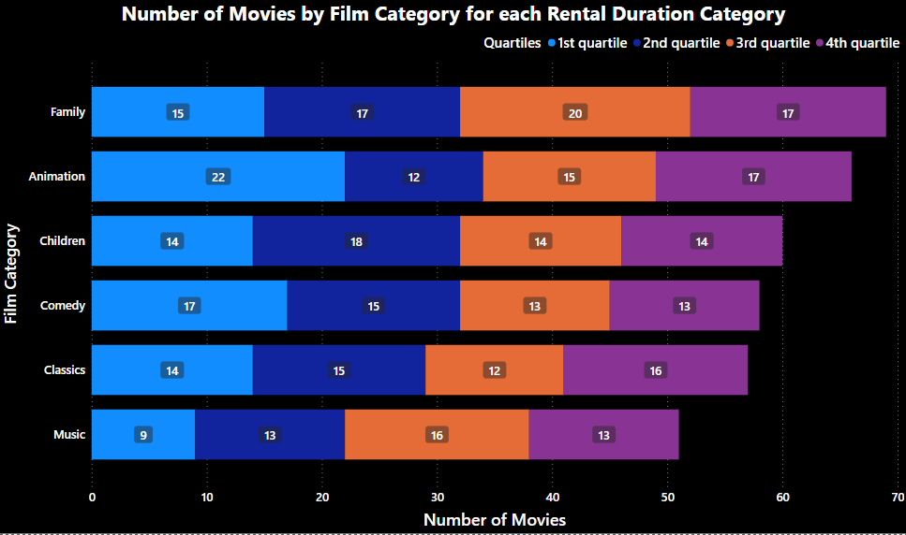
Which Family-Friendly Film category has the least number of movies in the first and third quartile of the rental duration category?
We can see that Music category has the least number of movies in the 1st quartle while Family category has the most number of movies in the third quartile
Staff ID
Notes:
SELECT DATE_TRUNC('month',rental_date) AS mon, staff_id,
COUNT(rental_id)
FROM rental
GROUP BY mon, staff_id
ORDER BY mon, staff_id
/* This query isn’t as complex as yours should be, as there isn’t a join - this is just an example template of what your ending slide should like */

Slide 3
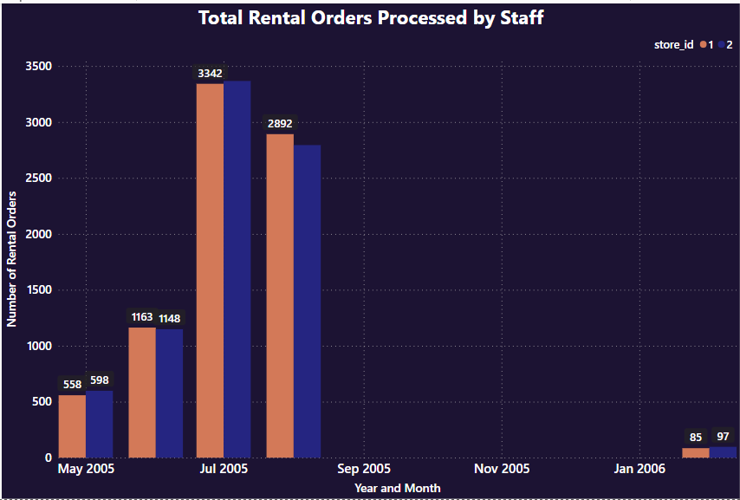
What were the total Rental Orders Per Staff?
We can see both store staff members filled in almost the same number of rental orders during each time unit.
Staff ID
Notes:
SELECT DATE_TRUNC('month',rental_date) AS mon, staff_id,
COUNT(rental_id)
FROM rental
GROUP BY mon, staff_id
ORDER BY mon, staff_id
/* This query isn’t as complex as yours should be, as there isn’t a join - this is just an example template of what your ending slide should like */

Slide 4
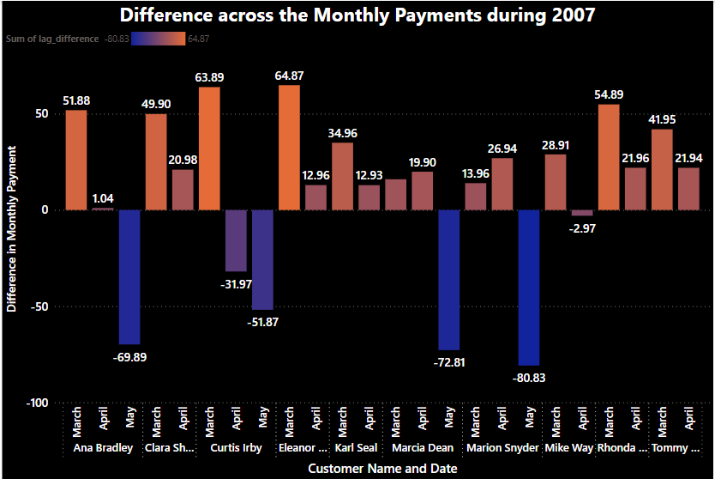
For each of the top 10 paying customers, which customer paid the maximum difference and least difference and which month and year?
We can see that the customer Eleanor Hunt paid the maximum difference of $64.87 during March 2007 while Marion Snyder pay the least difference of $-80.83 during May 2007
Staff ID
Notes:
SELECT DATE_TRUNC('month',rental_date) AS mon, staff_id,
COUNT(rental_id)
FROM rental
GROUP BY mon, staff_id
ORDER BY mon, staff_id
/* This query isn’t as complex as yours should be, as there isn’t a join - this is just an example template of what your ending slide should like */

