Slide 1

FoodWheel Strategic Insights: Driving Growth Through Data
Comprehensive Analysis of Restaurant Partnerships, Order Trends, and Customer Behaviour
Oladamola Sunday, Data Scientist

Slide 2
Key Findings and Strategic Opportunities
Key Findings:
- 7 cuisines offered; Queens, Uptown, UWS underserved.
- Order growth +207%, August dip noted.
- 69.64% repeat customers; retention opportunity.
- Peak orders on weekends.
Opportunities:
- Expand partnerships.
- Boost weekday orders.

Slide 3
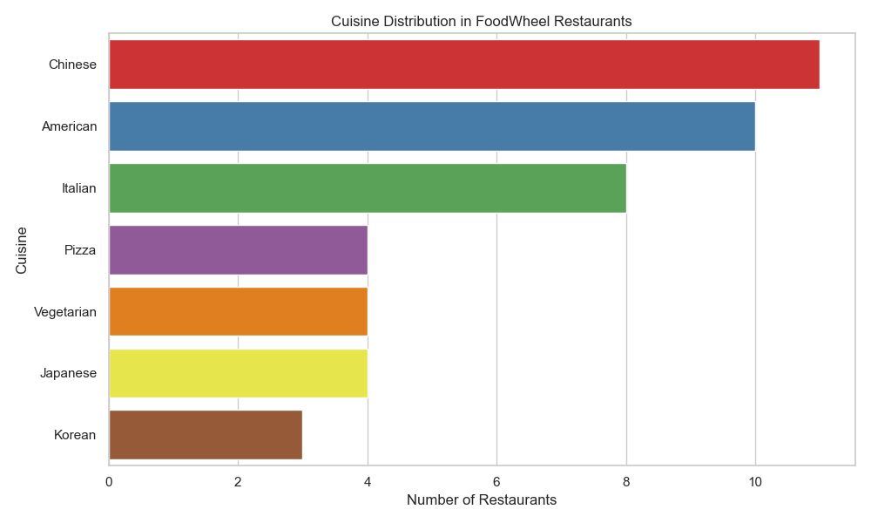
What Cuisines Does FoodWheel Offer?
7 cuisines: Chinese: 11 restaurants (25.0%), American: 10 restaurants (22.7%), Italian: 8 restaurants (18.2%), Pizza: 4 restaurants (9.1%), Vegetarian: 4 restaurants (9.1%), Japanese: 4 restaurants (9.1%), Korean: 3 restaurants (6.8%)

Slide 4
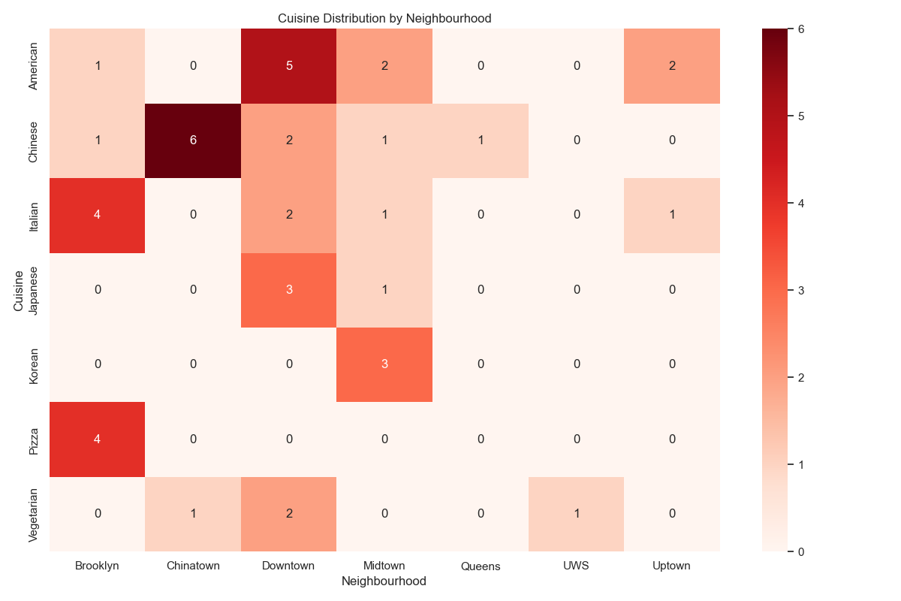
Cuisines distribution across neighbourhoods
Downtown: 14 restaurants (31.8%), Brooklyn: 10 restaurants (22.7%), Midtown: 8 restaurants (18.2%), Chinatown: 7 restaurants (15.9%), Uptown: 3 restaurants (6.8%), Queens: 1 restaurant (2.3%), UWS: 1 restaurant (2.3%)
Coverage strong in Downtown/Brooklyn; weak in Queens/UWS/Uptown.

Slide 5
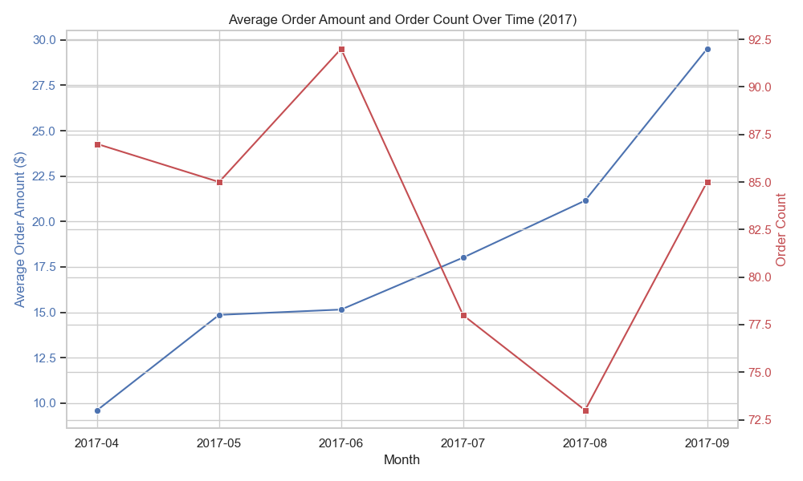
How Has the Average Order Amount and Numbers of Order Changed Over Time?
April: $9.61 (87 orders), Sept: $29.51 (85 orders), +207.06%.
August dip to 73 orders.
T-test for prices: p<0.0000 significant growth.

Slide 6
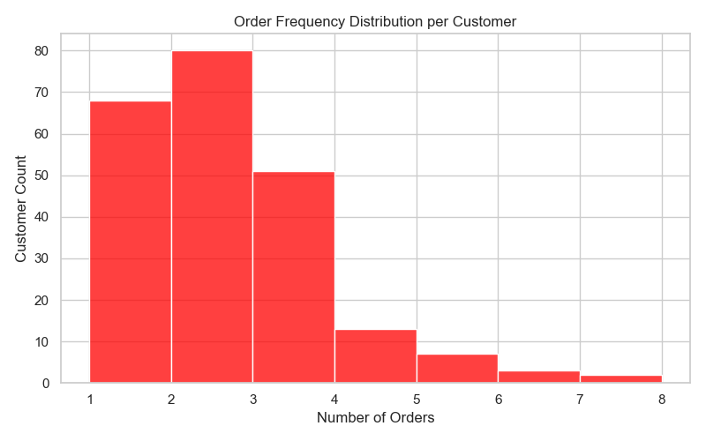
Customers and their orders
Avg. 2.23 orders per customer; ~70% with 2+ orders
Least order per customer 1; Highest 7

Slide 7
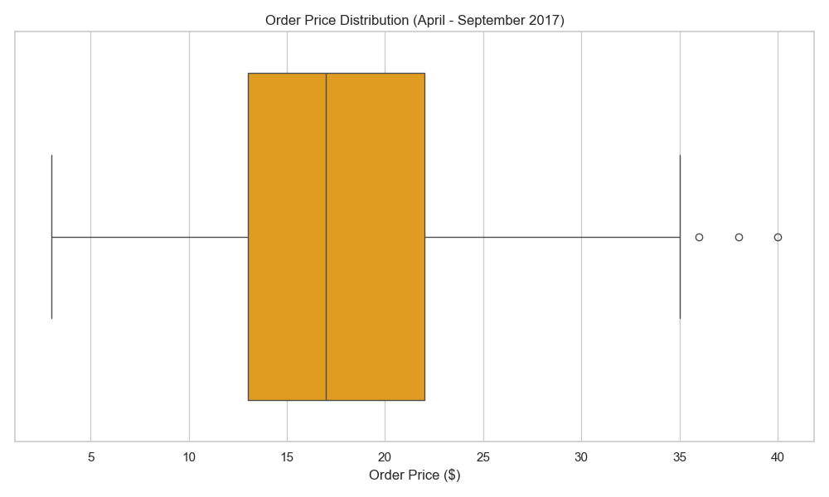
Optimizing Pricing and Operations
Min $3, Median $17, IQR $13–$22, Max $40
Outliers: $36-$40
500 orders; Average Order Value (AOV): $17.90

Slide 8
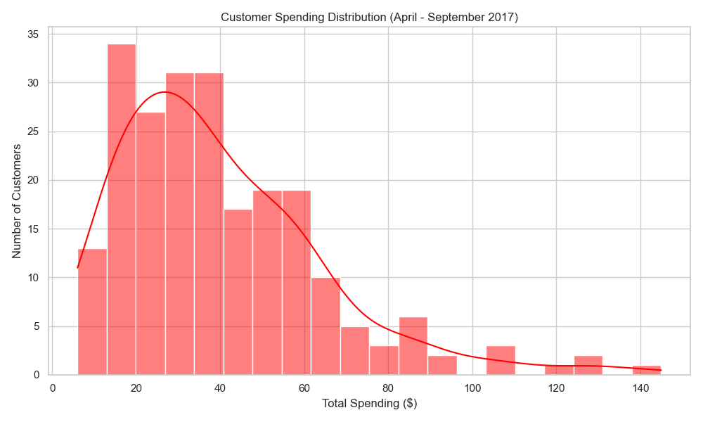
How Much Are Customers Spending?
224 customers, total revenue $8,950 ($39.96 avg., median ~$35)
Highest $145, Lowest $6

Slide 9
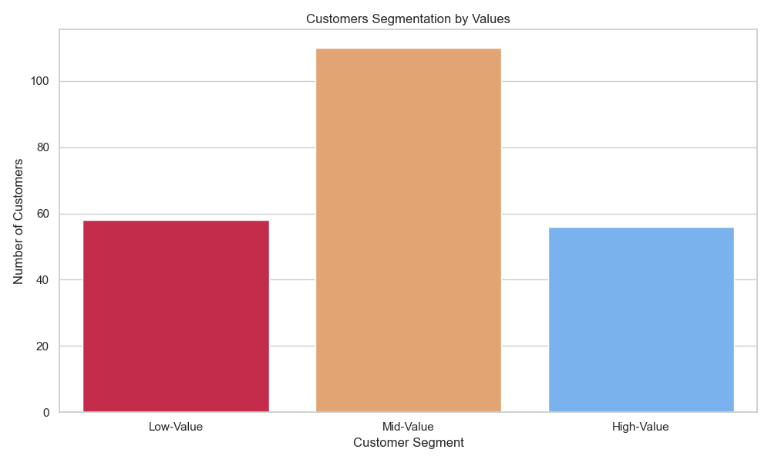
How are customers segmented by their total spending?
Segments: Low (< $22), Mid ($22–52), and High (> $52)
Mid-Value: 49.11% (110); Low-Value: 25.89% (58); High-Value: 25.00% (56)

Slide 10
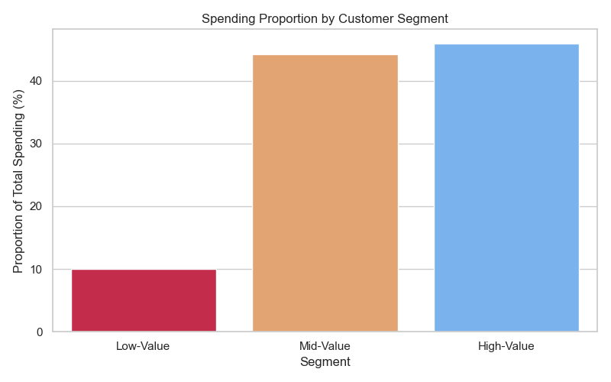
Customers Spending Proportion based on Segment
Segment | Total Spending | Spending Proportion (%)
Low-Value | 892.0 | 9.97
Mid-Value | 3952.0 | 44.16
High-Value | 4106.0 | 45.88

Slide 11
Are Customers Returning to FoodWheel?

Slide 12
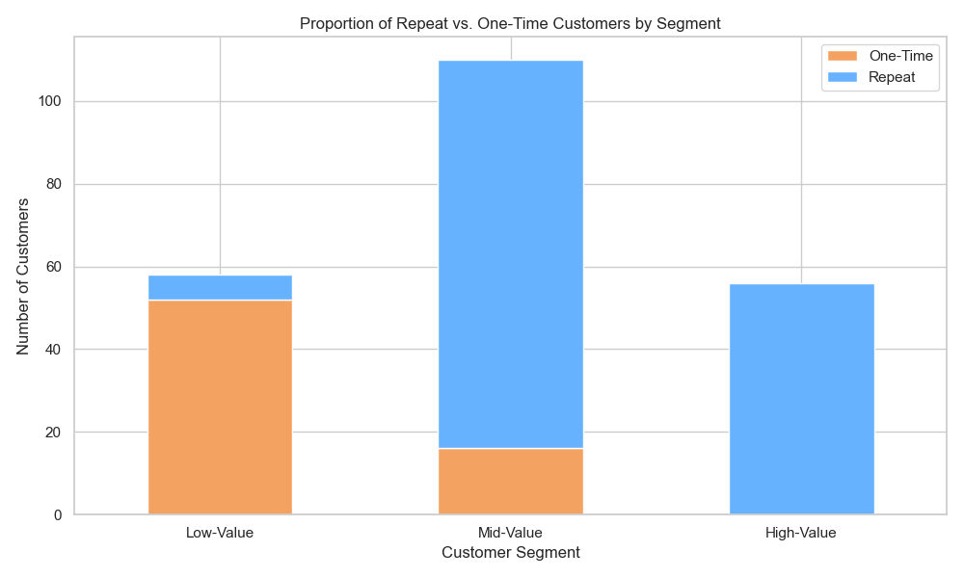
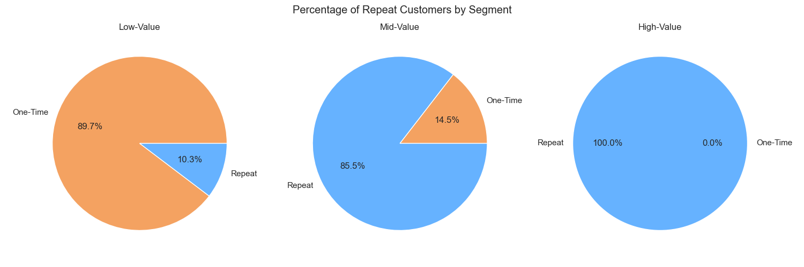

Slide 13
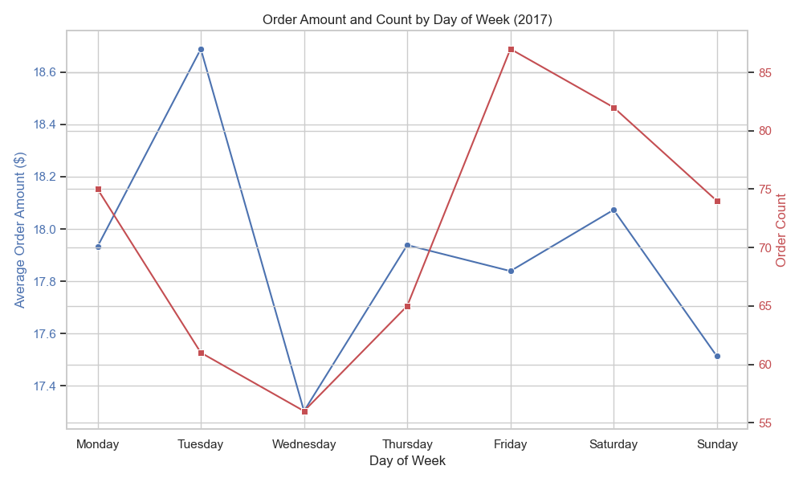
When Are Customers Ordering?
Peak: Friday (87 orders), Saturday (82)
Lowest: Wednesday (56), Tuesday (61)
Avg. order amount: ~$17–$18.69, highest Tuesday ($18.69)

Slide 14
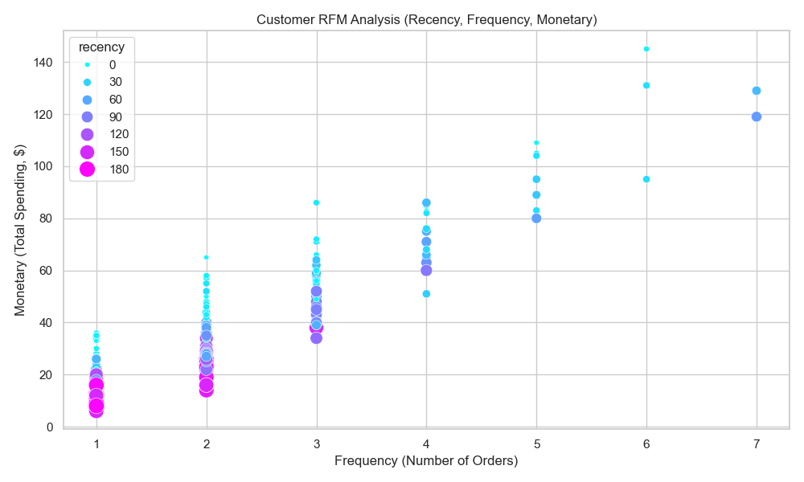
Unlocking Customer Insights with RFM Analysis
Recency avg. 65.63 days
Frequency avg. 2.23 orders.
Monetary avg. $39.96.

Slide 15
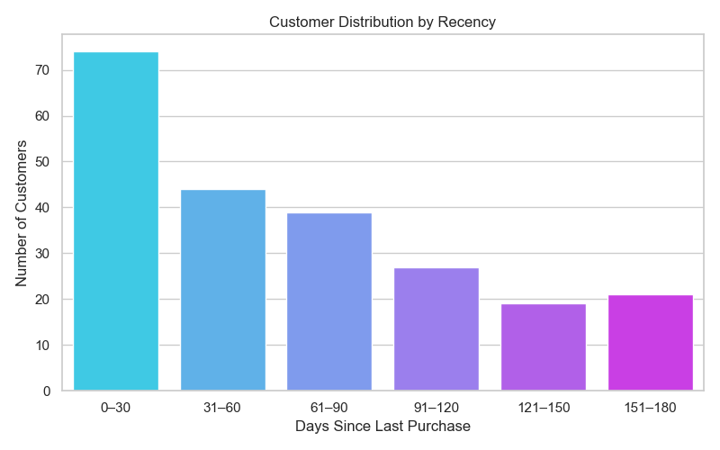
The largest segment (74 customers) made purchases within the last 0–30 days, indicating active behaviour.
Purchase counts steadily decline as recency increases from 44 customers in 31–60 days down to 21 in 151–180 days.
Engagement drops after 90 days, ~67 customers remain in the 91–180 days range.
Percentage of customers with recency > 30 days: 66.96%
Number of inactive customers (> 30 days): 150

Slide 16

Further insights on Customers behavioural pattern

Slide 17
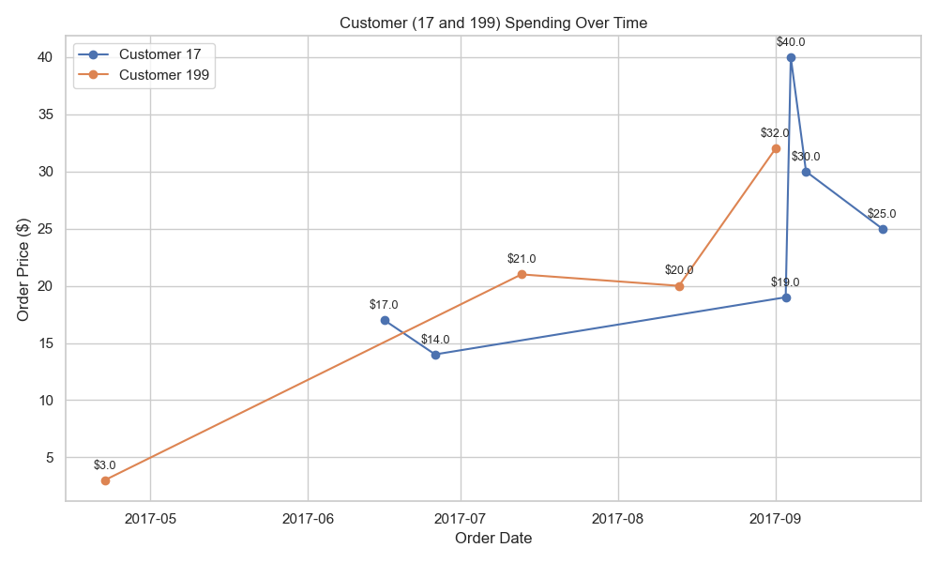
Case Study: High Value Isn’t Always Immediate

Slide 18
Key Highlights
Highest Spender - Customer 17
Total Spend: $145 across 6 orders
First Order: June (2 orders; $31)
Biggest Order: $40 (Highest spend per order of all customers) in September Pattern: Paused in July to August, returned in September (4 orders; $114)
Segment: High-Value
Lowest Spender - Customer 160
Total Spend: $6 from 1 order
Order Date: April (inception month)
Segment: Low-Value
Least spender per order - Customer 199
Least price per order: $3, placed in April.
Despite that, the customer made 4 orders totalling $76, culminating in a $32 purchase later in September.
Segment: High-Value
Pattern: April ($3); July ($21), August ($20), and September ($32)
This pattern hints at growing trust, interest, or satisfaction with the product.

Slide 19

DISCUSSION AND RECOMMENDATION

Slide 20
Our cuisine diversity is led by Chinese (11 restaurants) and American (10 restaurants), followed by Italian (8 restaurants). Chinatown specializes in Chinese cuisine (6 out of 7 restaurants), Brooklyn shows a strong presence in Pizza (4 out of 10), and Downtown offers a broad range, including American (5) and Japanese (3) options. There is huge market gap and a need to increase our reach to into the different neighbourhoods.
A remarkable 207% growth was observed in average order amount from April ($9.61) to September ($29.51), suggesting customers are increasingly willing to spend more, possibly due to new premium offerings or seasonal trends. However, a dip in August (73 orders, $21.15 average) points to a temporary demand slowdown, potentially linked to fewer high-value orders during that month.
Investigate the reasons for the dips in order on Wednesdays. Though with decreased orders compared to Mondays, there is an observed high spend on Tuesdays. This is worth investigating to know the customer status and the kind of orders they make, for example, bulk buys, recurring order etc.
Prioritize promotions on high-traffic days (Friday & Saturday). This can be by offering timed promotions like “Hot Friday” or “Weekend Special”.
Recommendation: Design a bonus model for Tuesday or loyalty benefits for high-spend behaviour. Push app notifications or email nudges on Thursday evenings to prime engagement. Run Wednesday-exclusive promos to lift volume (e.g. “Midweek Munch” offer).

Slide 21
Mid-value customers also show an immense loyalty (85.5% repeat). This tier has the capacity to be converted to high-value customers.
Recommendations: Recognition emails, loyalty rewards, incentives, or automation to guide them toward repeat purchases.
The RFM (Recency, Frequency, Monetary) analysis on 224 customers reveals a moderate level of loyalty with a notable churn risk. The average customer last ordered 65.63 days ago (maximum of 180 days), places 2.23 orders on average, and spends an average of $39.96 (with a maximum of $145). Approximately 70% of our customers have not ordered in over 30 days, and a quarter haven't placed an order in over 103 days, highlighting a need for proactive re-engagement.
Charts show that high-value customers peak in monetary, frequency and recency. They sit at the top of value pyramid. Prioritize retention efforts for them. Be committed to nurturing them.
High average recency (65.63 days) indicates churn risk, as many customers haven’t ordered recently. Make the ~67 customers in the 91–180 days range ideal targets for immediate win-back or reactivation strategies.
Recommendations: Start a reach-out campaign, engagement reminder, discounts and survey.

Slide 22

CONCLUSION
From our case study with customer 119, it is clear there is potential in all customers regardless of their initial order size. This echoes a need to strengthen our customer retention policies and strategies to migrate the low-value customers into the high-value customers’ bracket.

Slide 23
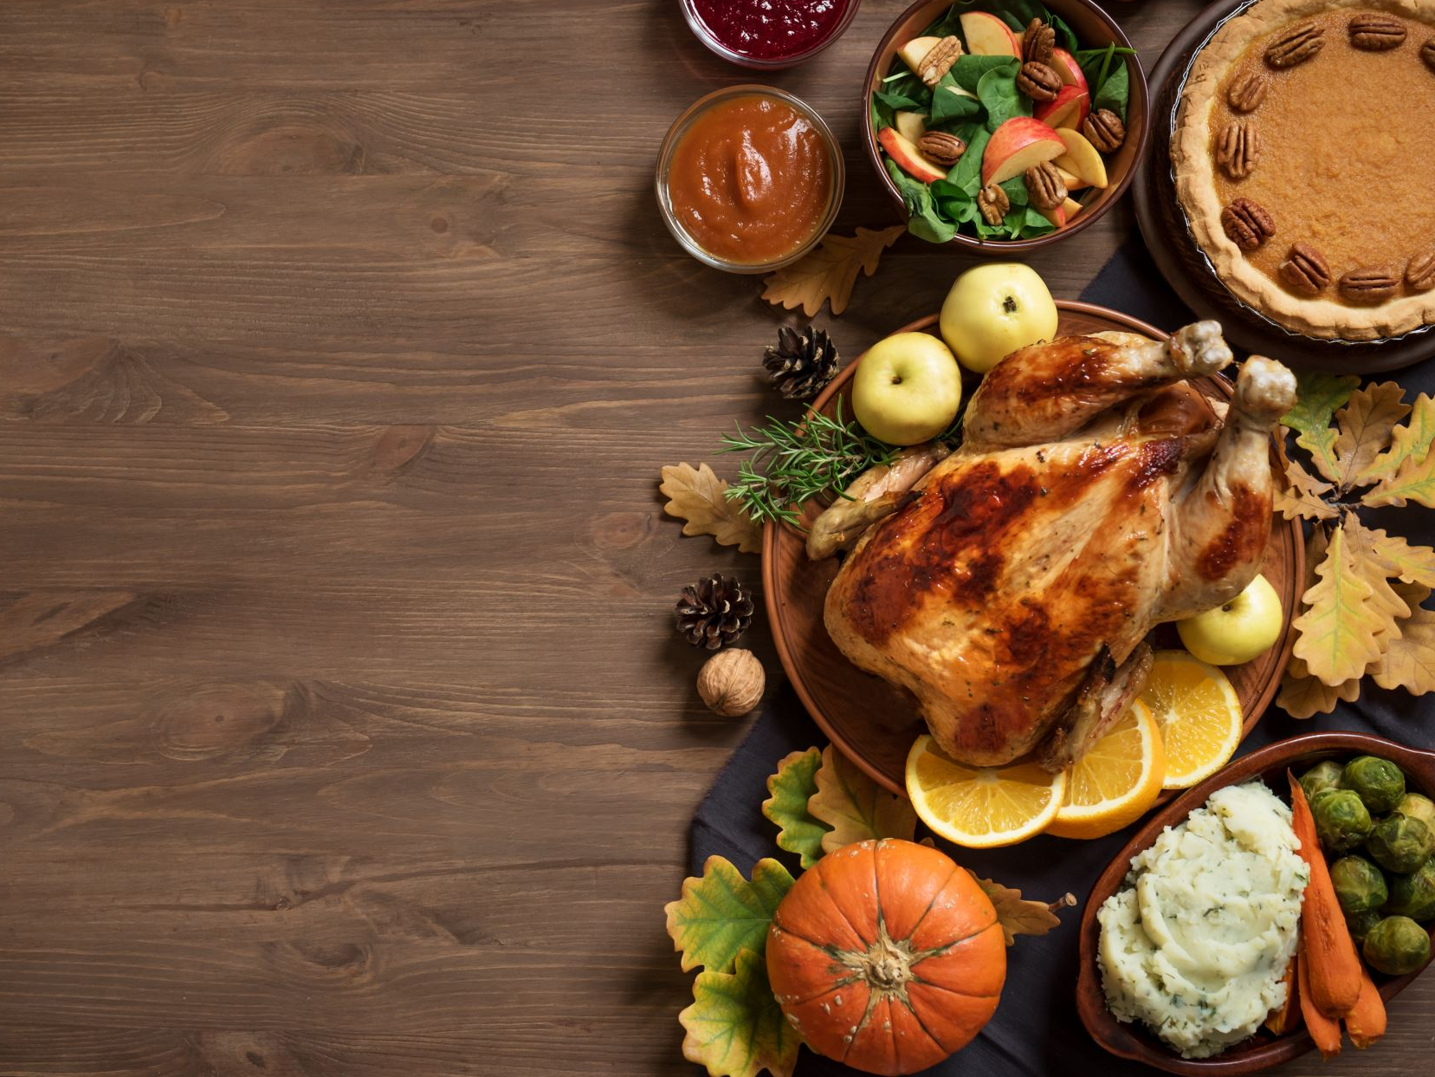
Thanks

