Slide 1
Development of an Anti-Keylogger System for Enhanced Cybersecurity
CAPSTONE PROJECT
Presented By:
1.Sundhararajan M – Madha Engineering College – BE.CSE

Slide 2
OUTLINE
Problem Statement
Proposed System/Solution
System Development Approach
Algorithm & Deployment
Result
Conclusion
Future Scope
References

Slide 3
Problem Statement
In today's digital age, cybersecurity threats pose significant risks to individuals and organizations. Keyloggers, a type of malicious software, are widely used by attackers to capture keystrokes on a user's keyboard, potentially leading to theft of sensitive information such as passwords, credit card numbers, and personal messages. To mitigate the threat posed by keyloggers, there is a need for the development of an Anti-Keylogger System aimed at enhancing cybersecurity.
The objective of this project is to design and implement an Anti-Keylogger System capable of detecting and preventing malicious keylogging activities on a user's system. The system should provide real-time protection against keylogger attacks while ensuring minimal disruption to the user's normal computing experience.

Slide 4
Proposed Solution
Proposed Solution: Anti-keylogger System For Enhanced Cybersecurity
Keyloggers pose a significant threat to cybersecurity by capturing keystrokes, potentially compromising sensitive information. To mitigate this threat, an Anti-Keylogger System can be developed using Python with a graphical user interface (GUI) provided by tkinter. This system allows users to block specific keys, toggle logging, start and stop the keylogger, and save logged data in both TXT and JSON formats.
Key Features:
Key Blocking: Users can block specific keys from being logged by the keylogger.
Toggle Logging: Logging can be toggled on or off to control when keystrokes are recorded.
Start/Stop Functionality: Users can start and stop the keylogger as needed.
Logging Status Display: The GUI displays the current logging status (enabled/disabled) to keep users informed.
Save Logs: Logged keystrokes can be saved in both TXT and JSON formats for analysis and further action.

Slide 5
System Approach
Implementation Overview:
Global Variables: Maintain variables to store blocked keys, logging status, output file paths, logged data, and the keyboard listener instance.
Blocking and Unblocking Keys: Functions to add or remove keys from the set of blocked keys.
Logging Functions: Event handlers to record key press and release events, respecting the logging status and blocked keys.
Toggle Logging: Function to toggle the logging status and update the GUI accordingly.
Save Logs: Function to save the logged data in TXT and JSON formats.
Start/Stop Keylogger: Functions to start and stop the keylogger, managing the keyboard listener instance.
GUI Setup: Tkinter-based GUI setup with labels and buttons for user interaction.

Slide 6
Algorithm & Deployment
Algorithm for the Anti-Keylogger System:
Step1:Initialization:
Import necessary libraries (tkinter, pynput.keyboard, json).
Define global variables to store blocked keys, logging status, output file paths, logged data, and keyboard listener instance.
Step2:Function Definitions:
Define functions to block specific keys, unblock keys, check if a key is blocked, handle key press event, handle key release event, toggle logging, save logs in TXT and JSON formats, start the keylogger, and stop the keylogger.
Step3:GUI Setup:
Create a Tkinter window with a title "Anti-Keylogger System" and set a larger window size.
Add a label to display the logging status.
Add buttons for blocking keys, unblocking keys, toggling logging, starting the keylogger, and stopping the keylogger.

Slide 7
Step4:Button Actions:
Define actions for each button:
Block Keys: Adds specified keys to the set of blocked keys.
Unblock Keys: Removes specified keys from the set of blocked keys.
Toggle Logging: Toggles the logging status and updates the status label accordingly. If logging is disabled, it saves the logs.
Start Keylogger: Initializes and starts the keyboard listener.
Stop Keylogger: Stops the keyboard listener if it's running.
Step5:Mainloop:
Run the Tkinter mainloop to display the GUI and handle user interactions.

Slide 8
Algorithm & Deployment
Deployment Steps:
Step1:Installation:
Install Python if not already installed.
Install the required libraries: tkinter, pynput.
Step2:Code Compilation:
Copy the provided Python code into a file with a .py extension.
Step3:Execution:
Run the Python script by executing the file.
The GUI window for the Anti-Keylogger System will appear.
Step4:User Interaction:
Use the provided buttons to perform actions such as blocking/unblocking keys, toggling logging, starting/stopping the keylogger.

Slide 9
Step5:Logging:
When logging is enabled, the system will log key press and release events to the specified output files in both TXT and JSON formats.
Step6:Closing the Application:
Close the Tkinter window or terminate the Python process to exit the application.
Step7:Customization:
Modify the code as needed for custom key blocking/unblocking, output file paths, or other configurations.
Step8:Testing:
Test the functionality of the Anti-Keylogger System to ensure it meets the desired requirements for enhanced cybersecurity.

Slide 10
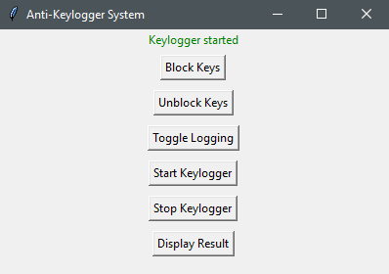
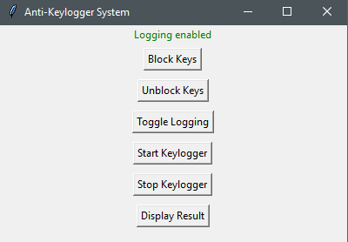
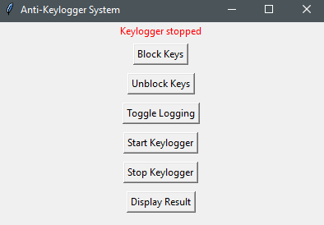
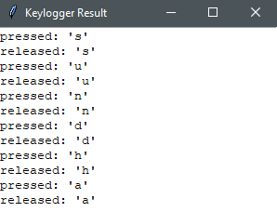
Result
The "Display Result" button in the Anti-Keylogger System presents a convenient way to view the recorded keypress and release events. Clicking the button opens a separate window where users can easily review the logged data, enhancing their understanding of keyboard activity and ensuring system security.

Slide 11
Conclusion
In conclusion, the Anti-Keylogger System provides a user-friendly interface to block/unblock keys, toggle logging, and start/stop the keylogger, ensuring enhanced cybersecurity by monitoring and recording keyboard activities. The system empowers users to conveniently access logged data for analysis and security auditing.

Slide 12
Future scope
Detection:
Real-time scanning: Continuously monitor system activities for the presence of keyloggers.
Behavioral analysis: Analyze user behavior patterns to detect anomalies indicative of keylogger activity.
Prevention:
Keystroke encryption: Encrypt keystrokes to prevent keyloggers from capturing sensitive information.
Secure input methods: Implement secure input mechanisms like virtual keyboards to thwart keylogging attempts.
Anti-hooking techniques: Employ methods to prevent keyloggers from intercepting system functions and capturing keystrokes.
User Awareness and Education:
Educate users about keylogger risks: Provide information about the types of keyloggers and their potential impact on privacy and security.
Promote security measures: Encourage users to use strong passwords, enable multi-factor authentication, and stay vigilant against suspicious activities

Slide 13
References
Python Documentation. (https://docs.python.org/3/)
Tkinter Documentation. (https://docs.python.org/3/library/tkinter.html)
Pynput Documentation. (https://pypi.org/project/pynput/)
JSON Documentation. (https://docs.python.org/3/library/json.html)

Slide 14
THANK YOU

