Slide 1
Breast Cancer Prediction System
Satyam Jhawar, Sundharees, Epsita R
Department of Computer Science
MSAIM
Christ (Deemed-to-be-University)
Banglore, India

Slide 2
Contents:
Understanding Breast Cancer
Need of ML model for prediction
Classification
3.1 Logistic regression
3.2 Decision tree
3.3 Random Forest
3.4 SVC
Visualization
Conclusion

Slide 3
Understanding Breast Cancer
Breast cancer is a common form of malignancy that primarily affects women but also affects a small percentage of men. Breast cancer is a neoplastic condition characterised by the uncontrolled development and multiplication of cells inside the breast tissue. The condition develops when breast cells alter abnormally and grow out of control, creating a lump or mass known as a tumour.
Although the actual causes of breast cancer are not entirely understood, a number of risk factors, including as age, gender, family history, and specific genetic alterations, may raise a person's likelihood of acquiring the illness.
Early detection can benefit from routine screenings like mammograms and breast self-exams. The survival rates and prognosis for those with breast cancer have dramatically improved thanks to early detection and advancements in treatment.
Hence, it brings us to our topic, Breast Cancer Prediction System.

Slide 4
Need of ML model for prediction
By combining machine learning with medical expertise in breast cancer diagnosis and prediction, powerful tools are made available to help healthcare providers to make decisions that are more fast and accurate, eventually benefiting patients through early identification, individualised therapy, and better outcomes. Due to its capacity to analyse vast volumes of complicated data and spot patterns that can be challenging for humans, machine learning is playing a crucial role in the prediction and diagnosis of breast cancer. Here is how machine learning is assisting in breast cancer prediction:
Feature Selection and Engineering
Treatment Planning and Prognosis
Genomic Analysis and Biomarker Identification
Research and Insights
Integration of Multimodal Data
Notes:
Early Detection and Diagnosis: In order to find anomalies or early indicators of breast cancer, ML models can examine a variety of medical imaging data, including mammograms, MRI scans, and ultrasound pictures. Early detection can greatly enhance treatment effectiveness and survival rates.
Feature Selection and Engineering: To increase predicted accuracy, ML systems can automatically choose pertinent features (such as tumour characteristics and patient demographics) and engineer new features. In order to train models that predict the existence, stage, or type of breast cancer, these characteristics are essential.
Treatment Planning and Prognosis: Based on patient-specific information, including tumour features, general health, and treatment history, machine learning (ML) algorithms can help determine the best course of treatment. Additionally, ML can forecast patient prognosis and survival rates, which helps clinicians make wise treatment choices.
Genomic Analysis and Biomarker Identification: To pinpoint specific genetic alterations or indicators linked to breast cancer, machine learning (ML) can examine genomic data. Drug development and tailored treatments can both benefit from this information.
Research and Insights: The examination of enormous volumes of research data is made easier by machine learning, speeding up the study of breast cancer. Researcher understanding of disease progression, treatment outcomes, and prospects for novel therapeutics is aided by machine learning (ML).
Integration of Multimodal Data: Medical imaging, clinical history, genetic data, and pathology reports are just a few of the many data sources that machine learning algorithms may combine and analyse. This thorough examination aids in locating characteristics and trends that might be suggestive of breast cancer.

Slide 5
Classifications Used to Develop The Model
Building a model that can analyse different features or attributes associated to patients and their medical history in order to forecast the likelihood of breast cancer or classify cancer into distinct categories is required when using machine learning (ML) algorithms to predict breast cancer. For this, a variety of classification algorithms can be used, out of which we have implemented:
Logistic Regression
Decision Trees
Random Forest
SVC

Slide 6
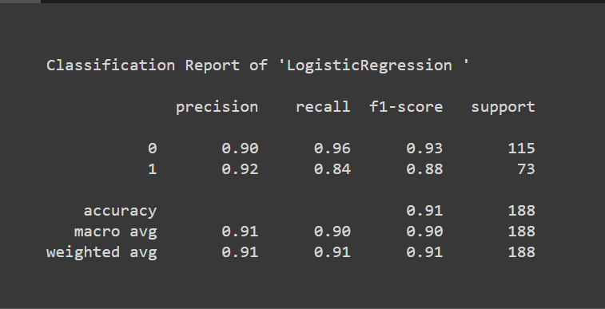
Logistic Regression
In binary classification tasks, where the objective is to predict a binary result, commonly expressed as 0 or 1 (e.g., malignant or benign, presence or absence), logistic regression is a statistical and machine learning technique that is utilised. Contrary to what its name implies, logistic regression is a classification algorithm.

Slide 7
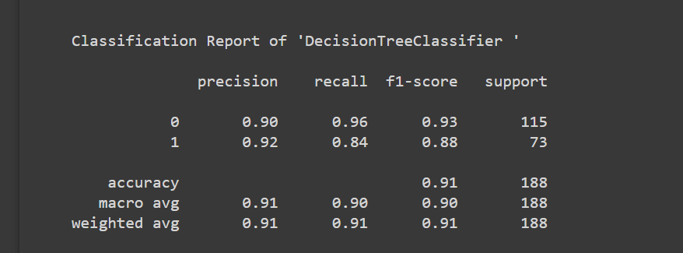
Decision Tree
In a decision tree each internal node represents a feature, each branch indicates a choice based on that feature, and each leaf node provides an outcome or class label.
A decision tree is used to create a model that predicts whether a breast mass is malignant or benign in the context of predicting breast cancer based on numerous features or properties such tumour size, form, texture, and other pertinent clinical markers.

Slide 8

Random Forest
In machine learning, the widely used ensemble learning technique Random Forest is a development of decision trees, models that are flexible and easy to understand. By lowering overfitting and raising prediction accuracy, Random Forest overcomes the drawbacks of decision trees.

Slide 9
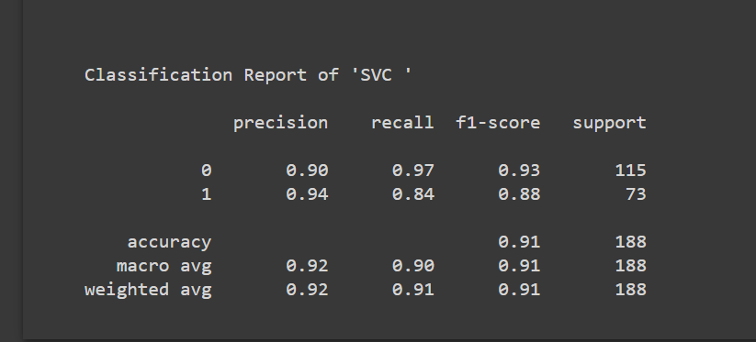
SVC
The supervised learning technique Support Vector Classification (SVC), a variation of Support Vector Machine (SVM), is used for binary and multiclass classification tasks. It is extensively used in many different industries, including medical diagnostics like predicting breast cancer.

Slide 10
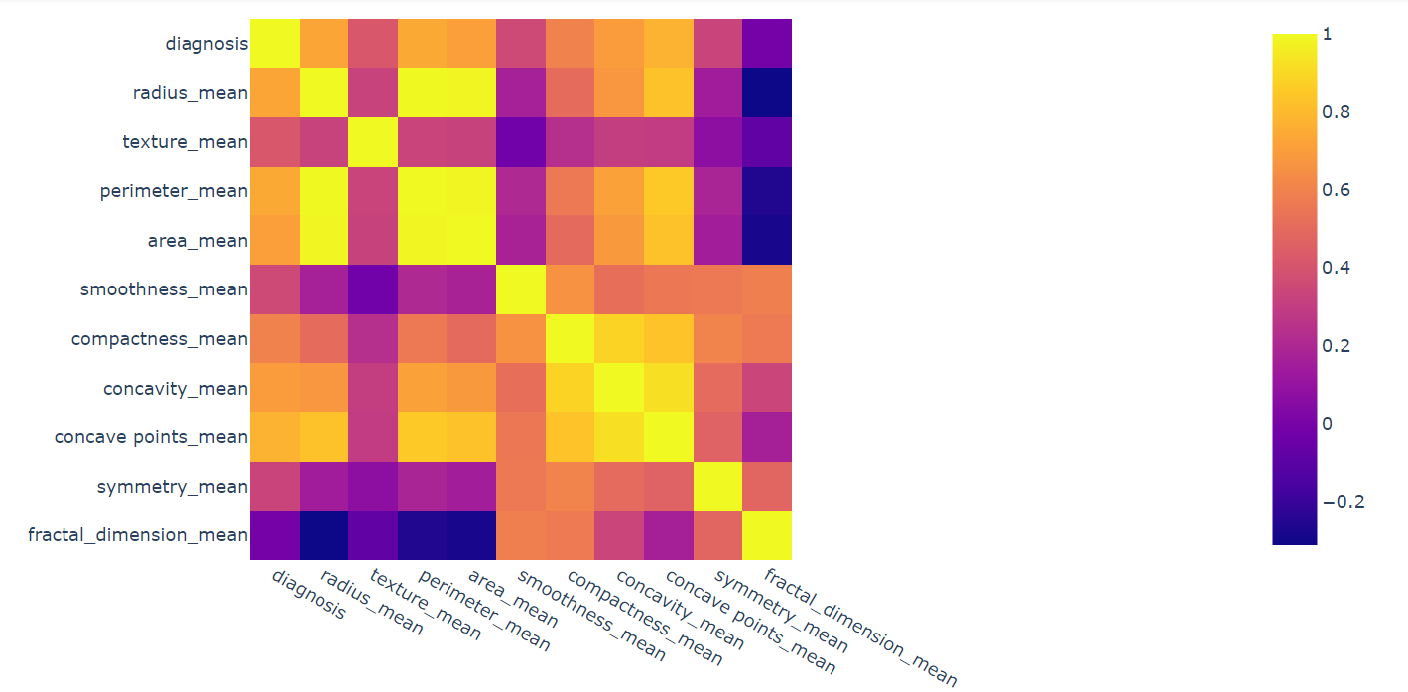
Visualization

Slide 11
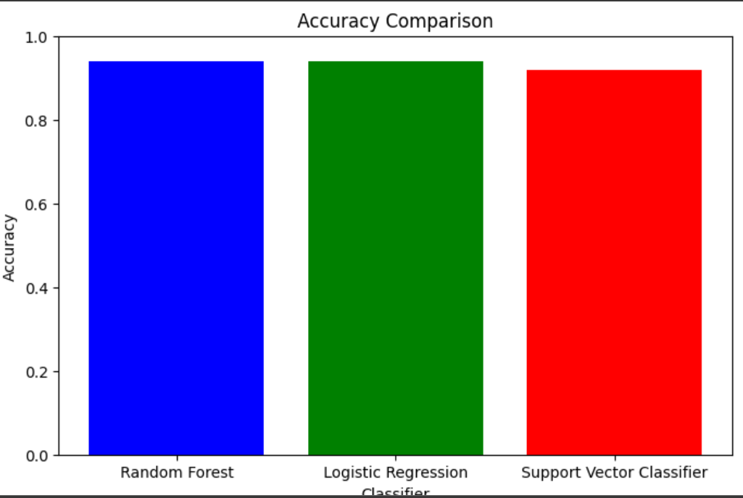

Slide 12
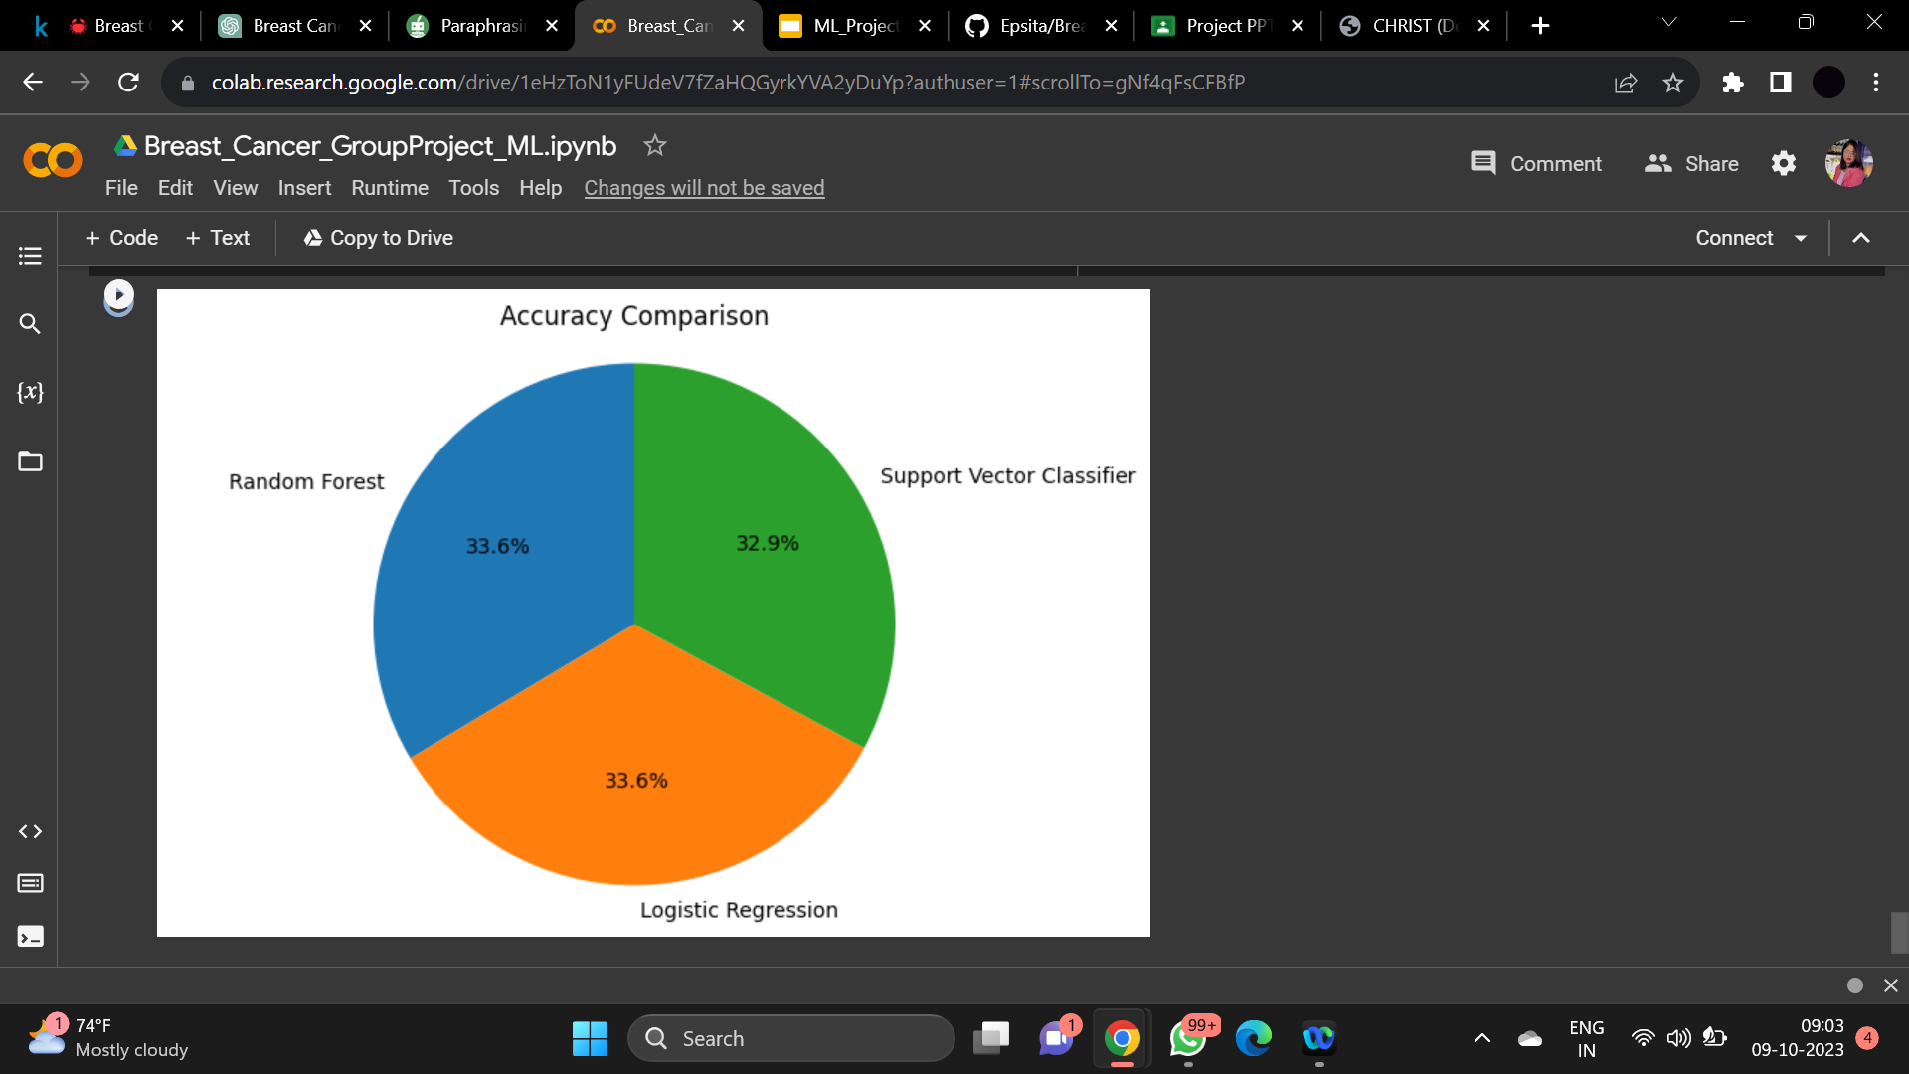

Slide 13
Conclusion
By incorporating ML models into breast cancer prediction, healthcare workers are given strong tools for making timely and correct decisions. Since ML can process enormous volumes of complex data and spot patterns that are difficult for human experts to spot, it is an essential tool in the ongoing battle against breast cancer that will ultimately enhance patient outcomes and public health.
In conclusion, machine learning models for breast cancer prediction have become crucial instruments in the field of healthcare and medical diagnosis.

