Slide 1


Stack and Queue
손일비
Mobile & Network Intelligence Laboratory

Slide 2
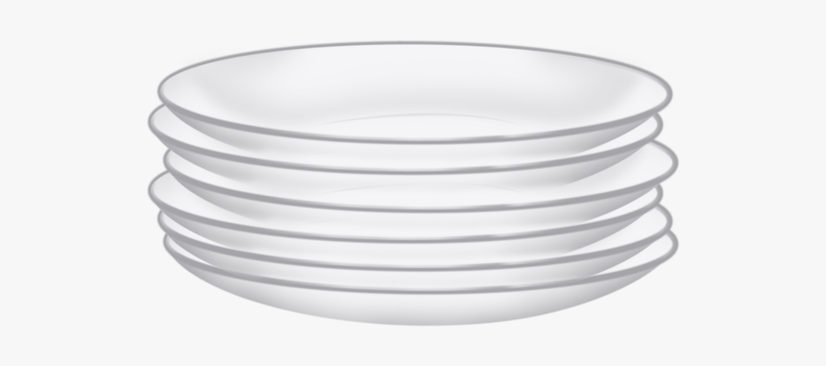
Stack (1/5)
Concept
A linear data structure
Insertion and deletion principle : LIFO (Last-In First-Out) or FILO (First-In Last-Out)
Elements can be added and removed from the stack only at the top.
Example : stacking up dishes
Notes:
Stack的长处： 能记住在何时push了什么内容进去。
算法和数据结构的差异：DFS BFS 是算法，栈是数据结构。

Slide 3
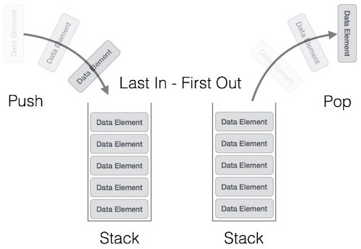
Stack (2/5)
Operations
Pop : remove the item out of the stack
Push : add the item into the stack
IsFull : check if stack is full
IsEmpty : check if stack is empty

Slide 4
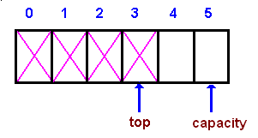
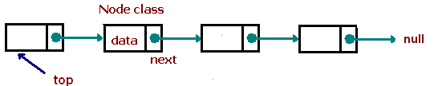
Stack (3/5)
Implementation
Array
Contiguous address space
One-dimensional array + two variable (top and capacity)
A stack is empty when top = -1, and the stack is full when top = capacity-1.
capacity can be fixed or dynamic.
Linked list
Discontinuous address space
One singly linked list + one variable (top)
Dynamic memory allocation

Slide 5
Stack (4/5)
Applications
Maze
Parenthesis matching
Expression evaluation
Syntax Parsing
String Reversal
......

Slide 6
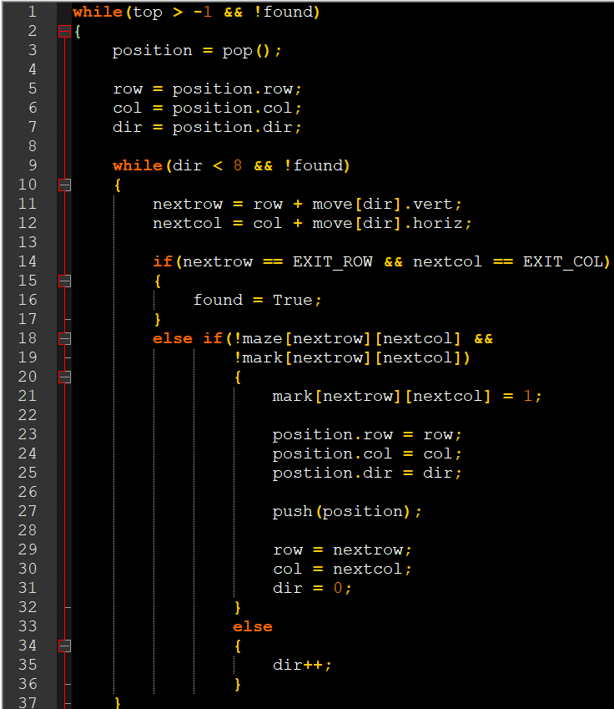
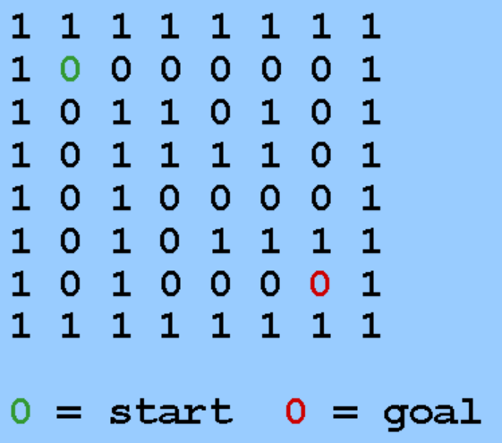
Stack (5/5)
Example : Maze
Notes:
使用另外的 matrix，可能会浪费空间，可以改善一下，即在原来的数组中，访问过的坐标用 2 表示。

Slide 7
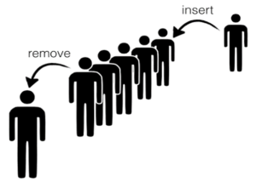
Queue (1/5)
Concept
A linear data structure
Insertion and deletion principle : FIFO (Fist-In First-Out)
Elements can only be added to the back of the queue and removed from the front.
Example : bank service

Slide 8
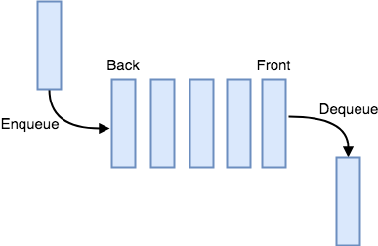
Queue (2/5)
Operations
Dequeue/Delete : remove an item from the front of the queue
Enqueue/Add : insert an item into the back of the queue
IsFull : check if queue is full
IsEmpty : check if queue is empty

Slide 9
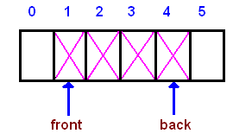
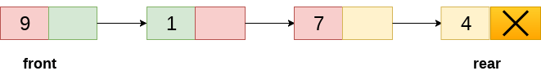
Queue (3/5)
Implementation
Array
Contiguous address space
One-dimensional array + three variable (front, rear and capacity)
capacity can be fixed or dynamic
Linked list
Discontinuous address space
One singly linked list + two variable (front and rear)
Dynamic memory allocation

Slide 10
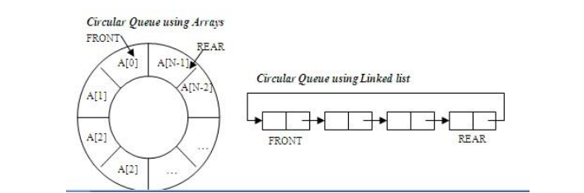
Queue (4/5)
Implementation
Circular queue
Also implemented using array or linked list, but logically forms a circle.
Index = (index+1) % capacity

Slide 11
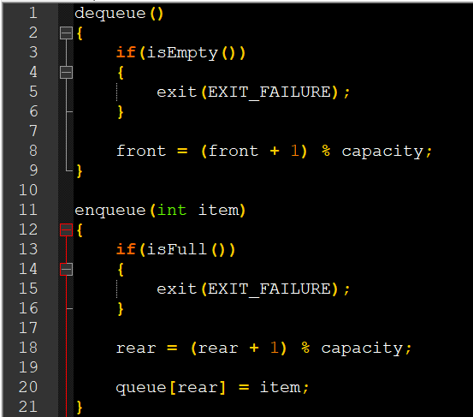
Queue (5/5)
Example : Circular queue

Slide 12
Q & A

