Slide 1


Huffman Tree
손일비
Mobile & Network Intelligence Laboratory

Slide 2
Huffman Tree (1/1)
Concept
A full binary tree with minimum external path weight.
The weighted path length of a leaf is its weight times its depth.
More efficient.
Can save more space.
Notes:
霍夫曼树可以用来构造最优判别树？

Slide 3
Huffman Code (1/11)
Concept
A data compression algorithm used to assign codewords to characters according to the frequency of the character.
A shorter length codeword is assigned for a character which is used more number of time (or has a high frequency).
A longer length codeword is assigned for a character which is used less number of times (or has a less frequency).
Implementation : Huffman Tree

Slide 4
Huffman Code (2/11)
Implementation
Example :
Character | a | b | c | d | e | f
Frequency | 42 | 20 | 5 | 10 | 11 | 12

Slide 5
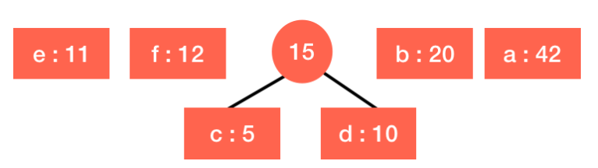
Huffman Code (3/11)
Implementation
Encoding : always merge the two nodes with the lowest frequency
Step 1 : construct the binary tree
Character | a | b | c | d | e | f
Frequency | 42 | 20 | 5 | 10 | 11 | 12

Slide 6
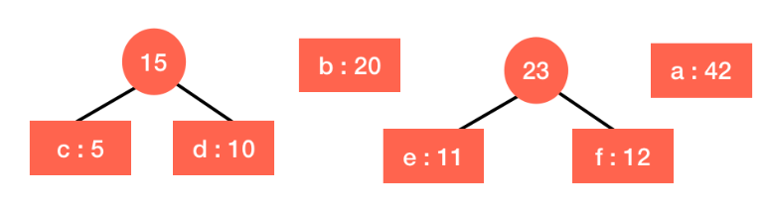
Huffman Code (4/11)
Implementation
Encoding : always merge the two nodes with the lowest frequency
Step 2 : construct the binary tree
Character | a | b | c + d | e | f
Frequency | 42 | 20 | 15 | 11 | 12

Slide 7
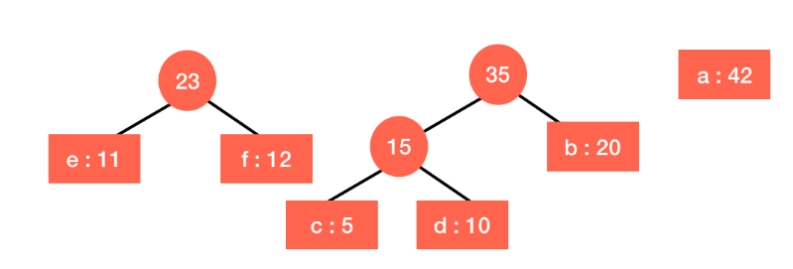
Huffman Code (5/11)
Implementation
Encoding : always merge the two nodes with the lowest frequency
Step 3 : construct the binary tree
Character | a | b | c + d | e + f
Frequency | 42 | 20 | 15 | 23

Slide 8
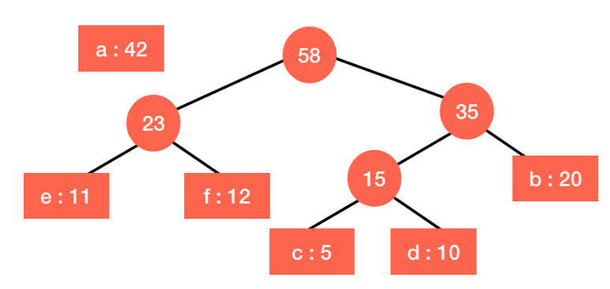
Huffman Code (6/11)
Implementation
Encoding : always merge the two nodes with the lowest frequency
Step 4 : construct the binary tree
Character | a | b + (c + d) | e + f
Frequency | 42 | 35 | 23

Slide 9
Huffman Code (7/11)
Implementation
Encoding : always merge the two nodes with the lowest frequency
Step 5 : construct the binary tree
Character | a | (b + (c + d)) + (e + f)
Frequency | 42 | 58

Slide 10
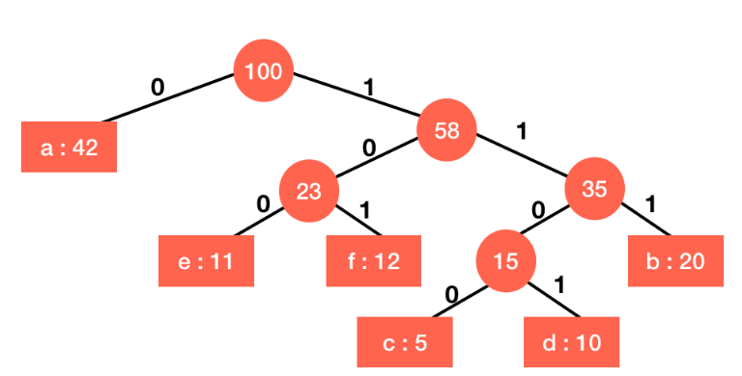
Huffman Code (8/11)
Implementation
Encoding : always merge the two nodes with the lowest frequency
Step 6 : construct the binary tree
Character | a + (b + (c + d)) + (e + f)
Frequency | 100
Character | a | b | c | d | e | f
Code | 0 | 111 | 1100 | 1101 | 100 | 101

Slide 11
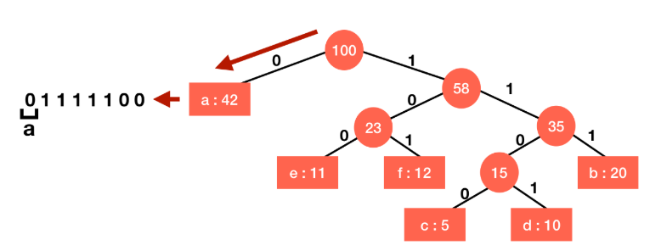
Huffman Code (9/11)
Implementation
Decoding : start from the root of the tree and proceed to the leaf
Example : 01111100 → abc
Step 1 : start from the root and move

Slide 12
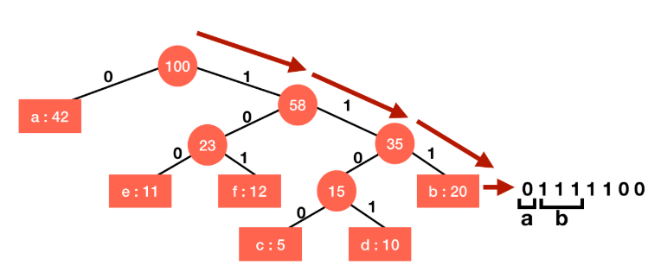
Huffman Code (10/11)
Implementation
Decoding : start from the root of the tree and proceed to the leaf
Example : 01111100 → abc
Step 2 : start from the root and move

Slide 13
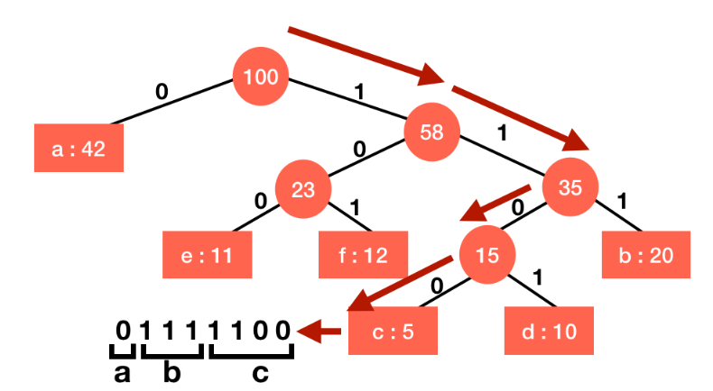
Huffman Code (11/11)
Implementation
Decoding : start from the root of the tree and proceed to the leaf
Example : 01111100 → abc
Step 3 : start from the root and move

Slide 14
Q & A

