Slide 1
Idea Evaluation
Dong Sun

Slide 2
1.
Visualize Walking Trace in the Wild

Slide 3
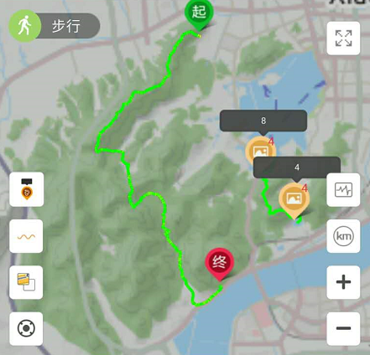
Motivation
Navigation in the wild where there is no path on the map.
Get lost. How to find a way out? Or where to get help?
Path planning. Find the best way in the wild with complicate conditions.

Slide 4
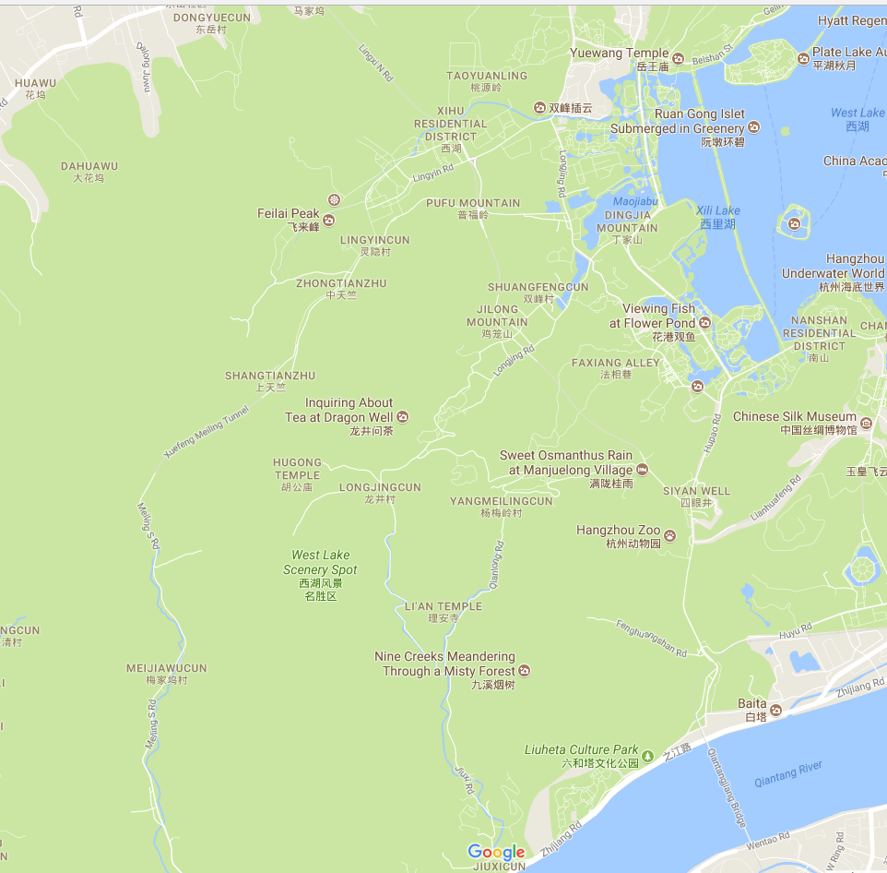

How to find a route in the wild where there is no path on the map?

Slide 5
2.
Visualize Medical Data

Slide 6
Motivation
Meng Xia’s disease
Visualize physical conditions of patients to help doctors diagnose
Which phase is your disease on?

Slide 7
3.
Visualize the Adversarial Process in GANs

Slide 8
Motivation
Difficult to know the adversarial details for researchers.
GANs was the most popular model for papers last year.

