Slide 1
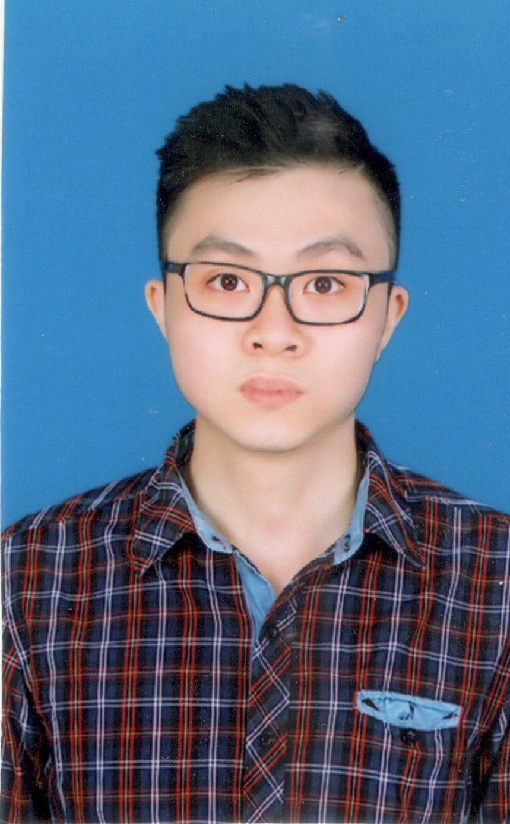







NGO DO DANG KHOA
AI ENGINEER
Hanoi, Vietnam
ngododangkhoa@gmail.com
+84 818 068 000
https://www.linkedin.com/in/ngododangkhoa/
BIOGRAPHY
I am a 25-year-old AI engineer from the capital city of Vietnam – Hanoi. I have about four years of experience in Artificial Intelligence and Data Science, especially in Computer Vision. I am now working in Panasonic R&D Center Vietnam.
EXPERIENCE
HONORS AND AWARDS
AI Engineer at FPT Software | 2 years
Competitions Expert in Kaggle: 4 silver, 2 bronze medals.
3 scientific publications.
3 times as a speaker in FPT Software AI Lab Webinars.
Project: akaDoc - OCR Platform
Experience: OCR (Japanese, Latin), Document Retrieval, OMR, etc.
Data Science intern at G-Group | 10 months
Experience: Credit Scoring, OCR for Vietnamese ID card
B.Sc. in Electronic and Telecommunication
Hanoi University of Science and Technology | Talent Program
GPA: 8.6/10

Slide 2
SKILLS (GENERAL)
LANGUAGES
Deep learning
Computer Vision
Python
Pytorch
Born in Vietnam. Use Vietnamese and English fluently.
Vietnamese: Native
English: Full professional proficiency
Spanish: Elementary proficiency
SKILLS (DETAILED)
Python
Pytorch
Keras
Tensorflow
ASP.NET
C#
C/C++
Matlab
Linux
Git
Cloud
Docker

