Slide 1
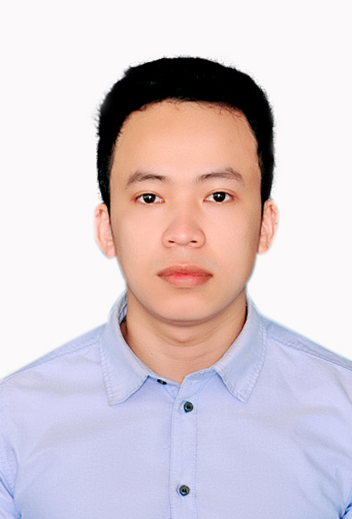







DANG CONG HOANG
AI ENGINEER
Hanoi, Vietnam
hoang.dangcong@vn.panasonic.com
+84 932537625
https://www.linkedin.com/in/hoang-dang-cong-60a5b811a/
BIOGRAPHY
I have several years of experience in Software and Machine learning development, mainly interested in Deep Learning and Computer Vision. Currently I’m conducting research as an AI Engineer at Panasonic R&D center Vietnam. With experience working as an AI Engineer who completed different advanced projects, I believe in my contribution to the success of our group.
EXPERIENCE
Viettel Cyberspace Center, Vietnam | 4 months
HONORS AND AWARDS
Project: Study of Synthetic Aperture Radar (SAR) and Automatic Identification System (AIS)
for Ship Target Detection and Classification using Deep Learning
Russia Federation fully-funded Master scholarship.
First prize on Marathon student projects between Russia and Austria.
1 scientific publication (1 ready to publish).
AI Engineer at Pattern recognition laboratory Polytechnic University, Russia | 16 months
Project: Self-driving car using machine learning approaches.
Graz University of Technology Computer Vision laboratory, Austria| 3 months
3S Intersoft JSC, Backend-developer| 9 months
Peter the Great St. Petersburg Polytechnic University
Master of Computer Science, First Class Honours (GPA 4.9/5)
B.Sc. in Computer Science
Danang University Of Science and Technology
Top highest score on Bachelor thesis (9,4/10)

Slide 2
SKILLS (GENERAL)
LANGUAGES
Deep learning
Machine learning
Python
Pytorch
Vietnamese: Native
English: Advanced
Russian: Upper Intermediate
SKILLS (DETAILED)
Python
Pytorch
Keras
Tensorflow
ASP.NET
C#
C/C++
Matlab
Linux
Git
SQL
JAVA

