Slide 1
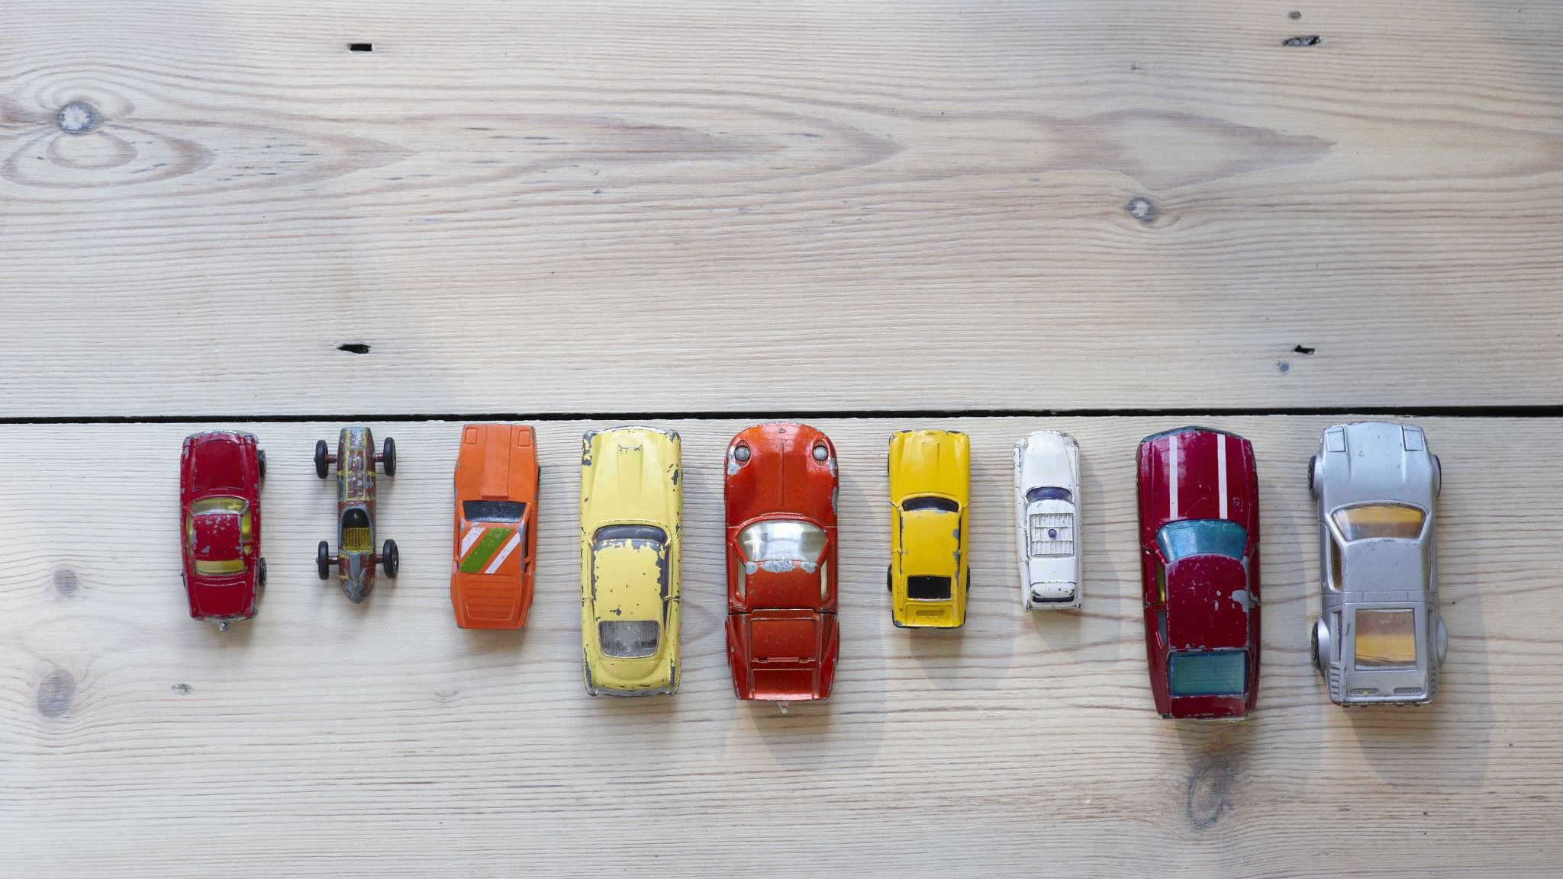
Budget and Environmentally Friendly Car Recommendation System
Sundus Yawar

Slide 2



Non-Technical Overview & Potential Impact
- Opens doors to making environmentally responsible decision within a tight budget given the increased cost of living
- environmentally friendly i.e. fuel efficient, low CO2 emissions, best smog rating
- cost efficient i.e. within budget for purchase & fuel efficiency
Notes:
Cost of living has increased substantially but salaries remain the same, last summer gas prices went up till 217 cents/Litre and this summer they went from 145 cents/Litre to 172 cents/Litre
Helping users find a car that is both within their budget, is environmentally friendly and cost efficient in terms of fuel can help everyone make an environmentally responsible choice while staying within their budget

Slide 3

Proposed Vision for Tackling the Problem
The data isn’t labeled for whether the cars in the dataset are green or not. However, it has sufficient information for an unsupervised learning model to detect similarities and cluster similar items together, which can help label the data
Unsupervised Machine Learning Technique to cluster the data for best and worst CO2 rating, Smog rating, Combined fuel consumption rating by Make and Vehicle class
Then will explore the data and label the clusters
Build a website that will allow users to select budget range and vehicle class they are interested in and since the data is labeled now thanks to unsupervised machine learning technique (clustering), it will just filter the data based on user input and recommend greener option within budget selected and vehicle class chosen

Slide 4
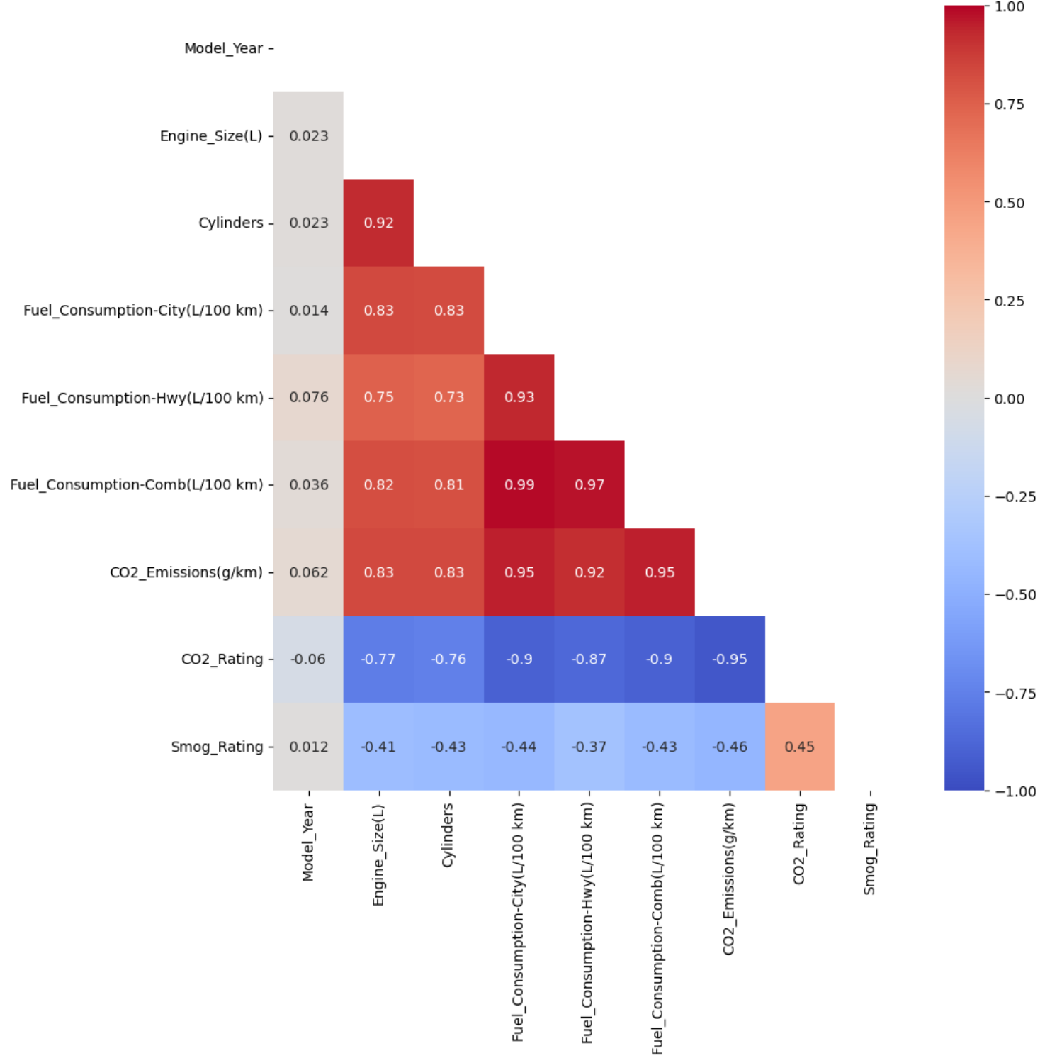
Overview of the Dataset & Preprocessing Procedures
6,951 rows and 8 columns; 19 columns after 1 hot encoding
Model_Year | Make | Model | Vehicle_Class | Fuel_Type | Fuel_Consumption-Comb(L/100 km) | CO2_Emissions(g/km) | Smog_Rating
Vehicle_Class | Fuel_Consumption-Comb(L/100 km) | CO2_Emissions(g/km) | Smog_Rating
- Prices data was brought in from other datasets, some of them included Price by Make, Model, Year and Mileage so I grouped by the 3 columns and took average then joined the grouped data with the main dataset. 1 of them required currency conversion.
- Found data quality issues in the prices dataset where prices for cars were in 100s and the mileage wasn’t even > 10,000. The cars in the dataset were from 2017-2020.
- Domain Knowledge & Correlation Matrix
Chi2 test (Model & Vehicle Class)
VIF Analysis for multicollinear columns
- Scaled the columns

Slide 5
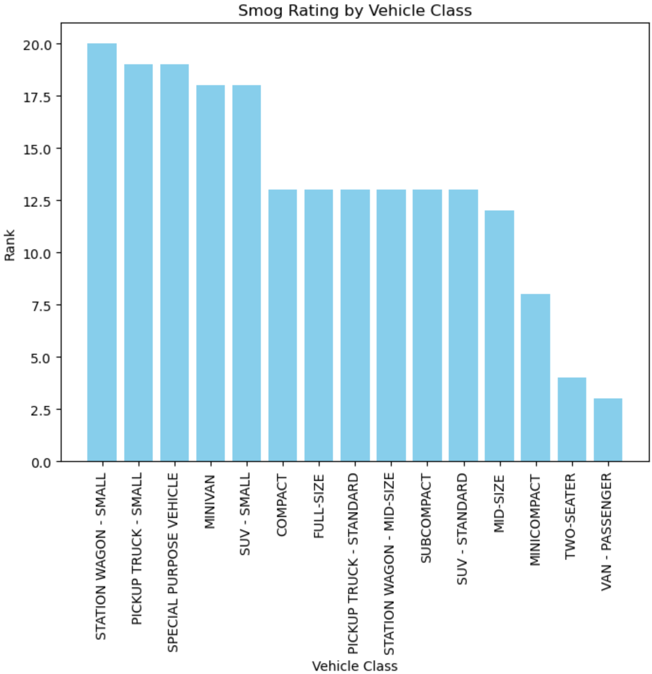
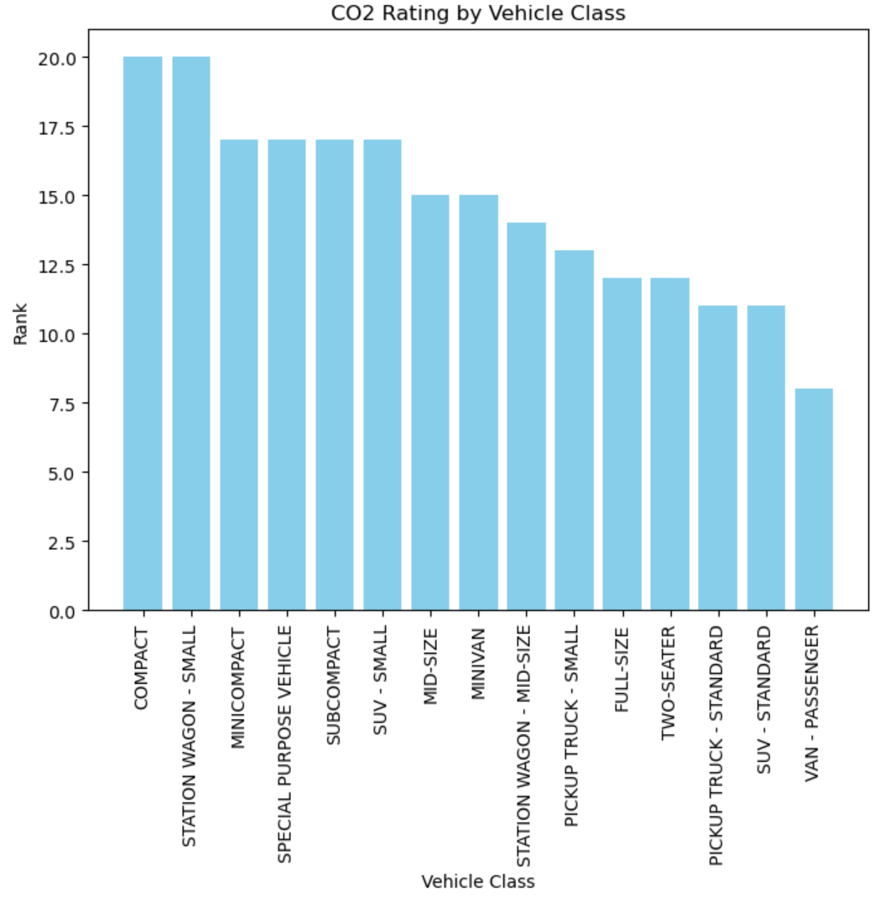
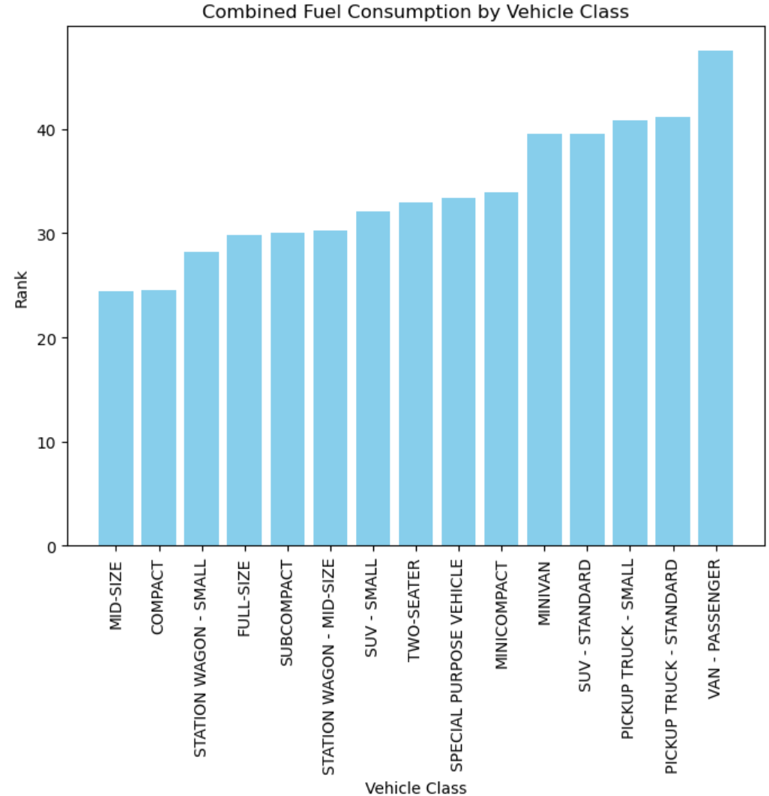
Few Important Findings from EDA

Slide 6
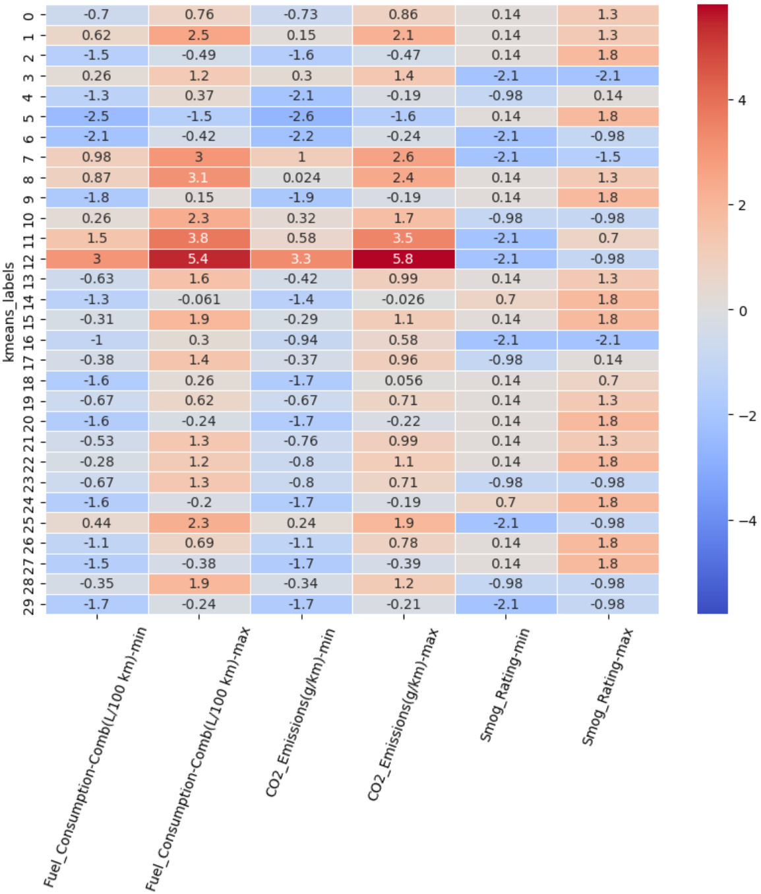
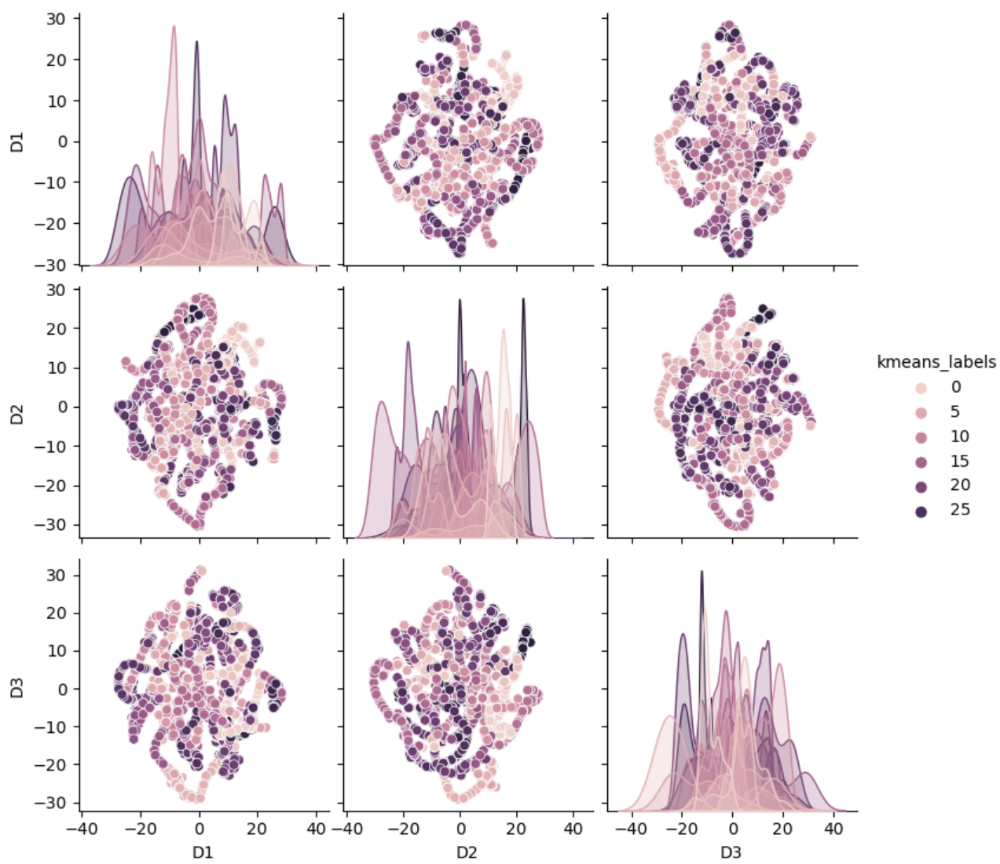
Baseline Model & Evaluation Metrics
Notes:
Evaluation metrics for this include Inertia and Silhouette. Inertia is basically the distance of data points from the centroid of the cluster, which decreases as the number of clusters increases. But when used on its own it may lead to unnecessary number of clusters so that’s where silhouette comes into play. Silhouette is the distance between clusters, the greater the distance the better because clusters close to each other could mean they are pretty much same cluster which helps do sanity check when inertia decreases as number of clusters increases.
I can tell that cluster 25, 12, 11, 10, 8, 7, 3 and 1 definitely are clusters containing vehicles that aren't green as their min and max values are greater than 0 and other clusters have smaller values. But of course, since more clusters are needed to properly cluster these, it is not easily distinguishable for other current clusters aren't at greater distances from one another (silhouette). Hence, will do this again in the final sprint to see if distinguishing green vehicle from non green ones will get easier with more clusters as distance among them will be larger and there will be adequate number of clusters.Helping users find a car that is both within their budget, is environmentally friendly and cost efficient in terms of fuel can help everyone make an environmentally responsible choice while staying within their budget

Slide 7
Next Steps
Model_Year | Make | Model | Vehicle_Class | Fuel_Type | Fuel_Consumption-Comb(L/100 km) | CO2_Emissions(g/km) | Smog_Rating
Data Processing And Feature Engineering:
Try backward feature selection & see what # of clusters work best
One hot encoding for Model_Year, Make and Fuel Type
One hot encoding can lead to dimensionality issues, so will need to handle that if it appears
Handle the missing prices values
Modelling
Baseline Modeling:
K-Means clustering algorithm
Simple to implement
Computationally efficient for moderately sized dataset
Easy interpretations as it assigns each data point to the nearest cluster center
Advanced Modelling:
DBScan
Find better way for cluster visualization
Look into the data and label clusters as green or not green
Build the website and host it on heroku

