Slide 1
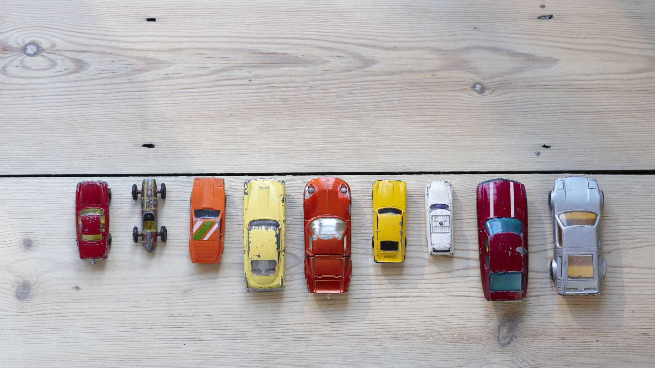
Budget and Environmentally Friendly Car Recommendation System
Sundus Yawar

Slide 2



Non-Technical Overview & Potential Impact
- Opens doors to making environmentally responsible decision within a tight budget given the increased cost of living
- environmentally friendly i.e. fuel efficient, low CO2 emissions, best smog rating
- cost efficient i.e. within budget for purchase & fuel efficiency
Notes:
Not everyone can afford hybrid and electric vehicles. So this reccommendar system helps people make environmentally responsible choices even within a tight budget as it recommends green vehicles based on their budget.
Cost of living has increased substantially but salaries remain the same, last summer gas prices went up till 217 cents/Litre and this summer they went from 145 cents/Litre to 172 cents/Litre
Helping users find a car that is both within their budget, is environmentally friendly and cost efficient in terms of fuel can help everyone make an environmentally responsible choice while staying within their budget

Slide 3

Proposed Vision for Tackling the Problem
The data isn’t labeled for whether the cars in the dataset are green or not. However, it has sufficient information for an unsupervised learning model to detect similarities and cluster similar items together, which can help label the data
Unsupervised Machine Learning Technique to cluster the data for best and worst CO2 rating, Smog rating, Combined fuel consumption rating by Make and Vehicle class
Then will explore the data and label the clusters
Build a website that will allow users to select budget range and vehicle class they are interested in and since the data is labeled now thanks to unsupervised machine learning technique (clustering), it will just filter the data based on user input and recommend greener option within budget selected and vehicle class chosen

Slide 4
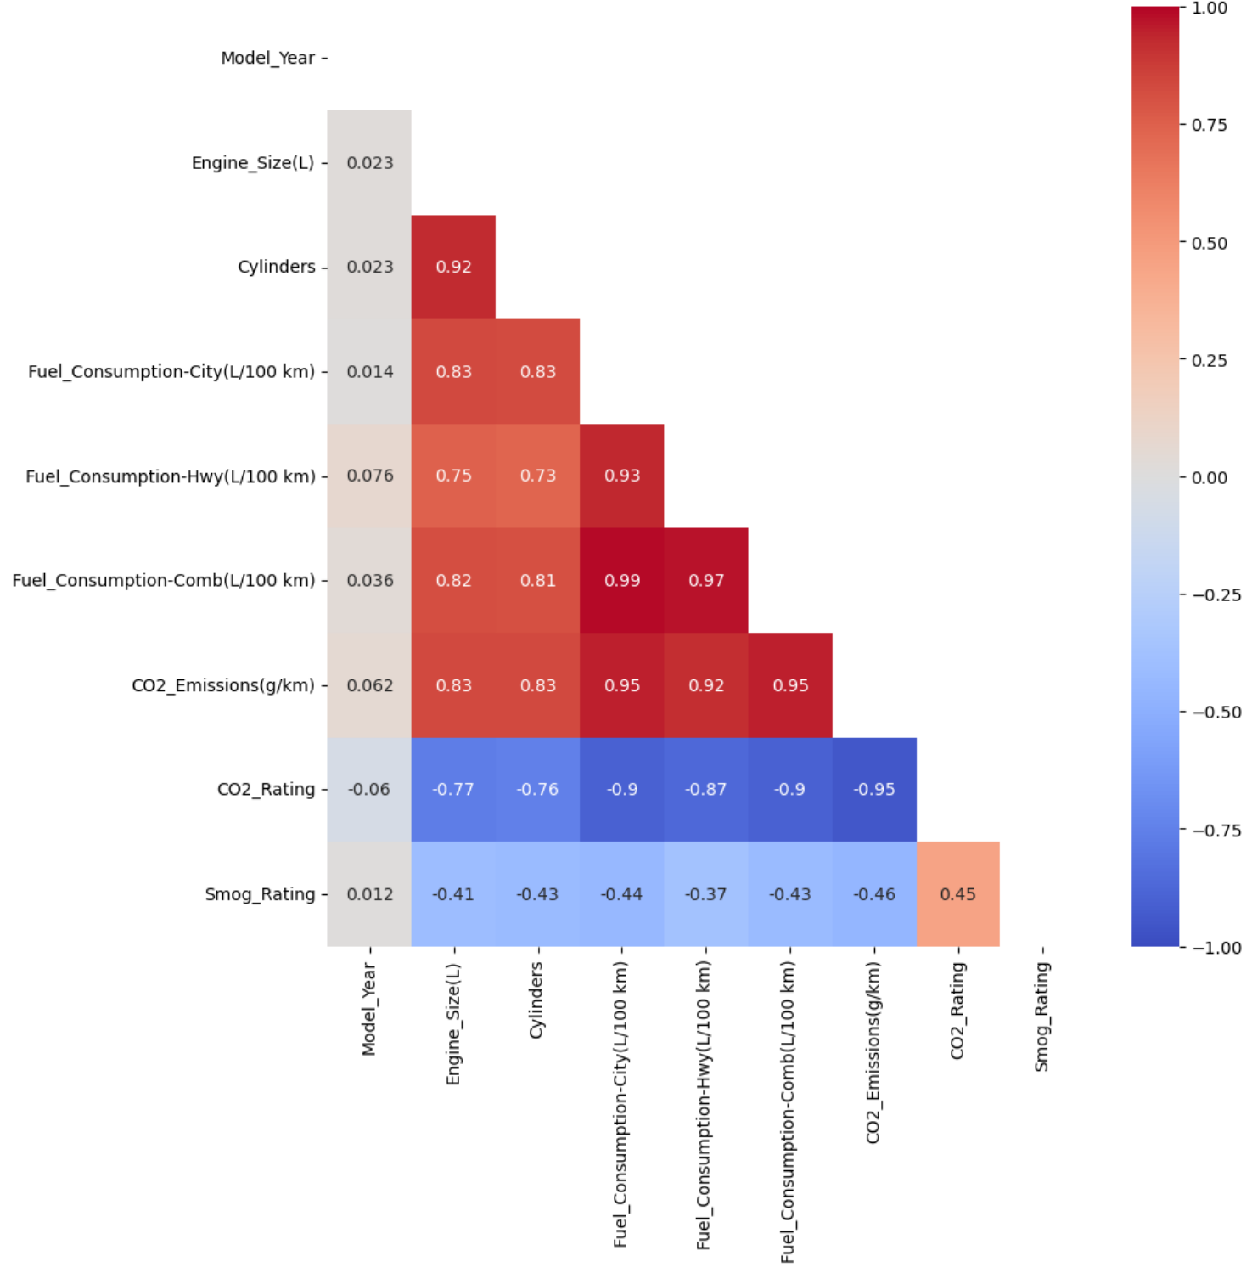
Overview of the Dataset & Preprocessing Procedures
6,951 rows and 8 columns; 19 columns after 1 hot encoding
Model_Year | Make | Model | Vehicle_Class | Fuel_Type | Fuel_Consumption-Comb(L/100 km) | CO2_Emissions(g/km) | Smog_Rating
Vehicle_Class | Fuel_Consumption-Comb(L/100 km) | CO2_Emissions(g/km) | Smog_Rating
- Prices data was brought in from other datasets, some of them included Price by Make, Model, Year and Mileage so I grouped by the 3 columns and took average then joined the grouped data with the main dataset. 1 of them required currency conversion.
- Found data quality issues in the prices dataset where prices for cars were in 100s and the mileage wasn’t even > 10,000. The cars in the dataset were from 2017-2020.
- Chi2 test (Model & Vehicle Class)
- Domain Knowledge & Correlation Matrix
- VIF Analysis for multicollinear columns

Slide 5
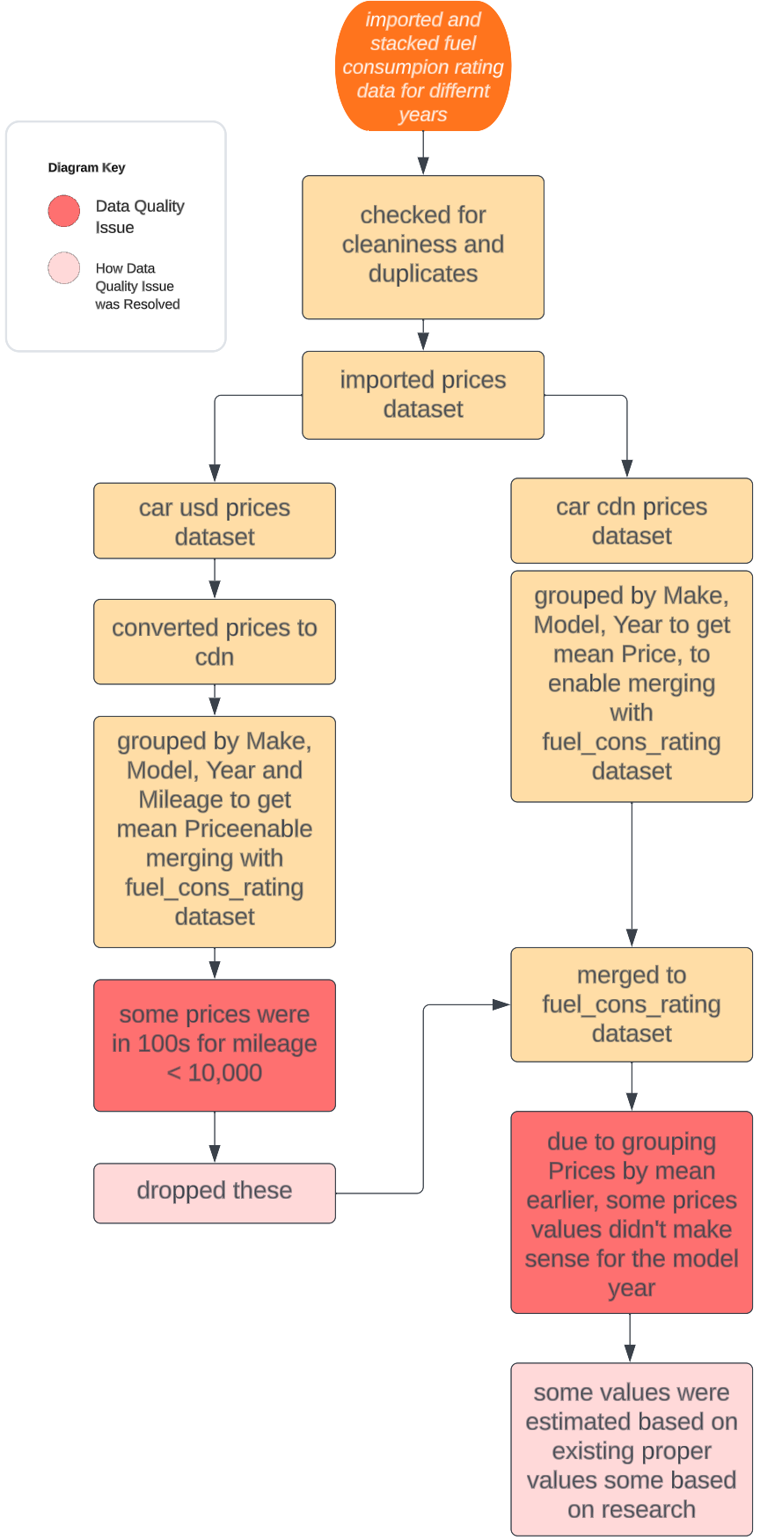
Overview of the Dataset & Preprocessing Procedures
Dataset Originally consisted of 6,951 rows and 15 columns
Some of the Important Features
Model_Year | Make | Model | Vehicle_Class | Fuel_Type | Fuel_Consumption-Comb(L/100 km) | CO2_Emissions(g/km) | Smog_Rating
Feature Selection
- Domain Knowledge
- Chi2 test (Model & Vehicle Class)
- Correlation Matrix
- VIF Analysis for multicollinear columns
- ex Engine_Size, Cylinders, CO2_Emissions and CO2_Rating
- Backward Feature Selection
Final Features Selected via Backward Feature Selection
→ Fuel_Consumption_Comb, CO2_Emissions, Smog Rating
Notes:
This flow chart talks about some of the preprocessing steps I had to take, data quality issues encountered and how I resolved them.
Dataset Originally consisted of 6.9k rows and 15 columns
On the right, you can see some of the important features in the dataset like Make, Model, Vehicle Class, combined fuel consumption co2 emissions and smog rating
I selected the features based on domain knowledge, chi 2 test, correlation matrix and VIF analysis for multicollinearity between numeric columns and finally backward feature selection
============================================================
Fuel consumption rating data was in several files so I had stack dataframes after importing.
I also had 2 different datasets for prices and had to merge their prices by mean and grouping them by Model, Make and Year.
Data quality issues I encountered
- In the first dataset some prices for cars did not make sense as they were in 100s so I had to drop them
- Second dataset didn’t have any issues
- however after merging the prices data I noticed that some vehicles were overpriced for their model’s years so I looked into those and fixed them
Talk about feature selection

Slide 6
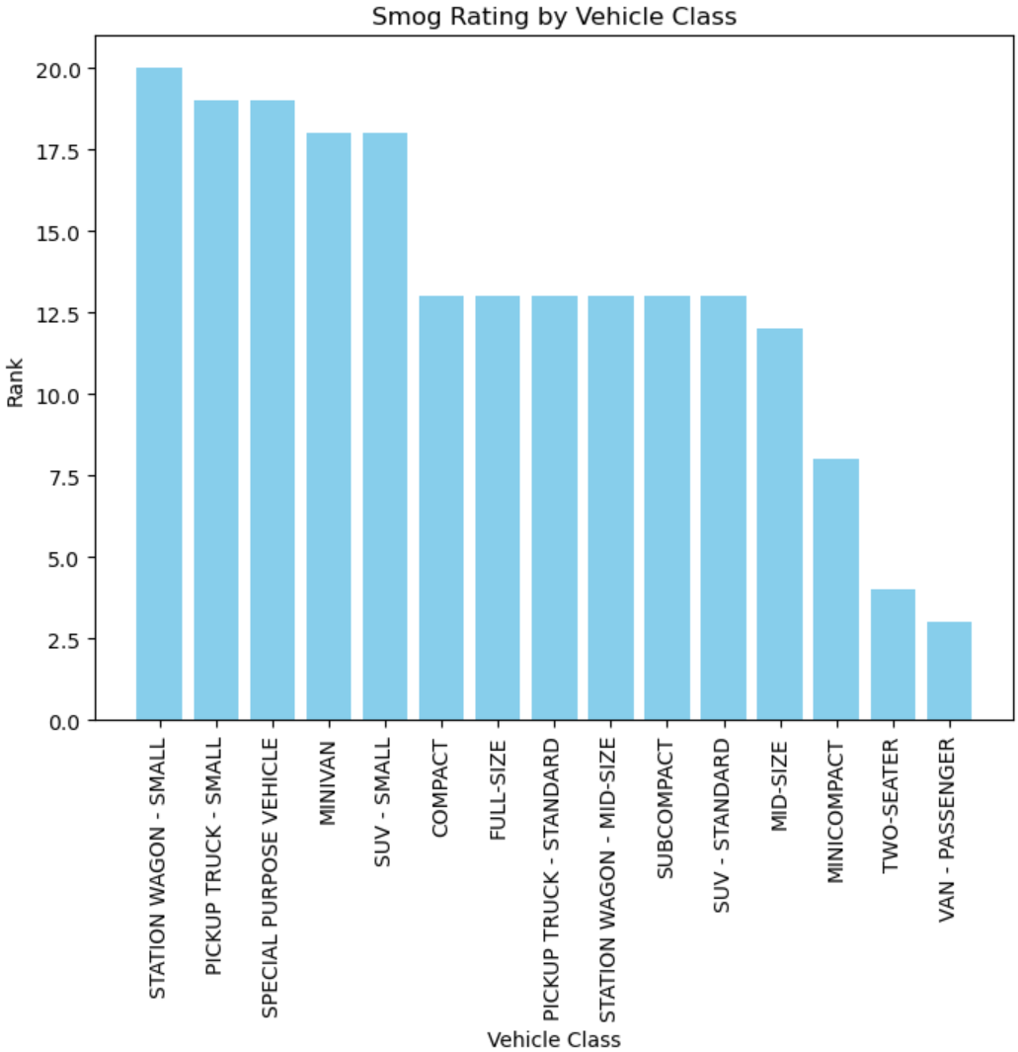
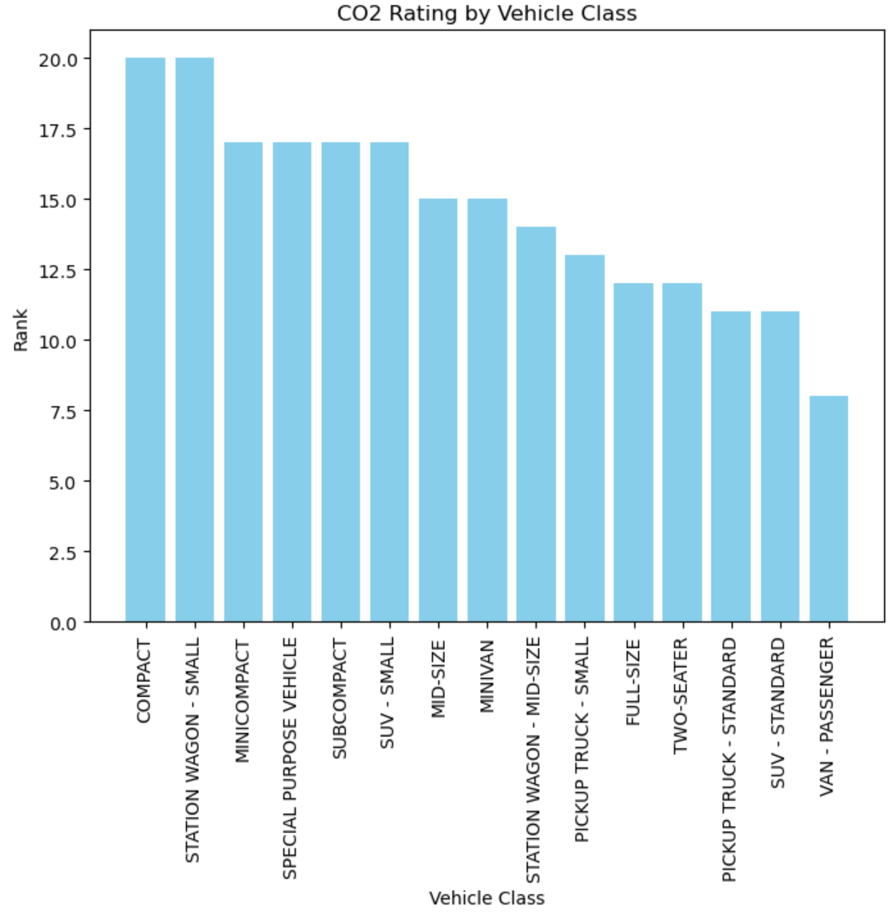
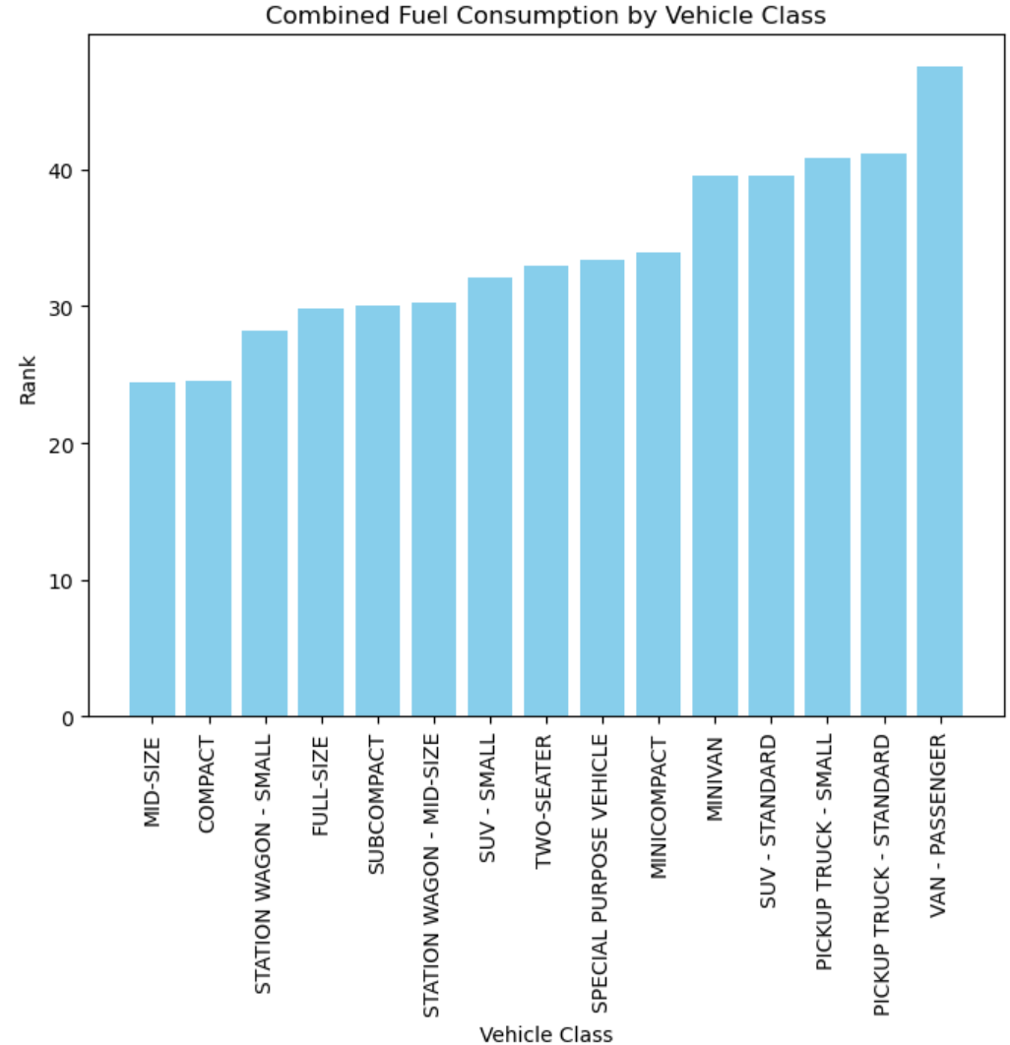
Few Important Findings from EDA
Notes:
Rating are 1-10 10 being the best hence in descending order, for fuel consumption in ascending order cux lower means best here.
Weighted score was calculated to rank these.
- for Smog & CO2 Ratings it was calculated based on:
- median, 75% and IQR
- 2, 2, 3
- for fuel cons it was calculated based on
- median, 25% and IQR
- 2, 2, 3

Slide 7
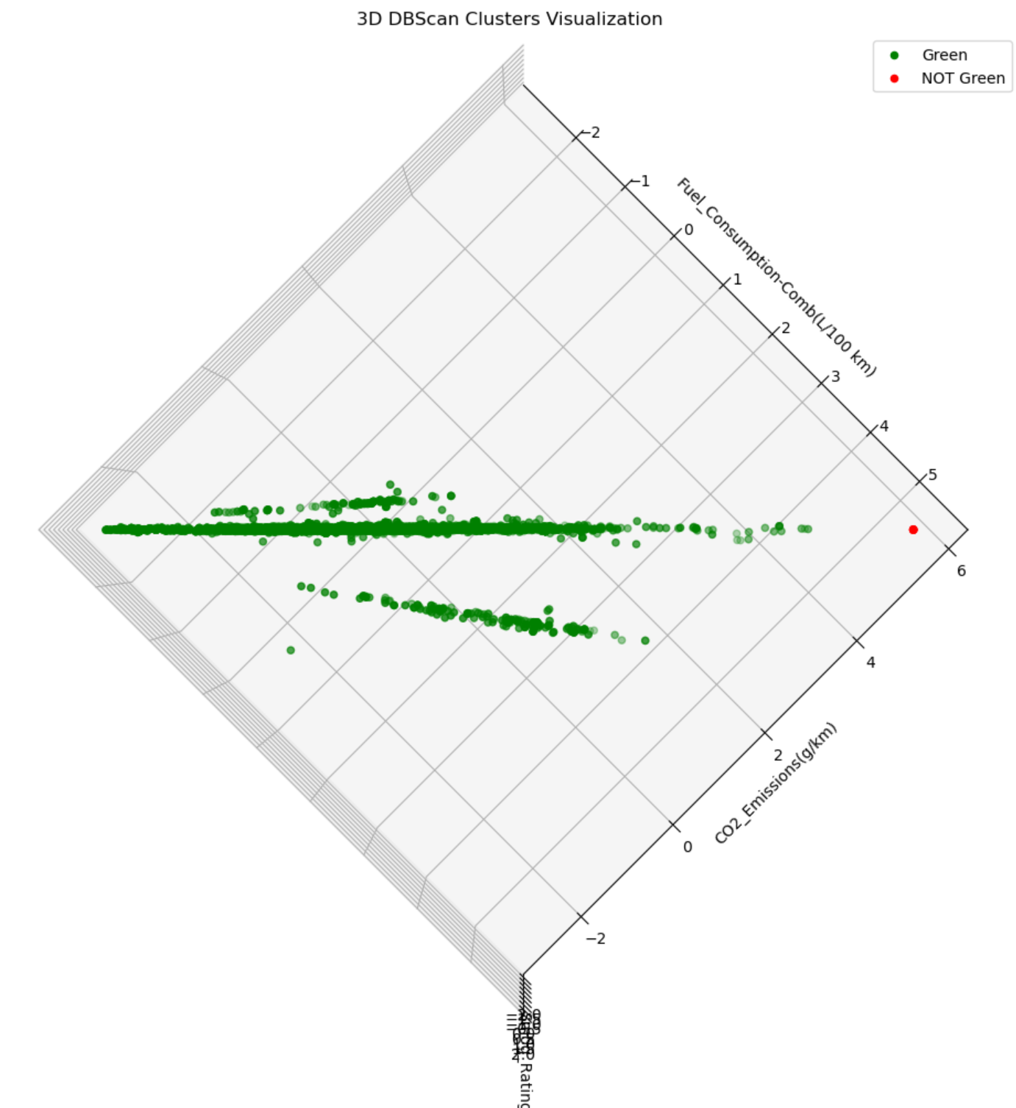
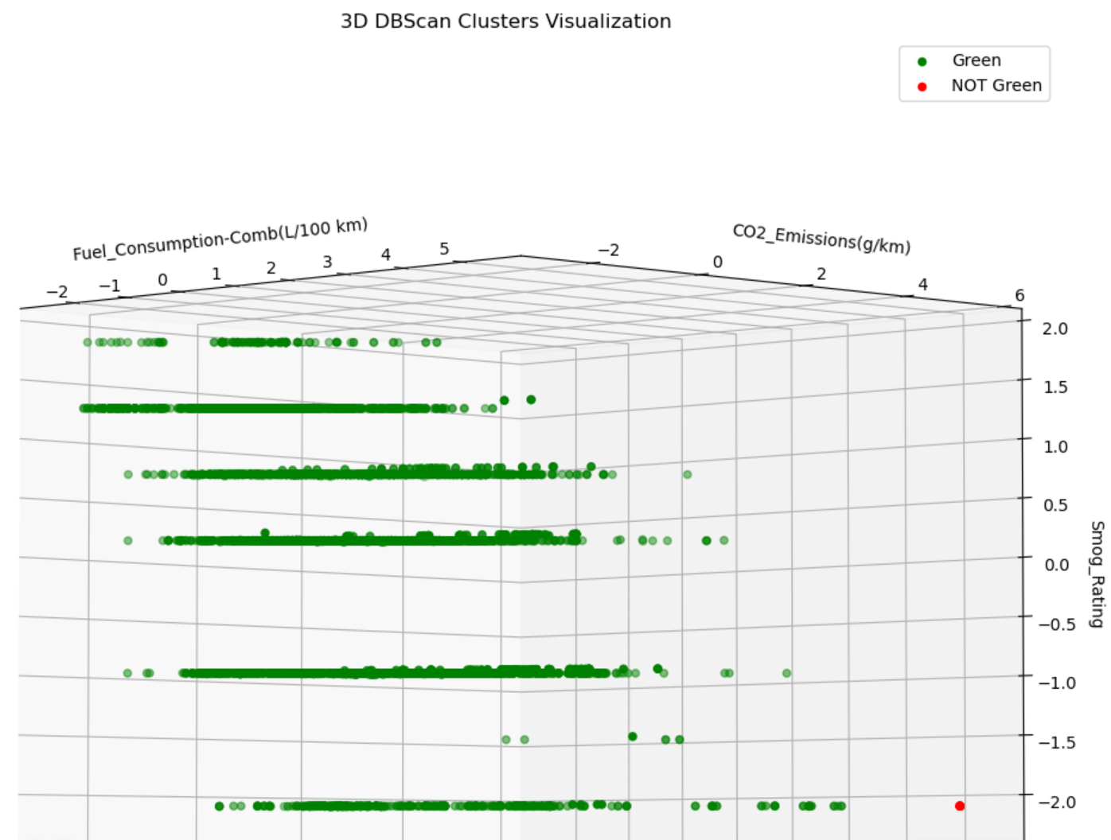
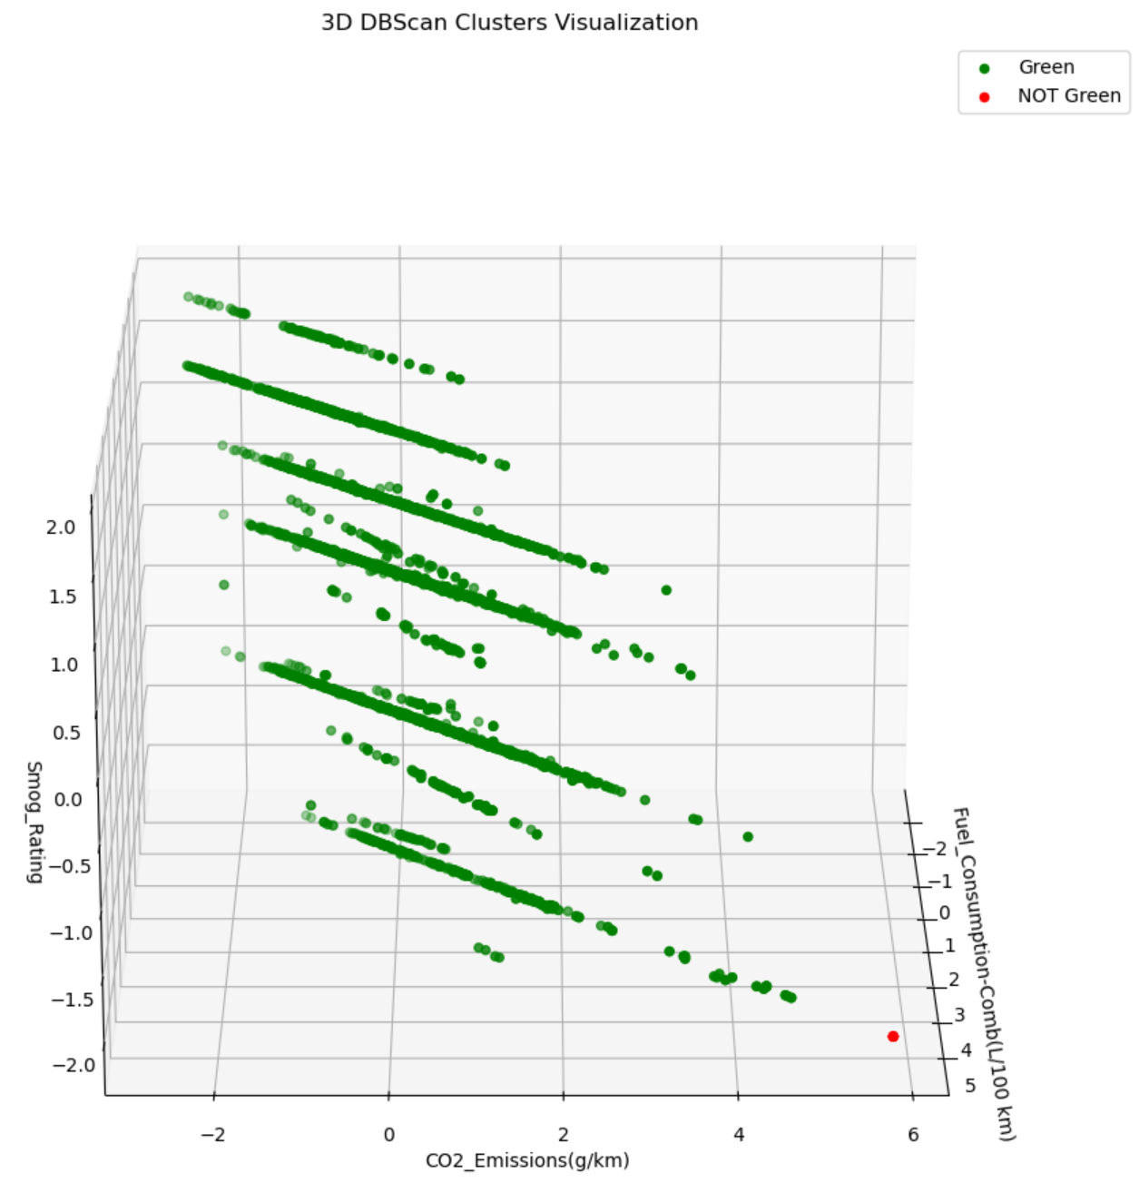
Model Comparison & Interpretations
Best | KMeans | DBScan | DBScan_v2
# of features | 18 after 1 hot encoding | 18 after 1 hot encoding | 3
Clusters formed | 420 | 2 | 2
Silhouette Score | 0.60303 | 0.5395 | 0.72877
Notes:
- silhouette score was chosen here for comparison cux inertia is something for kmeans only
- initially when kmeans had 420 clusters I thought hmmm that make sense because combined fuel consumption, co2 emissions and smog rating vary for different year, make and vehicle classes and each would have 2 categories (green or not green) but it definitely looked daunting to analyze to label the clusters as green or not green.
- As you can see that when both models had same number of features DBScan was able to produce 2 clusters while Kmeans was only able to yield better silhouette score with 420 clusters. Seeing just 2 custers from DBScan modelling, gave me the idea that perhaps it really all just boils down to 3 features even though green or not green varies by make and vehicle class as well. Those 3 features are:
- Combined fuel consumption
- CO2 emissions
- Smog Rating
- So I tried again with just these 3 features and was able to yield much better results as you can tell by the silhouette score.
- cluster separation is very clear from all angles
-

Slide 8
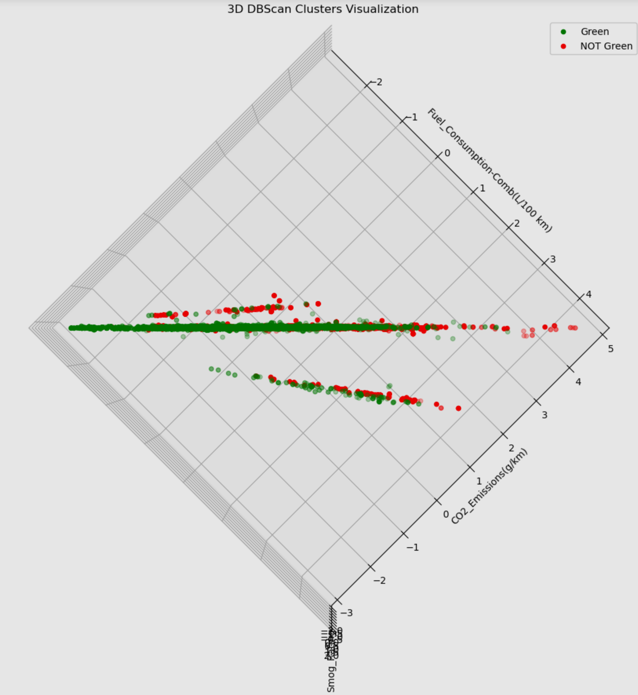
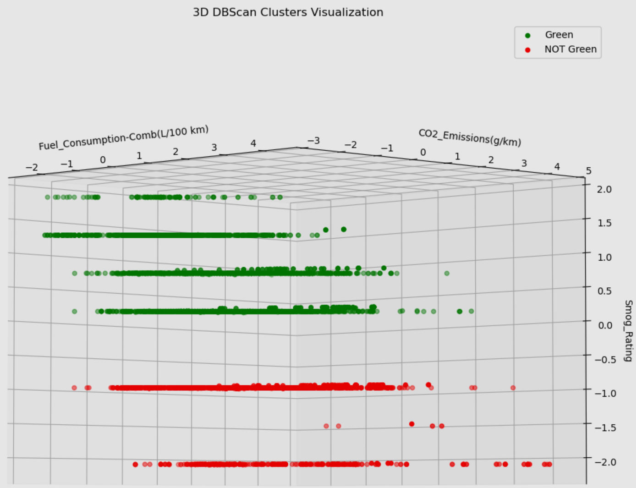
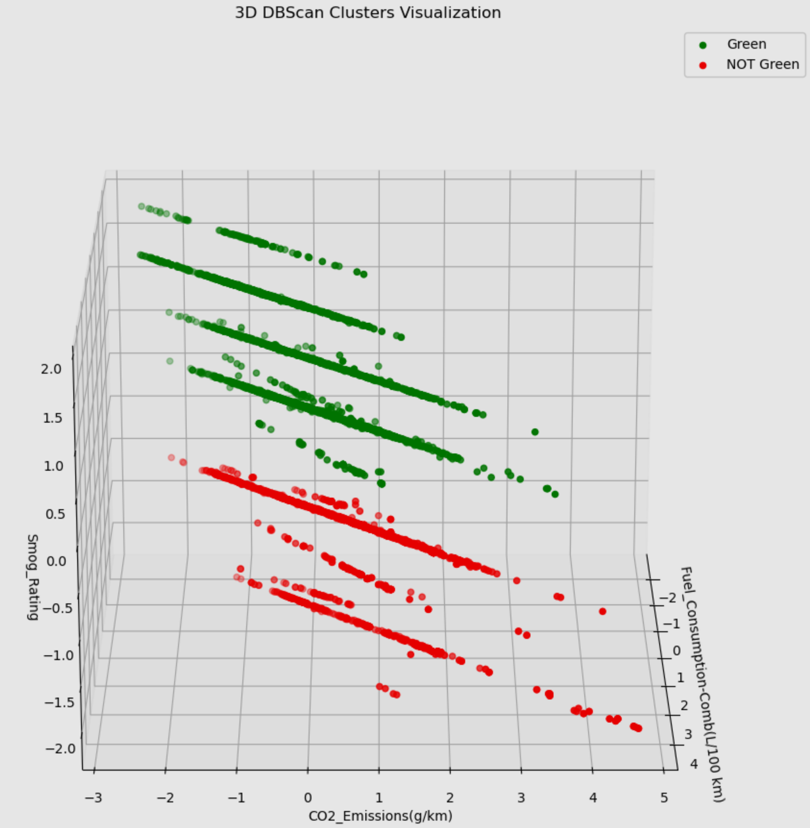
Model Comparison & Interpretations
DBScan Model Silhouette Score: 0.72877
DBScan Model Silhouette Score: 0.36285
Notes:
- Model visualization with white background are of DBScan model with silhouette score of 0.72877
- Model visualization with grey background are of DBScan model with silhouette score of 0.36285
- As you can see the model at the bottom did cluster with almost an equal separation however, if you see the bird’s eye images most of the red clusters lies in the greener segment because they have both fuel consumption and co2 emissions values low, mainly
- this tells me 2 things:
- that Fuel consumption and CO2 emissions have a higher feature importance compared to smog rating for determining whether the vehicles are green or not green

Slide 9
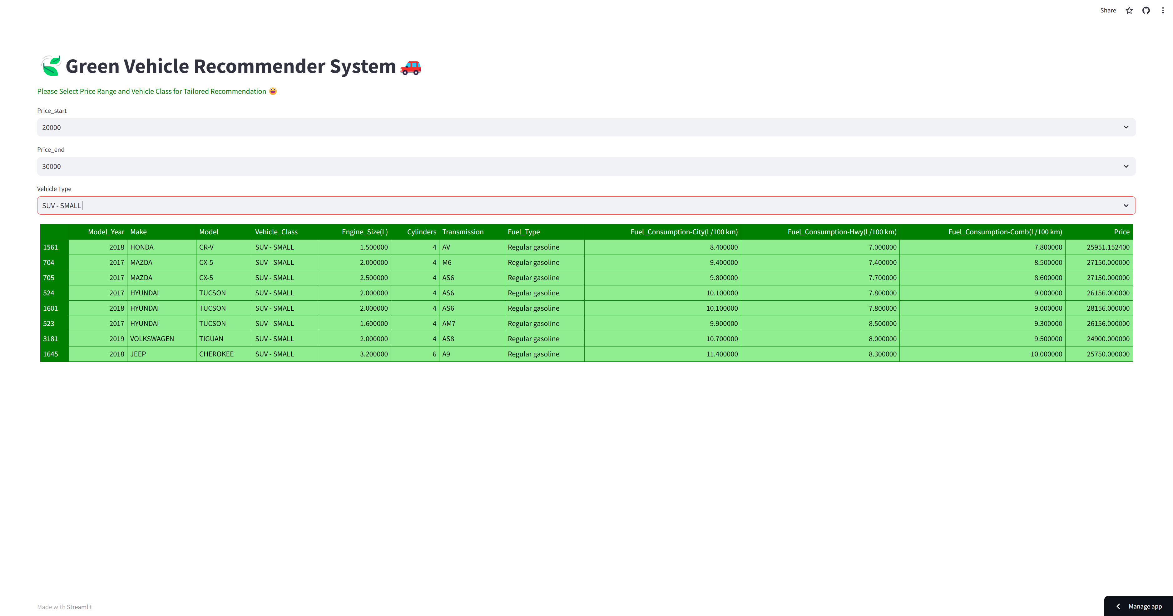
Demo
Demo Link: https://green-vehicle-recommender-system.streamlit.app/

