Slide 1
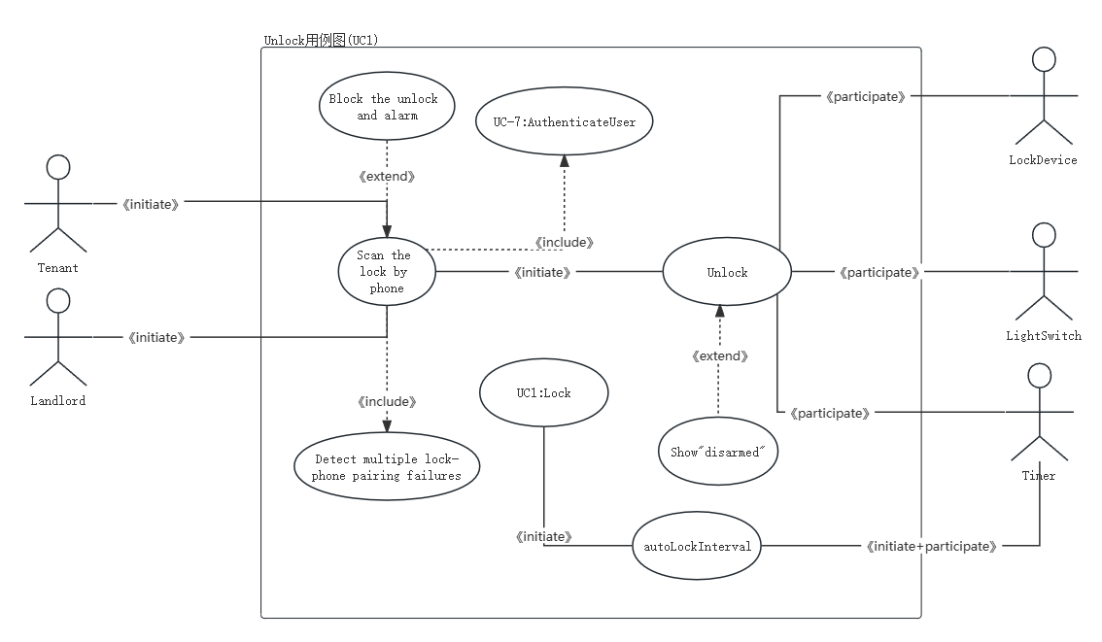

Slide 2
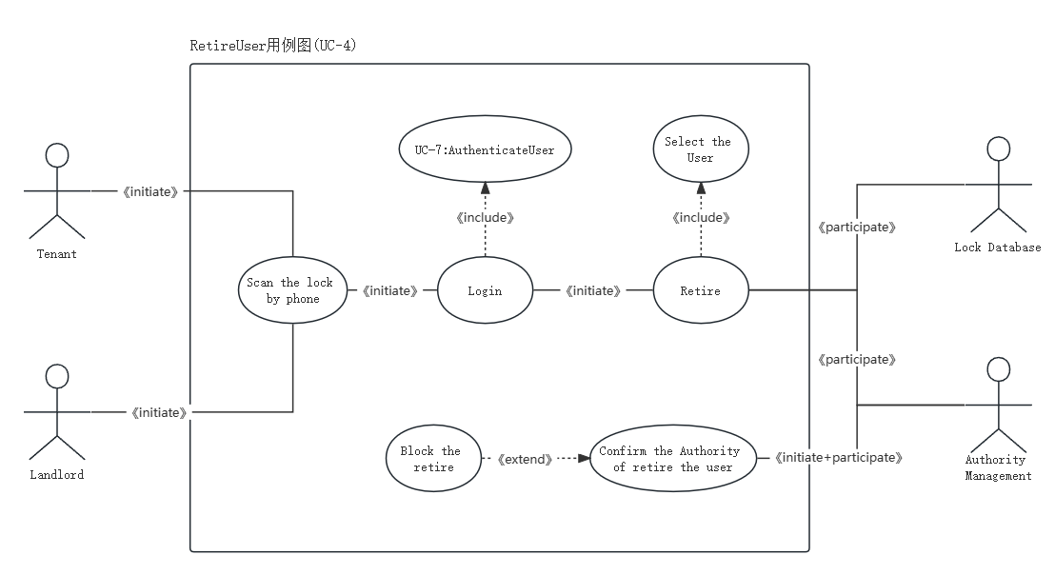

Slide 3
Use Case 1: Unlock
Use Case UC-1: |  |  | Unlock
Related Requirem’ts: |  |  | REQ1, REQ2, REQ3, and REQ4
Initiating Actor: |  |  | Any of: Tenant, Landlord
Actor’s Goal: |  |  | To disarm the lock and enter, and get space lighted up automatically.
Participating Actors: |  |  | LockDevice, LightSwitch, Timer
Preconditions: |  |  | • The set of valid mobile phone message stored in the system database is non-empty. • The system displays the menu of available functions; at the phone the menu choices are “Lock” and “Unlock.”
Postconditions: |  |  | The auto-lock timer has started countdown from autoLockInterval.
Flow of Events for Main Success Scenario:
→ | 1. | Tenant/Landlord arrives at the door and scan the lock
 | 2. | include::AuthenticateUser (UC-7), and decide to block or not selects the menu item “Unlock”
← | 3. | System (a) show the message “disarmed” on phone (b) signals to LockDevice to disarm the lock, and (c) signals to LightSwitch to turn the light on
← | 4. | System signals to the Timer to start the auto-lock timer countdown
→ | 5. | Tenant/Landlord opens the door, enters the home [and shuts the door and locks]

Slide 4
Use Case 4: RetireUser
Use Case UC-4: |  |  | RetireUser
Related Requirem’ts: |  |  | REQ7
Initiating Actor: |  |  | Any of: Tenant, Landlord
Actor’s Goal: |  |  | To manage additional user accounts by user mobile device
Participating Actors: |  |  | Lock database, Authority Management
Preconditions: |  |  | • The set of valid mobile phone message stored in the system database is non-empty. • The system displays the menu of available functions; at the phone the menu have the choice “RetireUser”
Postconditions: |  |  | The Lock database will delete the information of retired user.
Flow of Events for Main Success Scenario:
→ | 1. | Tenant/Landlord arrives at the door and scan the lock to login
 | 2. | include::AuthenticateUser (UC-7) selects the menu item “RetireUser”, and choose the user
← | 3. | System (a) signals to Authority Management to determine whether retire or not, if not, block the delete.
← | 4. | (b) signals to Lock database to delete the info of the user and his/her phone.
→

Slide 5
Acceptance Test Case for UC-1 Unlock
Test-case Identifier: | TC-1
Use Case Tested: | UC-1, main success scenario
Pass/fail Criteria: | The test passes if the user with authority uses his/her phone to scan the lock, with less than a maximum allowed number of unsuccessful attempts
Input Data: | Phone which scans the code, door identifier
Test Procedure: |  | Expected Result:
Step 1. Using the phone without Authority to scan the code |  | System beeps to indicate failure; records unsuccessful attempt in the database; prompts the user to try again
Step 2. Using the phone with Authority to scan the code |  | The phone show “disarmed” to indicate success; records successful access in the database; disarms the lock device

Slide 6
Acceptance Test Case for UC-4 RetireUser
Test-case Identifier: | TC-2
Use Case Tested: | UC-4, main success scenario
Pass/fail Criteria: | The test passes if the user with authority uses his/her phone to retire someone, with less than a maximum allowed number of unsuccessful attempts
Input Data: | Phone which scans the code, the user who will be retired
Test Procedure: |  | Expected Result:
Step1.Using the phone without Authority to scan the code |  | System beeps to indicate failure; attempt is blocked by Authority Management
Step2. Using the phone with Authority to scan the code |  | Records of the user successful be removed in the database;

