Slide 1
Electronic voting application based on public verifiable secret sharing
Author:
Sune Chung Jepsen Kasper Jensen Lemming
Notes:
Start: Sune

Slide 2
Presentation
Who are we?
Motivation for this thesis?
Notes:
Sune starter med at præsentere sig
Kasper: præsentation og motivation

Slide 3
INtroduction
Notes:
Sune: Objective, More research on the Subject: How can we tie our theoretical part together with the pratical part , Voting: registration, poolingsite, votingbox, ballotbox, officials, implicit security requirements
Sune: Paper based voting
Kasper: Electronic voting: remote internet, broad access, universal verfiability, roboustness, privacy

Slide 4

Objectives
Notes:
Sune

Slide 5

Paper based Voting
Notes:
Sune

Slide 6
General electronic voting and Crypthography
Notes:
Actually there where litterature which has describe the different element for an general electronic voting scheme

Slide 7
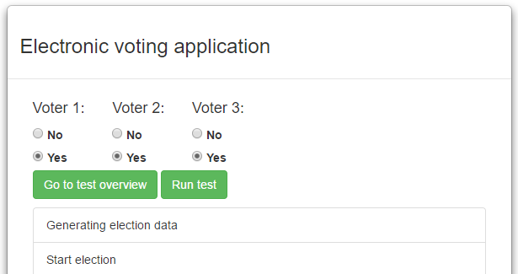
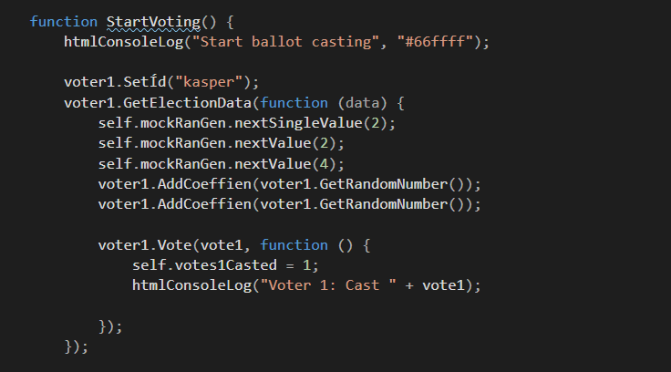
Showcase of application
Notes:
Sune: første del af applikationen
Kasper: anden del af applikationen

Slide 8
Protocol

Slide 9
Explaination of the protocol
Notes:
Kasper

Slide 10
Ballot casting and tallying
Notes:
Sune

Slide 11
Public verifiable secret sharing
Multiparty computation
Shamirs Secret Sharing
HOMOMORPHIC ENCRYPTION
ZERO KNOWLEDGE PROOF
Notes:
Shamirs Secret Sharing
Lagrange interpolation
Example computation

Slide 12
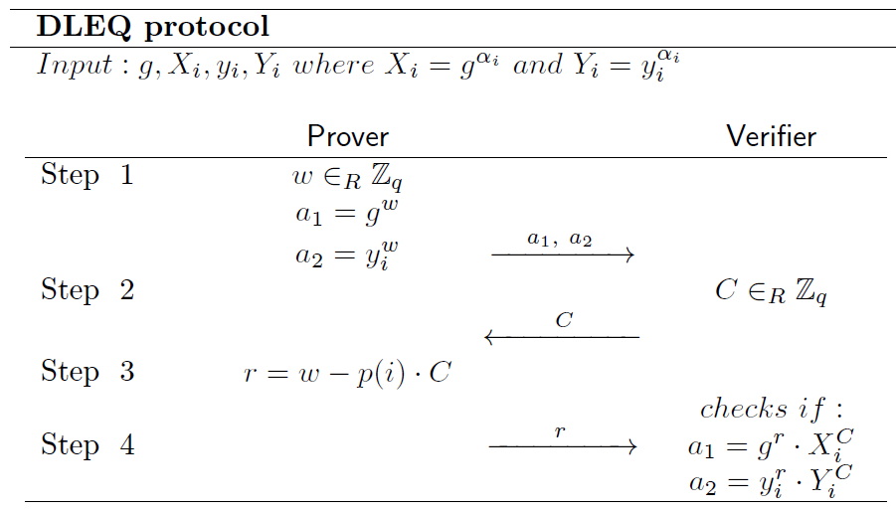
Proofs
DLEQ: CONSISTENCY IN EXPONENTS
PROOF_U: BALLOT CONTAINS A VALID VOTE
Notes:
Additional to this protocol is the proofs.

Slide 13
Mathematical understanding

Slide 14
The application
Notes:
Kasper køre overgangen

Slide 15
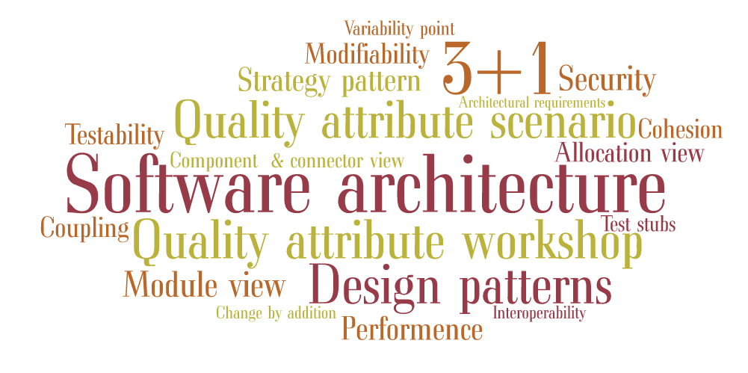
ArchitecTural design
Notes:
Tagcloud: QAW, QAS, Tactics, 3+1, design patterns, performence, model view c&C , strategy pattern
Sune kører showet

Slide 16
Design decisions
Interoperability
Modifiability
Security
Testability
Notes:
Sune

Slide 17
Implementing the application
Challenges
External libraries (remainder vs modolus)
Primality test (time consuming)
Debugging
Proof of concept
Notes:
Sune: Debugging , proof of concept

Slide 18
Reflection
The learning process
Limitations
What would we do if we should do a new thesis

