Slide 1
MOVIE RECOMMENDATION SYSTEM
Himanshu:2023UG000159
RohitKumar:2023UG000181
ShaikSameerRoshan:2024UG100001
Manjushree.M.R:2024UG000175
Suneel:2023UG000150
Thanushree:2024UG000165

Slide 2
INTRODUCTION
A movie recommendation system suggests films based on user preferences, such as genre, actors, and directors. It offers personalized recommendations, keeping content fresh for both new and returning users. First-time users can receive smart suggestions even with minimal input, ensuring an engaging experience for all.

Slide 3
DOMAIN
The movie domain refers to the world of films, including various genres, actors, directors, and the different elements that make up the film industry. It includes everything from big-budget Hollywood blockbusters to independent art house productions and international films.
Movies serve as a powerful medium for storytelling, combining visual imagery, sound, and dialogue to entertain, educate, and evoke emotions in audiences. The domain involves various aspects of filmmaking, including scriptwriting, directing, acting, cinematography, editing, and sound design.

Slide 4
Problem Statement.
Build a movie recommendation system that suggests a mix of different movies and genres so users don’t get bored with the same suggestions. It should show new types of movies, and work well even when there’s little information about a new user.

Slide 5
GOAL.
The goal is to create a system that recommends movies users will enjoy, while offering variety. It should avoid repeating the same films, help users explore new genres, and recommend good movies to new users, even with limited data.

Slide 6
Data Visualization & Insights.

Slide 7
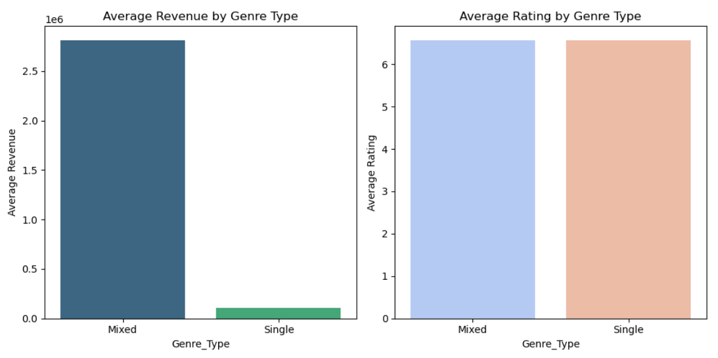
QUESTION: How does the distribution of genres impact a movie's success?Do movies with mixed genres (e.g., action-comedy, drama-thriller) perform better in terms of revenue and ratings than single-genre films?
Visualization: The left bar chart shows the average revenue of movies categorized as either "Mixed" (movies with more than one genre, such as action-comedy) or "Single" (movies with a single genre).
The right bar chart shows the average IMDb ratings for the same genre categories.
Insights:
This analysis highlights that combining genres can boost a movie's revenue but does not necessarily lead to higher viewer ratings.

Slide 8
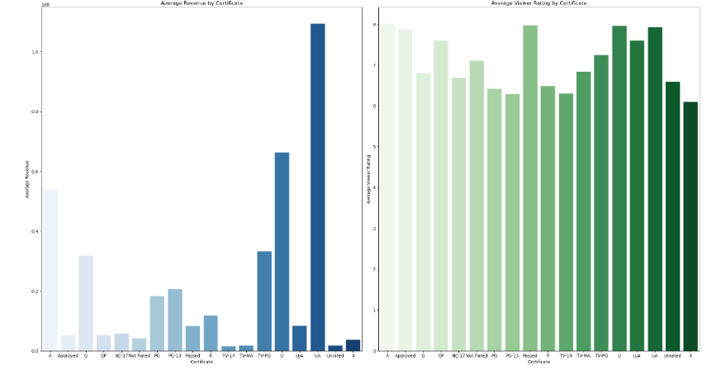
QUESTION:Is there a relationship between a movie's age rating (G, PG, R, etc.) and its popularity and revenue? Do movies with specific age ratings tend to perform better in terms of box office or viewer ratings?
Visualization: The left bar chart presents the average revenue of movies by their age rating (or certificate).
Insights: This analysis highlights that age ratings play a significant role in determining both the revenue and viewer approval of a movie. Some ratings tend to perform better financially, while others focus more on satisfying viewer preferences.

Slide 9
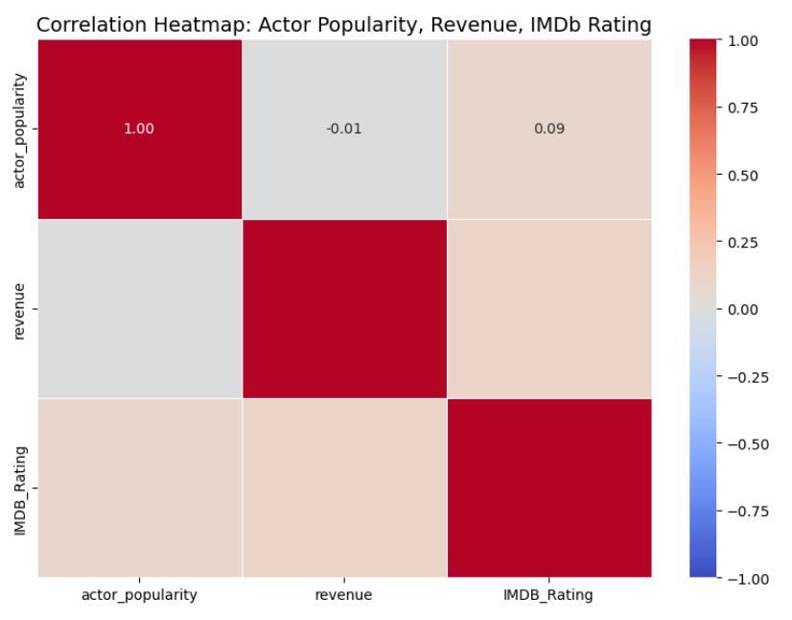
QUESTION: How does the lead actor/actress's popularity influence a movie's success? Do movies featuring highly popular actors tend to generate more revenue and higher ratings?
Insights: Popular actors don't significantly influence box office revenue, as shown by the very weak correlation of -0.01.
Actor popularity has minimal influence on IMDb ratings, showing a very weak positive correlation (0.09)
Higher revenue doesn't guarantee higher IMDb ratings, as the correlation between them is low.

Slide 10
More Insights:
Q) How do movie release windows (summer, winter, or other periods) affect average revenue and IMDb ratings?
IMDb Ratings Stay Constant: Despite the difference in revenue, movies released in different windows receive similar ratings. This indicates that higher revenue is more likely tied to the time of release rather than the quality or audience satisfaction.
Q)Which movie genres generate the highest total revenue?
Mixed genre movies: Higher average revenue, suggesting wider commercial appeal but potentially with slightly diluted critical acclaim or audience preference.
Q) How does the number of production countries affect a movie's revenue and IMDb rating?
There seems to be a sweet spot for revenue around 9-10 production countries. Releasing in too many countries might dilute the movie’s appeal, leading to lower returns. The number of countries a movie is released in doesn’t show a strong correlation with IMDb ratings, with significant fluctuations rather than a steady increase or decrease. This implies that releasing in more countries does not consistently enhance audience satisfaction.

Slide 11
Q)How does a movie's budget relate to its revenue and IMDb rating?
Budget Matters, But Not Entirely: Budget plays a role in a movie's revenue potential, but it's not the only factor.
Quality vs. Spending: A larger budget doesn't directly translate to a higher-rated or more critically acclaimed film. Other factors heavily influence audience and critic perception.
Q)How does the popularity of movies vary with their vote average ?
Strong Correlation Between Vote Average and Popularity: The chart clearly shows that movies with higher vote averages tend to be significantly more popular. The higher the rating a movie receives, the more popular it becomes with audiences.
Popularity Spikes for Top-Rated Films: The most notable surge occurs for movies with a 9-10 vote average, indicating that audiences are heavily drawn to highly acclaimed movies, both in terms of reviews and likely overall quality.
Q) How does a movie's runtime affect its popularity and revenue?
The relationship between runtime, popularity, and revenue may vary across different genres. For example, certain genres like dramas or epics may have higher acceptance for longer runtimes.
The quality of the movie, including its storytelling, acting, and production values, will also influence its popularity and revenue. The specific preferences of the target audience should be considered when making decisions about runtime.

Slide 12
Q)How does the IMDb rating relate to the vote average and the Meta score of movies?
Moderate Correlation: The scatter plot reveals a moderate correlation between IMDb ratings and vote averages, particularly in the mid to high rating ranges. While some divergence exists for lower-rated movies, there is a clear alignment of high IMDb ratings with higher vote averages, showing that movies highly rated by IMDb are generally well-received by the audience as well.
Q) Which production companies have the highest average budgets and revenues?
It is interesting to note that many of the companies that have high average revenue are associated with big-budget films and franchises. This suggests that there is a strong correlation between average revenue and the scale of a film production.
Q) What is the impact of spoken language on movie performance in terms of average ratings and revenue?
Strong Viewer Approval vs. Revenue: While some languages such as Arabic, English, and Urdu show strong audience approval, the connection between high vote averages and revenue isn't as direct. English-dominant movies, especially when paired with major international languages like Hindi and Spanish, perform the best in terms of revenue.

Slide 13
Multilingual Appeal: It appears that multilingual movies, especially those including English in combination with other prominent languages (e.g., Italian, Spanish, Hindi), generate more box office revenue.Cultural Preferences: Movies spoken in a variety of languages (like Arabic, Turkish, Urdu, and Malay) may attract high ratings but don't necessarily translate to higher revenue and This type of analysis highlights the complexities of global cinema, where critical reception (vote averages) doesn't always align with financial success.
Q) What are the most frequent collaborations between music composers and directors/production companies in the dataset?
The horizontal bar chart provides a clear and effective way to visualize the collaboration frequencies between composers and directors/production companies. It helps us identify the most prolific collaborators, understand the dynamics of the film industry, and gain insights into the preferences of directors/production companies.
Q) What are the runtimes of the top 10 hit movies based on IMDb ratings?
The pie chart demonstrates that hit movies span a wide range of runtimes, with epics like The Lord of the Rings and Schindler's List taking up a larger share, while shorter films like 12 Angry Men still retain a significant place in cinematic history despite their brevity. This analysis highlights how runtimes vary widely among top hit movies, and that both long and short movies can achieve critical acclaim and success.

Slide 14
Conclusion.
The movie recommendation system created in this project offers personalized suggestions, solving challenges like limited genre options and the cold-start problem. The analysis shows that mixed-genre films often earn more revenue, although viewer ratings are stable across genres. Other important factors include movie budgets, release timing, actor fame, and age ratings, all impacting both financial success and audience approval. By considering these elements, the system can improve user satisfaction, making it a useful tool in the competitive streaming market and boosting user engagement.

