Slide 1
+-------------------------+
| User uploads Excel |
+-----------+-------------+
|
v
+-----------+-------------+
| Preprocess & Schema |
| - parse, clean, map |
+-----------+-------------+
|
v
+-----------+-------------+
| Compute RAG Scores |
| - apply thresholds |
| - tag rows R / A / G |
+-----------+-------------+
|
+-------------------------+-------------------------+
| |
v v
+-------+-------+ +-------+-------+
| Index rows | | Dashboard / |
| (embeddings) | | KPI summary |
+-------+-------+ +-------+-------+
| |
v |
+-------+-------+ |
| Chat / RAG |<------- User queries / Chat UI ---------+
| Assistant | (retrieval → LLM → explanation/actions) |
+-------+-------+ |
| |
v v
+-------+-------+ +-------+-------+
| Suggested | | Report gen |
| edits/actions| | (Excel/PDF) |
+-------+-------+ +-------+-------+
| |
+-------------------------+-----------------------+
|
v
+-----------+-------------+
| Apply edits to Excel |
| → save version / export|
+-------------------------+

Slide 2
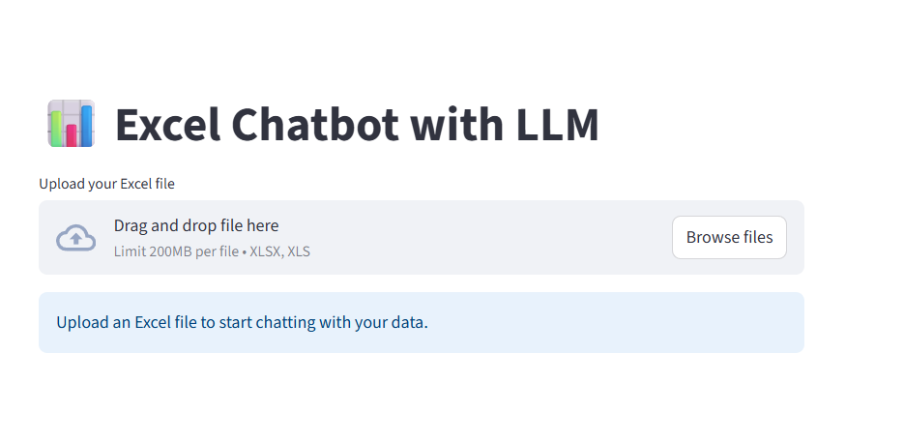

Slide 3
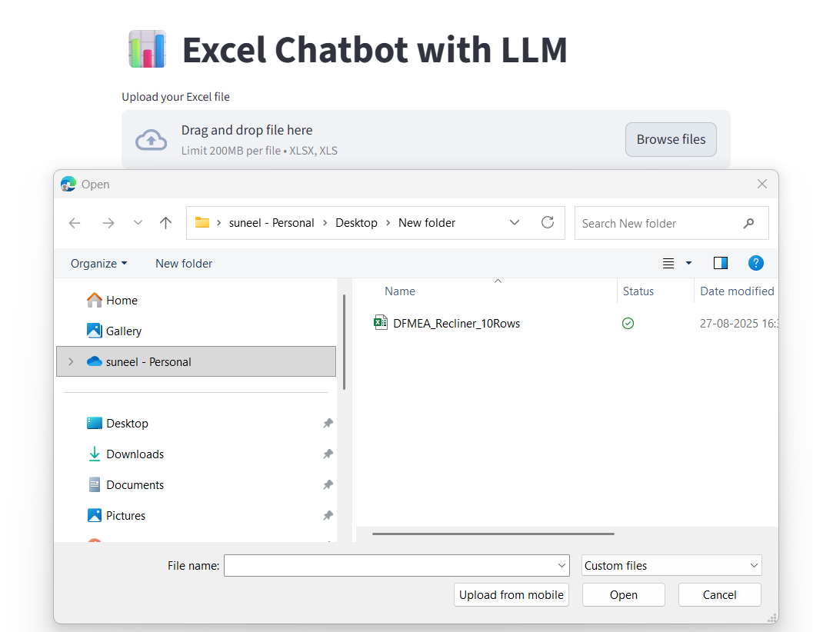

Slide 4
