Slide 1

3rd International Conference on Advanced Network Technologies and Intelligent Computing (ANTIC-2023) 20-22 December, 2023 Organized By: Department of Computer Science, Institute of Science, Banaras Hindu University, Varanasi, India
Paper ID: | 419
Title: | On Designing an Intelligent Shipping Algorithm for Decentralized E-Commerce Systems
Author(s) Name: | Suneel Kumar^{1,2}, Sarvesh Pandey², Umesh Bhatt^{2,3}
Author(s) Affiliation: | ¹Department of Computer Science, Banaras Hindu University, Varanasi-221005, India ²Computer Science, Mahila Mahavidyalaya, Banaras Hindu University, Varanasi-221005, India ³Indian Institute of Technology Madras, India
Presenter: | Suneel Kumar

Slide 2
Outline
Introduction
Related Work
Problem Statement
Proposed Work
Methodology
Results
Conclusion
References

Slide 3
Introduction
E-commerce is the activity of electronically buying or selling products or services over the Internet.
The major e-commerce platforms include Amazon, Flipkart, and others.
Importance of Reward Systems in E-commerce
Enhance customer engagement and loyalty.
Drive revenue growth through incentivized purchases.
We have utilized blockchain technology to store the user order data in a decentralized, transparent, and immutable manner.

Slide 4
Related Work
Idea-level Contribution
Investigated the impact of delivery costs on supply chains.[1]
Explored designing shipping policies with top-up options.[2]
Limitation
Shipping fee exemptions only after a threshold amount
Favoring customers with purchases exceeding the threshold.
[1] | Shao, Xiao-Feng. "Free or calculated shipping: Impact of delivery cost on supply chains moving to online retailing." International Journal of Production Economics 191 (2017): 267-277.
[2] | Li, Guang, Lifei Sheng, and Dongyuan Zhan. "Designing shipping policies with top‐up options to qualify for free delivery." Production and Operations Management (2023).

Slide 5
Problem Statement
Existing e-commerce reward models often favor larger purchases, neglecting frequent small-transaction users.
There is a clear demand for an inclusive shipping algorithm that fairly rewards users based on transaction frequency and amounts in decentralized e-commerce systems.
Current research lacks holistic solutions, highlighting the need for a novel approach that optimizes user benefits, retailer engagement, and platform growth.

Slide 6
Proposed Work
HIShip Algorithm
Historically Informed Shipping Algorithm.
Overcoming limitations of previous approaches.
Key Features
Considers recent transactions for eligibility.
Incorporates a threshold mechanism for free delivery.

Slide 7
Methodology
Python-based Blockchain Simulation
Simulating the HIShip algorithm.
Testing feasibility in a controlled environment.
Smart Contracts based Implemenatation on Ethereum Framework
Implementing HIShip using Ethereum's smart contracts.
Ensuring real-world applicability.
TPC-H Decision Benchmark Dataset
Utilizing a standardized dataset for performance evaluation.
Total orders – 500K

Slide 8
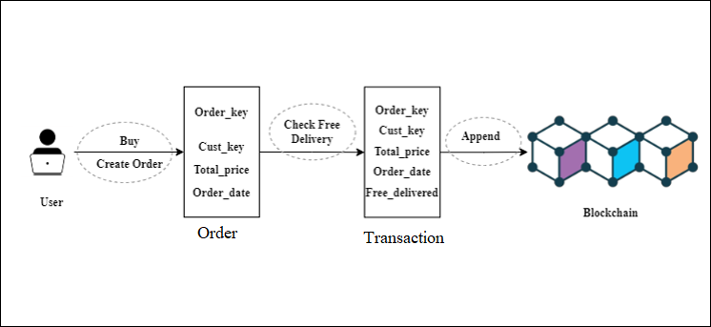
Simulation Workflow
Figure 1: Blockchain Simulation Flowchart

Slide 9
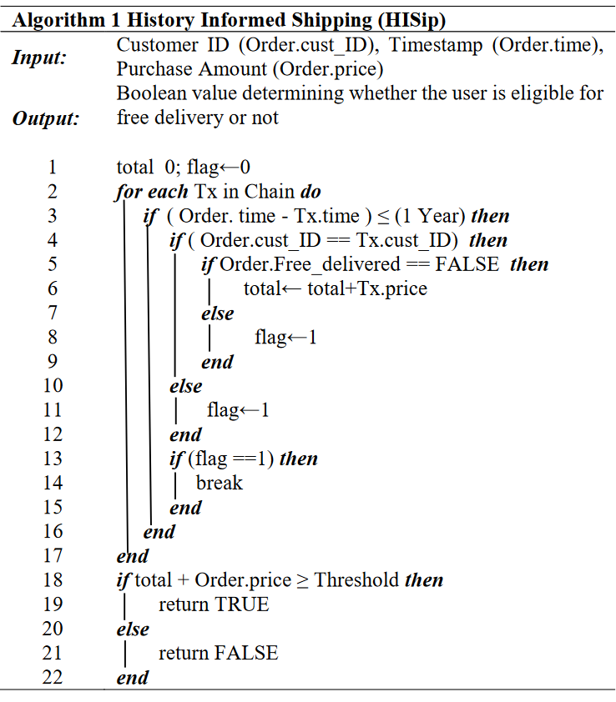
Simulation Workflow (Cont.)
User places an order on the e-commerce platform.
Historical Transaction Analysis:
HIShip (Algorithm 1) traverses recent blocks.
Calculates total past spent of that customer until an order with free delivery or one year has passed.
Threshold Mechanism:
Threshold set at 200K.
If past spent + current purchase amount is greater than threshold, free delivery is assigned.
Blockchain Process:
Transactions are added to the pool.
Miners compete to append blocks using Proof of Work consensus algorithm with difficulty 2.
After each block is mined, the chain is dumped into a JSON file.

Slide 10
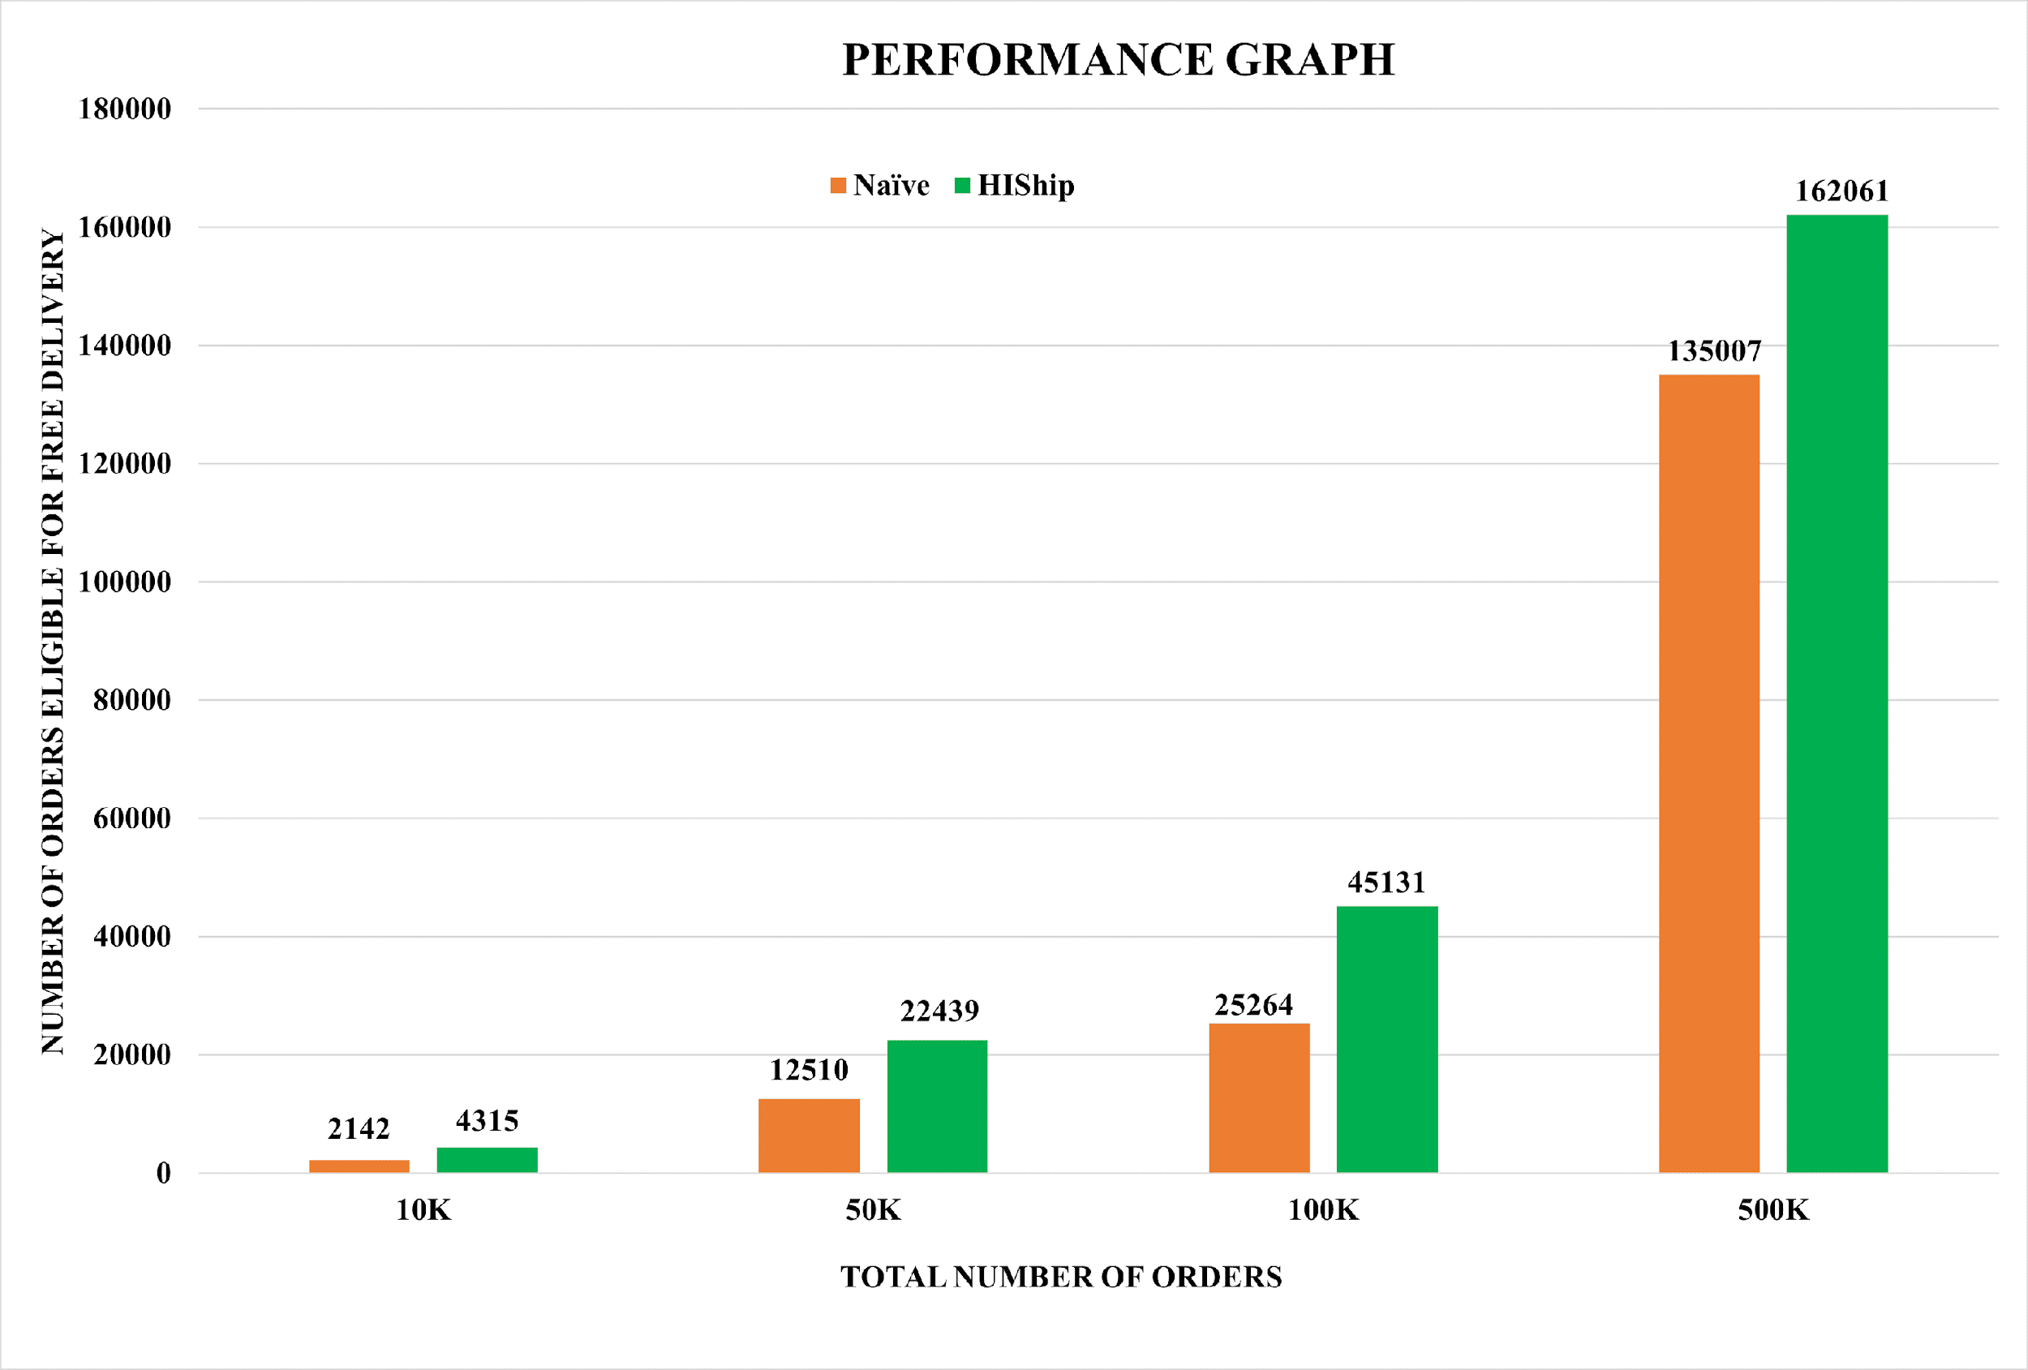
Results
Evaluation with TPC-H Dataset
Dataset containing 500K orders.
For evaluation we used data of different volumes (10K, 50K, 100K and 500K)
Increased User Benefits
HIShip outperformed basic threshold approach.
About 50% (in 10K, 50K, 100K) and 20%(500K) more users received free delivery (see Figure 2).
.
Figure 2: Performance comparison HIShip with the Naïve algorithm.

Slide 11
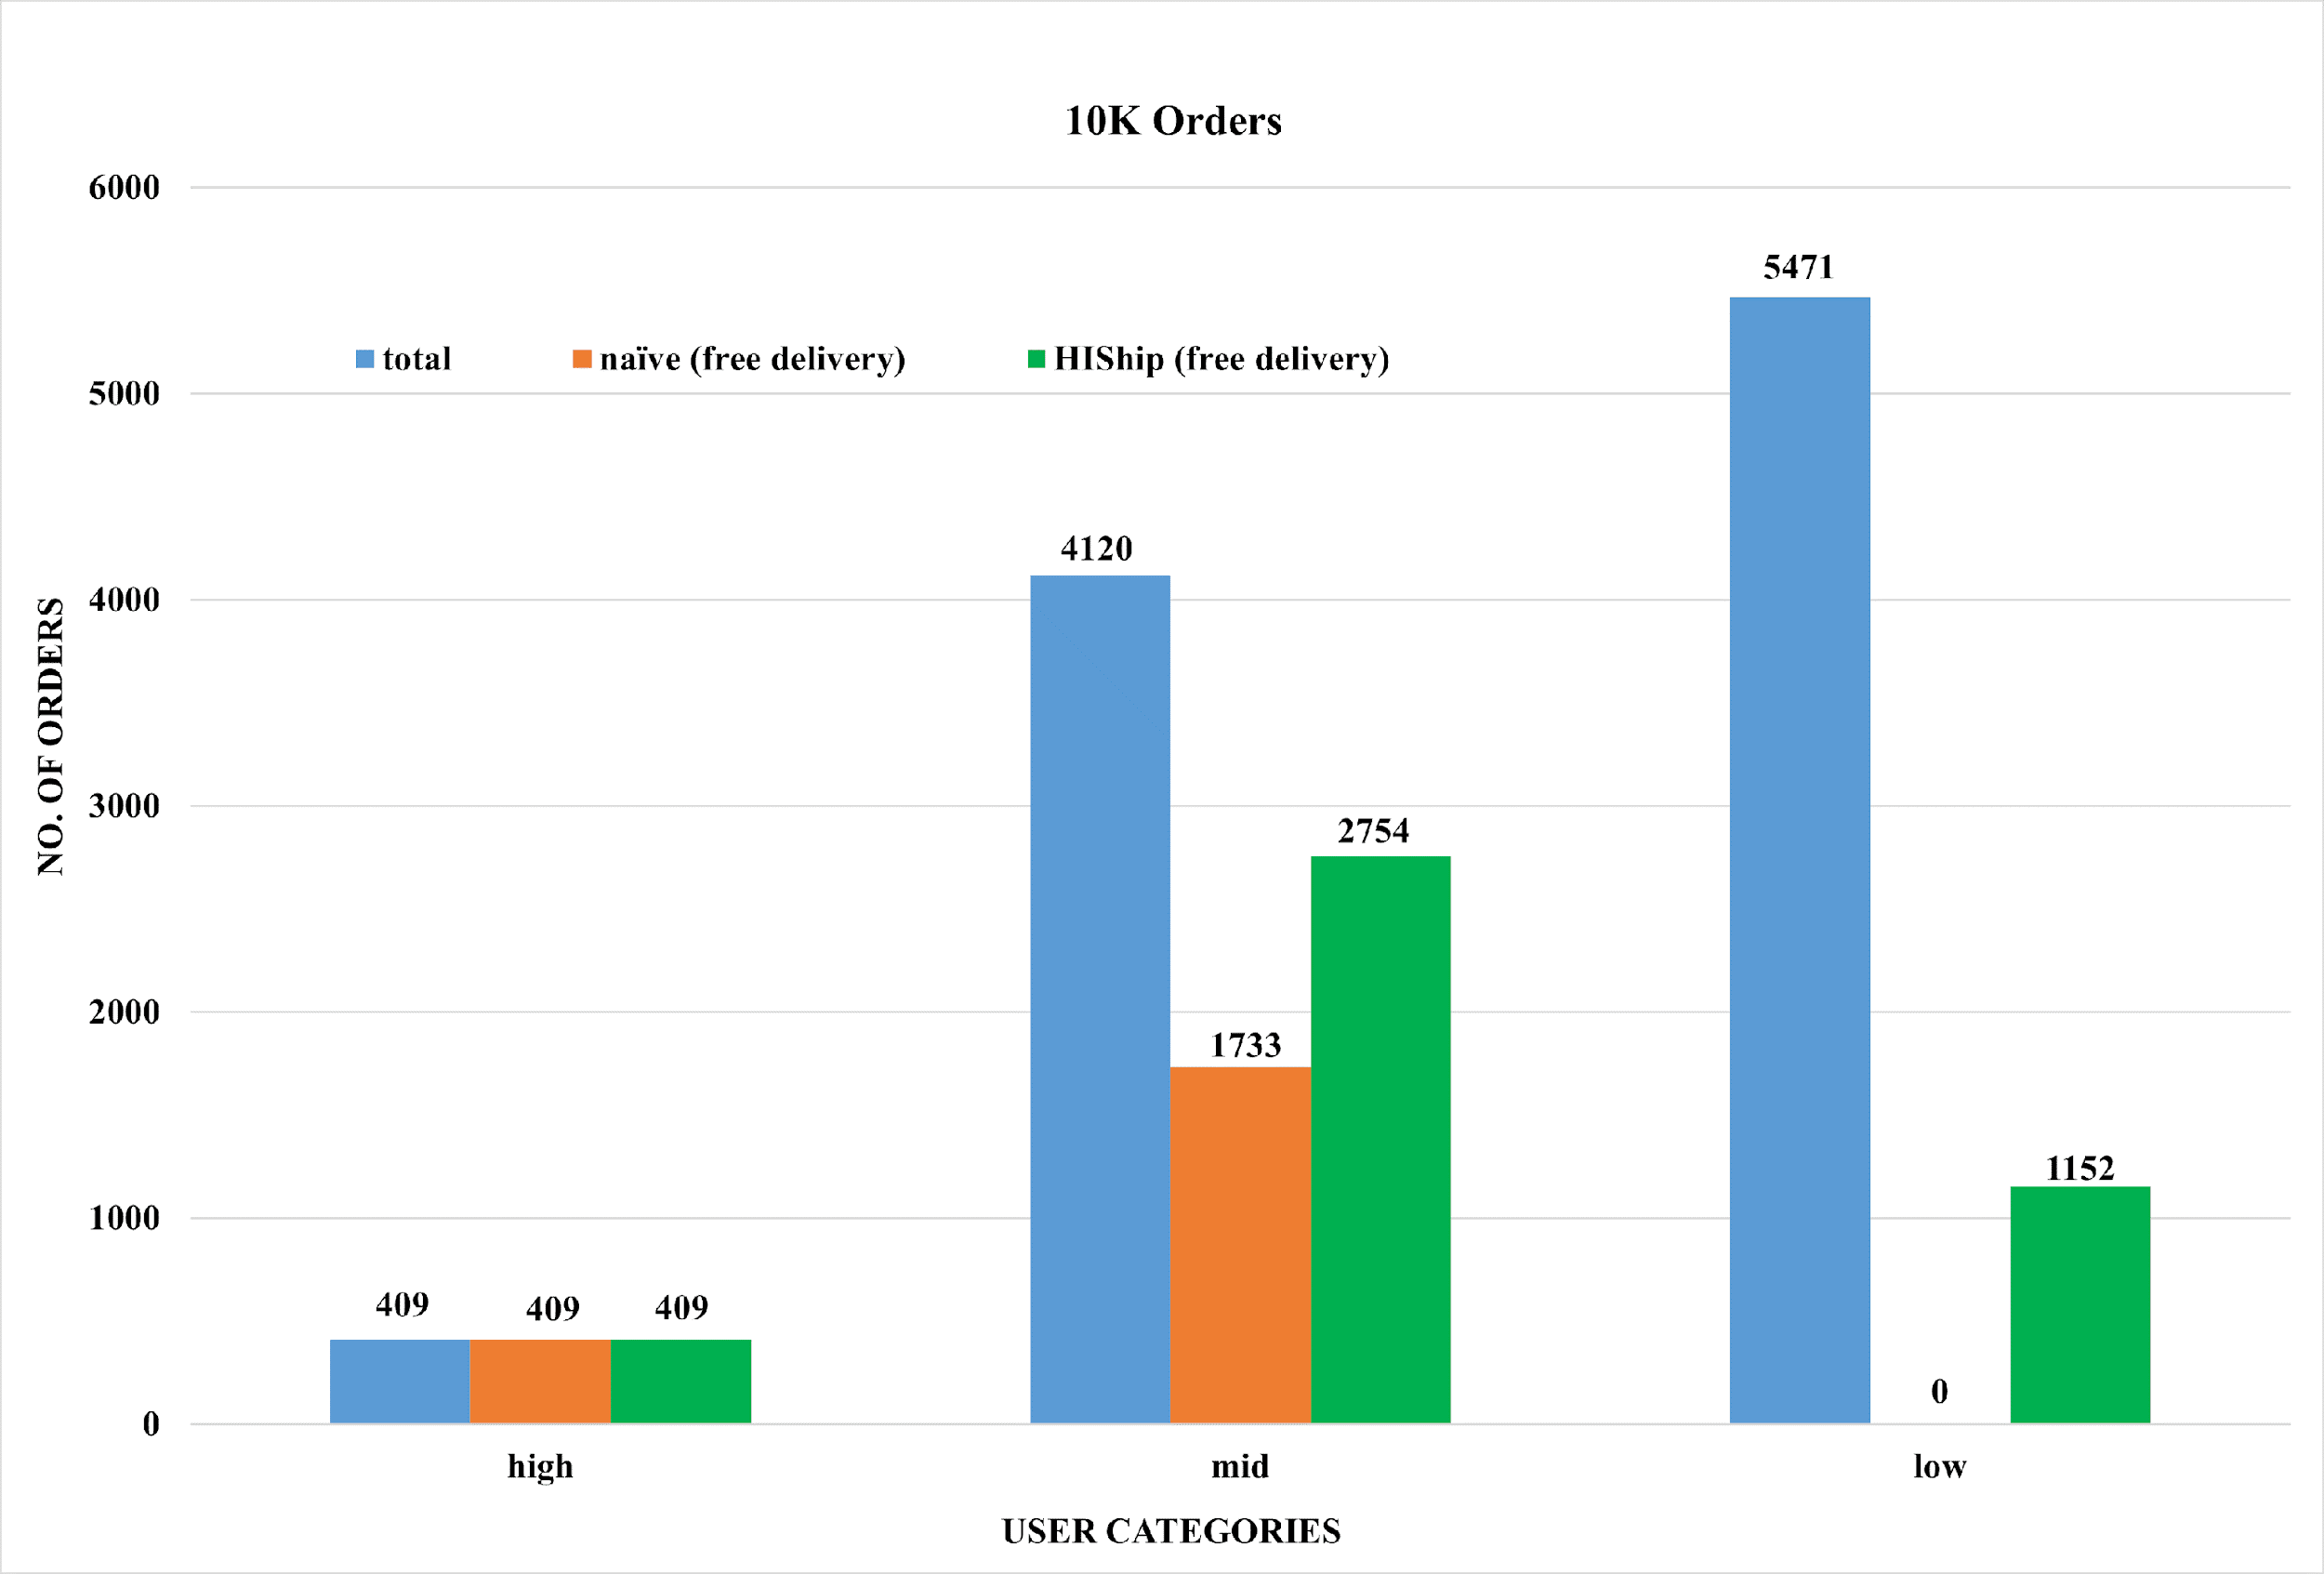
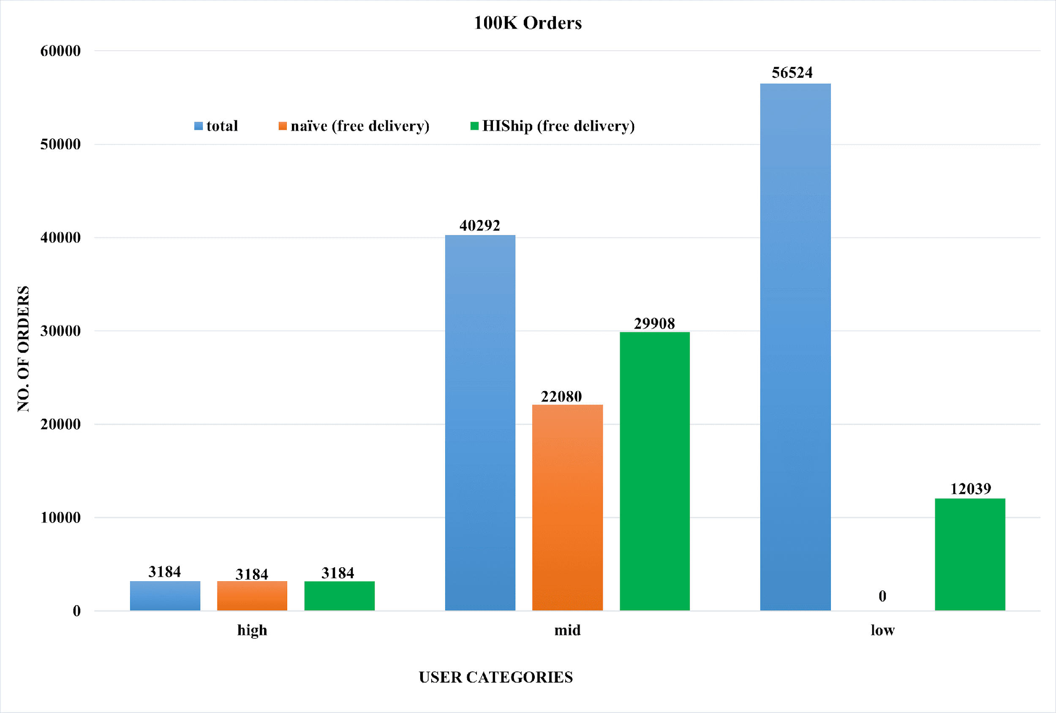
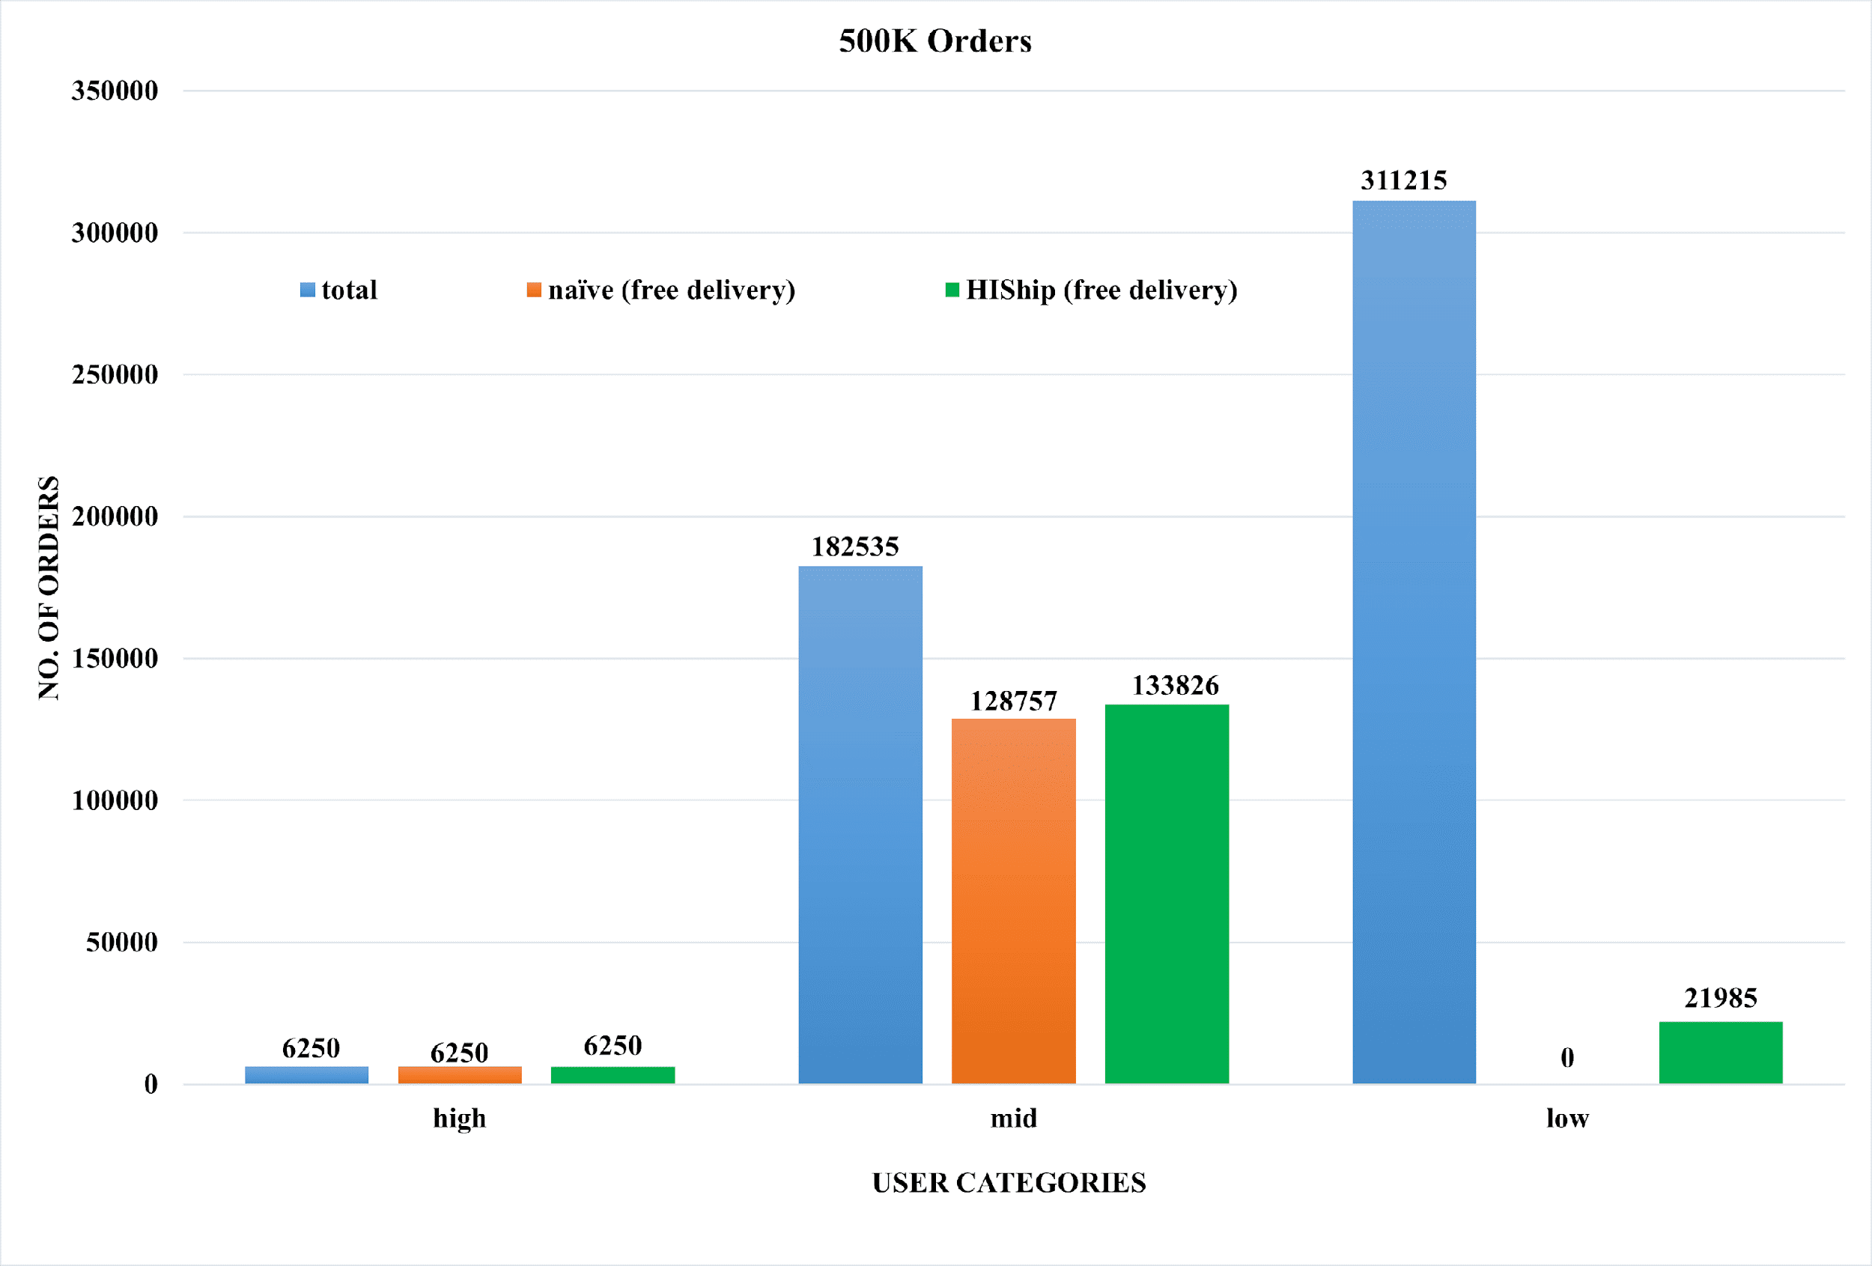
Results (Cont.)
Order Amount Categories
Categorization into high, mid, and low order amounts
Improvements Across Categories
20% increase in free deliveries for small orders.
36% increase for medium orders (see Figures 3-5).
Figure 3: 10K Orders Classification & Free Delivery Eligibility
Figure 4: 100K Orders Classification & Free Delivery Eligibility
Figure 5: 500K Orders Classification & Free Delivery Eligibility

Slide 12
Conclusion
HIShip effectively addresses e-commerce reward system limitations, ensuring fairness and inclusivity.
Blockchain integration enhances transparency and security in user order data storage.
The algorithm fosters mutual benefits, promoting customer engagement and sustainable revenue growth.
Performance validation using TPC-H dataset underscores HIShip's real-world feasibility and superior outcomes.
Categorization results highlight HIShip's adaptability across diverse order volumes, emphasizing its versatile impact.

Slide 13
References
[1] | India Brand Equity Foundation, "E-commerce Industry in India," [Online]. Available: https://www.ibef.org/industry/ecommerce. [Accessed 1 09 2023].
[2] | H. P. Bulsara and P. S. Vaghela, "Blockchain Technology for E-commerce Industry," International Journal of Advanced Science and Technology, vol. 29, pp. 3793 - 3798, 2020.
[3] | M. X. Teo, T. A. Maen and A.-M. Qusay, "Blockchain technology in E-commerce platform," International Journal of Management, vol. 11, pp. 1688--1697, 2020.
[4] | Hotea Solutions, "TPC-H Vesion 2 and Version 3," 14 09 2023. [Online]. Available: https://www.tpc.org/tpch/
[5] | B. Melyssa, B. Jorge and F. Pedro, "An overview of decision support benchmarks: TPC-DS, TPC-H and SSB," New Contributions in Information Systems and Technologies, vol. 1, pp. 619-628, 2015.
[6] | W. Gavin, "Ethereum: A secure decentralised generalised transaction ledger," Ethereum project yellow paper, 2014.
[7] | K. Kamal, S. Sarvesh and U. Shankar, "A journey from commit processing in distributed databases to consensus in blockchain," in IEEE 38th International Conference on Data Engineering (ICDE), Kuala Lumpur, Malaysia, 2022.
[8] | L. Guang, S. Lifei and Z. Dongyuan, "Free or calculated shipping: Impact of delivery cost on supply chains moving," International Journal of Production Economics, 2023.
[9] | A. Ali and A. a. R. A. Fadwa, "Enhancement of E-commerce Service by Designing Last Mile Delivery Platform," Computer Systems Science \& Engineering, vol. 42, 2022.
[10] | M. A. Yunifa, N. Hani, H. Sri, M. S. N. Supeno and H. Mochamad, "Decentralized Tourism Destinations Rating System Using 6AsTD Framework and Blockchain," in 2020 International Conference on Smart Technology and Applications (ICoSTA), Surabaya, Indonesia, 2020

Slide 14
References (Cont.)
[11] | S. Andreas, R. N. Sina, P. Lucas, W. Severin, B. Thomas, R. Lawrence and S. Burkhard, "EUREKA – A Minimal Operational Prototype of a Blockchain-based Rating and Publishing System," in 2019 IEEE International Conference on Blockchain and Cryptocurrency (ICBC), Seoul, Korea (South) , 2019.
[12] | H.-T. Wu, S. Yi-Jen and H. Wu-Chih, "A Study on Blockchain-Based Circular Economy Credit Rating System," in International Conference on Security with Intelligent Computing and Big-data Services, 2017.
[13] | Y. Ching-Nung, C. Yi-Cheng, C. Shih-Yu and W. Song-Yu, "A reliable e-commerce business model using blockchain based product grading system," in In 2019 IEEE 4th International Conference on Big Data Analytics (ICBDA), Suzhou, China, 2019.
[14] | S. Valerii and B. Maxim, "Stay some more and buy? Modeling the effects of visit time on online shopping purchases," in International Workshop on Data Mining and Knowledge Engineering, 2020, pp. 111--118.
[15] | W. Robin, "The influence of user affect in online information disclosure," The Journal of Strategic Information Systems, vol. 22, no. 2, pp. 157-174, 2013.
[16] | Z. Liu and Z. Li, "A blockchain-based framework of cross-border e-commerce supply chain," International Journal of Information Management, vol. 52, 2020.
[17] | J.-S. C. a and C.-C. Ting, "Will you spend more money and time on internet shopping when the product and situation are right?," Computers in Human Behavior, vol. 27, no. 1, pp. 203-208, 2011.
[18] | B.-A. Rafael, M. Leng and P. Mahmut, "Online retailers’ promotional pricing, free-shipping threshold, and inventory decisions: A simulation-based analysis," European Journal of Operational Research, vol. 230, pp. 272--283, 2013.
[19] | N. T. Koukova, J. Srivastava and M. Steul-Fischer, "The effect of shipping fee structure on consumers’ online evaluations and choice," Journal of the Academy of Marketing Science, vol. 40, pp. 759--770, 2012.
[20] | N. Satoshi, "Bitcoin: A peer-to-peer electronic cash system," Decentralized business review, 2008.
[21] | Ethereum Foundation, "Remix," [Online]. Available: https://remix-project.org/. [Accessed 09, 2023].

Slide 15
Thank You !

