Slide 1

Presentation.
SB
Suneel Bharthi
CSC-21F-121

Slide 2

Parkinson’s Disease Prediction Using Machine Learning

Slide 3

Introduction
Objective
Importance
Develop an ML model for early Parkinson's Disease detection using voice and clinical data.
Early diagnosis can slow disease progression and improve patient outcomes significantly.
Dataset
Approach
Sourced from Kaggle, focusing on structured medical data patterns.
Utilize classification algorithms to identify patterns in the data.

Slide 4
Problem Statement
Problem
Goal
Why ML?
Challenges
Parkinson’s Disease is a progressive neurological disorder affecting movement and speech, making early detection difficult.
Build an accurate, non-invasive classification model to predict Parkinson’s using voice features and clinical indicators.
Machine Learning detects subtle data patterns, enabling efficient preliminary screening.
High-dimensional data, class imbalance, and the need for interpretable results are key challenges.

Slide 5





Methodology
Dataset
Kaggle Parkinson’s dataset with voice and clinical features.
Preprocessing
Handle missing values, scale features, address class imbalance.
Algorithms
Logistic Regression, Random Forest, SVM, Gradient Boosting, XGBoost.
Evaluation
Accuracy, Precision, Recall, F1-Score, ROC-AUC metrics.
Training
Split data (80% train, 20% test), use cross-validation.

Slide 6
Working Code Snippets
# Importing libraries import pandas as pd from sklearn.model_selection import train_test_split from sklearn.preprocessing import StandardScaler from sklearn.ensemble import RandomForestClassifier from sklearn.metrics import accuracy_score, classification_report # Load dataset data = pd.read_csv('parkinsons.csv') X = data.drop('status', axis=1) y = data['status'] # Split and scale data X_train, X_test, y_train, y_test = train_test_split(X, y, test_size=0.2, random_state=42) scaler = StandardScaler() X_train = scaler.fit_transform(X_train) X_test = scaler.transform(X_test) # Train Random Forest model model = RandomForestClassifier(n_estimators=100, random_state=42) model.fit(X_train, y_train) y_pred = model.predict(X_test) # Evaluate print("Accuracy:", accuracy_score(y_test, y_pred)) print(classification_report(y_test, y_pred))

Slide 7
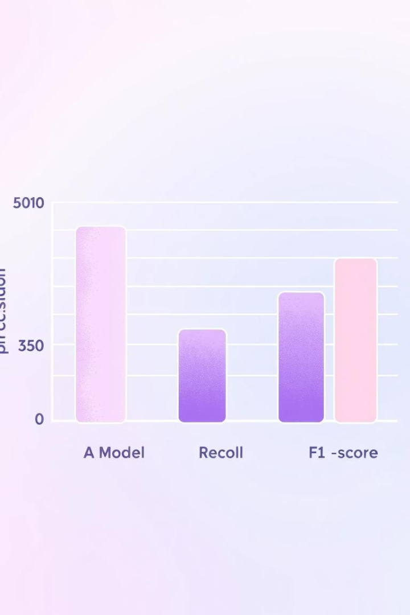
Results
Performance of different algorithms on the test set:
Algorithm
Accuracy
Precision
Recall
F1-Score
ROC-AUC
Logistic Regression
0.85
0.84
0.87
0.85
0.90
Random Forest
0.92
0.91
0.93
0.92
0.95
SVM
0.88
0.87
0.89
0.88
0.92
Gradient Boosting
0.90
0.89
0.91
0.90
0.94
XGBoost
0.93
0.92
0.94
0.93
0.96

Slide 8

Analysis
Best Algorithm
XGBoost performed best with 0.93 accuracy, 0.93 F1-Score, and 0.96 ROC-AUC.
Why XGBoost?
Handles non-linear relationships, robust to overfitting, captures complex patterns.
Key Observations
Random Forest also strong (0.92 accuracy). Logistic Regression had lower performance.
Limitations
Potential overfitting on small datasets; class imbalance may affect results.

Slide 9

References
Kaggle Dataset: https://www.kaggle.com/datasets/debasisdotcom/parkinson-disease-detection
Research Paper: Detection of Parkinson’s Disease Using Multiclass Machine Learning https://arxiv.org/abs/2008.00238

Slide 10

Conclusion
Future Work
Key Takeaway
Explore deep learning models and integrate additional data types like imaging.
Project Summary
Machine learning offers a powerful tool for early, non-invasive disease detection.
We developed and evaluated ML models for Parkinson's prediction, identifying XGBoost as the top performer.

