Slide 1

Data Analysis for High Cloud Airlines
By Group 6

Slide 2
Chethan
Kumar L
V Visakh
Binayak
Sahoo
Team Members of Group 6
Gagan R
Devineni Rajasekhara
Kandekandi
Suneetha
Arjun Premji

Slide 3
Objective
High Cloud Airline is seeking to improve operational efficiency, route optimization, and passenger satisfaction through data analysis for the given data between 2008 to 2013.
The airline operates a complex network of flights with multiple carriers, aircraft types, and service classes across numerous cities and regions.

Slide 4
Overview
High Cloud Airlines is a leading global aviation company committed to delivering safe, efficient, and reliable air travel experiences. Renowned for its diverse fleet of state-of-the-art aircraft, offering services across an extensive network of domestic and international routes, connecting people across the globe.
High Cloud Airlines operates in 113 countries, serving 1,445 cities worldwide through a network of 208 carriers. With a total travel distance exceeding 82 million miles in the sky. In total, more than 187 million satisfied passengers have traveled with High Cloud Airlines which has a average load factor of 76.77 %.

Slide 5
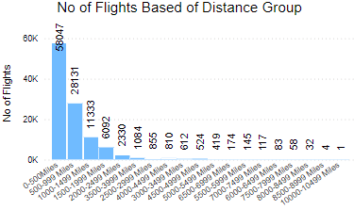
Flight Distance Distribution
Around 52% of carriers operate flights under 500 miles, focusing on short-haul, regional, or domestic routes with quick turnaround times and high demand. Many top routes in this category are within the USA, reflecting its strong domestic network.
Approximately 25% of carriers fly between 500 and 999 miles, covering medium-haul routes that connect larger cities or neighboring countries. These routes balance short-haul convenience with the demands of longer flights, with many top routes also in the USA.
The remaining flights range from 1,000 to 10,000 miles, covering long-haul and ultra-long-haul routes that connect major international hubs. These require advanced aircraft and complex planning, with the USA continuing to dominate the top routes.

Slide 6
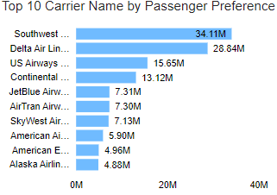
Passenger Choice Trends Across Leading Airlines
The top carriers based on passenger preference are led by Southwest Airlines Co, with 26.4% of the market share. Southwest operates exclusively within the USA, serving 117 cities, positioning it as a dominant domestic carrier
Following closely is Delta Airlines Inc, with 22.32% of passenger preference. Delta boasts a broad global network, servicing 319 cities across 70 countries. Its strength lies in offering both domestic and international flights
US Airways Inc holds 12.11% of the market share, with operations in 171 cities across 70 countries. Like Delta, US Airways provides both domestic and international flights

Slide 7
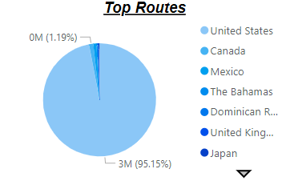
Top Routes
As observed in the graph below, over 95% of the routes originate from or are associated with the USA, representing a dominant portion of the data. This is followed by Canada, which contributes just slightly more than 1% of the total routes. The disparity between the USA and Canada indicates a significant skew in route distribution, highlighting the United States as the primary hub for these routes. The remaining percentage is distributed among other countries, which collectively account for less than 3% of the total.

Slide 8

Load Factor
load factor is calculated as the ratio of transported passengers to available seats, representing the percentage of seating capacity that was utilized on a flight.

Slide 9
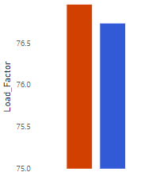
Load Factor Trends: Weekday vs. Weekend
76.96%
Weekend
76.73%
Weekday
These load factor suggests that the airline's capacity is being utilized consistently across both periods. The slight increase on weekends could be attributed to several factors: Leisure Travel, Passenger Behavior and Flight schedule & frequency

Slide 10
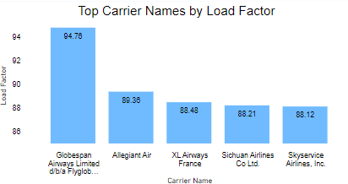
Carrier Names based on Load Factor
Globespan Airways Limited leads with an impressive load factor of 94.76%, despite operating only 3 flights. This indicates strong demand on its specific routes, although the airline ceased operations after 2009.
Allegiant Air follows with a solid load factor of 89.36%, operating 2,020 flights across 6 countries and 226 cities. Despite its larger network, Allegiant maintained high efficiency. However, it was inactive in 2012 and resumed in 2013, potentially affecting its performance during that time.
XL Airways France achieved a load factor of 88.48% with just 5 flights. While its service was limited to 2008 and 2011, it still demonstrated strong demand on those routes.
Sichuan Airlines Co. Ltd. ranks next with a load factor of 88.21% from 4 flights, operating in 2011 and 2013. This high load factor suggests a focus on high-demand routes.
Next is Skyservice Airlines Inc. achieved a load factor of 88.12% with just 1 flight in 2008, indicating that this single flight was in very high demand.

Slide 11
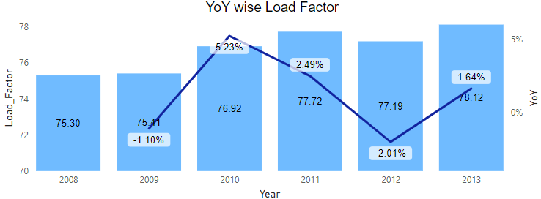
YoY Load Factor Optimization Strategies
The above visual illustrates the Year-over-Year load factor trends, highlighting three key years: a dip in 2009, a spike in 2010, and another dip in 2012. It is essential to analyze the factors contributing to these fluctuations in the load factor during these years.

Slide 12
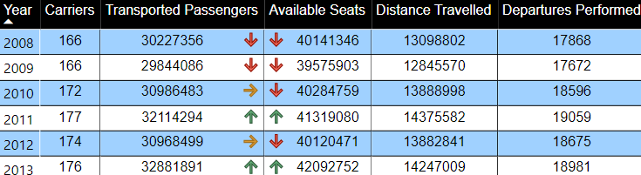
Factors Influencing YoY Load Factor
Based on the table above, the following observations can be made:
2009 Dip: The decline in load factor is attributed to a reduction in both transported passengers and available seats. Despite the number of carriers remaining the same as the previous year, changes in the carrier mix led to fewer departures and shorter distances traveled.
2010 Spike: The increase in load factor is driven by a slight rise in transported passengers and available seats, coupled with a significant growth in the number of carriers, departures, and distance traveled.
2012 Dip: The sharp decline in load factor in 2012 is largely due to a significant drop in transported passengers and available seats. Additionally, a reduction in the number of carriers contributed to fewer departures and a shorter total distance traveled.

Slide 13
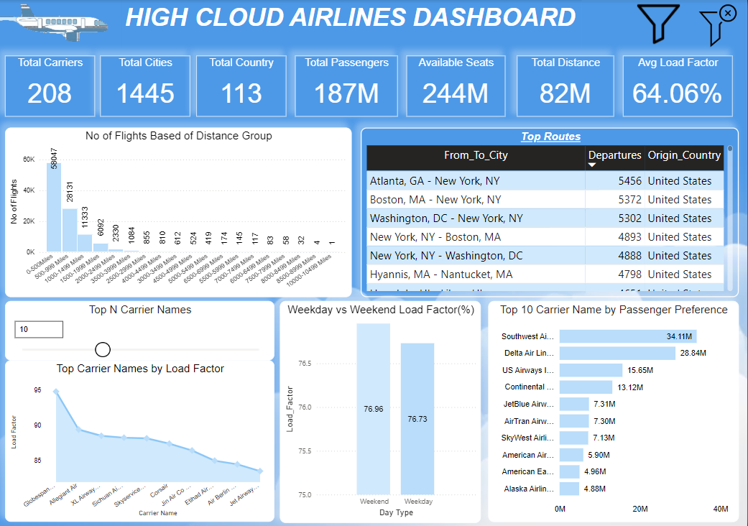

Slide 14
Conclusion
By focusing on high-demand short-haul routes (under 500 miles), High Cloud Airline can improve fleet utilization, reduce costs, and enhance operational efficiency.
Additionally, optimizing medium-haul routes (500-999 miles) to increase connectivity between larger cities and neighboring countries will cater to both business and leisure travelers.
Analyzing peak demand periods, like weekends, will allow High Cloud to adjust schedules and increase flight frequency during high-traffic times. Drawing inspiration from successful carriers like Allegiant Air, XL Airways, and Southwest Airlines, High Cloud can improve load factors, service quality, and overall passenger satisfaction, leading to better operational performance.

Slide 15
Thank you for flying High Cloud Airlines

