Slide 2
WELCOME

Slide 3
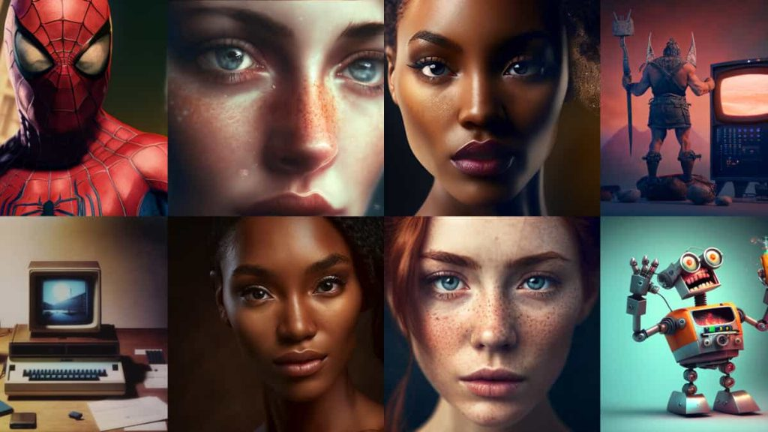
Generative AI

Slide 4

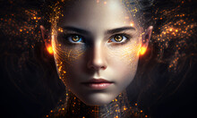
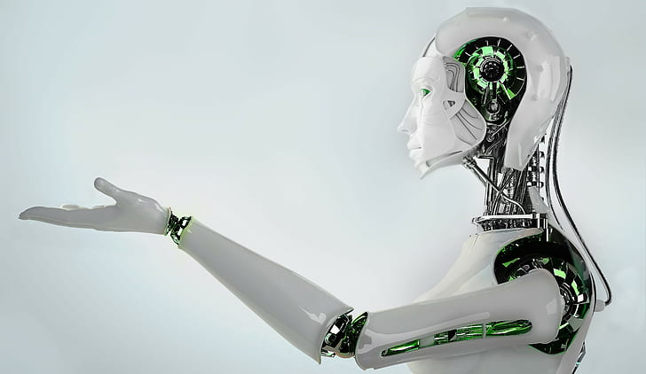
Introduction to Generative AI

Slide 5
AI Works
Overview of neural networks and deep learning.
Explanation of models like GPT and diffusion models.
How Generative AI Works

Slide 6
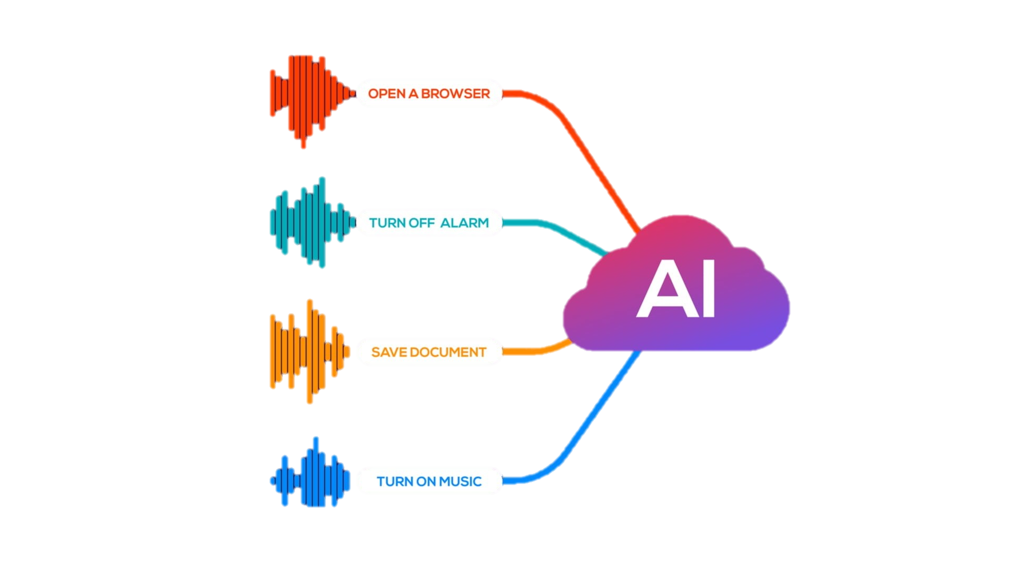
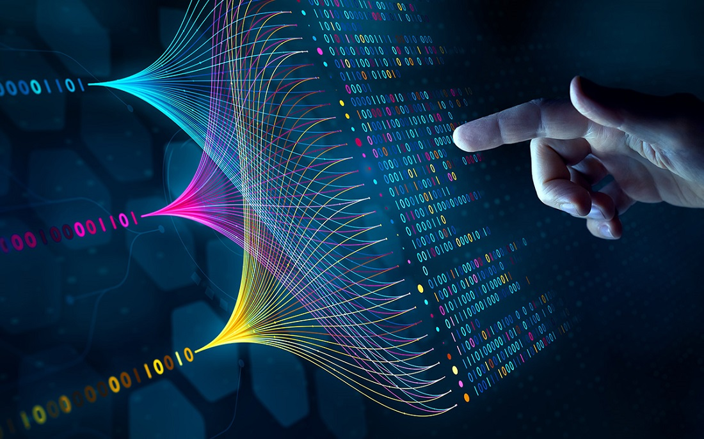
Introduction to Generative AI
Brief definition and how it differs from traditional AI.
Real-world examples (chatbots, image generation, etc.).
This Photo by Unknown Author is licensed under CC BY-SA

Slide 7
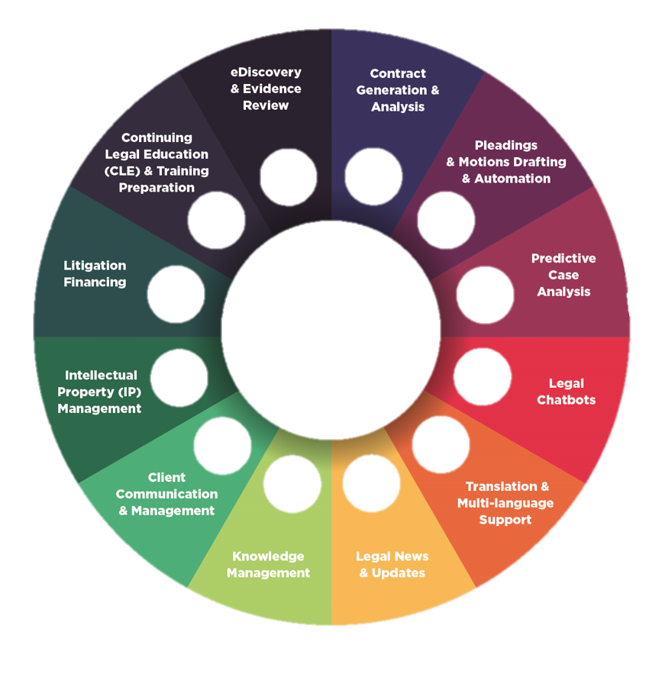
Text Generation (ChatGPT, Bard).
Image Generation (DALL·E, MidJourney).
Music & Video Generation.

Slide 8
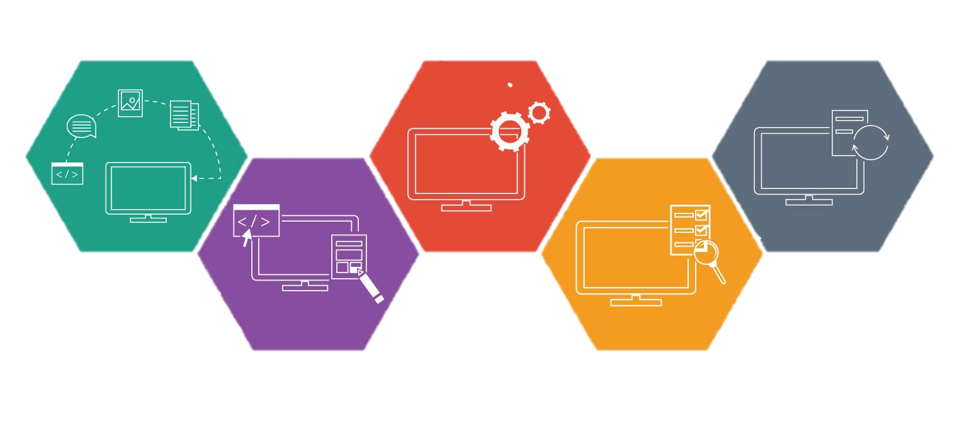
The Training Process
2
Clean, Prepare & Manipulate Data
4
Test Data
1
Get Data
3
Train Model
5
Improve

Slide 9

Applications of Generative AI
Content creation (blog writing, art, coding).
Scientific research & automation.

Slide 10

Ethical Considerations & Risks
Bias in AI models.
Deepfake dangers & misinformation.

Slide 11
Generative AI in Business & Education
Enhancing productivity.
AI-powered learning & creativity tools.
8️⃣ Future of Generative AI
What's next? AI collaboration with humans.
Breakthroughs in AI-human interaction.
9️⃣ Limitations & Challenges
AI hallucinations & errors.
Over-reliance on AI vs. human creativity.
🔟 Conclusion & Discussion
Key takeaways & questions for further exploration.
SSSSSSS

Slide 12
THANKS

