Slide 1
Online Shopping Management
PROJECT PRESENTATION
Suresh Prajapati 109524
Sunena Gwachha 109578
Senait Habte 109707

Slide 2
Online Shopping Management
(a Complete Shopping Solution)
Easy shopping process
Efficient Product management
Multi-Product Purchasing Anytime
Easy Search Option
Time Saving

Slide 3
Objective
To minimize going to store for product purchase
Real time information presentation regarding product availability
To provide complete solution to add and remove product in cart at any time
To manage product details in the system

Slide 4
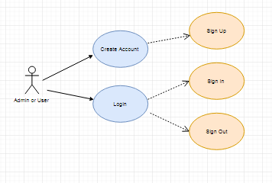
Use Cases
User and Admin Signup, login and logout

Slide 5
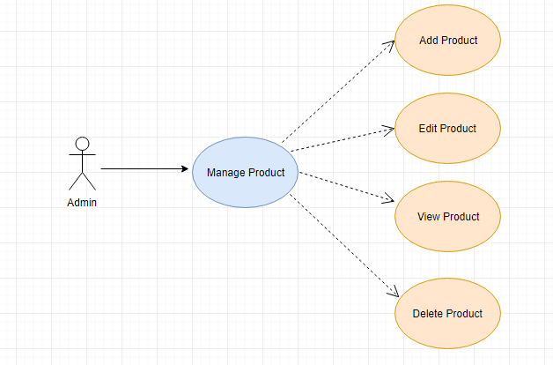
Use Cases
Admin Add, Edit, View and Delete product

Slide 6
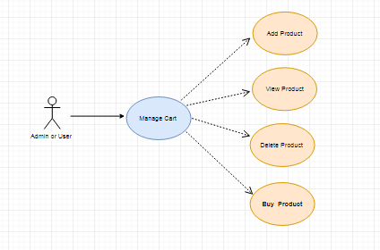
Use Cases
User Add, View, Delete and Buy product from Cart

Slide 7
Thank you all for your time

