Slide 1
Online Shopping Management
PROJECT PRESENTATION
By:
Efrem Tekle (109623)
Daniel Abraha (109548 )
Luwam Tesfamariam (109410)
Suresh Prajapati (109524)
Sunena Gwachha (109578)

Slide 2
Online Shopping Management
(a Complete Shopping Solution)
Easy shopping process
Efficient Product management
Multi-Product Purchasing Anytime
Easy Search Option
Time Saving

Slide 3
Problem Statement
In store shopping system
Although there are some available system, they have Cranky and Outdated User Interface
Unable address user requirements
Ad-hoc approach and no resiliency

Slide 4
Online Shopping - SOLUTION
Systematic Online Shopping Management
Ease of Access
Good User Interface (UI)
Iterative development approach and flexible solution to adjust with changing business scenario

Slide 5
Objective
To minimize going to store for product purchase
Real time information presentation regarding product availability
To provide complete solution to add and remove product in cart at any time
To manage product details in the system

Slide 6
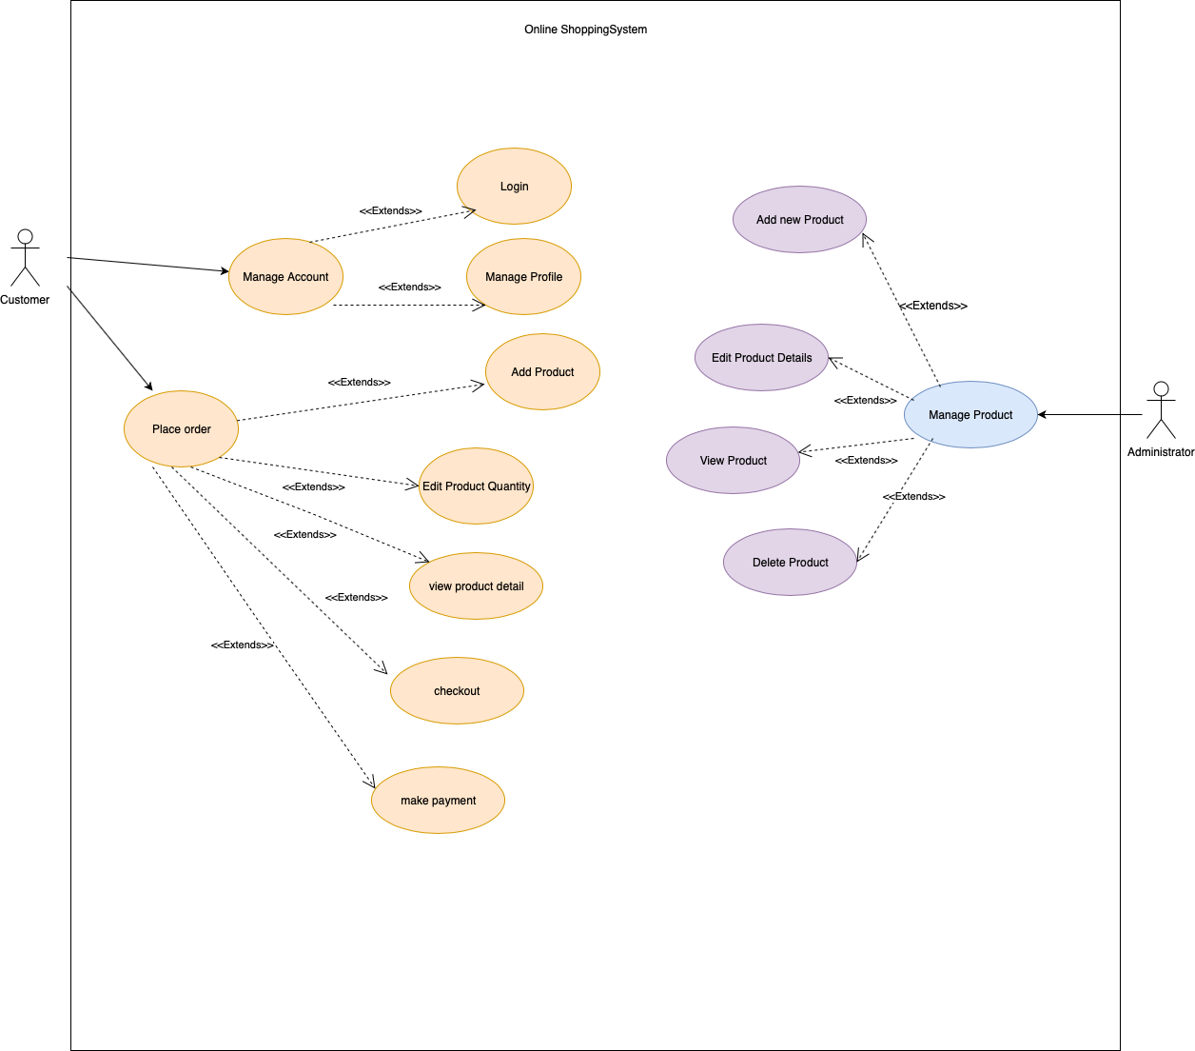
Use Case Diagram

Slide 7
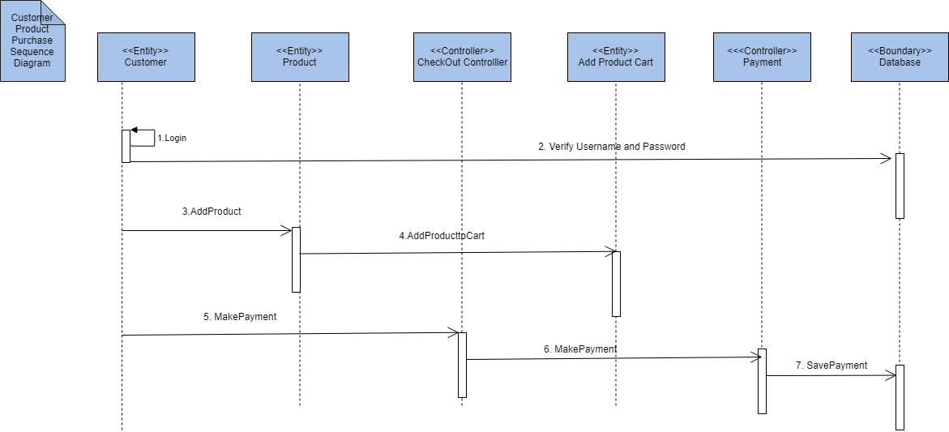
Sequence Diagram

Slide 8
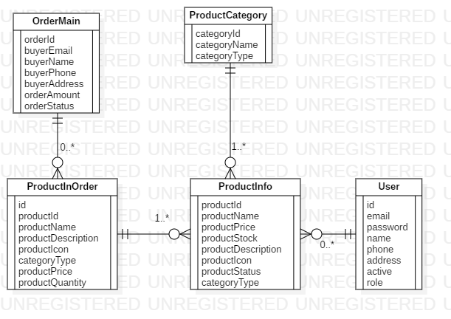
ER Diagram

Slide 9
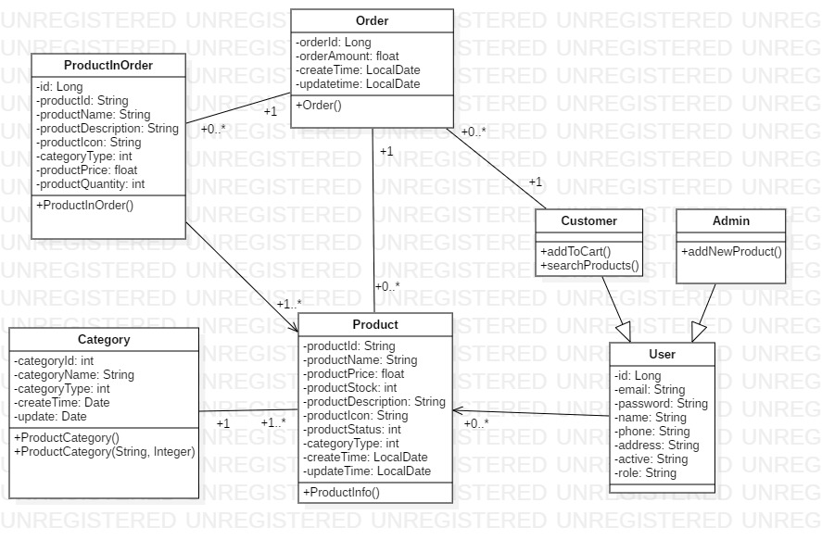
Class Diagram

Slide 10
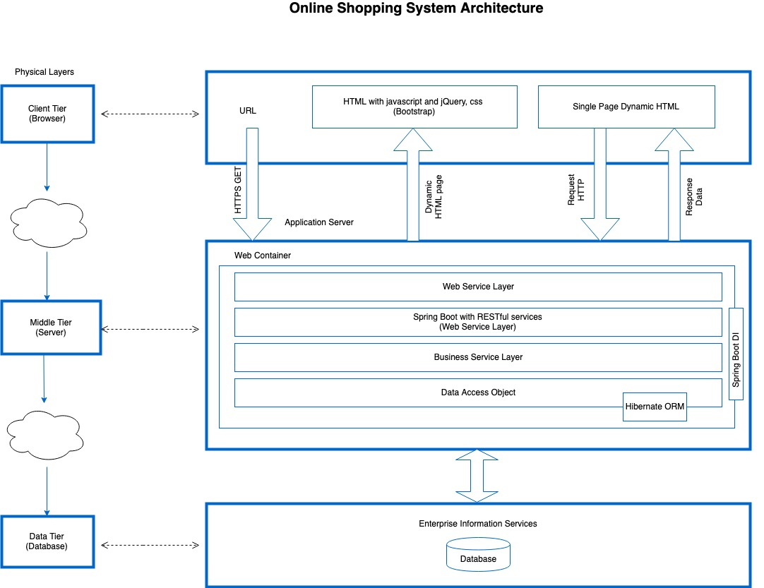
Detail System Architecture

Slide 11
Thank you all for your time
Any Questions ??

