Slide 1



Social Event Recommendation Agent on Pepper
July 13, 2026
Sunesh Praveen Raja Sundarasami
Hochschule Bonn-Rhein-Sieg | M.Sc. Autonomous Systems
Course
Human-Centered Interaction with Collaborative Robots (HCICR)

Slide 2
Introduction & Motivation
System Architecture
Dialogue Manager
Bayesian Reasoning
Behaviour & Integration
Conclusions

Slide 3
Why This Project?
Design goal (per PLAN.md): natural language input, but the final decision stays inspectable
Inspectable = explicit Evidence dict + interpretable latent factors, not a opaque score
Three cooperating components: finite-state manager, LLM evidence parser, Bayesian network

Slide 4
Four Building Blocks
Perception (WP1)
Dialogue Manager (WP2)
Bayesian Reasoning (WP3)
Behaviour (WP4)
Traditional Post-Processing
Traditional Post-Processing
dialogue/graph.py -- 6-node LangGraph StateGraph + Groq Llama-3.3, own Python 3.11 process
behaviour/pepper_behaviour.py -- say_with_gesture() blocks until speech + gesture both finish
perception/face_detector.py -- Haar cascade + 5-frame smoothing -> InteractionFSM.Idle/Greeting
mity. DBSCAN [5] enforces geometric consistency within isolated clusters. CRFs [6] model pairwise contextual potentials to enforce boundary coherence. Graph-structured label smoothing [7] improves classification accuracy while preserving spatial context.
recommender/bayesian_network.py -- pyAgrum LazyPropagation over a 3-layer BayesNet
KNN majority voting smooths isolated misclassifications based on local spatial proximity. DBSCAN [5] enforces geometric consistency within isolated clusters. CRFs [6] model pairwise contextual potentials to enforce boundary coherence. Graph-structured label smoothing [7] improves classification accuracy while preserving spatial context.

Slide 5
Introduction & Motivation
System Architecture
Dialogue Manager
Bayesian Reasoning
Behaviour & Integration
Conclusions

Slide 6
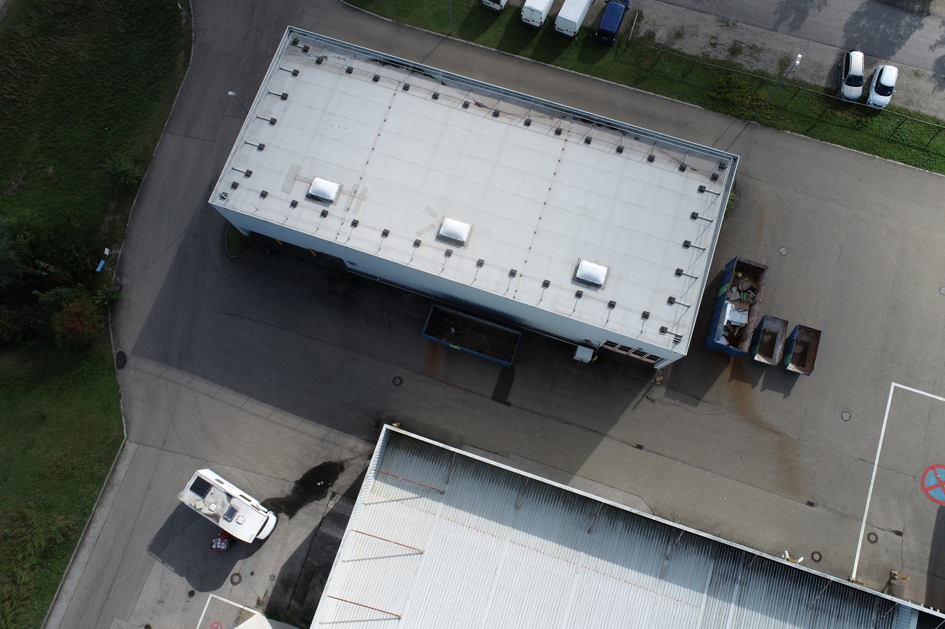
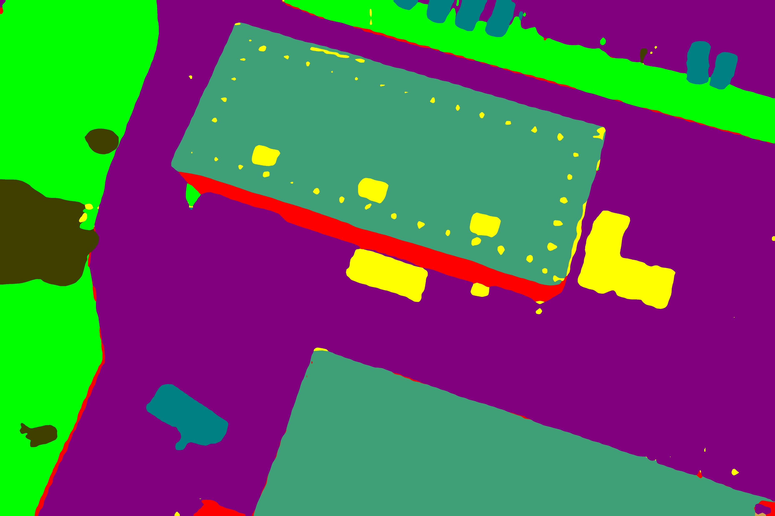
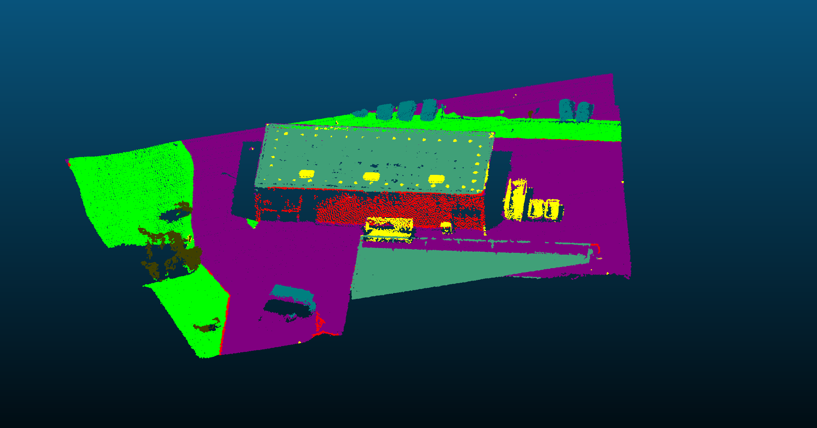
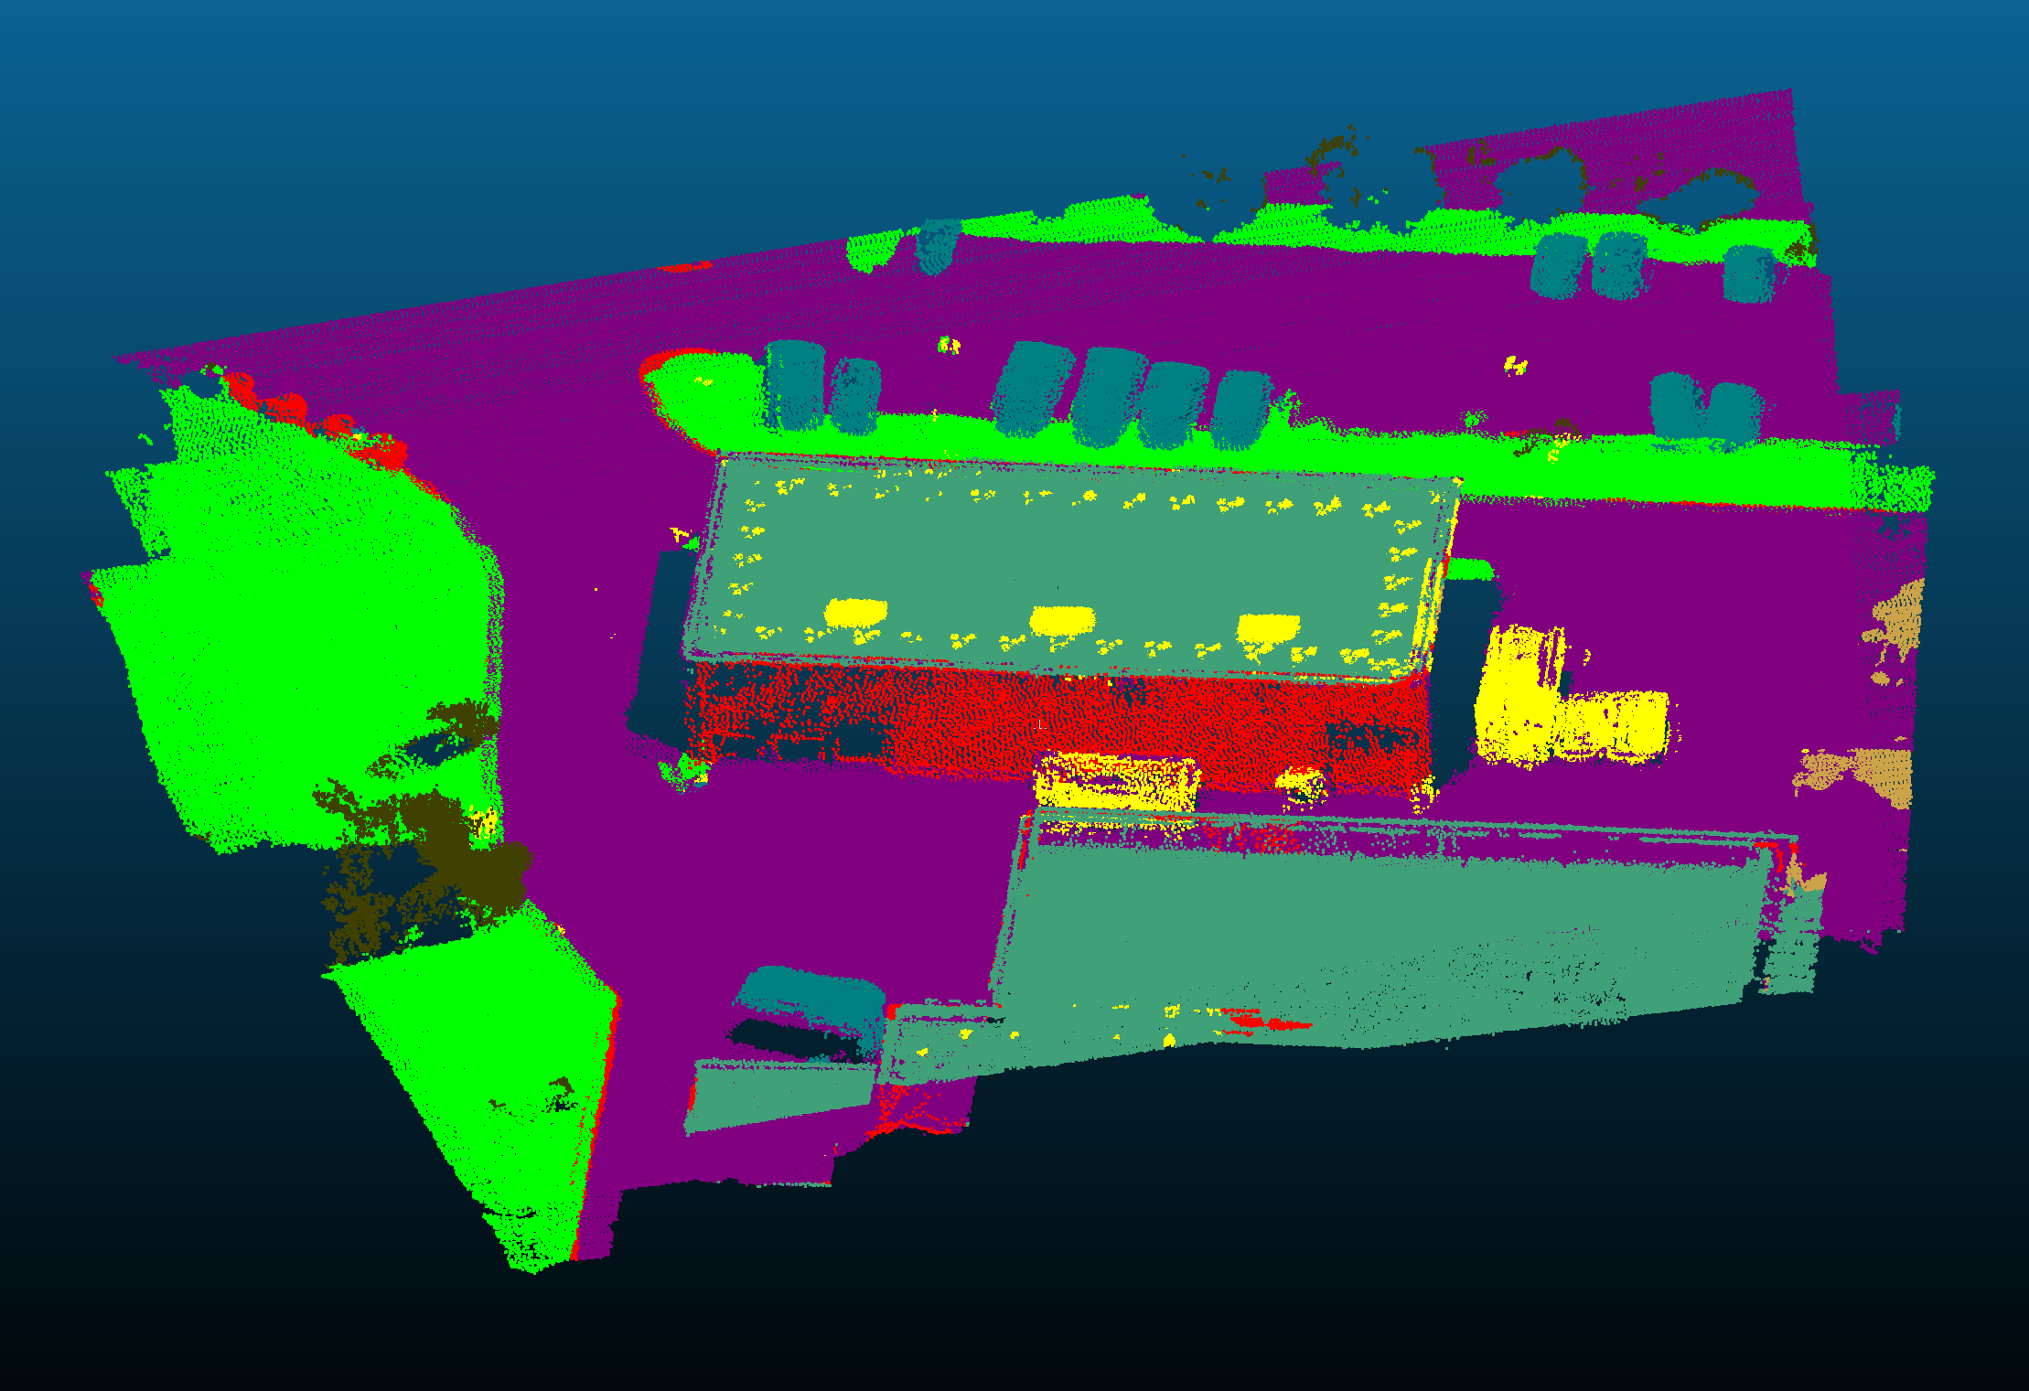
System Architecture
based on Kopp & Hassan, 2022 (slides 7–8) | red = processing, green = decision, blue = generation, grey = knowledge. The Dialogue stage is the LangGraph (expanded below).
Knowledge & data
Bayesian CPTs from event catalogue ·
8 events + images (imgs/) · schema (contracts.py)
per turn: Pepper asks (TTS) → user answers (ASR) → repeats until 6 prefs filled
User
face + speech
Perception
(sense + recognize)
Face: Haar + 5-frame smoothing
ASR: faster-whisper (local)
or typed text
Interpretation
(understand) — LLM
Groq Llama-3.3 service:
frames questions & parses
replies → 6 slots (validated)
Dialogue Manager
(manage turn / select)
FSM 'Conversation' state runs
the LangGraph slot-filling loop
▼ expanded below ▼
Bayesian Reasoning
(decide)
3-layer Bayes net (pyAgrum)
6 evidence → 3 latent → 8 events
ranked events + explanation
Behaviour & Acting
(create + perform)
speech (TTS) + gesture
(wave/nod/think/present)
+ tablet image · Pepper/qiBullet
User
sees + hears
Single route: perception → interpretation → dialogue (LangGraph, looping per turn) → Bayesian reasoning → behaviour → Pepper. One recommendation is reasoned once all 6 preferences are gathered.

Slide 7
Perception: WP1 Implementation
HaarFaceDetector over OpenCV's frontal-face cascade; sources: WebcamSource / PepperCameraSource
face_stable() requires N consecutive detections; is_present() uses a looser threshold for dropout tolerance
ThreadedPerception runs detection on a background thread so the preview window stays live during dialogue

Slide 8
Introduction & Motivation
System Architecture
Dialogue Manager
Bayesian Reasoning
Behaviour & Integration
Conclusions

Slide 9
Dialogue Manager -- LangGraph Detail
Dialogue Manager — LangGraph (dialogue/graph.py)
runs during the FSM 'Conversation' state · fills the 6 preference slots one at a time, with LLM reframing and conflict handling
usable / committed / default → next slot
answer not usable → reframe
conflict → ask either/or
Router
pick next empty slot
QuestionFramer
ask (LLM-framed),
capture the reply
AnswerParser
reply → candidate
evidence (LLM)
ConflictResolver
spot contradictions,
re-open the slot
Evaluator
commit / reframe /
default
START
missing
no conflict
↑ question out via Behaviour-TTS · answer in via Perception-ASR
all slots filled
END
Finish

Slide 10
Six Preferences the Conversation Learns
Every value the LLM produces passes through a whitelist before it can reach the Bayesian network
A conversation never has to fill all six - partial evidence still works
Preference | Possible values | Example cue
Budget | Low . Med . High | “keep it cheap”
GroupSize | Solo . Small . Large | “just me”
ActivityLevel | Relaxed . Moderate . Active | “something chill”
Setting | Indoor . Outdoor . Either | “fresh air”
TimeOfDay | Day . Evening . Night | “later tonight”
Interest | Arts . Music . Food . Sports | “live music”

Slide 11
Introduction & Motivation
System Architecture
Dialogue Manager
Bayesian Reasoning
Behaviour & Integration
Conclusions

Slide 12
Bayesian Reasoning Engine
Interest
Setting
GroupSize
Budget
ActivityLevel
TimeOfDay
VenueType
SocialContext
EnergyProfile
EventRec
8 events, ranked by probability

Slide 13
Explainability: Posterior, Not a Score
recommend() runs LazyPropagation on the BayesNet, sorts EventRec's posterior descending
explain() reads back the argmax of VenueType / SocialContext / EnergyProfile to phrase the reason
Museum 34% - cultural venue (VenueType) + intimate vibe (SocialContext) + low-key feel (EnergyProfile)

Slide 14
Introduction & Motivation
System Architecture
Dialogue Manager
Bayesian Reasoning
Behaviour & Integration
Conclusions

Slide 15
Behaviour: WP4 Implementation
tts.py: edge-tts neural voice, pyttsx3 offline fallback, selectable via TTS_BACKEND
say_with_gesture(text, name) launches speech + ALAnimationPlayer gesture concurrently, blocks on both
Tablet image is a textured panel pinned to the tablet link; falls back to a desktop preview window

Slide 16
Two Runtimes, One Bridge
newline-delimited JSON over stdio (subprocess)
Robot FSM
Python 3.8 . qiBullet / NAOqi
owns voice + camera
Dialogue Service
Python 3.11 . LangGraph + Groq
owns language understanding
speaks each question, captures the reply
frames questions, parses answers

Slide 17


Evaluation Criteria
RUN MODES
--source
Check | Expected result | Status
Face detection | Starts when a user is visible | Pass
Dialogue | Asks each question once | Pass
Parsing | Converts replies into evidence | Pass
Recommendation | Top events match preferences | Pass
Presentation | Speaks the result + gestures | Pass
scripted . webcam . pepper . hybrid
GOAL
A working prototype
not a full user study
RUNTIMES
Python 3.8 + 3.11
bridged via uv + JSON over stdio

Slide 18
Introduction & Motivation
System Architecture
Dialogue Manager
Bayesian Reasoning
Behaviour & Integration
Conclusions

Slide 19
Conclusions
CONCLUSIONS
CONCLUSIONS (CONT.)
Explainable by design
Partial evidence still works
1
6
Evidence -> 3 latent nodes (VenueType, SocialContext, EnergyProfile) -> EventRec posterior; never a black-box score.
LazyPropagation runs on whatever evidence subset exists; missing slots fall back to uniform priors.
LLM output is sandboxed
2
CPTs are rule-derived
validate_evidence() in contracts.py whitelists every LLM-produced slot value before it reaches the BayesNet.
7
Soft rule dicts (_INTEREST_VENUE, _GROUP_SOCIAL, ...) are normalised into each latent node's CPT at build time, not hand-tuned.
Fault-tolerant FSM
3
InteractionFSM resets to Idle on dropout and still calls recommend() on whatever Evidence is available.
Dialogue graph is fully offline-testable
8
Two runtimes, one bridge
Router/QuestionFramer/AnswerParser/ConflictResolver/Evaluator/Finish run against a ScriptedParser with no LLM or robot.
4
Python 3.8 (qiBullet/NAOqi) and 3.11 (LangGraph) exchange newline-delimited JSON via DialogueBridge.
Reasoning is decoupled from I/O
All 5 work packages integrated
9
5
recommend() and explain() are pure functions over an Evidence dict, independent of Pepper's speech or camera.
Perception, dialogue, reasoning, behaviour and FSM orchestration are wired end-to-end in main.py.
6
8
2
5
Preference slots
Event categories
Python runtimes bridged
Evaluation checks passed

Slide 20
Tech Stack
Simulation
Dialogue
Reasoning
Voice
Traditional Post-Processing
Traditional Post-Processing
LangGraph multi-agent graph + Groq (free Llama 3.3).
edge-tts / pyttsx3 for speech, faster-whisper for local ASR.
qiBullet / PyBullet - Pepper's joints, camera and tablet texture.
mity. DBSCAN [5] enforces geometric consistency within isolated clusters. CRFs [6] model pairwise contextual potentials to enforce boundary coherence. Graph-structured label smoothing [7] improves classification accuracy while preserving spatial context.
pyAgrum - the explainable Bayesian network engine.
KNN majority voting smooths isolated misclassifications based on local spatial proximity. DBSCAN [5] enforces geometric consistency within isolated clusters. CRFs [6] model pairwise contextual potentials to enforce boundary coherence. Graph-structured label smoothing [7] improves classification accuracy while preserving spatial context.

Slide 21
Thank You
Questions? A live demo is available.

